Slide 1
Sikhism: Belief and Practice
TRRS4008

Slide 2
The Adi Granth
The ‘First/Original Volume’
A compilation of spiritual poetic material composed by six of the Gurus as well as a large body of similar material attributed to non-Sikhs.
Contains very little historical material and only a small amount of biographical material.
Composed in the Gurmukhi script, an innovation attributed to Guru Angad.
Believed to have ultimate authority in all matters to do with one’s spiritual life; regarded as the eternal Guru of the Sikhs.

Slide 3
The Development of the Adi Granth
The development of the Adi Granth took place over a period of approx. 200 years.
Guru Nanak conveyed his message by means of poetry (947 hymns) and encouraged the use of his own composition during corporate worship.
Guru Angad is often credited with collecting the hymns of Guru Nanak together for the first time, possibly as a means of countering counterfeit compilations.
Guru Angad added only 62 of his own hymns.

Slide 4
The Development of the Adi Granth
Guru Amar Das: 907 hymns.
Guru Ram Das: 679 hymns.
Guru Arjan: 2218 hymns.
Guru Arjan took the decision to compile an authoritative collection of authentic bani, installing it in the Harmandir Sahib in Amritsar.
Besides making use of available written sources, Guru Arjan also had the help of Bhai Buddha, a survivor of the Kartarpur community, and Bhai Gurdas, the nephew of Guru Amar Das often called the first Sikh historian.

Slide 5
The Adi Granth Becomes the Guru Granth Sahib
The sixth, seventh, and eight Gurus did not compose hymns, although the ninth and tenth did.
In 1706, Guru Gobind Singh added the bani of his father, Guru Tegh Bahadur, to the Adi Granth but chose not to include his own.
Before his death in 1708, Guru Gobind Singh declared that there would be no further human Gurus. From that moment onwards, the gurbani would be the spiritual guide of the Sikhs.
The Adi Granth had become the Guru Granth Sahib.

Slide 6
The Dasam Granth
The compositions of Guru Gobind Singh were collected by one of his companions, Bhai Mani Singh, in 1734.
The title given to this collection, which also includes writings by poets who served at the Guru’s court, is the Dasam Granth (‘collection of the Tenth Guru’).
The Dasam Granth may be read in gurdwaras and on other occasions, but its authority does not equal that of the Guru Granth Sahib.

Slide 7
The Importance of the Guru Granth Sahib
The term ‘Guru’ informs us that the scripture is the spiritual teacher of the Sikhs.
‘I speak, O God, only when you inspire me to speak’ (AG 566: First Guru).
‘As you inspire me, so I praise you, for I, an ignorant man, can say nothing myself’ (AG 795: First Guru).
The GGS is believed to be inspired in the same way that Hindus believe the Vedas, and Christians the Bible, to be inspired, i.e. more than simply a human creation.

Slide 8
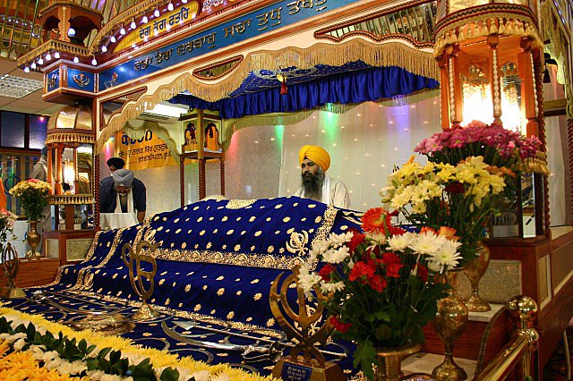
The Importance of the Guru Granth Sahib
The GGS occupies a central position in the diwan hall of the gurdwara, enthroned on the manji sahib and under a chanani, and is never left unattended.

Slide 9
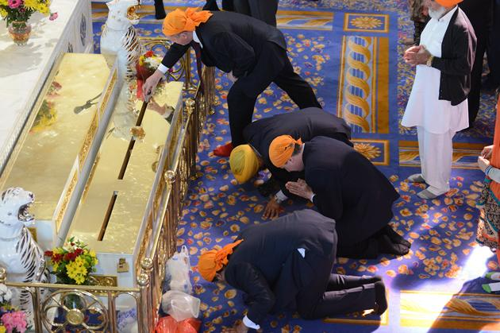
The Importance of the Guru Granth Sahib
Following the example of Guru Arjan, worshippers will prostrate themselves in front of the scriptures and make offerings to it.

Slide 10
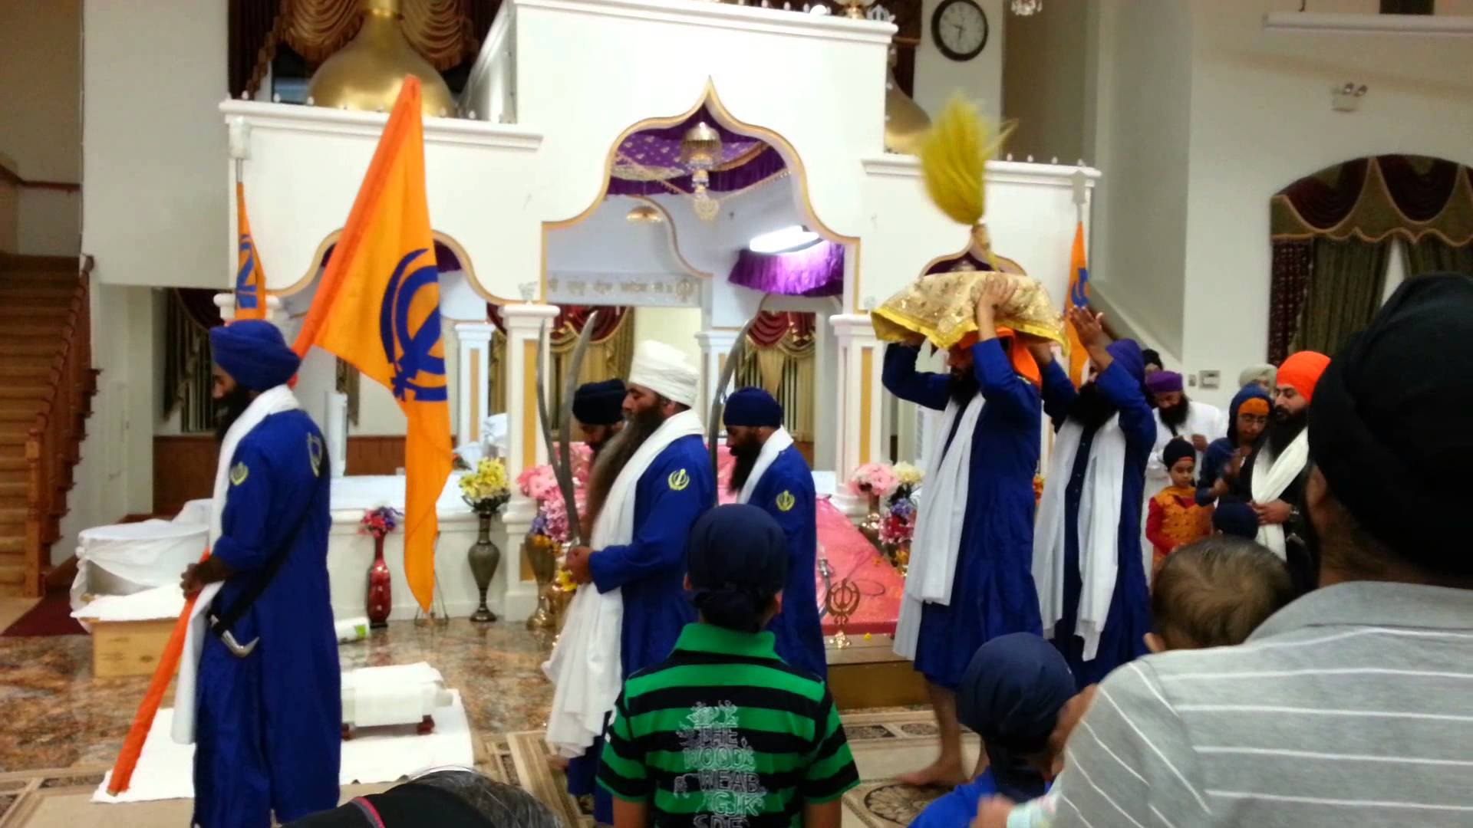
The Importance of the Guru Granth Sahib
At the end of the day, it is customary for the GGS to be closed ceremonially and placed in a special room. This ceremony, known as sukhasan is paralleled by another, parkash karna, in which the GGS is returned to the diwan hall in the morning for installation.

Slide 11
The Importance of the Guru Granth Sahib
The GGS is the focus of all Sikh ceremonies.
If a family possesses its own copy of the GGS, they will open it at random every morning and take a vak – a verse that gives them the Guru’s command (hukam) for the day.
Gurpurbs (anniversaries of the birth/death of a Guru) are marked by an akhand path, a continuous reading of the scriptures lasting roughly 48 hours.
Sikh ceremonies may be performed by any competent initiated Sikh. The insistence on this ensures that the authority of the GGS remains unrivalled.

Slide 12
Sikh Doctrine: The Mul Mantar
‘This Being (God) is One; the truth; immanent in all things; Sustainer of all things; Creator of all things; immanent in creation; without fear and without hatred; not subject to time, formless; beyond birth and death; self-revealing; known by the Guru’s grace’.

Slide 13

Sikh Doctrine: God
The opening invocation of the GGS, Ik Oankar, emphasizes the unity and uniqueness of God.
God is ‘one without second/equal’, i.e. having no partner or agent.
‘My God is one, truly, my God is one’ (AG 350: First Guru).
‘Apart from God there is no other. The Lord is both creator and cause’ (AG 626: Fifth Guru).

Slide 14
Sikh Doctrine: God
Akal Purakh (‘the Being beyond Time’ or ‘Eternal One’)
Akal Purakh is understood as Nirankar (cf. nirguna), ‘the One without Form’. Repeated emphasis is put on the ineffable quality of Akal Purakh.
Akal Purakh is self-revealing, manifested in the created world.
Those with spiritual understanding recognize Akal Purakh as immanent in all creation: ‘This whole phenomenal world that you see is the visible image of God. Yes, in it I see the face of God’ (AG 622: Third Guru).

Slide 15
Sikh Doctrine: Humankind
Humans are seen to be fundamentally misguided and blind to the presence of God around them.
This ignorance stems from haumai or self-centredness/self-reliance (literally, ‘I-Me’).
This ego creates an illusionary and erroneous sense of separation (duality) from the essence that binds all, preventing humans from realizing the oneness that is all around.
The ‘five thieves’ (panj chor): lust (kaam), rage (krodh), greed (lobh), attachment (moh), pride/ego (ahankar).

Slide 16
Sikh Doctrine: Humankind
Dependence upon God and obedience to the will of God (hukam) is essential to liberation. Haumai therefore denies liberation.
The consequence of haumai is the endless cycle of death and rebirth. As long as the person is in the grip of haumai there can be no hope of escape or union with God.
‘In haumai we fail to perceive the true nature of liberation. In haumai there is worldly attachment [maya] and its shadow, doubt. By acting under the influence of haumai we cause ourselves to be born again and again. If we understand haumai we can find the door of liberation but otherwise we argue and dispute’ (AG 466; First Guru).

Slide 17
Sikh Doctrine: The Path to Liberation
In order to achieve liberation, the process which has led to a person becoming ensnared by haumai must be reversed.
One must become gur-mukh, God-centred, instead of being man-mukh, self-centred. Attachment to maya (the temporal world) must be replaced by attachment to God.
The solution to haumai, according to Nanak, is the Nam, or ‘divine Name’. The person who learns how to appropriate the Nam will be freed from the chains which keep the individual in samsara.

Slide 18
Sikh Doctrine: The Divine Name
Nam is understood to be God manifest, God immanent and active in creation.
The Nam is the ever-present and all-pervading presence of Akal Purakh:
‘Nam gives form to everything. Through Nam comes all wisdom and light’ (AG 986: First Guru).
‘All creatures live by Nam, Nam supports the universe and its parts’ (AG 284: Fifth Guru).
Union with the divine can only be achieved by opening one’s eyes to the divine Name and by appropriating its wonders within the heart and mind.

Slide 19
Sikh Doctrine: Nam Simran
In order to secure liberation, the individual must seek to become more attuned to the divine spirit. This is done by means of nam simran, ‘remembrance of the Name’.
Nam simran consists of repeating a word or expression that summarizes the meaning of the divine Name, e.g. Sat-Nam (‘True Name’) or Vahiguru (‘Wonderful Lord’).
Whichever technique is preferred, the practice of reflecting or meditating on the Name is considered to bring the individual into harmony with the divine.

Slide 20
Sikh Doctrine: Nam Simran
‘Vahiguru is the Guru-mantra; by meditating on it, the filth of self-centredness (haumai) is removed’ (Bhai Gurdas, Var 13:2).
‘Without the Name of God there is no release. Those who, with the Guru’s help, meditate on Nam find liberation’ (AG 1127; First Guru).

Slide 21
Sikh Doctrine: Liberation
By persisting in the discipline of nam simran, the seeker is believed to gradually ascend through the five levels of spiritual enlightenment described by Guru Nanak.
The last of these stages is sach khand (‘the Realm of Truth’), in which the soul, through God’s grace, achieves the state of mystical union with the divine.
This is the condition of supreme and eternal bliss (sahaj) in which the mind and spirit of the individual becomes completely attuned to God.
The individual, having become gur-mukh, is no longer in the grip of haumai and karma and so has broken the cycle of death and rebirth.
In this way, liberation can be achieved during the present life (jivan mukti).

Slide 22
The Three ‘Pillars’ of Sikhism
Naam Simran/Japna: meditate on God’s name.
Kirat Karni: earn an honest living.
Vand Chakna: share with others.

Slide 23
The Gurdwara
Literally, ‘the door of the Guru’ (more often translated as ‘the abode of the Guru’)
The gurdwara is any place which houses the Guru Granth Sahib.
The distinguishing feature of any gurdwara from the outside will be the nishan sahib, the pennant established by Guru Harogobind.
All collective Sikh ritual and worship is centred on the gurdwara.

Slide 24

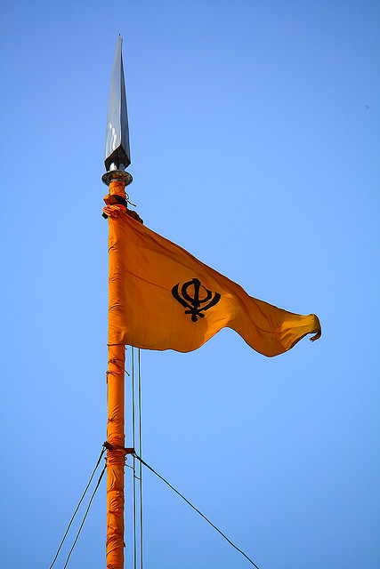
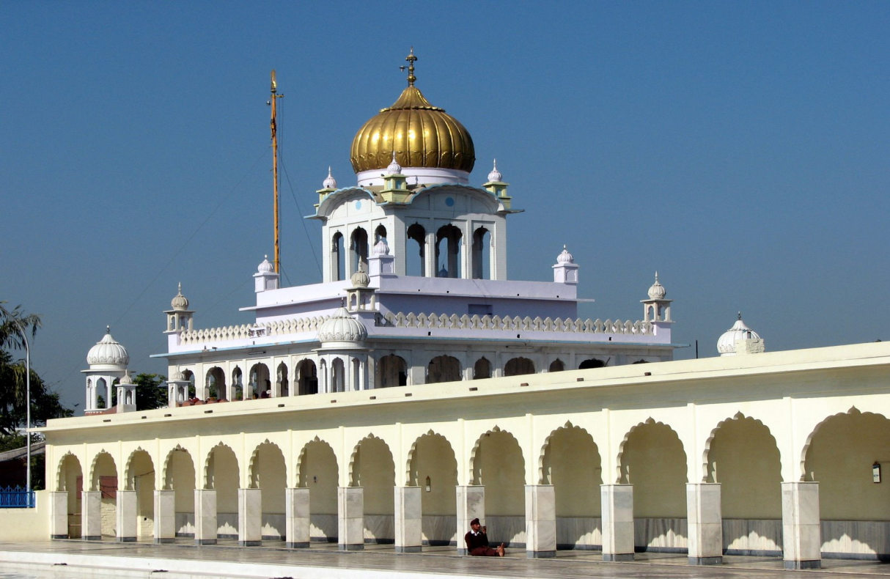
The Gurdwara

Slide 25
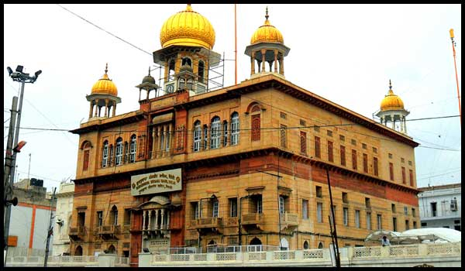
Historic Gurdwaras: Sis Ganj (Delhi)

Slide 26
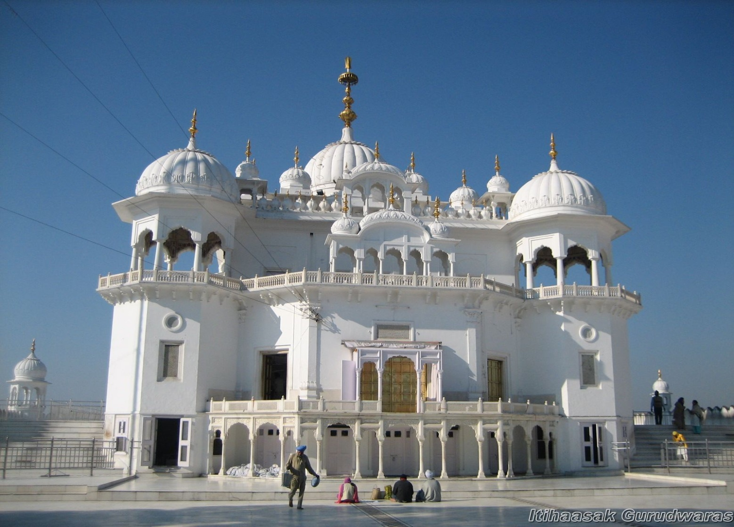
Historic Gurdwaras: Keshgarh (Anandpur)

Slide 27
Historic Gurdwaras
The practice of marking sites by building gurdwaras seems to have originated with Guru Harogobind.
Dharmsala was the original name for these structures. The word denoted a room or building reserved for devotional singing (kirtan) and prayers.
Harogobind is considered to have pioneered use of the term ‘gurdwara’.
The historic gurdwaras found in India and Pakistan are, however, largely 19th or 20th century reconstructions.

Slide 28
The Function of the Community Gurdwara
The function of the community gurdwara is not unlike that of the dharmsala from which it evolved.
More than simply a place reserved for devotional singing and prayer, it was in the dharmsala, and later in the gurdwara, that the congregation (sangat) met in the Guru’s name.
When Sikhs enter a gurdwara, they are entering the presence of the eternal Guru.

Slide 29
The Gurdwara Building
The gurdwara will consist of a number of different rooms.
Often there is a kitchen where food can be prepared, together with an eating hall or langar.
The main room is the one in which the Guru Granth Sahib is installed and where the community gathers for diwan.
The focal point of the diwan hall will be the GGS itself, placed upon cushions and underneath a canopy (chanani). In the gurdwara, the Guru Granth Sahib on its bed (manji) is the enthroned Guru.

Slide 30
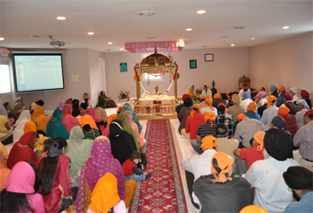
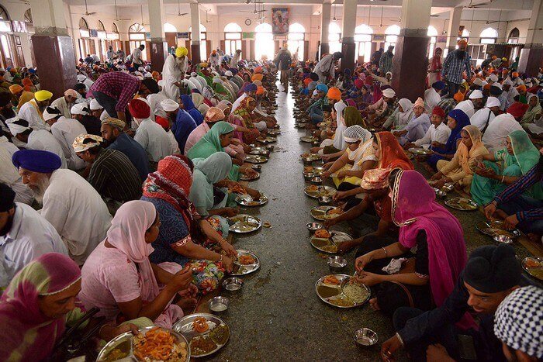
The Gurdwara Building

Slide 31
Entering the Gurdwara
Worshippers must cover their heads, remove their shoes, wash their feet, enter barefoot.
Once inside, they must kneel down and bow down before the Granth, forehead touching the floor.
They may make an offering of money or food for the kitchen.
They must greet the assembled worshippers palms joined with a salutation hailing the congregation and the guru.
They must walk backwards, facing the Granth all the time, and take their positions amidst the congregation, men and women on either side of a central aisle.
The congregation must always sit at a level lower than the Granth.

Slide 32
Worship in the Gurdwara
Worship may take place at any time in the gurdwara and no quorum is required.
It is customary for Sikhs to assemble for congregational worship early in the morning or in the evening.
During the day it is expected that Sikhs practice their faith at work.
There is no fixed day for worship!

Slide 33
Worship in the Gurdwara
The singing of the gurbani to the accompaniment of the tabla and harmonium, as well as other instruments, is an important part of worship. This constitutes the biggest part of the worship service.
Stories from the lives of the gurus may also be narrated.
Sikhism has no ordained priesthood (there is no human to rival the authority of the GGS) and so worship may be led by any initiated Sikh, male or female.

Slide 34
Worship in the Gurdwara
Towards the conclusion of worship, a fixed structure emerges:
The Anand Sahib (the hymn of bliss of Guru Amar Das).
The epilogue to the Japji Sahib prayer of Guru Nanak.
The Sukhmani Sahib (hymn of peace of Guru Arjan).
The congregation stands silently whilst a Khalsa Sikh offers the petitionary prayer, Ardas.
A random opening of the Guru Granth Sahib.

Slide 35
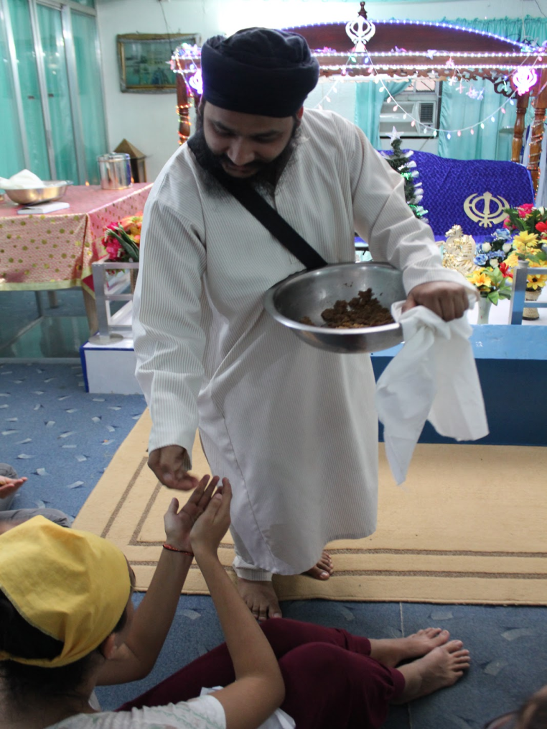
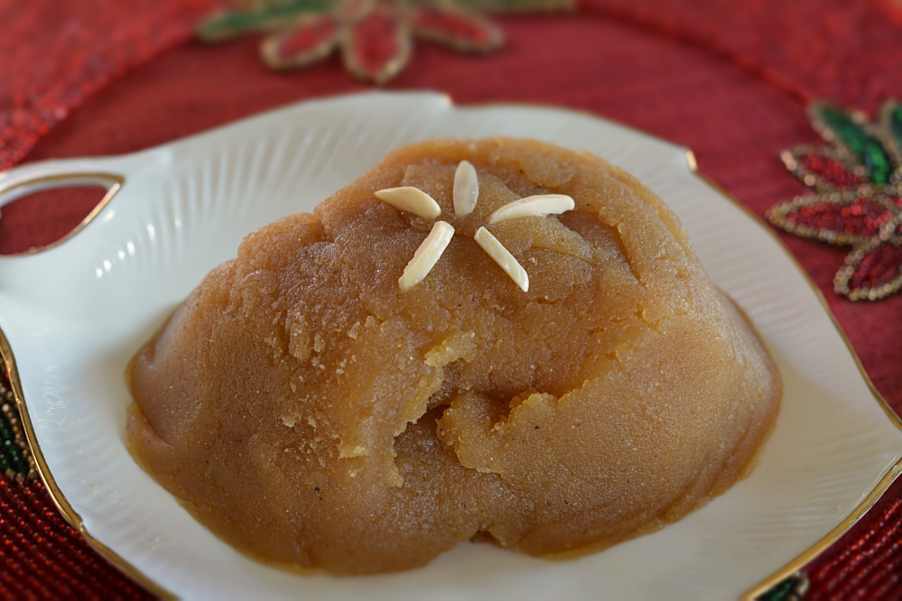
Worship in the Gurdwara
Diwan ends with a distribution of karah parshad, a symbol of belonging to a universal family.

Slide 36
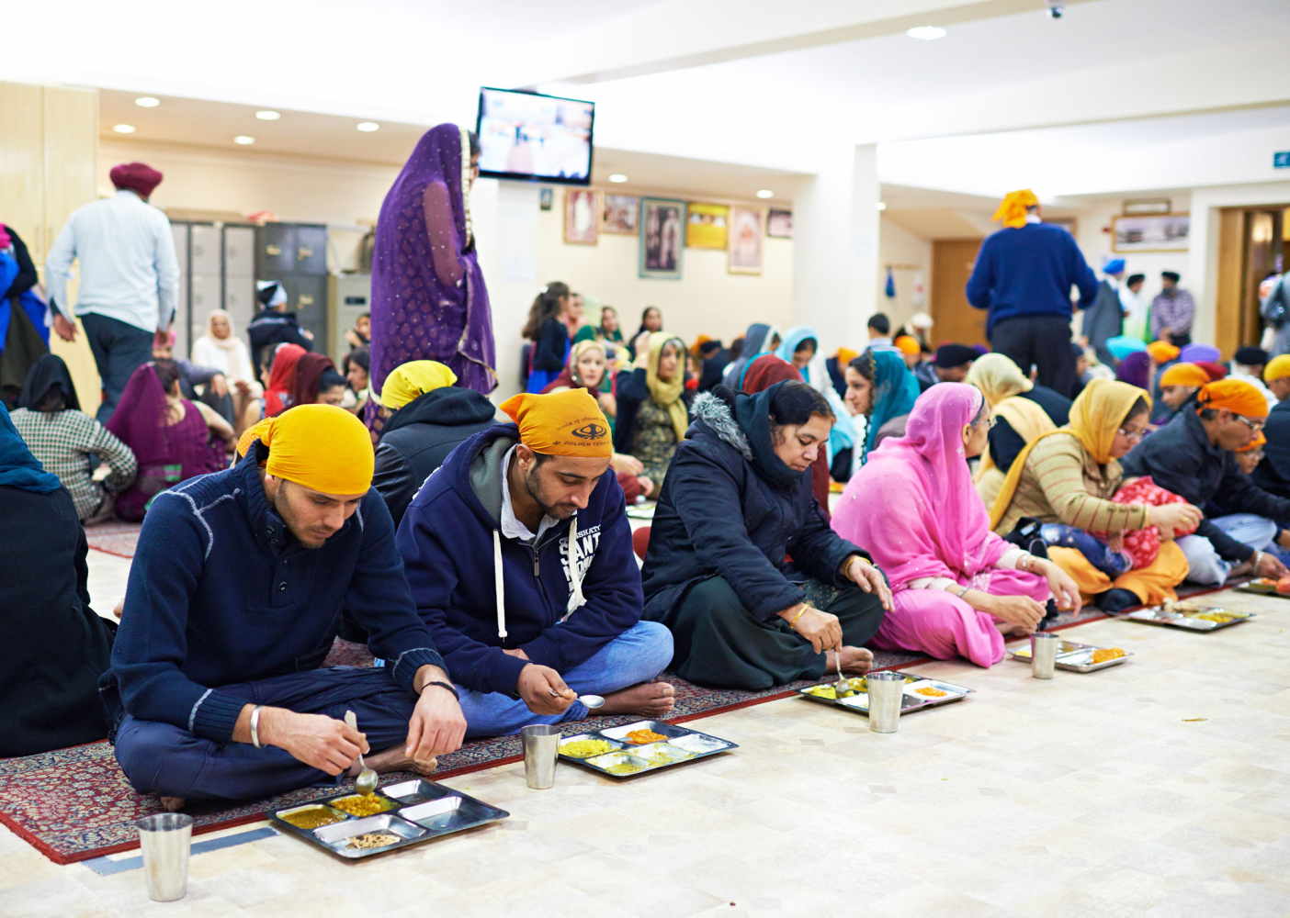
Worship in the Gurdwara
The congregation may then disperse for langar.

