Slide 1
Service improvement project.
By Samantha Alozie .

Slide 2
Why I Chose Meditation for My Service Improvement Project in Mental Health
Choosing meditation as the focus of my service‑improvement project because with the experience in my role , I have seen good outcomes in the small sessions. The strong evidence showing its effectiveness in supporting mental health, emotional regulation, and overall wellbeing. Meditation is simple, accessible, low‑cost, and aligns well with Occupational Therapy’s holistic and recovery‑focused approach.
Research shows that mindfulness meditation can improve psychological wellbeing and reduce symptoms of anxiety and stress (Aldbyani, 2025).

Slide 3
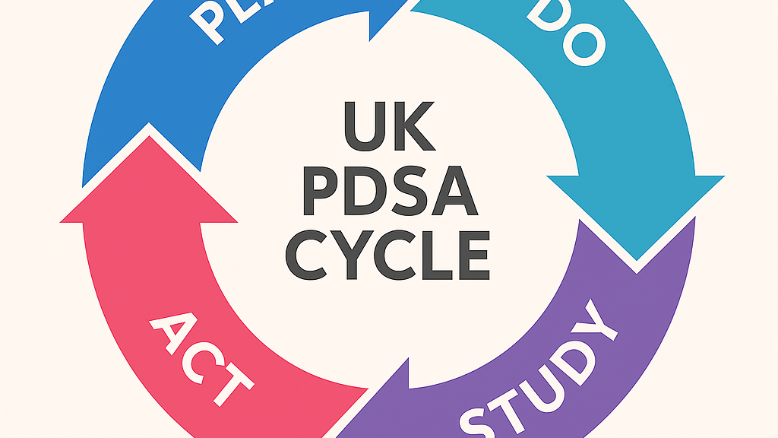
Why Use the PDSA Cycle?
The Plan–Do–Study–Act (PDSA) cycle is one of the most widely used quality‑improvement methods Across UK healthcare including the NHS and professional bodies — because it provides a simple structured and evidence‑based way to test and refine changes before implementing them on a larger scale.
The PDSA cycle is a core quality‑improvement method used across UK healthcare because it allows changes to be tested on a small scale before wider implementation, supporting safer and more effective improvement (NHS England & NHS Improvement, 2023)

Slide 4

Plan
Our aim is to enhance the quality of care within Adult Mental Health Services by integrating mindfulness and meditation into group sessions. These practices are chosen because they are proven tools for stress management, emotional regulation, and resilience-building.
Key planned objectives include:
Aligning mindfulness practices with occupational therapy goals and recovery-focused care.
Creating a calm, supportive therapeutic environment that benefits both service users and staff.
Introducing techniques that are simple, accessible, and suitable for varying levels of engagement.

Slide 5

Do
To implement the plan:
Start sessions with short breathing exercises and grounding techniques to foster calm and focus.
Gradually integrate guided meditations, beginning with 2–5 minute sessions and increasing duration over time.
Embed mindfulness practices into existing OT frameworks and everyday routines (e.g., mindful walking, mindful eating).
Provide practical tools such as handouts or audio resources for continued practice outside group sessions.
Collaborate with the wider MDT and gather ongoing feedback.

Slide 6

Study
Early observations and feedback indicate:
Service users show reduced anxiety, improved emotional regulation, and stronger coping strategies.
Engagement in sessions increased as participants feel calmer and more focused.
The environment became more therapeutic and predictable, helping create psychological safety.
Staff wellbeing also improved, with reduced stress and a calmer group dynamic.
This Photo by Unknown Author is licensed under CC BY-NC-ND

Slide 7
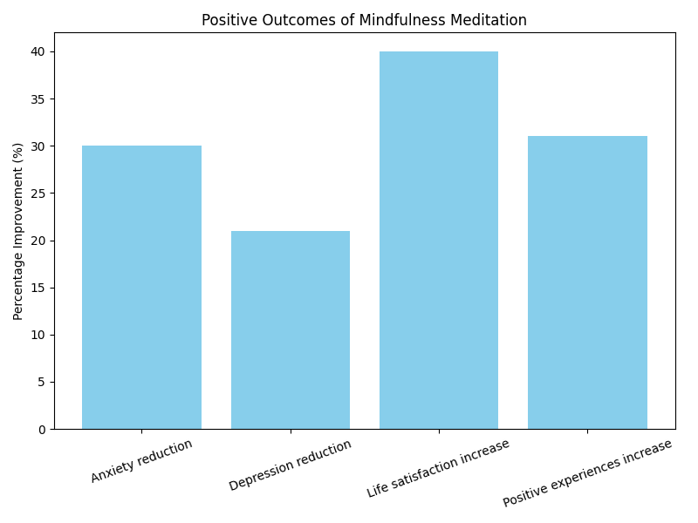

Slide 8

Overall Reflection
USING patient‑feedback forms played a crucial role in shaping me into a more thoughtful, evidence‑driven, and compassionate leader. It strengthened my communication, boosted my confidence in advocating for change, and helped me build collaborative relationships with both patients and staff. Most importantly, it taught me that effective leadership in mental‑health services must always be guided by the lived experiences of the people we support.

Slide 9
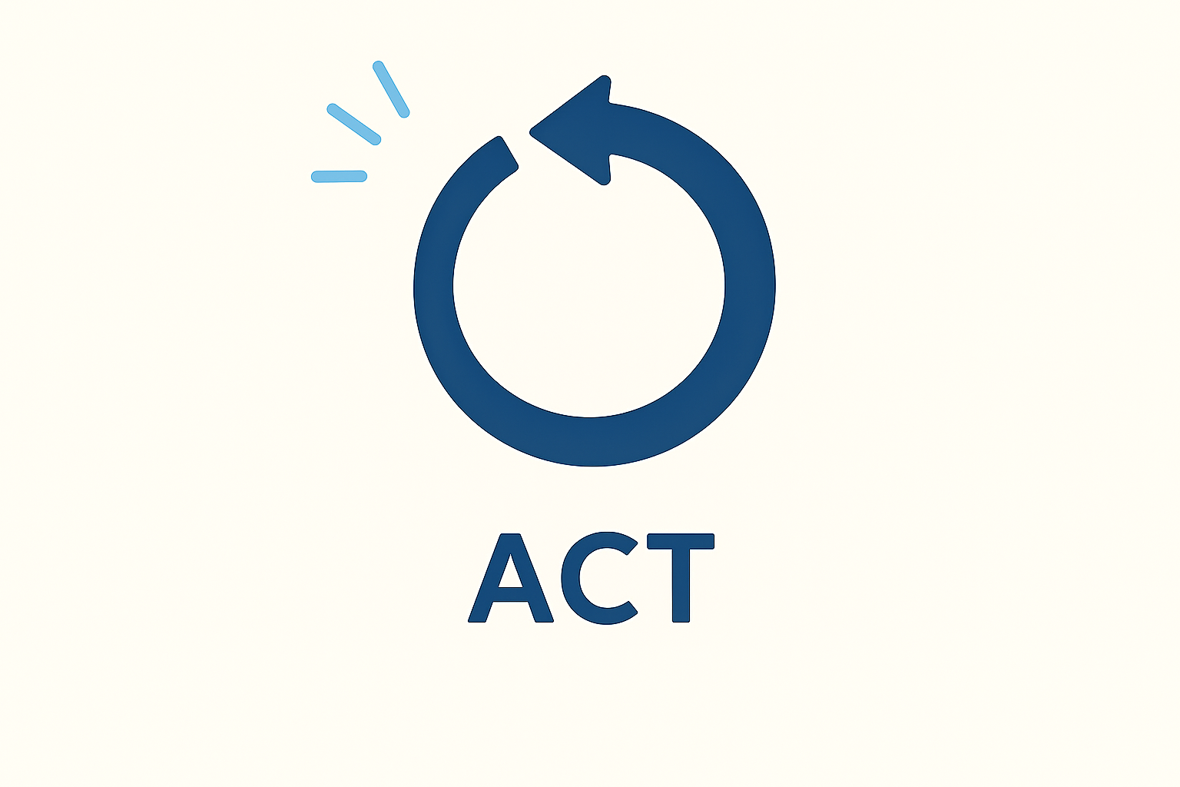
Act
Based on the positive outcomes:
Continue to expand mindfulness-based activities across additional groups and service areas.
Use ongoing service-user and staff feedback to refine techniques and adjust session structure.
Promote collaborative opportunities to ensure mindfulness stays integrated within multidisciplinary and recovery-focused practice.
Explore innovative ways to develop mindfulness offerings further, supporting long-term recovery and well‑being.

Slide 10
Service‑Improvement Project Influenced My Leadership Skills
Working on this service‑improvement project has had a significant impact on my leadership development. Choosing meditation as an intervention required me to step into a more proactive, confident, and collaborative leadership role, especially within a multidisciplinary mental‑health environment
Overall Reflection
This project has been a meaningful step forward in my leadership journey. It has shown me that leadership is not only about guiding others but also about learning, adapting, and growing alongside them. By leading a calm, evidence‑based, and wellbeing‑focused initiative, I have developed stronger communication, collaboration, and decision‑making skills—capabilities that I will continue to build on in my ongoing role within mental‑health services.

Slide 11
Refrences
Aldbyani, A. (June 2025) The effect of mindfulness meditation on psychological well‑being and mental health outcomes: a cross‑sectional and quasi‑experimental approach. Current Psychology, 44, pp. 3969–3978 . Available at The effect of mindfulness meditation on psychological well-being and mental health outcomes: a cross-sectional and quasi-experimental approach | Current Psychology | Springer Nature Link
NHS England & NHS Improvement (2023) Plan, Do, Study, Act (PDSA) cycles and the model for improvement. Available at: https://aqua.nhs.uk/wp-content/uploads/2023/07/qsir-pdsa-cycles-model-for-improvement.pdf.

