Slide 1

Developing and management individuals and teams
Component 1- individuals presentation
Student name: Julius Racz
Student Number: 2505678
Module code: LCLM5002
Programmed: BA(Hons) Leadership and Management Skills for workplace
Module: Developing and Management Individuals and Teams

Slide 2



Organisation overview and HR challenge
Health Connect UK
A fictional, growing UK digital healthcare provider offering virtual consultations, remote monitoring and digital services.
WHY HR MATTERS
The right people and skills support safe care, services quality, growth and patient trust. Technology alone cannot deliver good care
Main HR Challenges
Recruitment and retention burnout digital skills gaps leadership development effective teamwork.
Skills gaps
Work pressure
Turnover
Service risk
Implication: use one joined up people plan and measure recruitment, wellbeing, capability and retention.

Slide 3

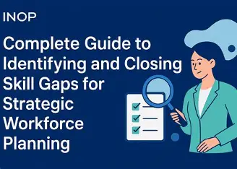
Workforce planning: Identify and close skills gaps
Workforce planning matches the skills and number of people available with future organisation need (CIPD, 2025).
Forecast
Use patient demand, growth plans rota date and service targets.
2. Map supply
Review headcount, vacancies, turnover, skills and absence.
3. Find gaps
Identify future needs in digital system, data literacy, cyber safety and leadership
4. Take action
Recruit, train, redesign roles or use temporary specialist support, review monthly.
Dashboard measure
Vacancy rate
Time to hire
6/12-month retention
Sickness absence
Trainning completion
Engagement
Critical evaluation
Forecast can be wrong when demand changes. Combine date with staff feedback and scenario planning: patient safety must guide staffing.

Slide 4

Recruitment strategy: use a balanced mix
External recruitment
Use professional network, universities and specialist agencies. Benefits wider choice and new expertise. Risk higher cost, longer time and uncertain fit.
Social media recruitment
Share realistic job previews and staff stories on professional channels such as linked. It raises awareness but should not replace fair formal selection.
Internal recruitment
Promote, transfer or develop current employees. Benefits faster onboarding, lower cost and visible career paths. Risk smaller pool and perceived favouritism
Online recruitment
Use an accessible careers page and reputable job boards. It can reach candidates quickly, but applications must be screened consistently
Recommendation: develop internal leaders and use external/online campaigns for scarce digital health skills.
Fairness: use a clear job describe, consistent scoring, structured interviews and reasble adjustment ( Acas guidance).

Slide 5



Practical example: recruit a digital health nurse
Role: support remote monitoring, patient communication and safe use of digital system
Plan
confirm workload and role
Attract
Internal online adverts
Shortlist
Use the person specification
Assess
Structure
Interview
scenario
Check
Registration and references
Onboard
Buddy day review
Essential criteria
Relevant nursing registration and experience: communication digital confidence: safe judgement confidentiality and teamwork.
Structural scenario
Ask all candidates: a patient remote monitoring reading triggers an alert. What would you do? Score answer against an agreed rubric.
Why it helps: consistent criteria can improve fairness and reduce bias assess only job relevant skills

Slide 6
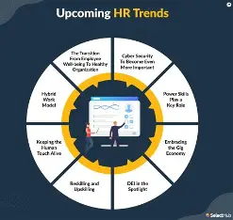

HR theories: explain the recommendations
Maslow hierarchy of needs
Staff needed safe conditions and belongs as well as growth. Address workload, team inclusion and development. Limitation people needs differ.
Human capital Theory
Skills and knowledge are assets. Invest in digital health training and career pathways. Limitation training takes time, so its impact should be measured
McGregor Theory X and Y
A theory Y approach support and trust, involvement and autonomy. Keep clear clinical standards so autonomy does not weaken patient safety
Herzberg two factor theory
Fair pay and conditions reduce dissatisfaction recognition and responsibility may motivate. Rewards alone cannot fix excessive workload or poor management
Critical point: theories are useful lenses, not guarantees. Test interventions through staff feedback, retention training outcomes and service quality measures.

Slide 7
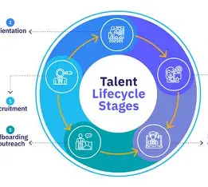

Learning, development and talent management
Develop existing staff as well as recruiting new people, especially digital health skills are scarce.
Formal learning
Digital systems and date literacy Cybersecurity and confidentiality remote consultation standards clinical escalation protocols
Learning with others
Mentoring and buddy shifts multidiscipline case reviews peer learning communities' leadership coaching
Learning through work
Supervised practice
Job shadowing and rotation
Improvement projects
Support stretch assignments
Individuals learning plan
Need: confident use of monitoring dashboard and safe escalation. Action: training modules, supervised scenarios monthly coaching. Evidence: skills checklist and manager observation.
Evaluate training
Check knowledge and confidence before/after training: observe correct system use review errors, escalation quality and staff feedback

Slide 8


Retention, motivation and employee wellbeing
Work design
Review caseload and rotas: protect breaks: offer flexible options where service needs allow
Fair reward
Benchmark scarce skill pay explain benefits: recognise teamwork and quality not only speed
Voice and leaderships
Pulse surveys, stay interviews, supportive one to ones and confidential wellbeing support
Retentional should be evidence: understand why people leave before choosing solutions.
Listen
diagnose
Act
Measure
Track turnover, absence, engagement, overtime, exit themes and training participations. Protect confidentiality and act on feedback.

Slide 9
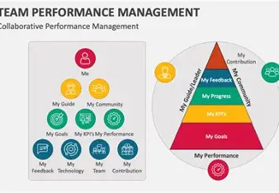

Performance management and team leadership
Continuous performance cycle
Agree goals provide resource and coaching give regular feedback review outcomes agree development action. Use two-way conversations, not only annual appraisal
Balanced measure
People: retention and wellbeing. Capability: training and competency services: response time, safe escalation and patient feedback. Avoid rewarding speed over quality
Clinical team leaders
Coaching, feedback, workload planning and psychological safety.
Digital team leads
Cross- functional communication, change leadership and date – informed decisions
Executive sponsors
Model fairness, fund development and review workforce outcomes quarterly.
Clear objective and ongoing feedback should support development rather than relying only on rating

Slide 10
Implementation plan and success measure
Timeline | Focus | Actions | Measure
Days 1 - 30 | Listen and diagnose | Review vacancy and turnover data: run staff pulse surveys and stay/exit interviews: map critical skills. | Baseline dashboard: priority roles agreed.
Days 31 - 60 | Design and pilot | Launch structure recruitment: start digital-health training pilot: coach team leaders: review workload hot spots. | Time to hire training participation: staff feedback
Days 61 - 90 | Evaluate and scale | Compare early results with baseline: improve adverts and onboarding: extent successful training and wellbeing actions | Retention trend: competency checks: engagement: service quality.
Accountability
HR lead + service management +team representative
Review rhythm
Monthly dashboard: quarterly executive review

Slide 11
Conclusion: a heathier, stronger workforce
Health Connect UK HR challenges need a join up response not one recruitment campaign alone.
Attract; balanced internal, external, online and social recruitment
Develop: targeted training, mentoring and career pathways.
Retain: fair reward, manageable workload, staff voice and wellbeing.
Measure: review retention, capability, engagement and service quality.
expect results: stronger recruitment and retention, better staff capability, lower burnout risk and more reliable patient care. Progress should be checked against a basline.

Slide 12
References
1. Acas (n.d.) Recruitment and selection. Available at: https://www.acas.org.uk/recruitment (Accessed: 11 October 2026).
2. Armstrong, M. and Taylor, S. (2023) Armstrong’s Handbook of Human Resource Management Practice. 16th edn. London: Kogan Page.
3. CIPD (2025) Workforce planning. Available at: https://www.cipd.org/uk/knowledge/factsheets/workforce-planning-factsheet (Accessed: 11 October
2026).
4. CIPD (2025) Talent management. Available at: https://www.cipd.org/uk/knowledge/factsheets/talent-factsheet/ (Accessed: 11 October 2026).
5. Herzberg, F., Mausner, B. and Snyderman, B.B. (1959) The Motivation to Work. 2nd edn. New York: John Wiley & Sons.
6. Maslow, A.H. (1943) ‘A theory of human motivation’, Psychological Review, 50(4), pp. 370–396.
7. McGregor, D. (1960) The Human Side of Enterprise. New York: McGraw-Hill.
8. Robbins, S.P. and Judge, T.A. (2022) Organizational Behavior. 18th edn. Harlow: Pearson.
9. Taylor, S. (2024) Resourcing and Talent Management: The Theory and Practice of Recruiting and Developing a Workforce. 9th edn. London:
CIPD/Kogan Page.
10. HealthConnect UK case study (module assessment brief). Use the exact title and date supplied by your tutor.

