Slide 1



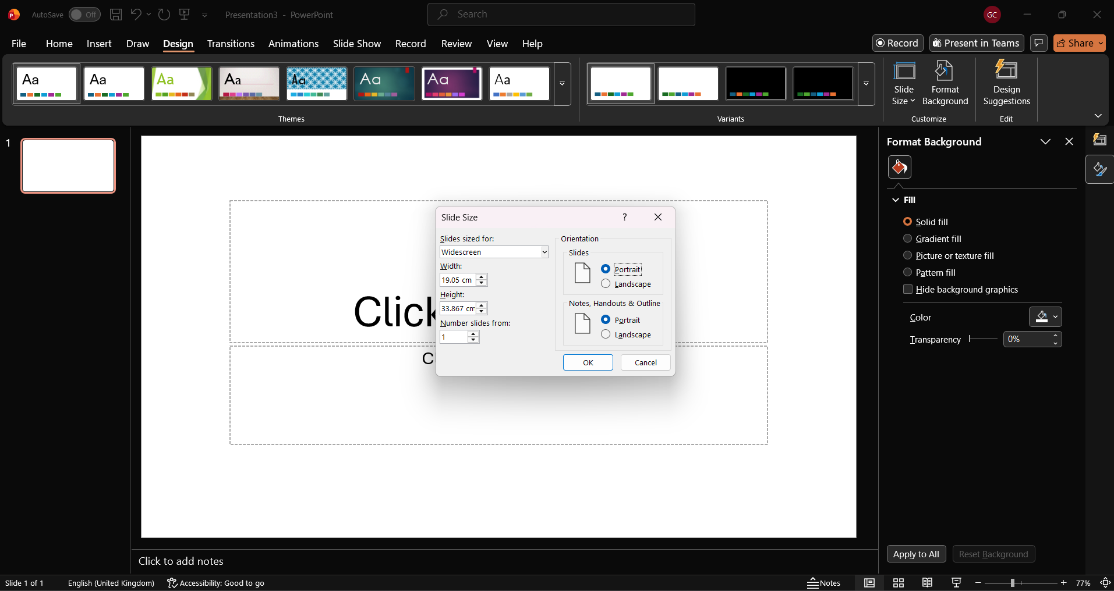
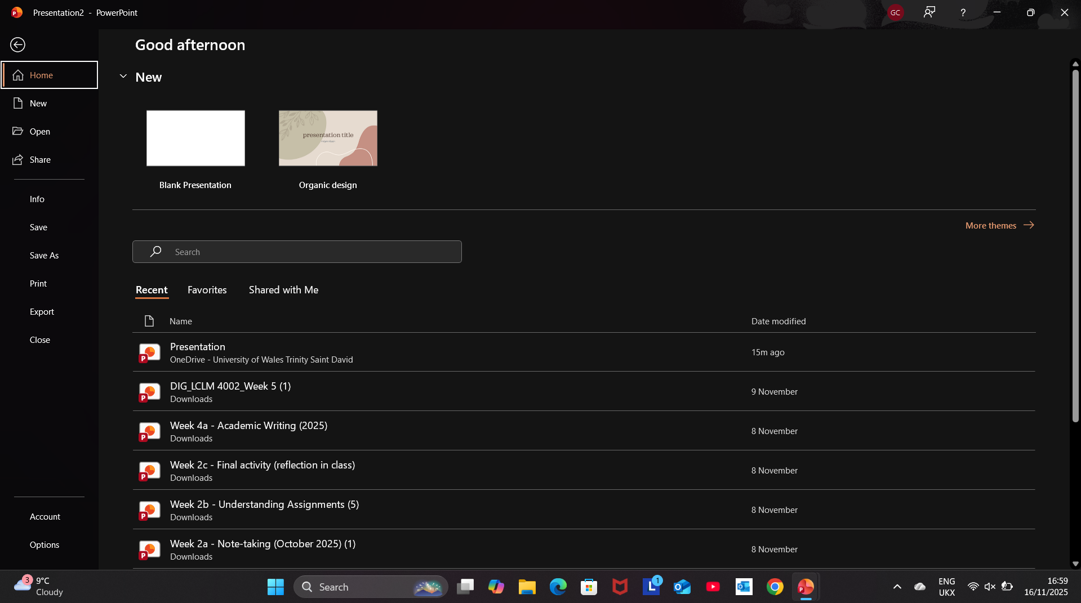


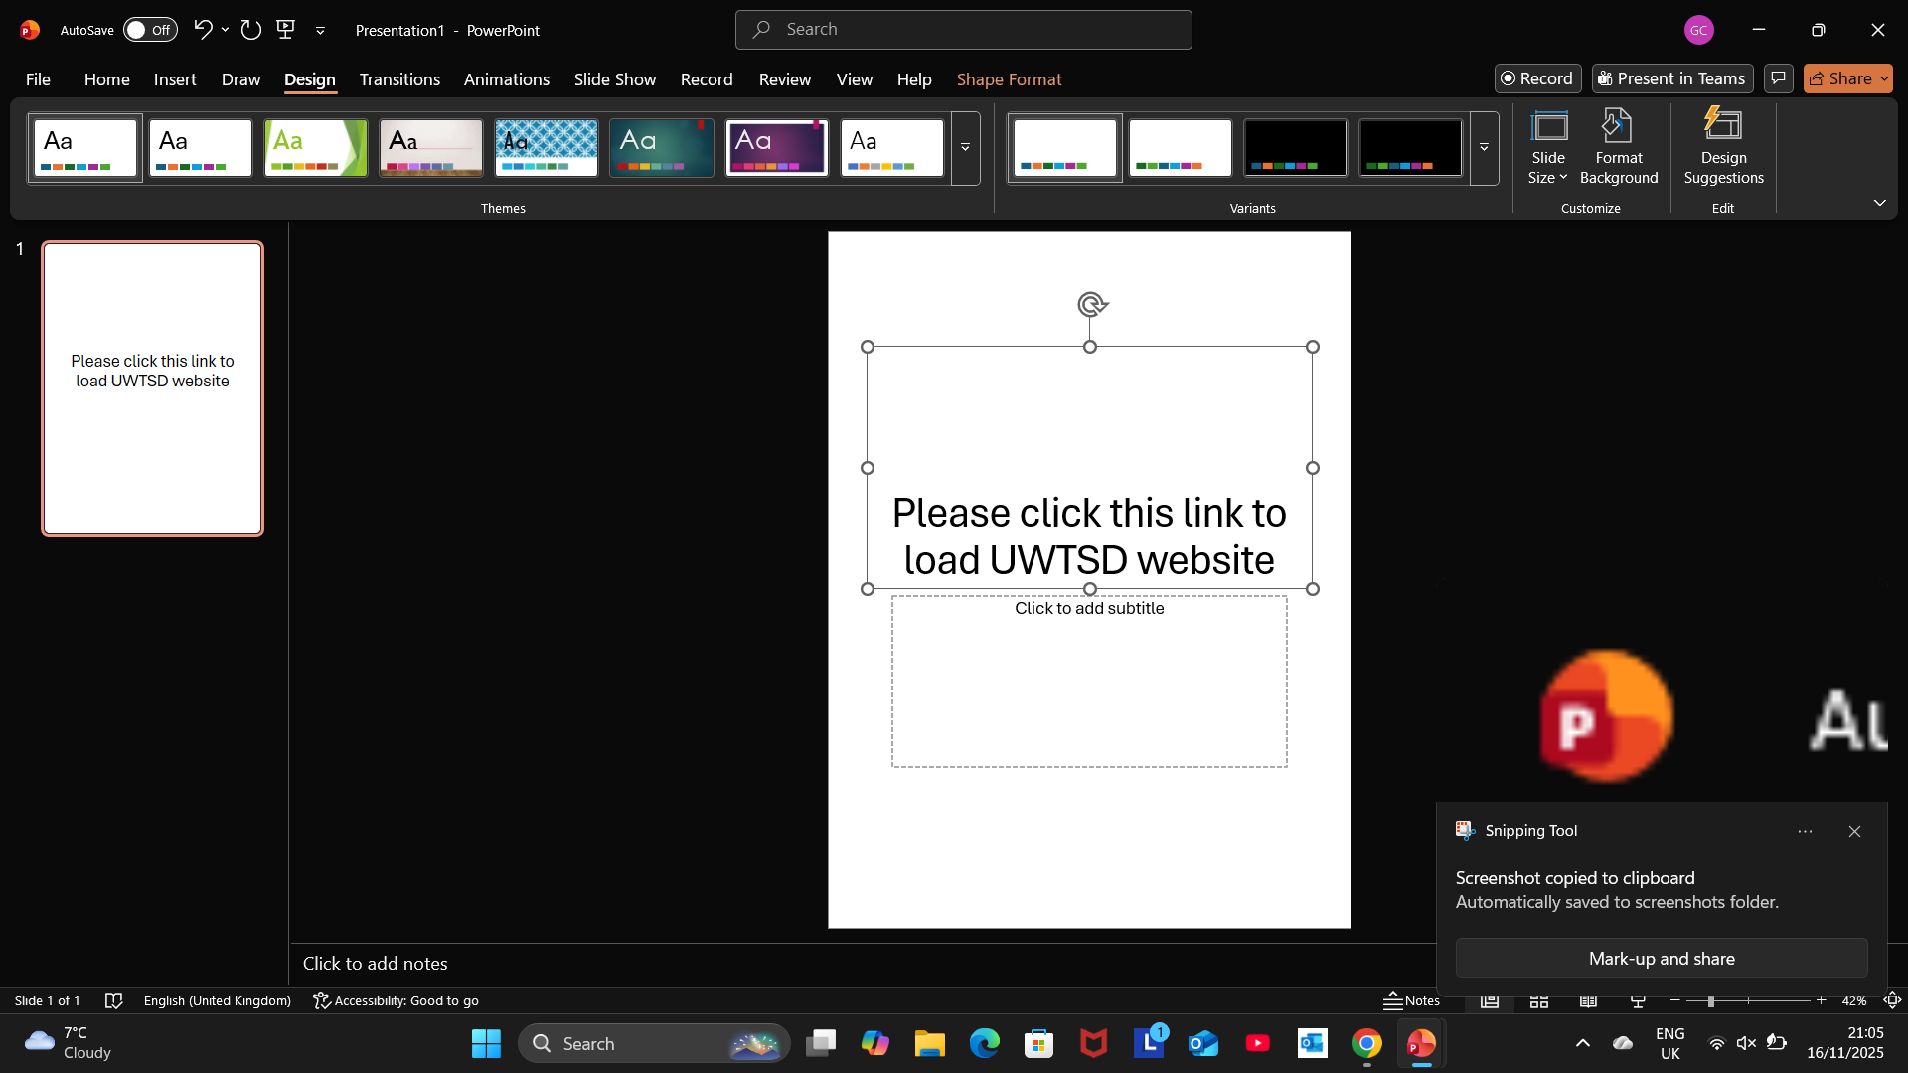
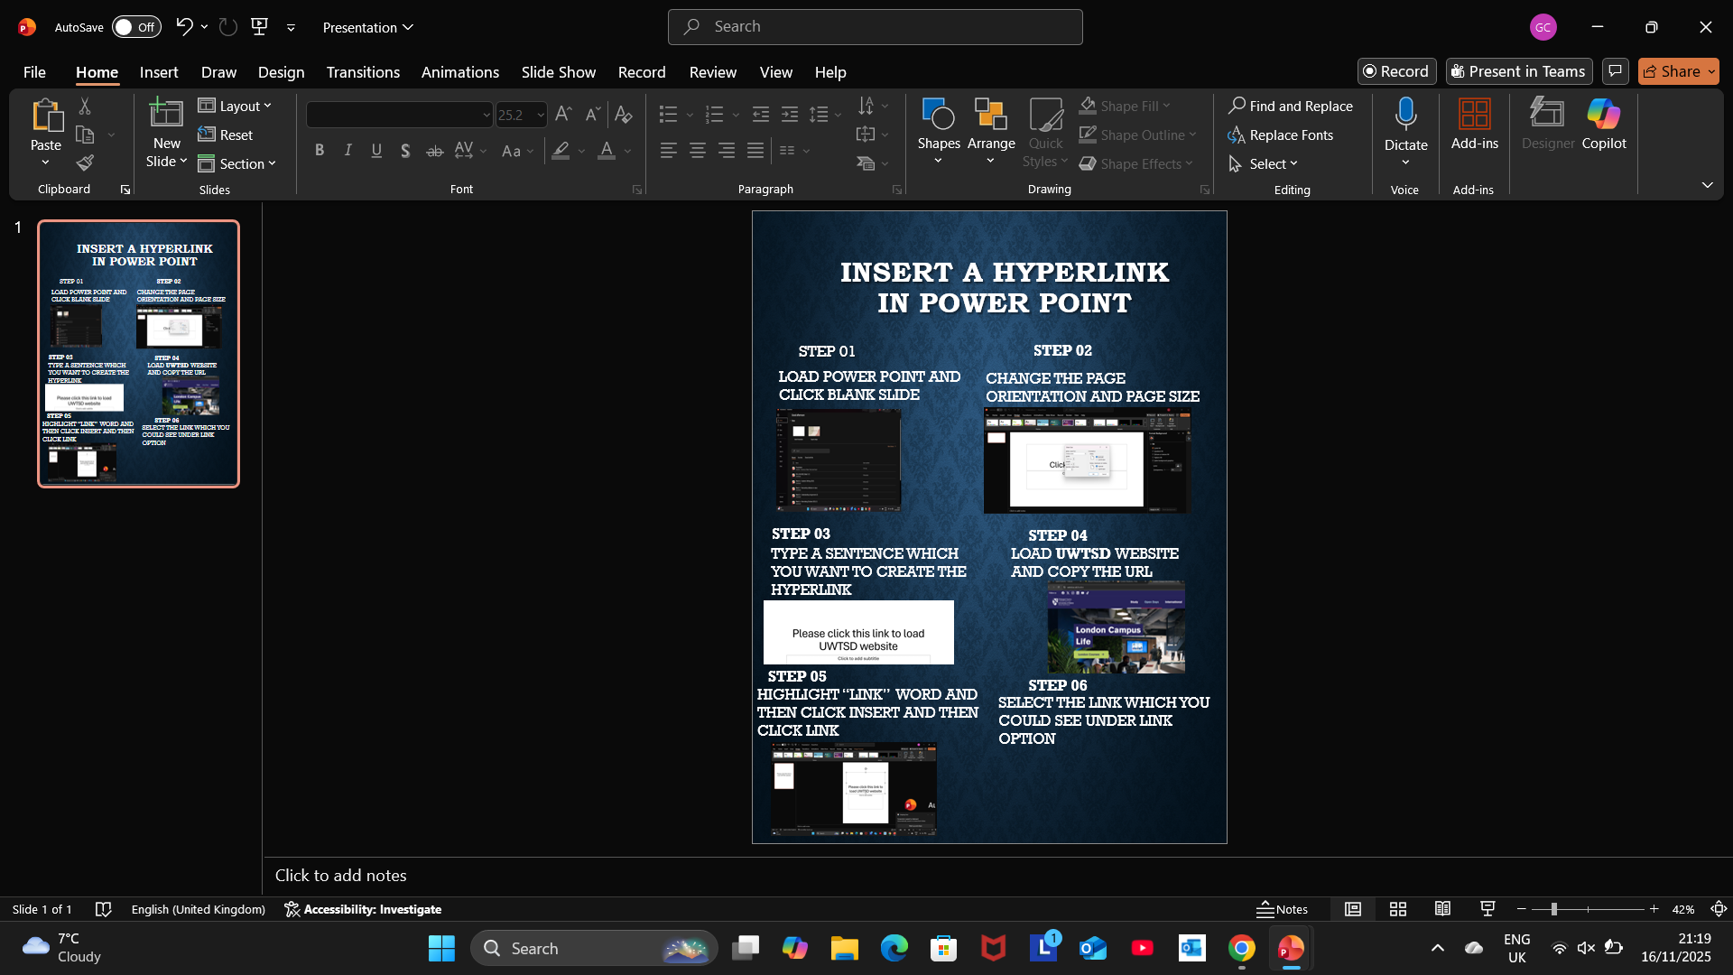
Insert a hyperlink in power point
STEP 01
STEP 02
LOAD POWER POINT AND CLICK BLANK SLIDE
CHANGE THE PAGE ORIENTATION AND PAGE SIZE
STEP 03
STEP 04
TYPE A SENTENCE WHICH YOU WANT TO CREATE THE HYPERLINK
LOAD UWTSD WEBSITE AND COPY THE URL
STEP 05
STEP 06
HIGHLIGHT “LINK” WORD AND THEN CLICK INSERT AND THEN CLICK LINK
SELECT THE LINK WHICH YOU COULD SEE UNDER LINK OPTION

