Slide 1
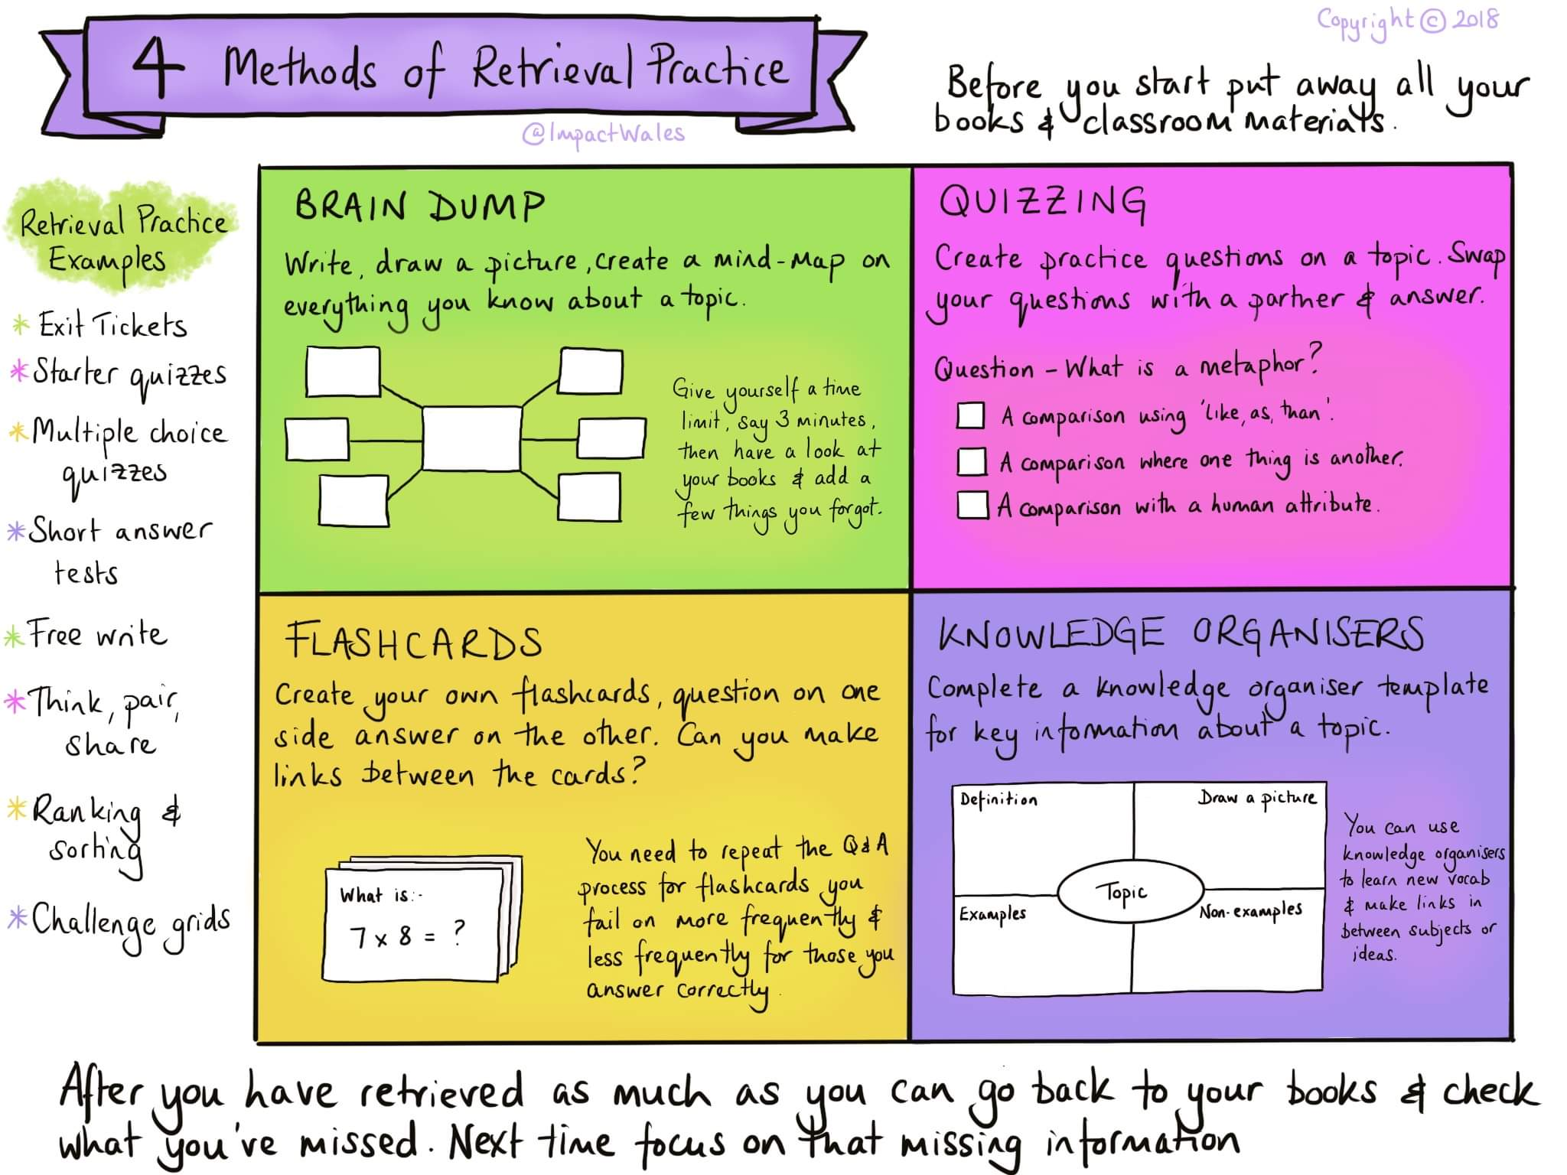
Developing Effective Study Skills: How do we use them?
ECEY4008/C
2311871
Introduction
This poster will highlight a few of the study skills needed when undertaking academic work. Moore, Neville, C., Murphy, M., & Connolly, C. (2010) suggests that there are many different ways to learn: all of which, need personal reflection to enable skills development and effective application.
Note Taking
Price (2007) outlines that effective note taking is a crucial part to learning and leads to professional success in the future.
Cottrell (2021) hints that note taking can support your definition and interpretation of information provided to build your academic work portfolio.
Pritchard (2008) exercises the benefits of note taking when used in conjunction with your personal learning strategies.
(Impact Wales, 2018)
Time Management
Lenvin (2007) implies that creating a structured routine , that includes professional and personal commitments, will develop effective time management skills. Also acknowledges this method of time management through exploring that this area of study skill can only be used effectively should students correctly appoint time to the most important areas of learning.
McMillan & Weyers (2021), Gives the impression that the organisation of study time is of upmost importance to best manage your time and efficiency. Lobdel (2011) supports this by referencing manageable bursts of study time, in essence, to absorb more accurate and concise information needed to further students quality of learning.
Barton (2015) provides a positive nod towards effective time management. He implies that good use of your time will produce higher functioning study, resulting in high quality academic achievements.
Critical Thinking
Eales-Reynolds, et al (2013) emphasise that critical thinking skills are a highly desirable attribute for a student to have and continue to develop. They deduce these skills to result in effective study, opportunity to gain high quality careers as well as aiding holistically formed judgements.
Haber (2020), suggests that critical thinking is a form of true reflection of a topic which allows you to form decisions using appropriate and relevant questioning and curiosity to support your findings.
The University of Edinburgh puts forward the idea that developing critical thinking skills can be performed in the way of skill specific activities. Thus resulting in challenging students thinking skills and broadening their thought processes.
Conclusion : Rose , J infers that a variety of study skills, when combined effectively can only progress learning and success. She hints that these should be used continuously throughout education to positively impact your later life endeavours.

Slide 2
References
Barton, D (2015) What Do Top Students Do Differently? Available at https://www.youtube.com/watch?v=Na8m4GPqA30 [Accessed September 26th 2023].
Cottrell, S. (2021) Skills For Success : Personal Development and Employability. 4th edition. London :Red Globe Press
Eales-Reynolds, L, Judge, B, McCreery, E, & Jones, P (2013), Critical Thinking Skills for Education Students, London: SAGE Publications, Limited.
George , D (2012) A Practical Application of Time Management. Time Management. InTech. DOI: 10.5772/38364.
Haber, J (2020), Critical Thinking, Cambridge: MIT Press.
Levin, P. (2007) Skilful time management! Maidenhead, England: Open University Press.
Lobdell, M (2011), Study More Study Less, Available at https://www.youtube.com/watch?v=IlU-zDU6aQ0 [Accessed September 26th 2023].
McMillan, K, & Weyers, J (2021), The Study Skills Book : Your Essential Guide to University Success, Harlow: Pearson Education Limited .
Moore, Neville, C., Murphy, M., & Connolly, C. (2010). The Ultimate Study Skills Handbook. McGraw-Hill/Open University Press.
Price, G and Maier, P (2007), Effective Study Skills Unlock Your Potential. Essex: Pearson Education Limited.
Pritchard, A. (2008) Studying and learning at university [electronic resource] : Vital Skills For Success In Your Degree . Los Angeles, CA :Sage Publications.
Rose, J (2023), 5 reasons Why Good Study Skills Are Important, Available at https://www.thetutorteam.com/study-skills/5-reasons-why-good-study-skills-are-important/ [Accessed September 2023].
The University of Edinburgh (2023) , Critical Thinking , Advice and resources to help you develop your critical voice, Available at https://www.ed.ac.uk/institute-academic-development/study-hub/learning-resources/critical [Accessed September 26th 2023].
Wales, I., 2018. Twitter. [Online] Available at: https://twitter.com/ImpactWales[Accessed 26 September 2023].

