Slide 1
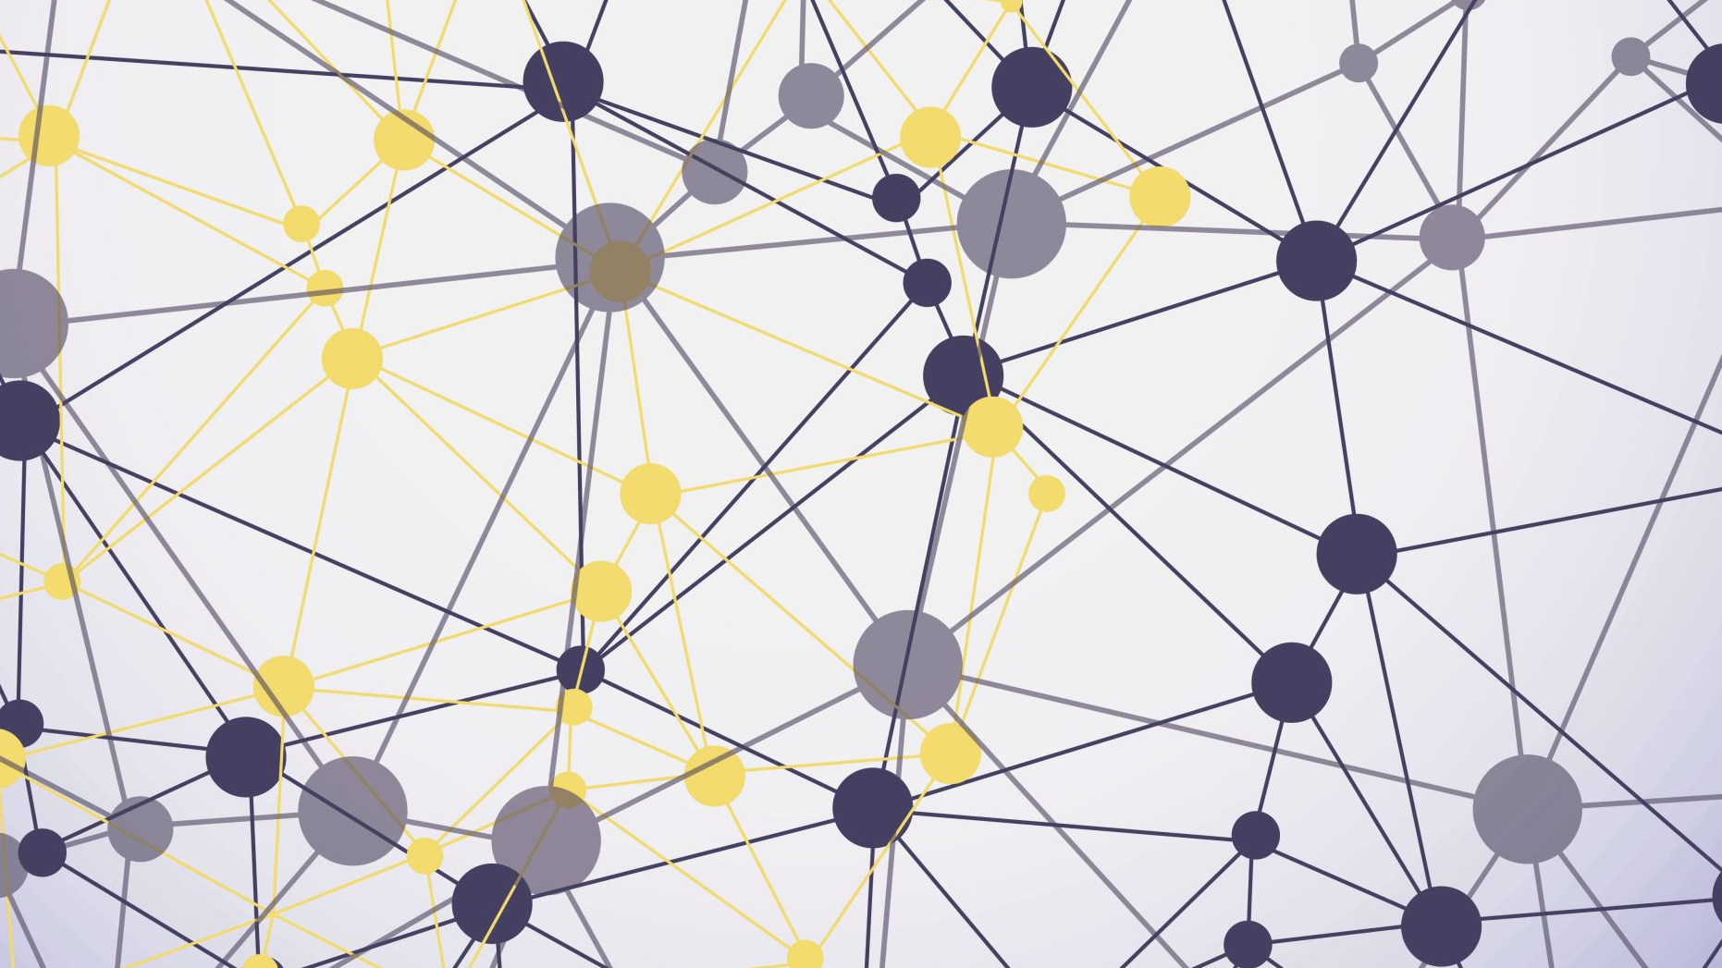
BANDURA THE BRIDGE TO COGNITION

Slide 2
Basic Acknowledgement format of AI tool use
I acknowledge the use of co pilot on week beginning the 10 of november to generate images.
the prompt(s):
1. Create image of bandura
2. Create image depicting the bobbo doll experiment
I confirm that I have not presented any AI generated text as my own work. I confirm I have copies of my drafts, notes, and other resources I used before, and after the use of AI tools which I may be asked to provide in evidence.

Slide 3
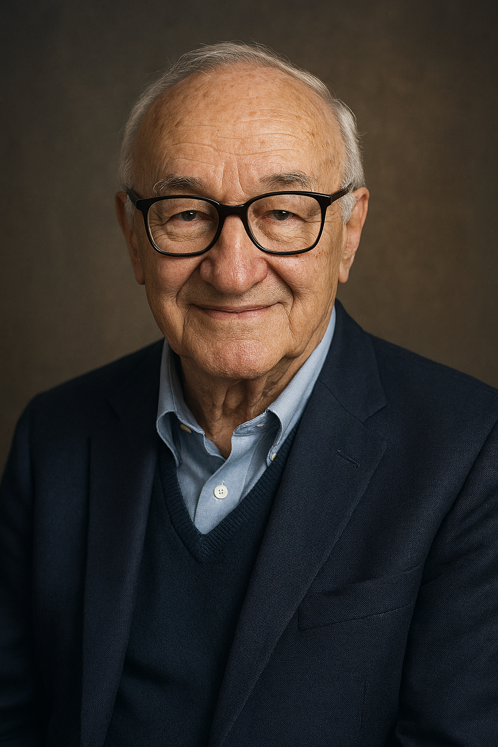

Slide 4
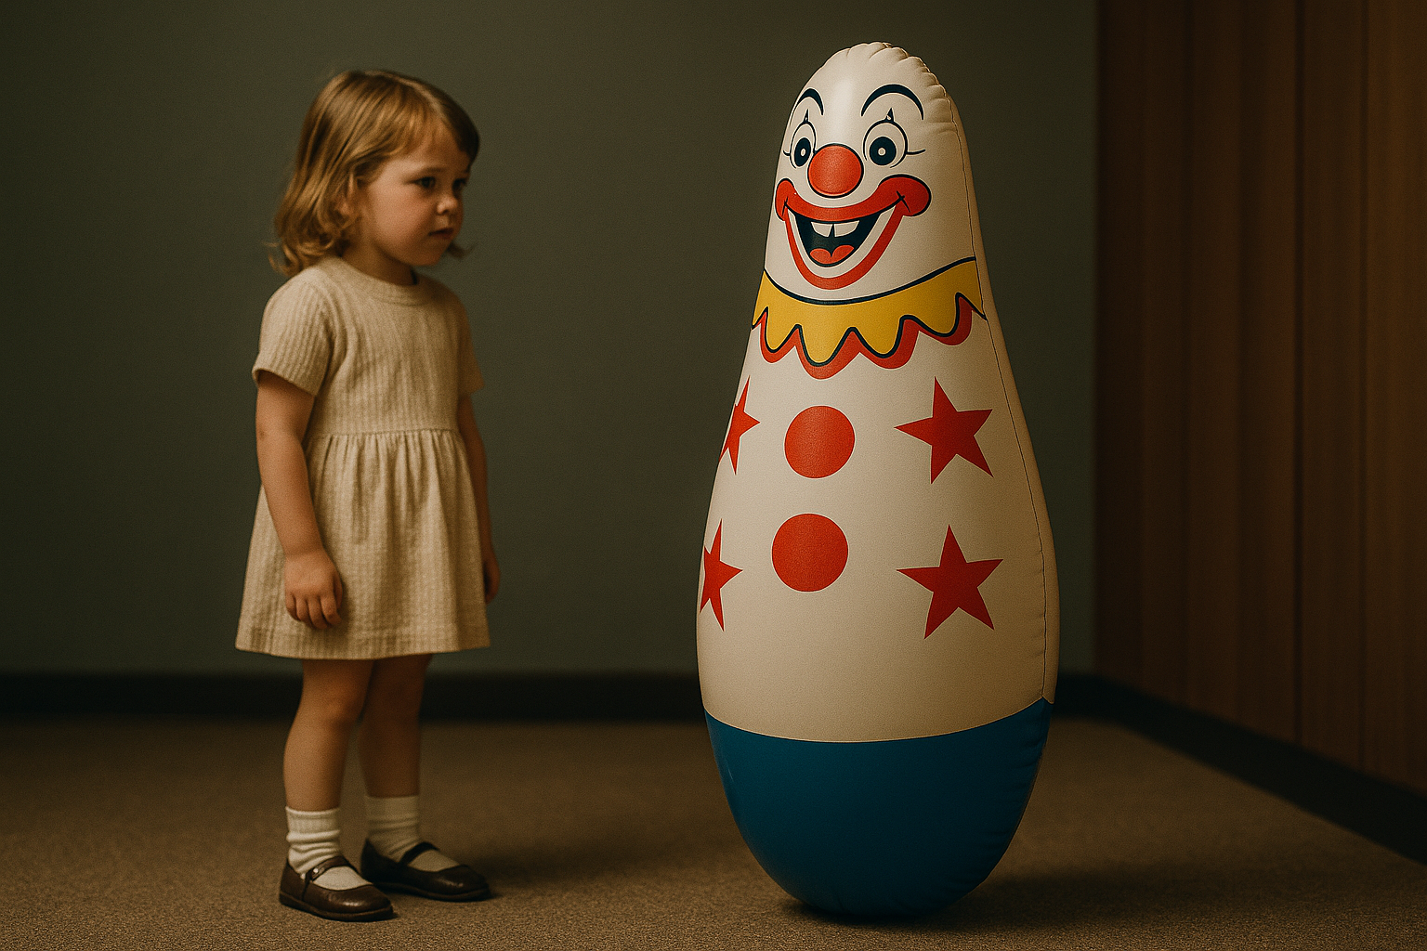
Now I didn’t set out to overthrow behaviourism. I just thought humans were a bit more complicated than pigeons. So, I introduced what I called social learning theory. In 1961, I conducted what’s now my most infamous study the Bobbo doll experiment. WE let children observe an adult behaving aggressively towards a clown doll, and sure enough many of them copied the behaviour. No rewards, no punishments, just observations.

Slide 5
The implications? Massive. In education, in media, in parenting. If we model violence we spread, it. If we model resilience and empathy, we spread that too.
As for the ethics of the Bobbo study, I do think we should have had things like informed consent, but things were much different back then. Besides no children were harmed, and none of the dolls were permanently damaged.
In hindsight, one of the main strengths of my theory is that it finally recognizes humans as active learners, not just responders to rewards and punishments. We watch, think and chose. It helped explain complex behaviours like aggression, empathy, and even the power of media. However, a weakness is that it’s hard to measure internal processes like attention or motivation scientifically. Also, my Bobbo doll studies took place in artificial lab settings, so they might not fully reflect real life. Still, I believe the core message stands: people learn by watching others, and this truth has shaped psychology ever since.

