Slide 1

Schizophrenia
Dushika. S
BSc Psychology
Msc Clinical and Health Psychology

Slide 2

Schizophrenia
It is one of the mental health disorder that could be traced back throughout human history
According to the NICE guidelines, Schizophrenia is a disorder that changes an individual’s perception, thoughts, emotions and behaviours.
The onset of the disorder is generally during late adolescence and early adulthood. Presentation of Symptoms below the age of 10 is rare.
In the UK lifetime prevalence of Schizophrenia is 14.5 per 1000 people
Categorized by Psychosis – Loss of touch with reality
Notes:
Resource: https://www.nhs.uk/conditions/schizophrenia/symptoms/
https://www.nice.org.uk/guidance/cg155/resources/psychosis-and-schizophrenia-in-children-and-young-people-final-scope2#:~:text=In%20the%20UK%20the%20lifetime,is%20considerable%20variation%20between%20estimates.

Slide 3
ICD-10
F20 Schizophrenia
  F20.0 Paranoid schizophrenia
  F20.1 Hebephrenic schizophrenia
  F20.2 Catatonic schizophrenia
  F20.3 Undifferentiated schizophrenia
  F20.4 Post-schizophrenic depression
  F20.5 Residual schizophrenia
  F20.6 Simple schizophrenia
  F20.8 Other schizophrenia
  F20.9 Schizophrenia, unspecified

Slide 4
Symptoms of Schizophrenia
Positive Symptoms | Negative Symptoms | Psychomotor
Hallucination | Social Withdrawal | Catatonia
Delusion | Poverty of Speech
Disordered Thinking and Speech | Flat Affect
 | Monotonous Voice
 | Anhedonia (Lack of Pleasure)
 | Lack of Motivation

Slide 5
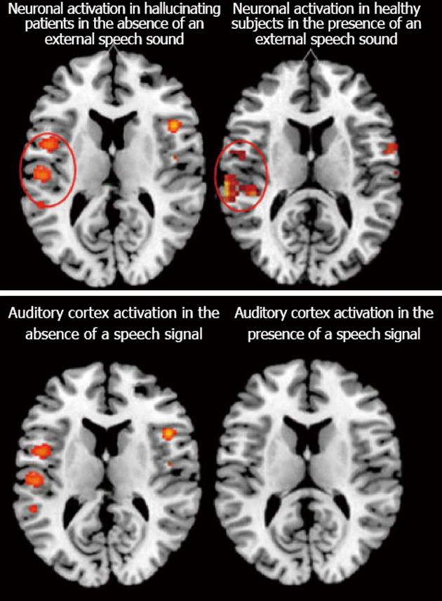
Hallucinations
Hallucination it is based on sensory perceptions
It is where an individual could hear, see, smell, feel or taste something that does not exist
However, the sensations experienced could feel quite real to the individuals, making it an extremely distressing experience.

Slide 6
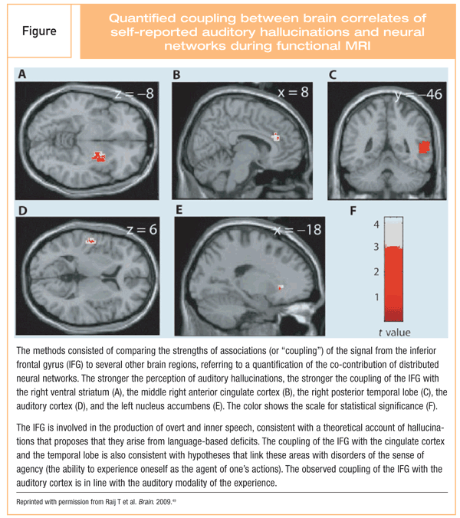
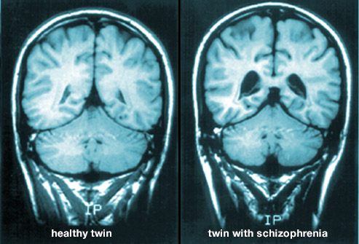

Slide 7
Hallucinations
Visual Hallucination (Non-existent visual/imagery)
Auditory Hallucination (Non-existent sounds)
Olfactory Hallucination (Non-existent odours)
Tactile Hallucination (Non-existent touch)
Gustatory Hallucination (Non-existent taste)

Slide 8
Delusions
Faulty interpretation of Reality
It is generally based on a bizarre on an unrealistic view
Delusion based on one’s beliefs and assumptions

Slide 9
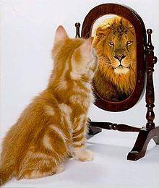
Delusions
There are several types of delusions
  Erotomanic – Someone popular is in love with them
  Grandiose – High sense of worth, power
  Jealousy – Someone close to the individual maybe perceived to be unfaithful
  Persecutory – May perceive that the individual or someone close to the individual is in threat
  Somatic – May perceive that they have some form of medical need, when evidence states otherwise.

Slide 10
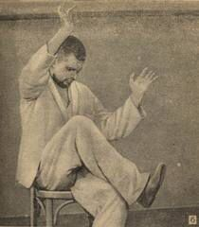
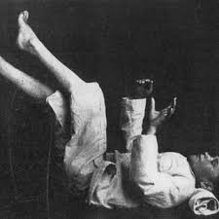
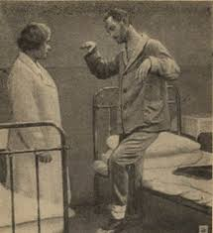
Catatonia

Slide 11

What do you think causes the disorder?

Slide 12
Theoretical Explanations
Explanation for causes of symptoms
  Biological Factors
  Psychological Factors
  Social Factors
Diathesis Stress Relationship

Slide 13
Biological Explanation
Genetic
  Predisposition to develop the disorder
  Twin studies – Research evidence has highlighted that if a monozygotic twin indicates symptoms of schizophrenia, then the other twin has a 48% likelihood of developing the disorder as well.
  However, a dizygotic twin only has a 17% possibility of developing a disorder
  Adoption Studies – infants adopted indicated symptoms of Schizophrenia, when their biological parents were diagnosed with such disorders.

Slide 14
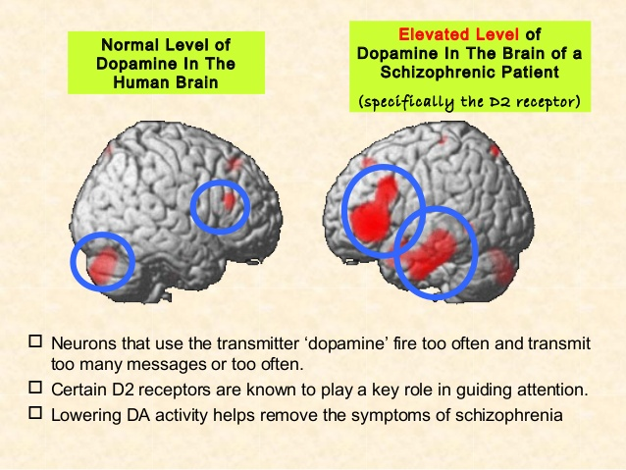
Biochemical Explanation:
  Dopamine Hypothesis Theory – Excessive secretion of dopamine (Patients with Parkinson developed Symptoms of Schizophrenia when they were treated with excess L-dopa)
  Individuals with Schizophrenia may possess several dopamine receptors (D2 Receptors), which lead to an increased reactivity in dopamine.

Slide 15
Abnormal Brain Structure:
  Some of the negative symptoms experienced by patients could be explained using the abnormal brain structure.
  Brain scans had indicated that individuals with Schizophrenia possess an enlarged ventricles, which may result in poor brain development or impairment to certain regions of the brain.
  Comparatively smaller temporal and frontal lobe
  Abnormal blood flow to certain regions of the brain

Slide 16
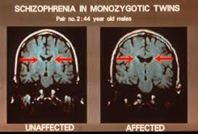
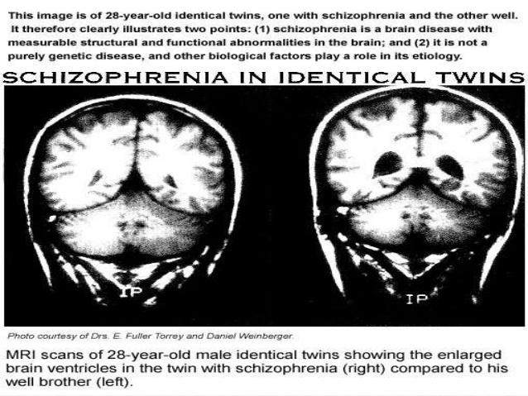
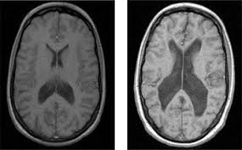

Slide 17
Psychological Explanation
Psychodynamic Explanation
Cognitive Explanation
Behavioural Explanation

Slide 18
Psychodynamic Approach
According to Freud, if an individual fails to effectively utilize their ego defense mechanisms, then it may lead to symptoms of Schizophrenia.
Schizophrenic Mothers: Individuals with Schizophrenia, may have had mothers, who were cold in nature. They may have been unresponsive/uninterested towards the child’s needs.
The explanations have limited research support.
However, Freud did state that individuals with Schizophrenia may not be suitable to be treated with psychoanalysis

Slide 19
Behavioral Approach
Operant conditioning was used as explanation towards Schizophrenia
Attention to social cues may not have been reinforced, hence the occurrence of such behaviors in the future is limited.
Instead, attention maybe redirected towards other external /internal cues.

Slide 20
Cognitive Approach
Acknowledgment is provided towards the Biological explanation
However, the explanation states that symptoms that are developed due to biological mechanisms could perpetuate due to faulty interpretations and misunderstanding of symptoms
  Experience of hallucinations may not be acknowledged, leading to false assumptions, thereby creating further symptoms such as delusions.
  Internal thoughts maybe misunderstood as auditory hallucinations.

Slide 21
Sociocultural Approach
  Multicultural factors
    Higher among individuals within black community than Caucasian.
    However economic challenges and day to day limitations will have to be accounted for.
  Social labeling
    Self-fulling prophecy (When social norms are not abided)
  Family dysfunction
    Double Bind Hypothesis
    Parents communicate contradictory messages, making it challenging to meet the expectation of the parent.
    Primary verbal communication maybe followed with contradictory non-verbal message.
    As a result, child adapts different coping strategies

Slide 22
Further Reading
Rosenhan, D.L., 1973. On being sane in insane places. Science, 179(4070), pp.250-258.
Pickard, B., 2011. Progress in defining the biological causes of schizophrenia. Expert reviews in molecular medicine, 13.
McCabe, R. and Priebe, S., 2004. Explanatory models of illness in schizophrenia: comparison of four ethnic groups. The British Journal of Psychiatry, 185(1), pp.25-30.
Howes, O.D. and Murray, R.M., 2014. Schizophrenia: an integrated sociodevelopmental-cognitive model. The Lancet, 383(9929), pp.1677-1687.

