Slide 1

RESEARCH PROPOSAL
An examination of the use of ‘task-based learning’ as a basis for the design of writing activities for adult learners and its implications for syllabus design.
----- a practical study of EFLT
DOUDOU HAO
18/4/2024
Notes:
Key words: TBLT, adults EFL writing proficiency, syllabus design (practical usage)

Slide 2
Research Background
  background
  significance
Research Development
  questions
  objectives
  rationale
Research Design
  settings
  data collection
  data analysis
Ethical Issues
Timetable
CONTENT
Notes:
PPT arranged along the research process.
Five parts analyse the bkgd, dvlp the research, design the research in detail, and thical and timetable

Slide 3
Research Bcakground
SECTION ONE
background
significance

Slide 4

Background
“a recent survey of adult educators, conducted by the authors, found that academic writing has not been a focus in many adult education programs, and teachers receive limited professional development in this area and instructional support in implementing it”
––– Peyton and Schaetzel, 2016
“Traditional approaches to writing instruction may focus heavily on grammar and structure, neglecting the development of communicative competence.”
––– Byrne, 1988
Writing is a complex skill in language learning, often presenting challenges for adult EFL learners.
Lack of studies
Lack of methods
wirting is complex
Notes:
an abvious reality is Lack of studies on adult EFLT

Slide 5
Significance
Improving the written literacy of newcomers to English-speaking countries can lead to better education, employment, or social integration opportunities. (Liaqat and Munteanu, 2018).
TBL offers a potential solution by integrating writing tasks into meaningful, purposeful activities that reflect real-life language use (Skehan, 1998).
Understanding the implications of TBL for adult EFL writing instruction is crucial for enhancing pedagogical practices and meeting the diverse needs of learners.
urgent for newcomers
possible solution
good for adult EFLT
Notes:
with the lacking of study and increasing demands of adult EFLT, we come up with the idea of implementing TBL in adult EFLT, to see whether it is applicable in adult learning/ real-life contexts.

Slide 6
Research Development
SECTION TWO
Rationale
Questions
Objectives

Slide 7
Rationale - Task Base Learning
Task-based language learning is a concept derived from communicative language teaching (CLT). It represents a significant shift in language teaching methodology, emphasizing real-world language use and learner-centeredness.
Task-Based Learning (TBL) has gained prominence in language teaching methodology due to its emphasis on real-world language use, learner engagement, and authentic communication (Ellis, 2003).
Task Based Learning (TBL) is an approach to language education that emphasizes authentic language use through tasks, driving skill-based teaching and learning while engaging students in the learning process (Sholeh, et. al. 2020)
TBL aims to enhance student motivation, imagination, and language acquisition by providing a framework for educators to create effective programs that meet learners' language use needs .

Slide 8
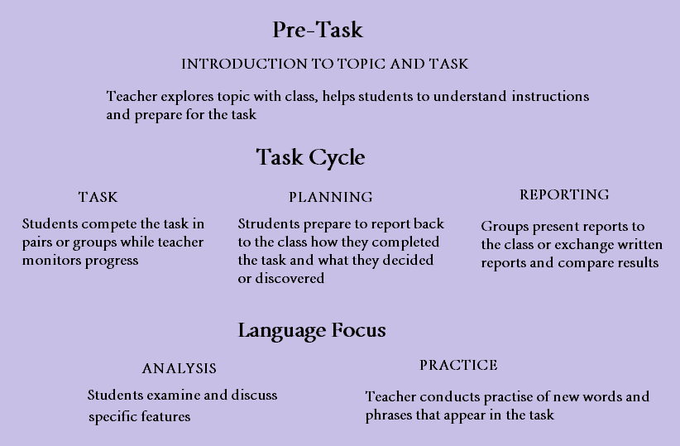
Rationale - Task Base Learning
source: https://www.myenglishlanguage.com/teacher-resources/task-based-learning-language-teaching/
Notes:
Here is how TBL conducted. it requires more time doing the activiries design (pre-task) for teachers than traditional teaching methods

Slide 9
Aims of the investigation
Questions
1. Will the application of TBL based teaching increase adult learners’ writing proficiency?
2. Is TBL suitable for designing writing activities in adult EFL contexts?
3. How to apply TBL for syllabus design in adult EFL education?
Notes:
to narrow down the research areas, we focus on the study of writing proficiency

Slide 10
Aims of the investigation
Objectives
1. Will the application of TBL based teaching increase adult learners’ writing proficiency?
Assess the impact of TBL on adult learners' writing proficiency.
2. Is TBL suitable for designing writing activities in adult EFL contexts?
Investigate the suitability of TBL for designing writing activities in adult ESL/EFL contexts.
3. How to apply TBL for syllabus design in adult EFL education?
Examine the implications of TBL for syllabus design in adult English as a Foreign Language (EFL) education.

Slide 11
•Conceptual themes
Communicative Language Teaching (CLT): TBL aligns with the principles of CLT by prioritizing meaningful communication and task-based activities. (Richards & Rodgers, 2001).
Learner Autonomy: TBL encourages learners to take an active role in their learning process, fostering autonomy and self-regulated learning (Little, 1991).
Task-Based Approaches: The investigation builds upon the theoretical foundations of task-based approaches to language learning, emphasizing the role of tasks in promoting language acquisition (Long, 1985).
Syllabus design principles and considerations: syllabus design principles；Curriculum design; lesson planning; curriculum design;

Slide 12
Research Design
SECTION THREE
Data Collection
Date Analysis
Settings

Slide 13
Settings
Participants
- New adult immigrants;
- English writing teachers;
- Sample size: 15/group*2-3groups
- With equal English learning background (for exmple: IELTS practical writing score >= 4.5)
Contexts
01
Settings
02
- A community college or adult education centre in Wales
- face to face English writing classes

Slide 14
Data Types
With the progress of the research, various data will be collected at different stages.
observation notes
writing samples and test scores
questionnaires
syllabus
01
02
03
04
During TBL writing activities in adult EFL classrooms, participant obeservation can be conducted on a monthly basis by researchers.
Writing tests are given to adults at the begining, and in the end of the research;
Writing sample will be collected as well
quiestionnairies are designed and given to both the teachers and learners
teachers’ syllabus , lesson plan notes, TBL activities planning notes and relevant documents will be collected.

Slide 15
Data Collection
Data will be collected through a mixed-methods approach combining qualitative and quantitative techniques with a preference on qualitative approach.
Interviews: with all participants
Observation: carried out by researchers
Document Analysis: obesevation notes, TBL writing activities planning materials; writing samples
Questionnaries: with open questions for syllabus design, such as the authenticity, task complexity, language focuses of TBL activities
Questionnaries: to rate for TBL activites: engagement, enjoyed, sactisfaction
Tests: vocubulary tests, writing tests (IELTS writing)
VS
Quantitative
Qualitative

Slide 16

Data analysis
MIXED METHODS
The quantitative data analysis: vocabulary and writing tests are conducted in the begining and in the end of the tests. Tests scores are collected and compared both individually and as a group.
mean\standard deviation
Tools: Excel, SPSS
The qualitative data analysis: Content Analysis and Thematic Analysis are used to explore learners' perceptions and experiences, the relationship between TBL activities and participants’ writing proficiency, and the integration of TBL principles into syllabus design.
Tools:NVivo;wenjuanxing
Notes:
mean, standard deviation

Slide 17
Ethical issues
SECTION FOUR

Slide 18
Ethical issues
the guidelines of the British Educational Research Association (BERA) and UWTSD Research Ethics & Integrity Code of Practice (2022):
Informed Consent: The necessity to ensure that participants are fully apprised of the research's objectives, methodologies, potential hazards, and advantages, and that they provide their consent willingly.
Privacy and Confidentiality: Upholding participants' privacy by protecting their personal data and guaranteeing that information is anonymized and stored securely.
Respect for Autonomy: Acknowledging participants' autonomy and entitlement to self-determination.
Data Protection and GDPR Compliance: Adhering to data protection legislations, such as the General Data Protection Regulation (GDPR), to guarantee that personal data is gathered, processed, and stored lawfully and securely.
Inclusion and Diversity: Ensuring that the research acknowledges diversity and inclusivity by considering the requirements and viewpoints of all participants, irrespective of their heritage, culture, or identity.
Research Integrity Research conducted in and by the University should be undertaken in accordance with commonly agreed standards of good practice.
informed consent privacy
confidential protection from harm respect for autonomy conflict of interests Research Integrity

Slide 19
Timetable
SECTION FIVE

Slide 20
Timetable
Timespan: 12 monthes
Presumed outcome: an article
 | 1 | 2 | 3 | 4 | 5 | 6 | 7 | 8 | 9 | 10 | 11 | 12
Planning and TBL design
pre-test
TBL activitie
Post-test
interviews
questionnaire
data analysis
finalizing
Observation

Slide 21
Reference lists:
Byrne, D. (1982). Teaching writing skills. London: Longman.
Joy Kreeft Peyton and Kirsten Schaetzel (2016). Teaching Writing to Adult English Language Learners: Lessons From the Field. Journal of Literature and Art Studies, 6(11). doi:https://doi.org/10.17265/2159-5836/2016.11.012.
Lester, J.N., Cho, Y. and Lochmiller, C.R. (2020). Learning to Do Qualitative Data Analysis: A Starting Point. Human Resource Development Review, 19(1), pp.94–106. doi:https://doi.org/10.1177/1534484320903890.
Liaqat, A. and Munteanu, C. (2018). Towards a writing analytics framework for adult english language learners. Proceedings of the 8th International Conference on Learning Analytics and Knowledge. doi:https://doi.org/10.1145/3170358.3170422.
Little, D. (1991). Learner Autonomy 1: Definitions, Issues and Problems.
Lopes, J. (2022). Exploring task-based learning: Past, present, and future trends.
Prasad Bhandari, L. (2020). Task-Based Language Teaching: A Current EFL Approach. Advances in Language and Literary Studies, 11(1), p.1. doi:https://doi.org/10.7575/aiac.alls.v.11n.1p.1.
Robinson, P. (2014). The cognition hypothesis, task design, and adult task-based language learning.
Skehan, P. (2003). Task-based instruction. Language Teaching, 36(1), pp.1–14. doi:https://doi.org/10.1017/s026144480200188x.
Zhuang, X. (2007). Serial No.30) US-China Education Review. US-China Education Review, 4(5), pp.1548–6613.

Slide 22
Reference List
Liaqat, A. and Munteanu, c. (2018). Towards a writing analytics framework for adult english language learners. 121-125. Available from: 10.1145/3170358.3170422
Peyton, J.k. and Schaetzel,K. (2016). Teaching Writing to Adult English Language Learners: Lessons From the Field. Journal of Literature and Art Studies, 6(11) Available from: 10.17265/2159-5836/2016.11.012
Ellis, R. (2017). Task-Based Language Teaching. 108-125. Available from: 10.4324/9781315676968-7
Sholeh,M.B., Salija, K. and Nur, S. (2020). Task Based Learning (TBL) in EFL Classroom: from theory to practice. 3(4), 139-144. Available from: 10.33750/IJHI.V3I4.97
Richards, J.C. and Rodgers, T.S. (2014) Approaches and Methods in Language Teaching. 3rd edn. Cambridge: Cambridge University Press (Approaches and Methods in Language Teaching).
Skehan, P. (2007). Language Instruction Through Tasks. In: Cummins, J., Davison, C. (eds) International Handbook of English Language Teaching. Springer International Handbooks of Education, vol 15. Springer, Boston, MA. https://doi.org/10.1007/978-0-387-46301-8_21
references

Slide 23
RESEARCH PROPOSAL
THANK YOU!
-----
DOUDOU HAO
18/4/2024

