Slide 1

Recommending a leadership and development strategy that values people while optimising organisational success
By Godlove N Nzimbi
Student number : 1809086
Masters in Leadership, University Of Wales Trinity Saint
Davids
Notes:
NOTE:
To change the image on this slide, select the picture and delete it. Then click the Pictures icon in the placeholder to insert your own image.

Slide 2


Have you ever been used?

Slide 3

The aim of this report is to make recommendations on how an organisation can develop human resources (“HR”) to achieve their business objective.

Slide 4
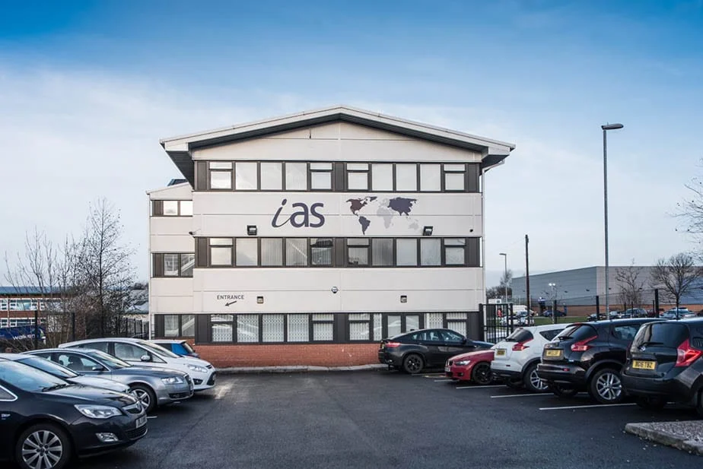
Introduction of the organisation
IAS is a UK based law firm with its head office in Manchester with over 21 branches in the United Kingdom. It also has partnerships with law firms in other countries, IAS(2023).
It is run by a director who has 75% shares which means he holds 75% or more of the voting rights, and a group of partners, Idia, (2023).

Slide 5

Organisation Design and values of IAS
IAS has as a mission to be the number one law firm in the UK and beyond for immigration law and more, and to be the best place to work. They also aspire to be able to deliver an exceptional customer experience and service to all clients and, to foster a supportive and motivational environment for all staff, Idia, (2023).

Slide 6
Organisation Design and values of IAS continues
1- Someone who takes personal responsibility for their work.
2- Someone who never lets the client down.
3- Someone who is a go-getter and will go the extra mile.
4- Someone who will not give up and do whatever it takes.
5- Someone who treats the client very professionally and provides excellent client care.
6- Someone who always treats colleagues as equals.
7- Someone who you can depend on to do the right thing.
8- Someone who is willing to change and adapt to meet business needs.

Slide 7
Organisation Design and values of IAS continues
9- Someone who sees the role as more than a job.
10- Someone who is willing to volunteer and collaborate.
11- Someone who is not afraid of challenges.
12- Someone who is willing to find solutions alone or within a team.
13- Someone who leads by example and action, not words.
14- Essentially, someone who just ‘gets it’, Idia,(2023)

Slide 8
SWOT ANALYSIS OF IAS
During an interview with a staff from IAS with the author of this report a SWOT analysis of IAS was established. The SWOT analysis will be commented on, in more detail during the second part of this report which is a power point presentation.
S: Strengths
1- Very diverse workforce. The management team is very divers, the pictures on the website attest to that, in terms of race and age.
2- Great success rate with immigration applications submitted.
3- Able to adapt – both hybrid and in-person.
4- Digitally efficient.
5- Gives room for employee innovation.

Slide 9
SWOT ANALYSIS OF IAS
W: weakness
1- Communication within the organisation can be poor.
2- Measuring performance output can be difficult.
3- At times the technological systems fail and do not give accurate statistics
4- Tasks are not always completed on-time and has a backlash on others
5- High turnover of staff in immigration business department

Slide 10
SWOT ANALYSIS OF IAS
: Opportunity
1- Market growth as development in immigration law continues, i.e., new types of visas
2- Opportunities for growth in other countries where a large market of people are who want to immigrate to the UK
3- Creating internships which can breed in-house lawyers who have developed through the company.
T: Threats
1- Large corporations with in-house immigration departments who can afford to pay thousands of pounds more in salaries.
2- Hackers always trying to penetrate the company’s system.
3- Loss of income when not topping google, Idia, (2023).

Slide 11
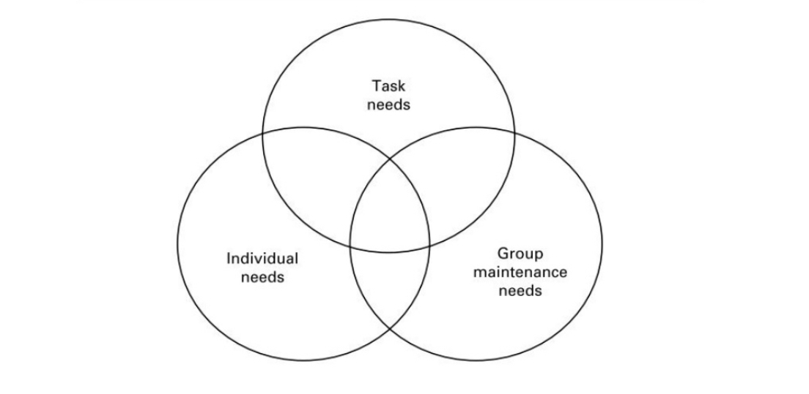
Recommendations
The leadership model that this report recommends for IAS is the John Adair (1973) model of what leaders do.

Slide 12

Conclusion
Coaching leadership style. And authentic leadership leadership styles
coaching leadership style is the best because coaching is a personal approach to helping people develop their skills and knowledge and improving their performance, Armstrong (2012).

Slide 13
For IAS to succeed the organisation needs a type of leader who is an authentic leader. The concept of an authentic leader was defined by George (2003), and he said an authentic leader genuinely desires to serve others through their leadership and he continued by saying that they are more interested in empowering the people they lead to make the difference than they are in power, money and prestige for themselves.

