Slide 1
Bachelor of Arts Business Management
ACADEMIC SKILLS
WEEK 6
Time Management Skills

Slide 2
Recap
What did we cover last week
Let discuss the main areas under writing for academic purposes

Slide 3
Referencing in your work
In-text citations
Reference list / Bibliography

Slide 4
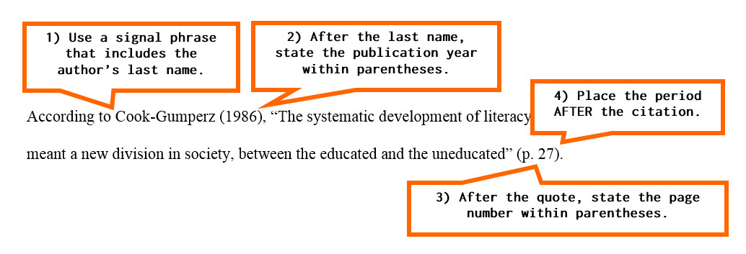
Example of in-text citations
In text citation for a quote

Slide 5

Can you explain what each of these students have done?
Notes:
Identify if the work shown in the following slides are good practices or bad practices.

Slide 6
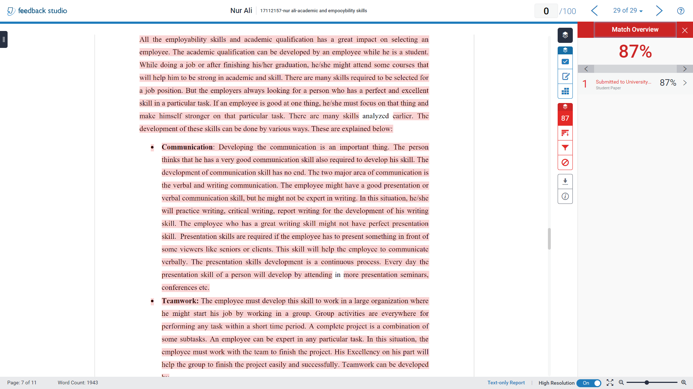
Did you note:
    Very high similarity index
    Almost all the text are highlighted
    No in-text citations were provided
Bad Practice
Notes:
Direct copy and paste

Slide 7
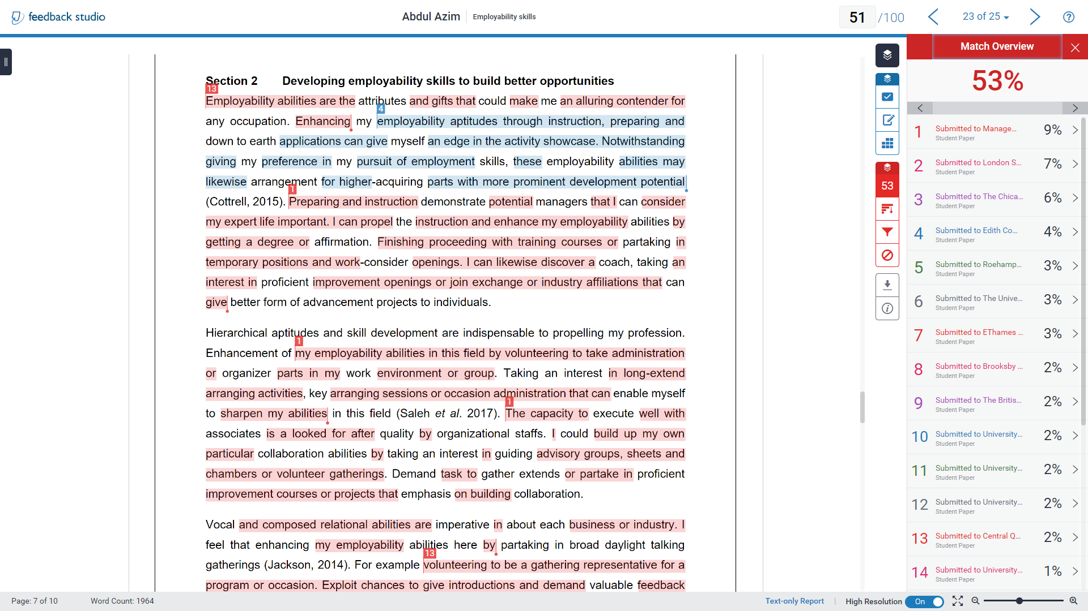
Did you note:
    Overall similarity index is relatively high
    Bits of almost all the sentences were highlighted
    This is an example of a student copying chunks of work and attempting to change some words
    To make it look authentic the student has added in-text citations
Bad Practice
Notes:
Using a thesaurus to change few words with few words added here and there to reduce the similarity. This is unacceptable practice. Will be penalised for plagiarism.

Slide 8
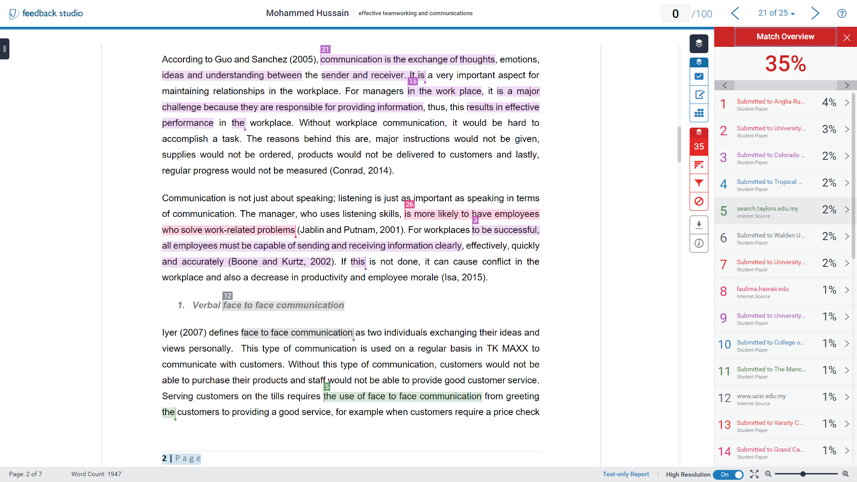
Did you note:
    Moderate level of Similarity index
    Bits of sentences were highlighted
    This is an example of poor paraphrasing skills
Poor Practice
Notes:
Information obtained form external sources have been acknowledge with appropriate references. Demonstrated good practice.

Slide 9
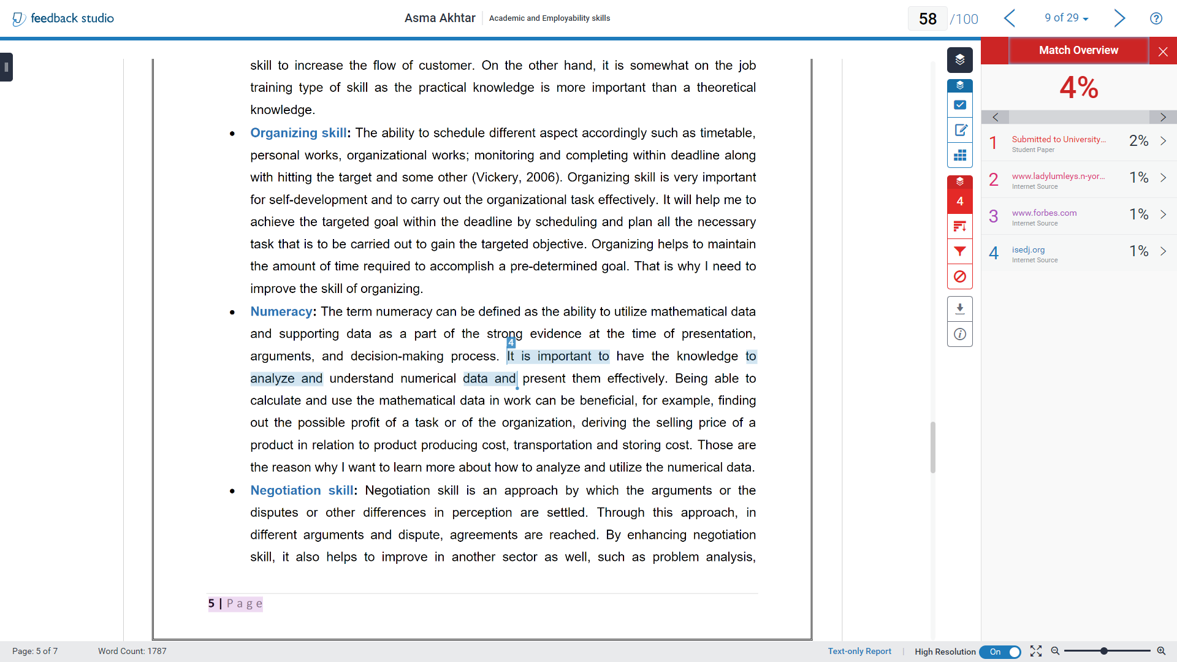
Did you note:
    The similarity index is very low
    Very small parts have been highlighted
Good
Practice
Notes:
Best quality work

Slide 10



Introductory Activity
1. Paraphrasing means expressing another person’s ideas in your own words.
Paraphrasing is often defined as putting a passage from an author into your own words.

Slide 11
Introductory Activity
2. If you have read something and then expressed it in your own words, you do not need to reference where the original idea came from.
Even if you write it in your own words if the ‘idea’ belongs to another person you need to provide reference for it.

Slide 12
Introductory Activity
3. You should paraphrase a section of text by using a thesaurus to change some of the words.
This is a poor practice and still may increase the level of similarity of your work.

Slide 13
Introductory Activity
4. You should paraphrase a section of text by expressing it in a different way, highlighting key ideas and getting to the heart of what the writer is saying.
The whole point of paraphrasing is to show you have read and understood another person’s ideas, and can summarise them in your own writing style

Slide 14
Introductory Activity
5. Good paraphrasing shows that you understand another writer’s point of view.
In order to paraphrase well, you must understand the essence of a writer’s argument.

Slide 15

Time Management Skills

Slide 16
Today’s Learning Outcome
By the end of today, you should have understood the following
What is Time Management?
Why Time Management is important
How to manage your time better
The steps, components and tools for Time Management
But, we will start with a very interesting survey
You need a pen and notepad/paper! Get these ready and we start in 5 minutes

Slide 17
There are 168 hours in a week.
How do you spend yours?
Complete Activity 1 – Plan out your time
worksheet
( 20 minutes)
In class – printed version.
Online – download and use the word version on Moodle.

Slide 18





Time stealers
Romance
Friends
Work
Social Media
Family

Slide 19
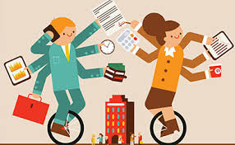
Time management strategies
‘To do’ lists
The 4 D strategy

Slide 20
The 4D Strategy
Moore et al (2010, p141) outlines the 4D approach to managing time.
The 4Ds are:
De-commitment (ditch it) – identify things that do not really need doing and abandon these.
        For example, learning to ice-skate.
Deferment (delay it) – putting things off until after assignments have been completed.
        For example, redecorating the kitchen.
Downgrading– do things to a less than perfect standard.
        For example, get your work done on time rather than perfect and late.
Delegation – ask others for help to do things you previously felt were your responsibility.
        For example, household chores.
When planning the next 10 weeks, think about these 4Ds, manage your precious time effectively.

Slide 21
The 4D Strategy
Complete Activity 2
- 4D’s Time management
worksheet
( 25 minutes)
In class – printed version.
Online – download and use the word version on Moodle.

Slide 22
Time-Management Assessment
On a piece of paper, write down if you agree or disagree with each of the 12 statements below:
I tend to be on time for classes and appointments.
I set aside time to study for exams.
I set aside time to study or read my textbook even if I do not have an exam to prepare for.
I regularly take part in social activities despite the fact that I have studying to do.
I usually cram for exams.
I usually feel prepared on the day of exams.
With everything I have to do, I find it hard to complete assignments and projects on time.
I do not experience “burn out” anytime between midterm and final exams.
I write down the things that I need to do.
I have enough time to get done what I need to, but I still find it hard to finish everything.
I hardly ever feel pressured to get things done.
Dealing with extenuating circumstances such as sorting out financial aid, getting extra tutoring, or seeing a professor during office hours seriously disrupts my daily or weekly routine.

Slide 23

Time-Management Assessment
Answer Key
For statements: 1, 2, 3, 6, 8, 9, 11
Give yourself 1 point for each statement that you said you agree with
For statements: 4, 5, 7, 10, 12
Give yourself 1 point for each statement that you said you disagree with

Slide 24
Where does your Time-Management clock in?
If you scored between 9 and 12, congratulations! You are a good time manager.
If you scored between 5 and 8, you are doing some things right.
If you scored between 1 and 4, you need to spend extra time working on your skills.
Regardless of your score, the tips on the following slides can help you improve your time management skills!

Slide 25
WHAT IS TIME MANAGEMENT?
Time Management is the art of arranging, organizing, scheduling and budgeting one’s time for the purpose of generating a more effective work and productivity.

Slide 26
Why Time Management?
Do you feel the need to be more organised and/or more effective?
Do you spend your day feeling busy and yet wondering why you haven’t achieved much?
Do you wish you had a more than 24-hour a day to accomplish a task?
Do you feel stressed by an ever-busy schedule with no time for yourself?
Do you feel you rarely achieve 100% production capability?

Slide 27
Why Time Management?
If you answered ‘YES’ to any of the previous questions, then your dilemma lies in Time Management.
The good news, you can do something about it!
What steps do you need to take to manage your time better?

Slide 28
Why is time management important for a student?
Allows you to keep control of all of your work and social activities.
It allows you to prioritise and complete activities to deadlines.
Managing time effectively results in you feeling less stressed and consequently more able to plan your studies and achieve good grades

Slide 29
Steps for Time Management
Set a Goal
Develop a Schedule
Revisit
Revise your Plan

Slide 30
Components of Time Management
Planning
Organising
Delegating
Managing Interruptions
Scheduling
Prioritising

Slide 31
Tools for Time Management
Planners
Calendars
To-do-lists
Activity Logs
Diary

Slide 32
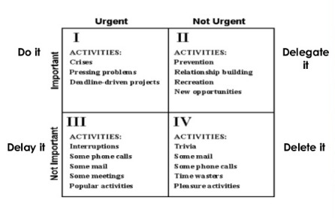
Strategies for urgent/important matrix

Slide 33
Managing your first Assignment
For example, an assignment is due on 1st March 2022
Can you think of steps that you can apply to manage your time in a way that enables you complete and submit your work on time?
For instance, what do you need to do in terms of planning and organisation of you time in relation to the assignment?
It is important to start with the most important things

Slide 34


Mayo Jar Activity
You have an empty jar and some large rocks, smaller rocks, gravel, sand, and water.
Depending on what objects you put in first determines how much of the other items you can put in afterward.
What would you put first, then afterwards etc?
You have 10 minutes to think this through and then share your answers

Slide 35
The Mayo Jar Activity
The mayo jar activity demonstrates the importance of doing the most important tasks first.
If you put sand in first, nothing else will fit (except some water)
But if you start with the big rocks (our most important tasks) and go down, you can fit some of everything in

Slide 36
The Mayo Jar – Relevance for your assignment
What then would be the most important tasks in relation to your assignment 1?
Can you write these down on a sheet of paper and then share them.

Slide 37
Time Management is linked to your individual circumstances
To effectively manage time in way that works best for you in relation to your studies, you need to
Understand your commitments
Be clear on your study goals
Determine what works best for you
https://www.youtube.com/watch?v=JGr46kYMEQQ
I will play you a short video and get you to think about the 3 points above

Slide 38
Learning Check
What do you understand by Time Management?
Why is Time Management important?
Do you now have an idea of what to do to manage your time better?
Are you now confident that you can manage your time such that you make timely submission/s of your assignments?
Do you know who to go to if you need help with issues related to this module’s assignments?

Slide 39
Next Week…
Data collection method

