Slide 1
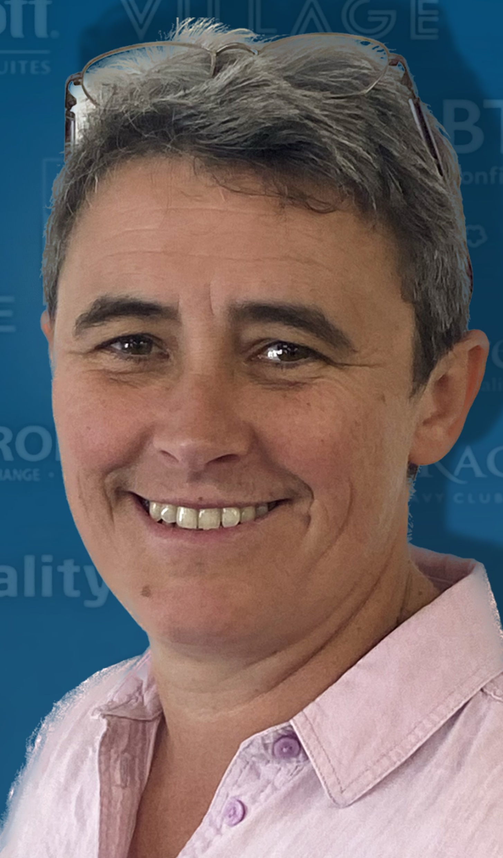
Welcome to IUBA6003
Leading and Developing People
Dr Emma Roberts
Wat is people management for?
e.roberts@uwtsd.ac.uk
(Please email me with any queries, rather than using Teams)

Slide 2
What is our pooled experience in this group?
Introductions
Dr Emma Roberts
22 years teaching in University Business Schools.
PhD in Organisational studies related to Flexible working patterns.
I deliver modules such as : Leadership, Organisational Behaviour, Managing Change.

Slide 3
Teaching schedule
 | Topic
Week 1 | LECTURE: Intro to Module & Overview of Leadership
Week 2 | INDEPENDENT STUDY: Key Concepts
Week 3 | LECTURE: Leadership Theories / Preparing for Assignment 1
Week 4 | INDEPENDENT STUDY: Select a Leader and analyse their approach
Week 5 | LECTURE: People Management Strategies and Context
Week 6 | ESSAY DEADLINE AND SUBMISSION
Week 7 | INDEPENDENT STUDY: Begin Groups - Select an organisation and identify their people strategy
Week 8 | LECTURE: The Role of HR / preparing for Assignment 2
Week 9 | LECTURE: Group tutorials
Week 10 | INDEPENDENT STUDY: Group preparation
Week 11 | LECTURE: Group tutorials
Week 12 | PRESENTATION DEADLINE AND SUBMISSION

Slide 4
Assessment 1
Essay 2,500 words (50%)
Essay brief: Critically examine the role of leadership of people in contemporary organisations. Refer to a range of theories in your analysis and apply these to a number of examples of leaders and organisations.
You should include at least 20 references from peer reviewed journals.
Please refer to a broad range of leadership theories and principles but without long descriptions or quotations. You will be given marks for applying these theories rather than describing or explaining them. There is no need for diagrams.

Slide 5
Assessment 2 – Comparative Case Study -Group Presentation
Video Group Presentation (50%) 5mins plus 1,000 words notes per student
Group Task: Comparative Case Study of the leadership of people within two organisations.
In groups of 3, choose two case study organisations and compare their people strategies and the effectiveness of these given the business context. (These can be organisations you work for or one that you have researched.) Present your findings, and provide supplementary notes, on the design, implementation and effectiveness of the strategy to meet current and future organisational needs.
You should upload to Turnitin a MSWord file that includes:
the link to your group recording. Please ensure that you give access to Emma Roberts and Vic Saunders.
the whole groups Supplementary notes and make it very clear which section is your own individual contribution.

Slide 6
Assessment 2 – Comparative Case Study -Group Presentation
Requirements of the Presentation: You must record your Group Presentation on any Video recording platform (e.g. Microsoft Teams).
Introduction and some key concepts
Overview of two case study organisations and why they have been selected including a brief consideration of the context and competitive environment.
Some detailed exploration of their people strategies – showing us clearly the source and presentation of the strategy adopted.
Analysis of both approaches and some clear conclusions about their effectiveness for their context.
Requirements of the Notes:
Each student should write 1,000 words analysis of the design, implementation and effectiveness of the strategy to meet current and future organisational needs. These notes should support the main analysis and conclusions drawn in the presentation.

Slide 7
Overview of Leading and Developing People: Leadership, Strategy and HR
Dr Emma Roberts
Business Context Context
Leadership and strategy
HRM

Slide 8
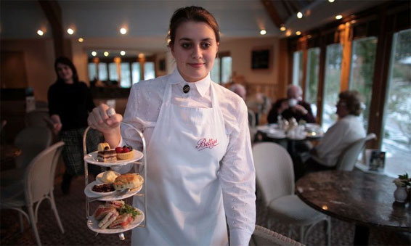


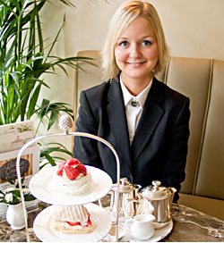
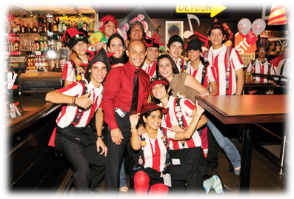
Are their people needs the same?
What are the different strategic concerns of HR in these two companies?
What kinds of people do they need?

Slide 9
Leading and managing people:
HRM designs the system
(in the background)
For example, leaders and managers have to deal with:
Recruiting new employees
Making sure they are trained for the job
Poor performers
Low motivation
Retaining excellent employees
Designing an online screening system to improve the quality of applicants.
Contract with local training company to provide technical updates to all staff annually.
Clear procedures for all managers to follow for warnings, written warnings and dismissal.
An easy to understand bonus system linked to a yearly appraisal system well integrated
Designing reward and benefit packages that entice employees to stay

Slide 10
Trait Theory
(simplistic common sense)
Leaders are born not made
Traits needed e.g.
  - Interpersonal skills - Problem-solving
  - Intelligence - Vision
  - Communication - Charisma
but which traits?
Do all leaders have an identical set of skills?

Slide 11
Leadership styles
(very simplistic/descriptive)
Autocratic - focus of power with leader, leader controls decisions, policy, tasks, rewards and punishment.
Democratic - focus of power on the group, leadership functions shared with the group.
Laissez-faire - no interference from leader

Slide 12
Tannenbaum & Schmidt’s Leadership Continuum
(introduces a spectrum of behaviour)
Subordinate-centred
Boss-centred
Use of Authority by Leader
Area of Freedom for Subordinates
Manager presents problem, gets suggestions, makes decision
Manager ‘Tells’
Invites questions
Manager defines limits, group makes decision
Group functions independently
Manager ‘Sells’
Notes:
Changed the order of these slides -
This is a classic model which describes
a continuum of leadership style.
Not just one way nor is there just 2 ways
This from X-y with abcdefg in between.
Strats to give an idea of the way in which you might train leaders.
Fiedler also came up with a model that predicts which style is most approapriate ffor each situation.
SO THIS IS ALL BUILDING ON THE STYLES THEORY WITHIN A SITUATIONAL FRAMEWORK

Slide 13
Blake & Mouton’s ‘Leadership Grid’
(introduces people vs task)
High
‘Country Club’ Management
Team Management
‘Middle-of-the-road’ Management
Concern for people
Impoverished Management
Authority- Compliance
Low
Low
Concern for Production
High
Notes:
Now we get more practical
designed as a diagnostic tool, for managers to explore their own leadership style.
Come across this on your (grad.trainee scheme)
‘Team managemtn style is ideal’
high concern for people and for production/task.
Again some situations need more direction.

Slide 14
New ways of conceptualising leadership
e.g
Servant leadership
Authentic leadership
Distributed leadership
Transformational leadership

Slide 15
Independent Study
Conduct your own reading and prepare answers for the following:
Define these three… | Answer the following questions…
Leadership | Why is Trait theory considered too simplistic?
Management | How useful is People vs Task as a way of understanding leadership?
Power | How do you describe ideal leadership?

