Slide 1
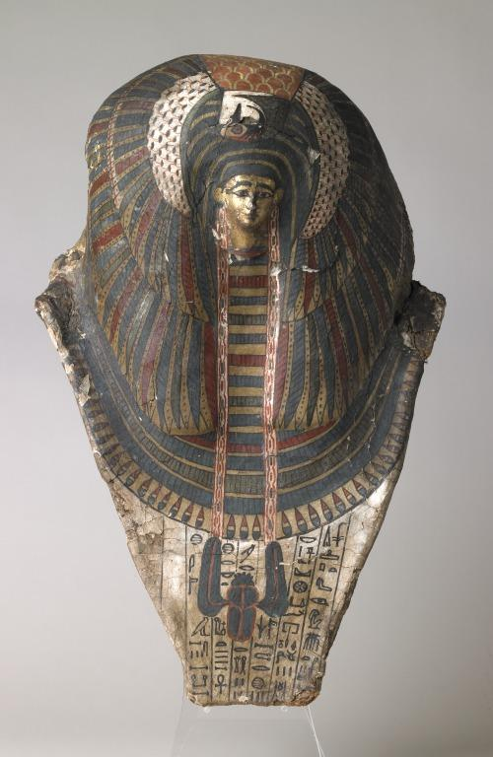
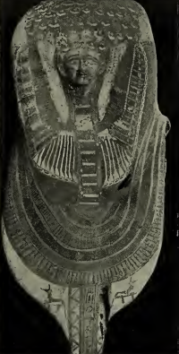
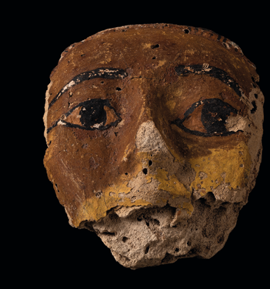

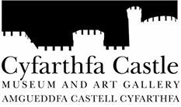
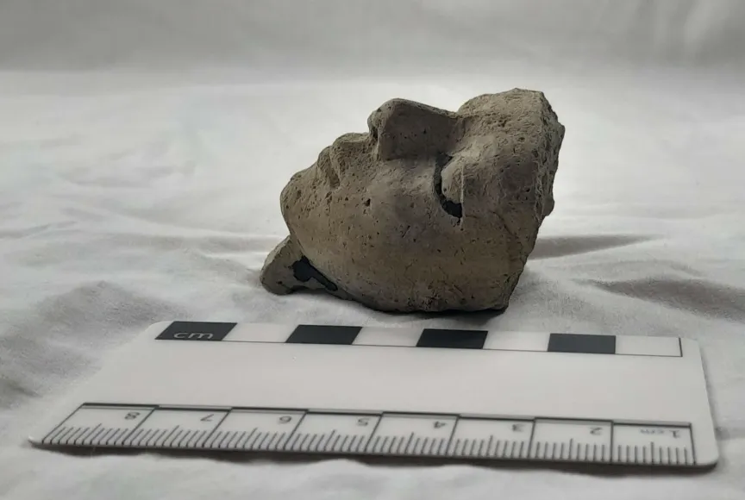
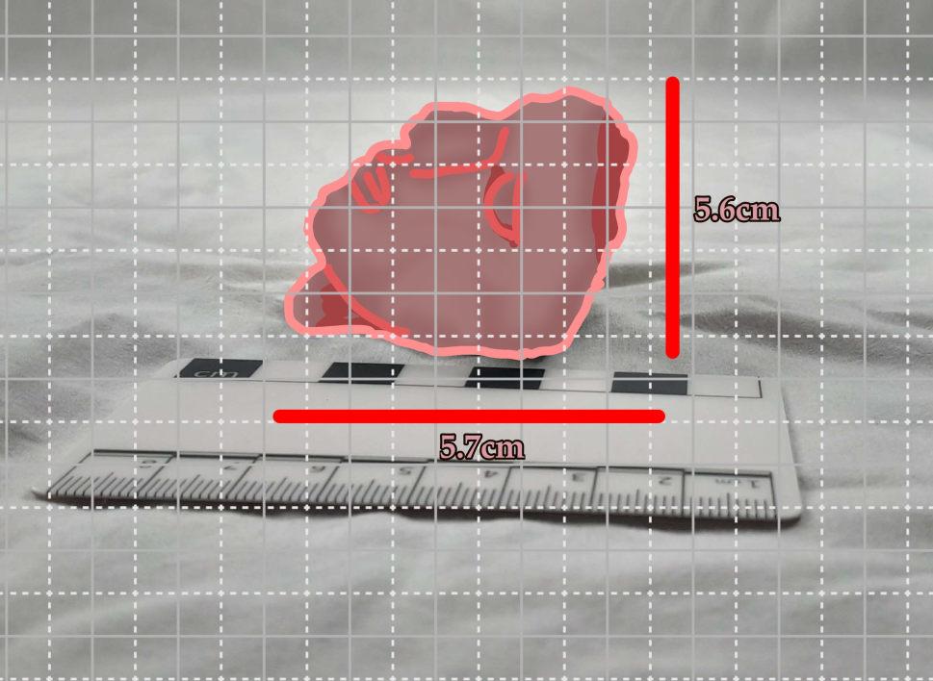
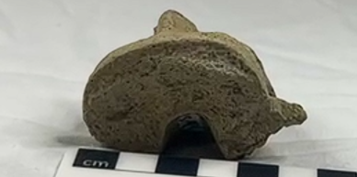
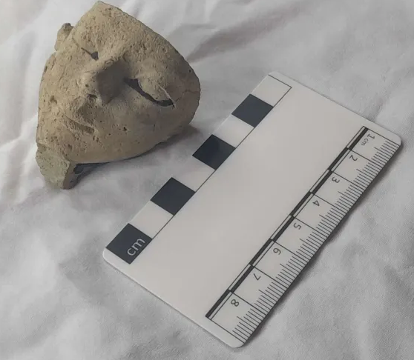
Mask type
Based on the reports of similar masks (see left) this small head may be from a Rishi style mask. Rishi style coffins and masks seem to have become popular during the 17th dynasty and likely existed afterwards, lining up with our head’s potential date.
Cartonnage mask, University of Jaén, 2022
Egyptian head figure
Iwa Lewis, University of Wales Trinity Saint David
Human head – CCM 175.996
Mummy mask, Liverpool Museum, 2005
Cartonnage mask, Garstang, 1907
Material and location
The human head seems to be similar to others found in areas such as Thebes and Aswan. It is suspected to be from sometime in the late seventeenth to early eighteenth dynasty, this is based on its material which we believe may be similar to Marl A3-A4 because of its colouring and it was one of the easiest materials to fire.
Personal conjecture and observations
The back of the head has a nook that fits a finger, signifying that it may have been made that way by its creator. It seems to have been made to be attached to and removed from another object, perhaps a coffin, with ease. If a coffin was reused a different head could be attached to personalise. The figure may have been made for someone rich enough for a nice funeral but not quite royalty.
Sideways head next to measuring plate, I Lewis, 2025
Measurement and design
The head measures 5.7cms in height and has a width of 5.6cms, it also has a depth of 4.3cms, making it fairly square in proportion.
The head shows remains of paint in some places such as the side of the beard and the eyes.
Head with nook visible, I Lewis, 2025
Austrian Archeological Institute, 2025. Aswan: Pottery of the Middle Kingdom [WWW Document]. Austrian Archeological Institute. URL https://www.oeaw.ac.at/en/oeai/research/prehistory-wana-archaeology/archaeology-in-egypt-and-sudan/aswan-pottery-of-the-middle-kingdom (accessed 10.20.25).De La Torre Robles, Y., Jiménez Serrano, A., 2022. Group of Cartonnage Masks. Presented at the A Decade of Excavations in Qubbet el-Hawa [Exhibition catalogue, University of Jaén.Dodson, A., 2012. Rishi Coffins and the Funerary Culture of Second Intermediate Period Egypt [WWW Document]. URL https://journals.sagepub.com/doi/abs/10.1177/030751331209800120 (accessed 10.20.25).Garstang, J., 1907. The burial customs of ancient Egypt as illustrated by tombs of the Middle Kingdom (Excavation report). University of Liverpool.Knoblauch, C., 2018. The late Middle Kingdom in the cemeteries at Mirgissa: pottery and relative chronology, Cahiers de la céramique égyptienne 11, 47-72. Cahiers de la céramique égyptienne 11, 47-72.Lythgoe, A.M., Lansing, A., Davies, N. de G., 1917. The Egyptian Expedition 1915-16. The Metropolitan Museum of Art Bulletin 12, 1–31. https://doi.org/10.2307/3253911Miniaci, G., 2007. Some remarks on the development of rishi coffins, in: Grallert, S., Grajetzki, W. (Eds.), Life and Afterlife in Ancient Egypt during the Middle Kingdom and Second Intermediate Period. Golden House Publishing, London, pp. 94–99.Mummy Mask, 1580.Rzeuska, T.I., 2011. Grain, water and wine. Remarks on the Marl A3 Transport-Storage Jars from Middle Kingdom Elephantine. Cahiers de la céramique égyptienne 11, 461–530.
Sketched over head with measurements, I Lewis, 2025
Head by measuring plate, I Lewis, 2025

Slide 2
Austrian Archeological Institute, 2025. Aswan: Pottery of the Middle Kingdom [WWW Document]. Austrian Archeological Institute. URL https://www.oeaw.ac.at/en/oeai/research/prehistory-wana-archaeology/archaeology-in-egypt-and-sudan/aswan-pottery-of-the-middle-kingdom (accessed 10.20.25).De La Torre Robles, Y., Jiménez Serrano, A., 2022. Group of Cartonnage Masks. Presented at the A Decade of Excavations in Qubbet el-Hawa [Exhibition catalogue, University of Jaén.Dodson, A., 2012. Rishi Coffins and the Funerary Culture of Second Intermediate Period Egypt [WWW Document]. URL https://journals.sagepub.com/doi/abs/10.1177/030751331209800120 (accessed 10.20.25).Garstang, J., 1907. The burial customs of ancient Egypt as illustrated by tombs of the Middle Kingdom (Excavation report). University of Liverpool.Knoblauch, C., 2018. The late Middle Kingdom in the cemeteries at Mirgissa: pottery and relative chronology, Cahiers de la céramique égyptienne 11, 47-72. Cahiers de la céramique égyptienne 11, 47-72.Lythgoe, A.M., Lansing, A., Davies, N. de G., 1917. The Egyptian Expedition 1915-16. The Metropolitan Museum of Art Bulletin 12, 1–31. https://doi.org/10.2307/3253911Miniaci, G., 2007. Some remarks on the development of rishi coffins, in: Grallert, S., Grajetzki, W. (Eds.), Life and Afterlife in Ancient Egypt during the Middle Kingdom and Second Intermediate Period. Golden House Publishing, London, pp. 94–99.Mummy Mask, 1580.Rzeuska, T.I., 2011. Grain, water and wine. Remarks on the Marl A3 Transport-Storage Jars from Middle Kingdom Elephantine. Cahiers de la céramique égyptienne 11, 461–530.

