Slide 1
Adapting Leadership to the Workplace
LCBB4008
Week 9 – Session 2

Slide 2
Objectives of the session
Importance of leadership in the workplace
Factors directly influencing leaders’ behaviour
Other factors influencing leaders’ behaviour
Need for adaptation
Skills required for adaptive leadership
Other essential elements to consider in adaptive leadership
Final thoughts in adapting leadership in the workplace.

Slide 3
Importance of Leadership in the Workplace
Leadership at its core involves the ability to influence, inspire, and guide others toward achieving common goals or objectives.
The importance of leadership in the workplace cannot be overstated. Here are several key reasons why leadership is crucial:
  Setting goals and objectives
  Guidance and direction
  Motivating and engagement
  Decision making
  Problem solving

Slide 4
Factors directly influencing Leaders Behaviour (1 of 3)
According to Yukl and Gardner (2020), there are multiple factors that can directly encourage or constrain a leader’s behaviour. Mainly, these are the company rules, policies, role expectations, and organisational values.
For example: An organisation creates a new policy requirement the team leaders or managers to provide bonuses to any employee exceeding a number of sales. When sales managers start awarding these bonuses, this will translate on the performance of the organisation and satisfaction of the employees.

Slide 5
Other factors influencing leaders’ behaviour (2 of 3)
Level of management: the job responsibilities and the skills for leadership vary somewhat for managers at different authority levels in the company.
Size of organisational unit: The size of the company affects the leadership requirement. Leaders in large organisations have more demanding jobs in comparison with leaders in small organisations.

Slide 6
Other factors influencing leaders’ behaviour (3 of 3)
External dependencies: The nature of information, resources, and cooperation from stakeholders has direct aspects on the leadership behaviour.
Extreme contexts: Some of the greatest leadership challenges happen where there is an urgent crisis or unpredictability. For example: a pandemic, natural disasters, or extreme events.
(Yukl and Gardner, 2020)

Slide 7
Need for Adaptation
The need for adaptation in leadership arises from the ever-evolving nature of the workplace and the dynamic challenges that leaders face.
Several key factors highlight why adaptation is essential:
  Changing work environment
  Changing regulations and policies
  Changing customer buying behaviour
  Rapid technological advancements
Notes:
Can you identify any other reasons why leaders need to adapt?

Slide 8
Skills Required for Adaptive Leadership
Adaptive leadership requires a diverse set of skills to effectively navigate the complexities of the modern workplace and lead teams through change and uncertainty.
  Flexibility
  Resilience
  Accountability
  Emotional intelligence
  Continuous learning and development

Slide 9

Other essential elements to consider in adaptive leadership (1 of 5)
Adaptive leaders should consider the following:
Understanding employee needs
Building trust and relationships
Embracing diversity and inclusion
Handling change

Slide 10

Understanding Employee Needs (2 of 5)
Understanding employee needs is essential for leaders to effectively engage and motivate their teams, foster a positive work environment, and drive organizational success.
Maslow's Hierarchy of Needs
Notes:
Leaders can use Maslow's hierarchy of needs as a framework to understand the fundamental needs that drive human behaviour in the workplace.

Slide 11
Building Trust and Relationships
(3 of 5)
To create a positive and productive work environment, foster employee engagement, and drive organizational success, leaders should build trust and relationships in the organisations.
This can be achieved by Leading by example. The leaders should demonstrate integrity, authenticity, and consistency in their words and actions.
Leaders should be transparent and honest in their communication, follow through on their commitments, and uphold ethical standards in all aspects of their leadership.

Slide 12
Embracing Diversity and Inclusion
(4 of 5)
Embracing diversity and inclusion is critically important for leaders to create a culture of belonging, innovation, and high performance within their organizations.
It enhanced creativity and innovation because it is bringing together individuals with different backgrounds, perspectives, and experiences.
It enhances brand image and customer relationships. Customers nowadays expect organizations to reflect the diversity of the communities they serve. Leaders who embrace diversity and inclusion build stronger connections with diverse customer bases.

Slide 13
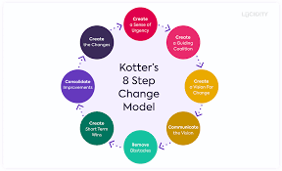
Handling change
(5 of 5)
Kotter’s 8 step change model
Handling change and uncertainty is crucial for leaders to navigate challenges effectively, maintain team morale, and drive organizational success.
(Kotter, 1990)

Slide 14
Final Thoughts on Adapting Leadership to the Workplace
In conclusion, adapting leadership to the workplace is fundamental in the current continuously changing and dynamic business environment.
Leaders must recognize that one size does not fit all when it comes to leadership styles and approaches.
Instead, leaders must be flexible, agile, and adaptive to meet the diverse needs of their teams and navigate the complexities of the modern workplace.

Slide 15
Activity 1
Individually think about a current leadership role or one you had in the past. It could be a formal role such as supervisor, team leader, coach , team captain or a student project team.
In this role, what demands were made of you?
What constraints did you face?
Describe any choices you made that defined the role to suit your strengths?

Slide 16
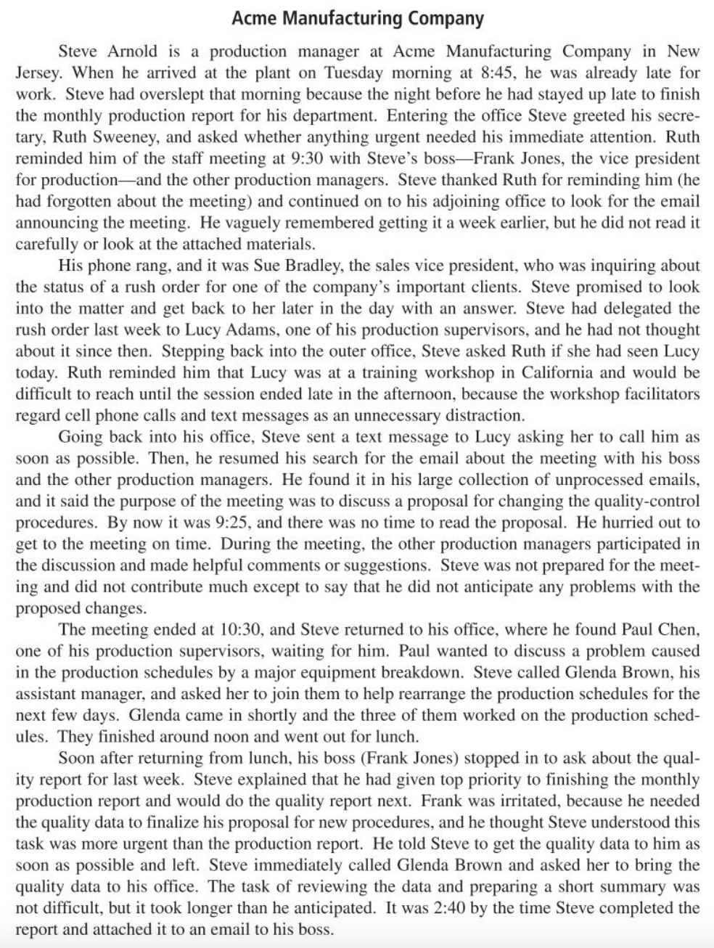
Activity 2: case study

Slide 17
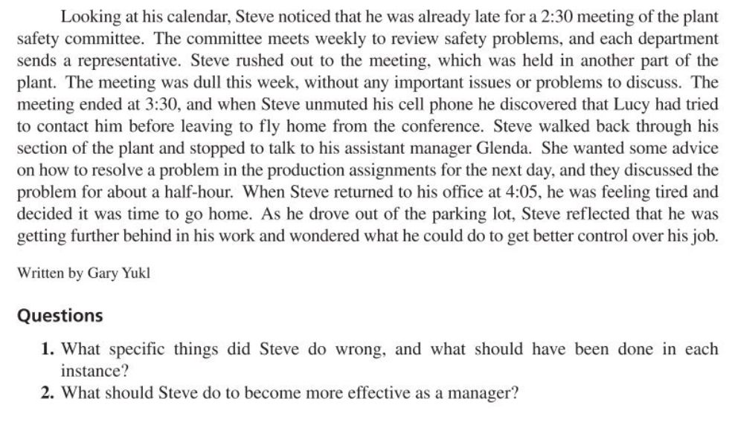

Slide 18
References
Cole, G.A and Kelly, P. Phil (2020) Management theory and practice. Ninth edition / Gerald A. Cole, Phil Kelly. Andover: Cengage Learning.
Kotter, J. P. (1990). "What Leaders Really Do." Harvard Business Review, 68(3), 103-111.
Needle, D. Burns, J. (2019) Business in context: an introduction to business and its environment. Seventh edition. Andover: Cengage Learning.
Robbins, S.P., Coulter, M.K. and Randel, A. (2021) Management. Global edition. Harlow, England: Pearson Education.
Yukl, G.A. and Gardner, W.L. (2020) Leadership in organizations. Ninth edition. Harlow: Pearson Education Limited.

