Slide 1
AI Acknowledgement
I confirm that I have not presented any AI generated materials as my own work.
I confirm that I have copies of my drafts, notes, and other resources I used, which I may be asked to provide in evidence.

Slide 2

Module Name: Managing Enterprise
Module Code: BMSW4011
Assignment Name: Presentation
Student Name: Ellie Pavelea
Student Number: 2514510
Lecturer: Melanie Squire
Deadline: 22nd June 2026 10:00AM

Slide 3
Presentation Overview
1. Business Proposition
1.1 Business Name, Concept, Story
1.2 Mission Statement, Aims & USP
1.3 SMART Objectives
1.4 Legal Structure
1.5 HRM Strategy
1.6 Location
1.7 Financial Overview
1.8 Market Research
2. 12-Month Marketing Strategy
2.1 Strategy Initiatives
2.2 Marketing Examples
2.3 Branding
3. Elevator Pitch
3.1 Feature & Benefits
3.2 Why Invest in Me?

Slide 4

1.1 Glow&Grow: Business Concept & Story
Glow&Grow is a women-only fitness and wellbeing centre combining childcare, fitness and wellness services under one roof.
Key Services
Fully equipped gym & fitness classes
On-site childcare facilities
PT & nutrition coaching
Postpartum recovery programmes
Healthy café & wellness events
Created to solve a problem I personally faced as a mother wanting to prioritise fitness while ensuring my child was cared for.
Identifying unmet customer needs is an important part to a successful business (Barringer and Ireland, 2023)
Notes:
Glow & Grow is a women-only fitness and wellbeing centre designed specifically for mothers. Alongside gym facilities and fitness classes, the business provides on-site childcare, allowing women to prioritise their health while their children are cared for in a safe environment.
The concept was inspired by my own experience as a mother struggling to find a facility that offered both

Slide 5

1.2 Mission Statement, Aims & USP
To create a space where mothers can focus on their own wellbeing without guilt, compromise or barriers.
AIMS
🩷 Support mother’s wellbeing
🩷 Empower healthier,
more confident women
🩷 Create a supportive community
USP
Women-only environment
Safe on-site childcare while you exercise
Fitness, wellbeing and community in one place
A strong USP helps businesses differentiate themselves in competitive markets (Hooley et al., 2024).
Notes:
USP: What makes Glow&Grow different is that it combines fitness, childcare and wellbeing in one place. Mothers can exercise knowing their children are safely cared for, while also enjoying a supportive women-only environment.

Slide 6
Within 12 months
SMART Objectives
Gain 250 members
Retain 80% of members
Achieve 85% customer satisfaction
£25,000 monthly revenue
Clear objectives help measure performance and support growth (Barrow, Barrow and Brown, 2022).
Notes:
To support the growth of Glow&Grow, I developed 4 SMART objectives. These focus on: 1.2.3.4

Slide 7

1.4 Legal Structure
Glow&Grow will operate as a Private Limited Company to protect the owner's personal finances and support future growth.
Advantages:
Limited liability protection
Professional business reputation
Supports future growth and investment
Disadvantages:
More paperwork and administration
Annual accounts must be submitted
Higher setup and compliance costs
Choosing the right legal structure is an important decision as it can influence liability, taxation and business growth (Barrow, Barrow and Brown, 2022)

Slide 8
1.5 HRM Strategy
Owner
Childcare Supervisor
Facilities
Supervisor
Fitness Supervisor
General Manager
Receptionist & Marketing Assistant
Personal Trainers (2)
Childcare Workers (2)
Cafe Assistant
Wellness & Nutrition Advisor
Cleaner
12 employees
Online recruitment
Full-time
& part-time roles
Effective leadership and teamwork are essential for achieving organisational goals (Adair, 2022).

Slide 9


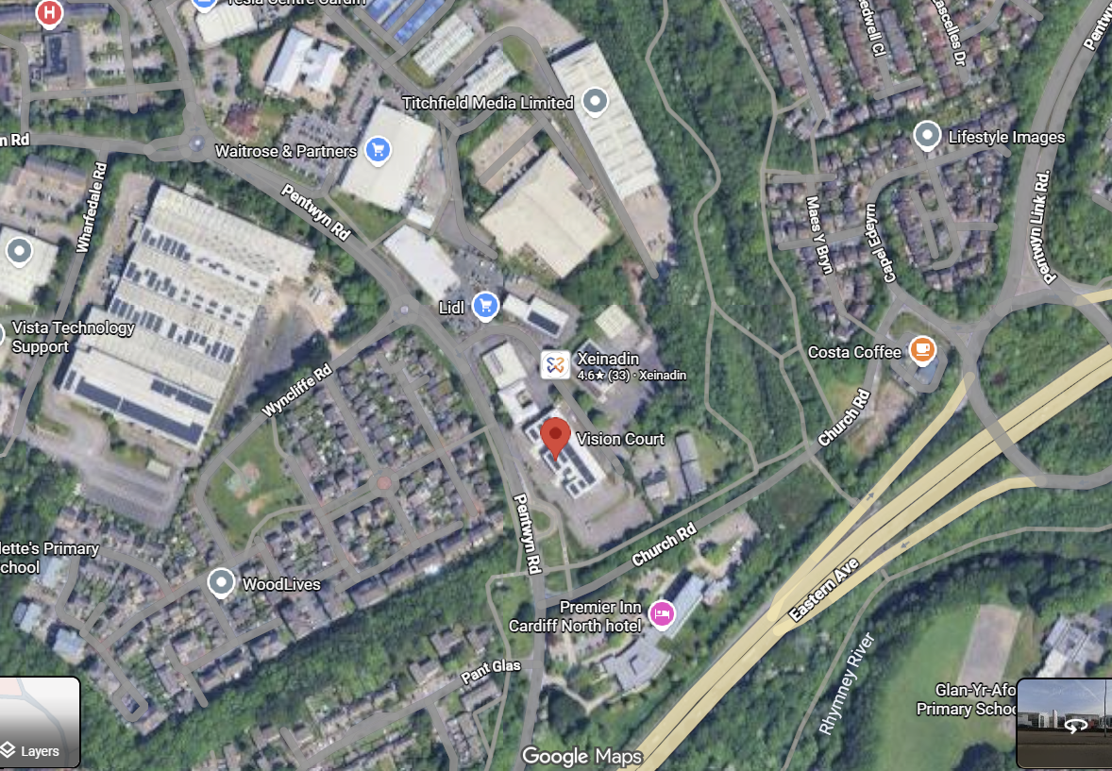
1.6 Location
Vision Court, Pentwyn Road, Cardiff
Excellent road access and transport links
On-site parking available
Close to Pontprennau, Pentwyn and other residential areas
Location decisions should reflect the needs and habits of the target market (Finch, 2023).
Notes:
Glow & Grow will be located at Vision Court in Cardiff. This location was chosen because it offers excellent road access, good transport links and on-site parking, making it convenient for busy mothers and working professionals. It is also close to residential areas such as Pontprennau and Pentwyn, helping us reach our target market.

Slide 10
1.7 Financial Overview
Sources of Finance
💰Personal Savings (£20,000)
🏦Small Business Loan (£60,000)
💼Government Support Schemes (£10,000)
🤝Potential investors (£20,000)
💵
£232,305
income
📉
£272,370
costs
🔻
£40,065
net loss
Financial planning helps businesses understand their costs, funding needs and future opportunities (Hisrich et al., 2025).
Notes:
The total start-up cost for Glow & Grow is estimated at £110,000. The largest investment is gym equipment at £45,000, followed by renovation costs of £20,000 and initial staff wages of £24,000. Funding will come from a combination of personal savings, a business loan, government support and investor funding.
During the first 12 months, income forecast is £232,305, while operating costs are estimated at £272,370, resulting in an expected loss of £40,065.
The loss is mainly due to high start-up and staffing costs in the first year. Revenue is expected to grow as memberships, personal training services and childcare usage increase.

Slide 11
SWOT
STRENGTHS
Solve a real customer need
Identified gap in the market
Multiple revenue streams
WEAKNESSES
High start-up costs
High staffing requirements (childcare)
Long time to reach profitability
OPPORTUNITIES
Growing demand for women’s wellbeing
Service expansion
Local partnerships
THREATS
Strong competition
Rising operating costs
Economic uncertainty
Entrepreneurs must assess both opportunities and challenges when developing and growing a business (Reuer, Matusik and Jones, 2019)
Notes:
This SWOT analysis highlights Glow&Grow's strengths, weaknesses, opportunities and threats. The main strength is addressing a real customer need through a unique combination of fitness and childcare services. The main challenge is the high start-up and staffing costs. However, growing demand for women's wellbeing services creates opportunities for expansion, while competition and rising costs remain important threats to consider.

Slide 12
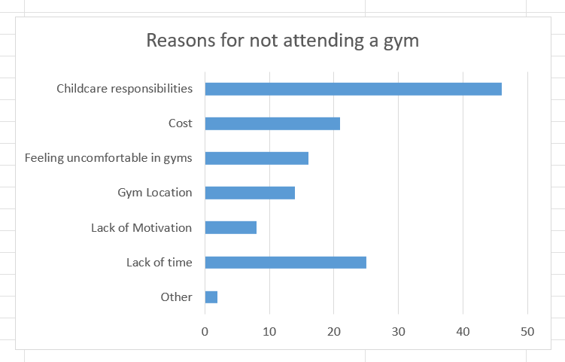
1.8 Market Research
Key Barriers Identified
🥇
Childcare responsibilities
🥈
Lack of time
🥉
Cost
Understanding customer needs helps businesses develop products and services that better meet market demand (Whittington et al., 2020).
Notes:
My primary research identified childcare responsibilities as the biggest barrier to gym attendance, followed by lack of time and cost. These findings support the need for a gym that combines fitness with childcare services.

Slide 13

2.1 Marketing Strategy Initiatives
Social Media
Instagram, Facebook & TikTok
1
Free Trial Classes
Introductory sessions for new members
2
Referral Awards
Incentives for recommending new members
3
Influencer Partnerships
Partnerships with local mum influencers
4
Promotional activities help businesses raise awareness and attract new customers (Kotler, Armstrong and Opresnik, 2022).
Notes:
To promote Glow & Grow during the first 12 months, I will focus on four marketing initiatives. These include social media marketing on Instagram, Facebook and TikTok, free trial classes to encourage first-time visits, referral rewards to increase word-of-mouth promotion, and partnerships with local mum influencers to build brand awareness and trust.

Slide 14


2.2 Marketing Examples
Promotional Flyer
Social Media Post

Slide 15

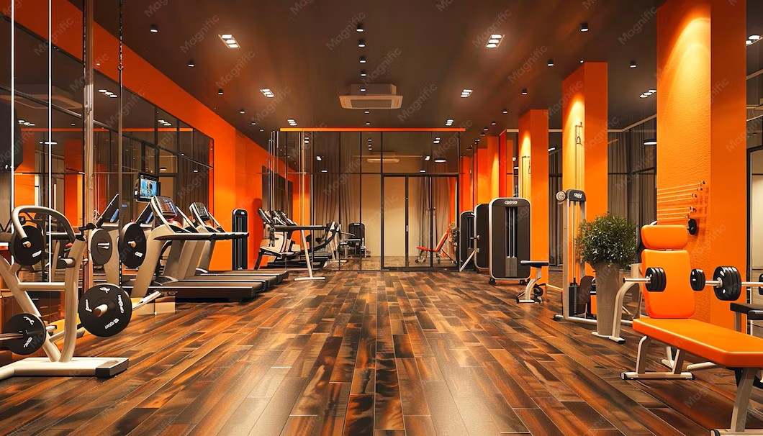
2.3 Branding
🎨 Colour Palette
🍑 Peach
#F7B267
🌺 Rose Pink
#F48498
🌅 Sunset Orange
#F28C28
🌸 Blush Pink
#F6BDC0
💬 Brand Personality
Empowering
Supportive
Welcoming
Family-focused
Strong branding helps communicate a business's values and personality to customers (Kotler et al., 2022).
Notes:
The Glow&Grow was designed to feel welcoming, supportive and empowering. The colour palette uses warm peach, pink and orange tones to create a friendly and positive atmosphere. The logo represents both fitness and motherhood, reflecting the business's focus on helping women prioritise their wellbeing while balancing family responsibilities.

Slide 16

3.1 Features & Benefits
Designed to help women prioritise their health, fitness and wellbeing without compromising family responsibilities.
👶On-Site Childcare
You gain: More time to focus on your health and fitness.
💪 Personal Training & Nutrition
You gain: Expert guidance and motivation.
🤝Community Events
You gain: New connections with like-minded people.
💖Wellness Services
You gain: Better physical and mental wellbeing.
Notes:
What we offer is on-site childcare, personal training, community events and wellness services. In return, customers gain more time for themselves, expert guidance, social support and improved wellbeing.

Slide 17
3.2 Why Invest in me?
Leadership Experience
• Managed teams of up to 100 employees
• Led daily operations in a fast-paced environment
• Introduced process improvements to improve efficiency
Resilience & Determination
• Balancing university studies and motherhood
• Consistently working towards long-term goals
• Committed developing Glow&Grow into a successful business
Entrepreneurial Mindset
• Identified a gap in the local market
• Developed Grow&Glow to address a genuine market need
• Willing to take initiative and embrace new challenges
Passion & Purpose
• Personal understanding of the challenges faced by mothers
• Strong motivation to create positive change
• Dedicated to supporting women’s health & confidence
Successful entrepreneurs combine opportunity recognition, determination and effective leadership skills (Baron and Hmieleski, 2019).
Notes:
I believe Glow&Grow is a strong investment because I bring leadership experience, resilience, an entrepreneurial mindset and a genuine passion for the business. Through my previous management role, I have led teams of up to 100 employees and gained experience managing daily operations. As a student and mother, I have developed resilience and determination while working towards long-term goals. I also identified a genuine gap in the market and created Glow&Grow concept to address a real customer need. Most importantly, I am passionate about supporting women and creating positive change in the community.

Slide 18
Reference List
Adair, J.E. (2022) Decision making and problem solving: break through barriers and banish uncertainty at work. Fifth edition. London: KoganPage. Available at: https://ezproxy.uwtsd.ac.uk/login?url=https://www.vlebooks.com/product/openreader?id=TrinityStD&accId=8886856&isbn=9781398606296&uid=^u.
Barringer, B.R. And Ireland, R.D. (2023) Entrepreneurship: Successfully Launching New Ventures. Updated Sixth Edition. Harlow, England: Pearson.
Baron, R.A. and Hmieleski, K.M. (2019) Essentials of entrepreneurship: changing the world, one idea at a time. 2nd edition. Cheltenham, UK: Edward Elgar Publishing
Barrow, C., Barrow, P. And Brown, R. (2022) The Business Plan Workbook: A Step-by-step Guide To Creating And Developing A Successful Business. Tenth Edition. London: Kogan Page.
Finch, B. (2023) How to write a business plan: win backing and support for your ideas and ventures. Seventh edition. London: Kogan Page.
Hisrich, R.D., Peters, M.P. and Shepherd, D.A. (2025) Entrepreneurship. Twelfth Edition. New York, NY: McGraw Hill LLC.
Hooley, G.J. et al. (2024) Marketing Strategy And Competitive Positioning. Eighth Edition. Harlow, England: Pearson.
Kotler, P., Armstrong, G. and Opresnik, M.O. (2022) Principles of marketing. Eighteenth edition, Global edition. Harlow, Essex: Pearson Education Limited.
Reuer, J.J., Matusik, S.F. and Jones, J. (eds.) (2019) The Oxford handbook of entrepreneurship and collaboration. 1st ed. New York: Oxford University Press.
Whittington, R. et al. (2020) Exploring strategy: text and cases. Twelfth edition. Harlow, England: Pearson Education Limited.

Slide 19
Thank you!

