Slide 1

Managing Business Information (LCLM 5004)
Analysing and Comparing Different Information Systems
Group Presentation
Lecturer: Amitave Banik
Student Name: Ana-Loredana Bran
Student Number: 2413290

Slide 2
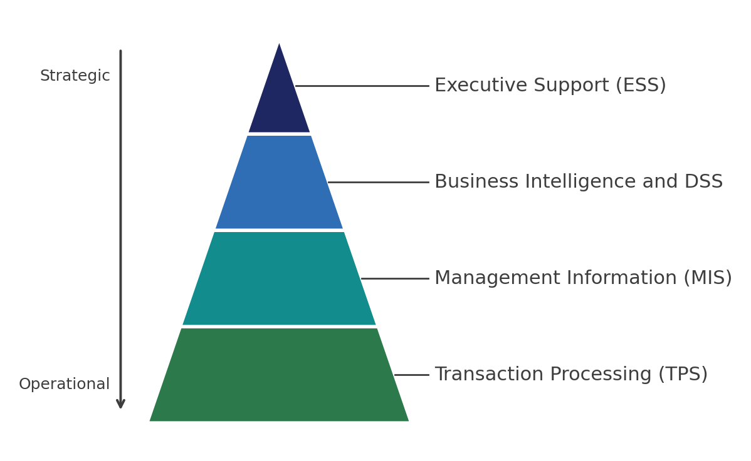
Introduction
• Modern organisations run on information systems, which collect, store, process and share data for faster and better informed decisions across every function.
• A strong data culture links to higher firm performance (Karaboga et al., 2023).
• The pyramid shows system types by management level, from transaction processing at the base to executive support at the top.
• Data driven firms answer market change and customer needs more quickly than rivals (Olaniyi et al., 2023).
• This presentation introduces the main system types, compares three of them and offers researched recommendations for the business in the brief.

Slide 3
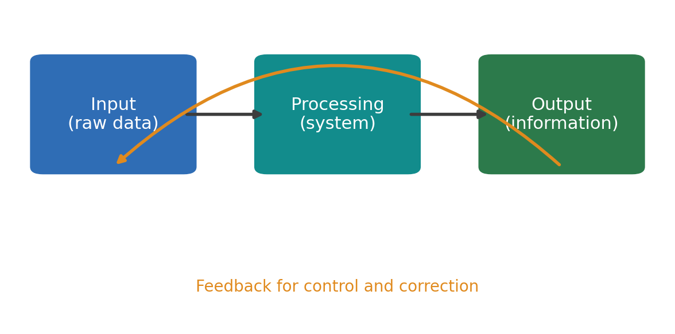
Role of Information Systems in Business Operations
• Every information system converts raw inputs into useful outputs through processing, with a feedback loop for control and correction.
• Dashboards and reports support decision making at operational, tactical and strategic levels (Gonçalves et al., 2023).
• Systems cut manual effort and reduce errors, freeing staff for value adding work.
• Enterprise systems improve operational performance once embedded in daily routines (Jo and Park, 2023).
• Shared data strengthens coordination between sales, finance, operations and human resources.

Slide 4
System type | Main purpose | Typical users
Transaction Processing System | Records daily business transactions such as sales and payments (Gonçalves et al., 2023) | Operational staff
Management Information System | Summarises transaction data into reports for monitoring performance | Middle managers
Enterprise Resource Planning | Integrates core processes into one shared database (Jo and Park, 2023) | The whole organisation
Customer Relationship Management | Manages customer data across sales, service and marketing | Sales and service teams
Business Intelligence | Turns stored data into dashboards and insight for decisions | Managers and analysts
Overview of Information System Types

Slide 5
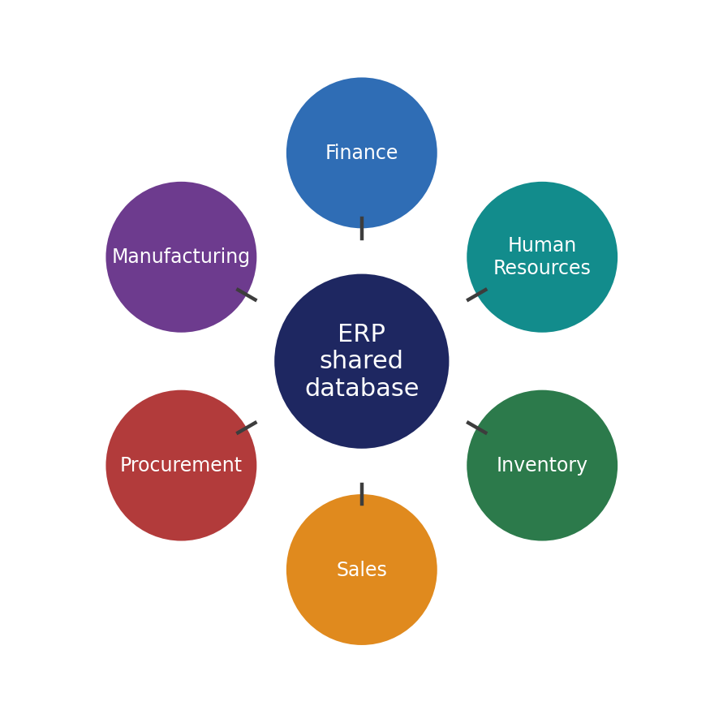
Enterprise Resource Planning
• Enterprise resource planning links finance, procurement, manufacturing, inventory and human resources into one integrated system on a single shared database.
• Enterprise resource planning shows a positive effect on operational performance (Jo and Park, 2023).
• A single shared database removes duplicate entry and gives managers one consistent view of the business.
• Critical success factors include leadership support, training and data quality (Al-Amin et al., 2023).
• Limitations include high cost, long roll out times and user resistance to change.

Slide 6
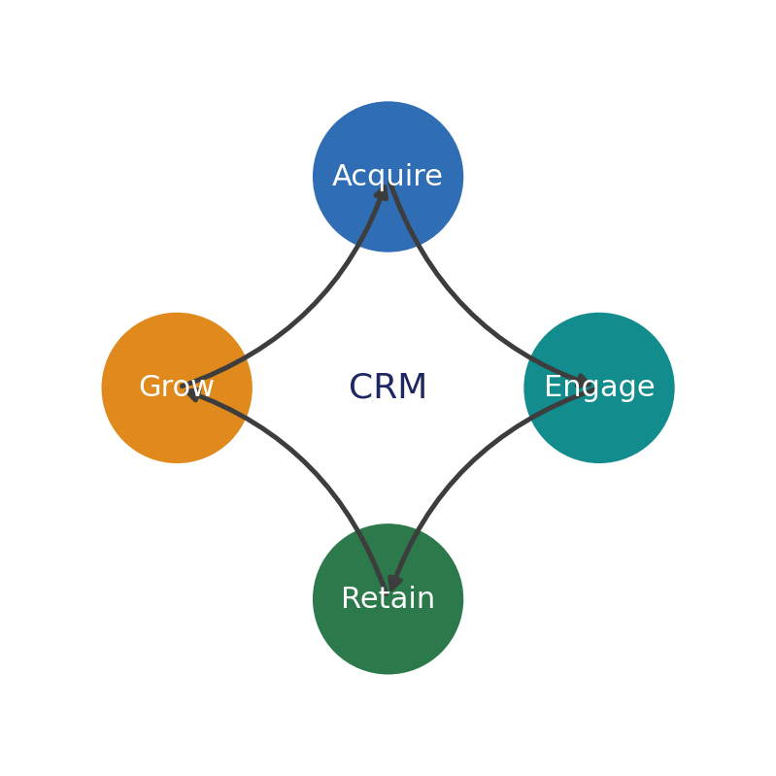
Customer Relationship Management
• Customer relationship management stores every interaction across sales, marketing and service to build one complete customer profile.
• System quality across information, service and system dimensions drives customer satisfaction (Nilashi et al., 2023).
• The lifecycle moves from acquiring customers through engaging and retaining them towards growing lifetime value.
• Customer relationship management raises satisfaction, retention and loyalty across service sectors (Saeed et al., 2023).
• Weak results appear when staff enter incomplete data or treat the software as technology rather than strategy.

Slide 7
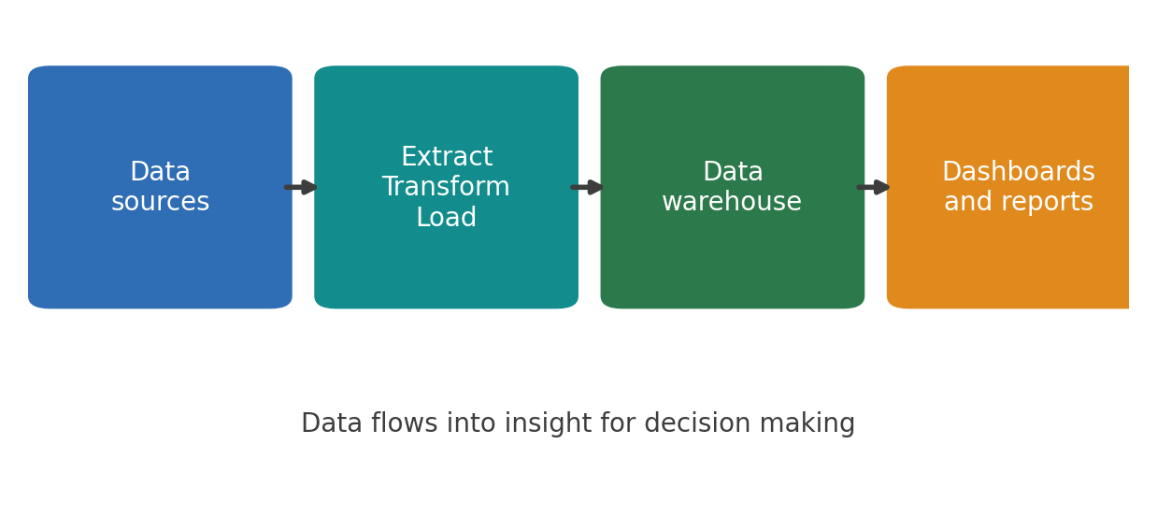
Business Intelligence
• Business intelligence gathers data from many sources through extract, transform and load into a data warehouse, then presents the data in dashboards.
• Power BI dashboards support faster decisions for managers (Gonçalves et al., 2023).
• Real time views of performance and key indicators sit in one clear place.
• Big data analytics improves decision making effectiveness and managerial work (Olaniyi et al., 2023).
• Limitations include low adoption among smaller firms, training gaps and data quality concerns.

Slide 8
Comparison of Three Information Systems
System | Core function | Key benefit | Main limitation
ERP | Integrates core operations in one database | Consistent data across the firm (Jo and Park, 2023) | High cost and complex roll out
CRM | Centralises customer information | Higher satisfaction and retention (Saeed et al., 2023) | Weak without complete data entry
BI | Converts stored data into insight | Faster informed decisions | Low adoption in smaller firms

Slide 9
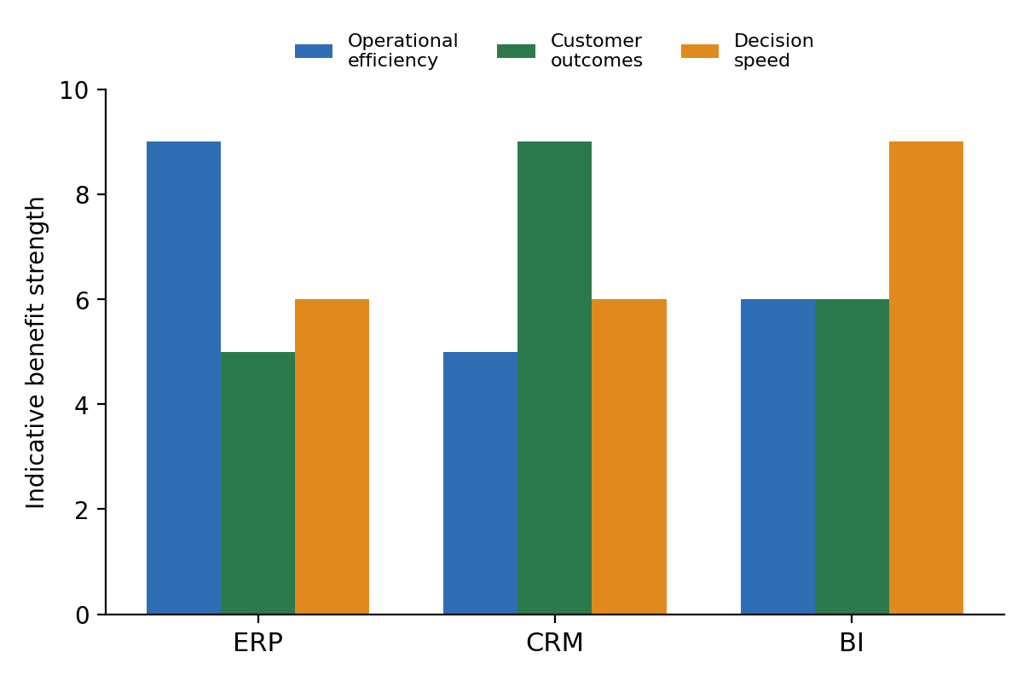
Reported Business Impact
• Firms adopting enterprise resource planning report gains in operational performance once systems mature.
• Customer relationship management shows a strong positive effect on satisfaction and retention (Saeed et al., 2023).
• The chart shows indicative benefit levels drawn from the studies for comparison across the three systems.
• Business intelligence and big data analytics lift decision making effectiveness (Olaniyi et al., 2023).

Slide 10
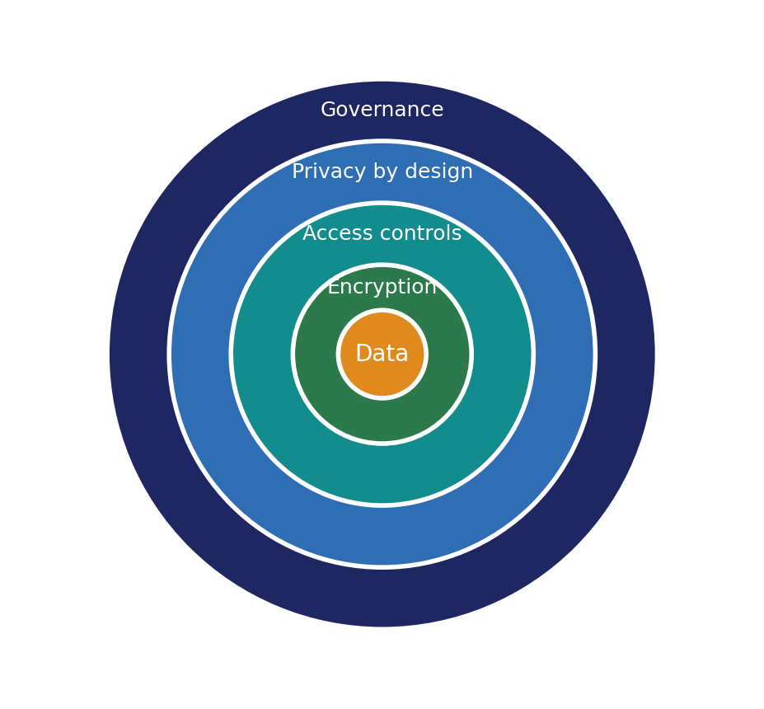
Ethical Considerations in Data Privacy and Security
• Information systems hold large volumes of personal and commercial data, which raises duties around privacy and lawful use.
• Cloud services add risks of unauthorised access and legal uncertainty during data transfers (Islam, 2023).
• Privacy by design, encryption and access controls form the layered protection shown here.
• Recent regulatory fines expose firms to financial penalty and loss of customer trust (Sebastian et al., 2025).
• The General Data Protection Regulation sets binding limits on collection, storage and breach notification.

Slide 11
• Automated decision systems learn from historical data, so biased training data produces unfair outcomes for particular groups.
• Camera and productivity monitoring intensifies stress and lowers job satisfaction (Glavin et al., 2024).
• Opaque models leave staff unable to see why a system flagged their performance, which weakens fairness and trust.
• The French regulator fined Amazon France Logistique a sum of 32 million euros in 2023 for intrusive monitoring (Sebastian et al., 2025).
• Responsible use asks for transparency, informed consent, human oversight and proportionate monitoring.
Ethical Considerations in AI, Monitoring and Bias

Slide 12
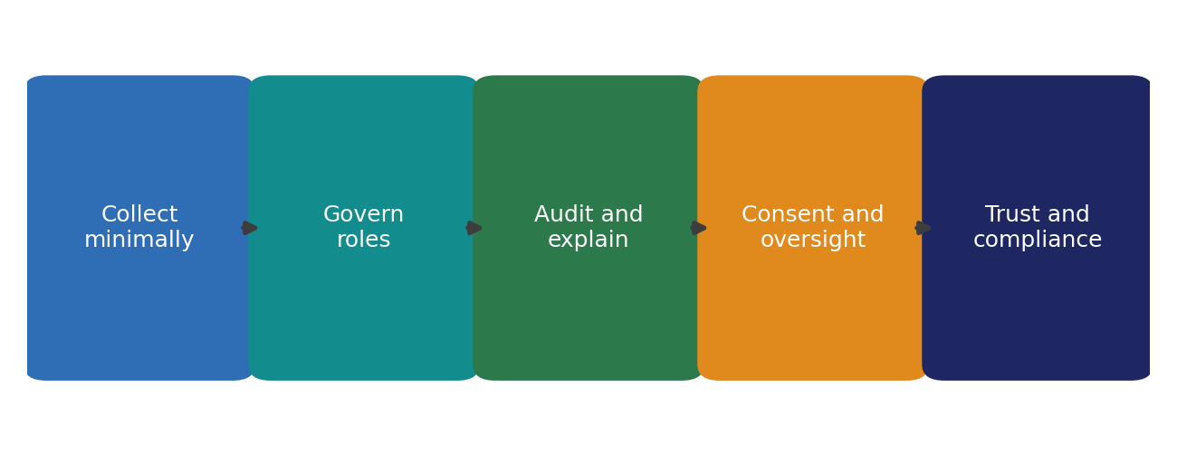
Mitigating Risk and Ensuring Responsible Use
• Firms reduce privacy risk by limiting data collection to genuine purpose and anonymising records wherever possible.
• Compliance with the General Data Protection Regulation builds customer trust (Islam, 2023).
• Clear governance assigns fairness, security and compliance to named roles across the organisation.
• Informed consent and employee involvement lift acceptance under monitoring (Glavin et al., 2024).
• Regular auditing of algorithms keeps systems accurate and free from hidden bias over time.

Slide 13
• Amazon runs integrated enterprise systems across logistics, inventory and delivery to coordinate a vast operation in real time.
• System integration supports operational performance at scale (Jo and Park, 2023).
• The firm applies analytics and monitoring tools to track driver behaviour and warehouse productivity.
• A regulator fined Amazon France Logistique a sum of 32 million euros in 2023 for excessive surveillance (Sebastian et al., 2025).
• The lesson is clear, since operational gains must sit alongside privacy, consent and respect for staff.
Case Study One Amazon and Integrated Systems

Slide 14

Case Study Two Retail CRM and Business Intelligence
• Retail and service firms use customer relationship management to unify customer data and lift repeat business (Saeed et al., 2023).
• Business intelligence dashboards read sales patterns and guide pricing and stock decisions (Gonçalves et al., 2023).
• For the growing business we recommend an enterprise resource planning core to connect operations under one database.
• We recommend adding customer relationship management for loyalty and business intelligence for sharper decisions.
• Every recommendation ships with strong data governance for lawful and ethical growth.

Slide 15
Conclusion
• Information systems drive efficiency, decision making and competitive advantage across the modern firm.
• Firms with a strong data culture record higher performance (Karaboga et al., 2023).
• Enterprise resource planning, customer relationship management and business intelligence each solve a distinct business need.
• Sound data governance turns compliance into a source of customer trust (Islam, 2023).
• Our recommendation pairs an integrated system core with strong governance for efficient and responsible growth.

Slide 16

References
Al-Amin, M., Hossain, M.T., Islam, M.J. and Biwas, S.K. (2023) History, features, challenges, and critical success factors of enterprise resource planning in the era of Industry 4.0. European Scientific Journal, 19(6). Available at https://eujournal.org/index.php/esj/article/view/16475 (Accessed 1 July 2026).
Glavin, P., Bierman, A. and Schieman, S. (2024) Private eyes, they see your every move, workplace surveillance and worker well being. Socius, 10. Available at https://journals.sagepub.com/doi/10.1177/23294965241228874 (Accessed 5 July 2026).
Gonçalves, C.T., Gonçalves, M.J.A. and Campante, M.I. (2023) Developing integrated performance dashboards visualisations using Power BI as a platform. Information, 14(11), 614. Available at https://www.mdpi.com/2078-2489/14/11/614 (Accessed 2 July 2026).
Islam, M.S. (2023) Exploring the General Data Protection Regulation compliance in cloud services, insights from Swedish public organizations on privacy compliance. Future Business Journal, 9, 107. Available at https://fbj.springeropen.com/articles/10.1186/s43093-023-00285-2 (Accessed 4 July 2026).
Jo, H. and Park, D.-H. (2023) Mechanisms for successful management of enterprise resource planning from user information processing and system quality perspective. Scientific Reports, 13, 12678. Available at https://www.nature.com/articles/s41598-023-39787-y (Accessed 1 July 2026).
Karaboga, T., Zehir, C., Tatoglu, E., Karaboga, H.A. and Bouguerra, A. (2023) Big data analytics management capability and firm performance, the mediating role of data driven culture. Review of Managerial Science, 17(8). Available at https://link.springer.com/article/10.1007/s11846-022-00596-8 (Accessed 5 July 2026).
Nilashi, M., Abumalloh, R.A., Ahmadi, H., Samad, S., Alrizq, M. and Abosaq, H. (2023) The nexus between quality of customer relationship management systems and customers satisfaction, evidence from online customers reviews. Heliyon, 9(11), e21828. Available at https://www.sciencedirect.com/science/article/pii/S2405844023090369 (Accessed 3 July 2026).
Olaniyi, O.O., Abalaka, A.I. and Olabanji, S.O. (2023) Utilizing big data analytics and business intelligence for improved decision making at leading Fortune company. Journal of Scientific Research and Reports, 29(9). Available at https://journaljsrr.com/index.php/JSRR/article/view/1785 (Accessed 2 July 2026).
Saeed, M., Asif, L., Akhrif, B. and Moroojo, A.W. (2023) Effect of customer relationship management on customer satisfaction. Asian Journal of Business Environment, 13(3). Available at https://accesson.kr/ajbe/assets/pdf/36769/journal-13-3-17.pdf (Accessed 3 July 2026).
Sebastian, R.A., Ehinger, K. and Miller, T. (2025) Do we need watchful eyes on our workers? Ethics of using computer vision for workplace surveillance. AI and Ethics, 5(4). Available at https://link.springer.com/article/10.1007/s43681-025-00726-4 (Accessed 4 July 2026).

