Slide 1
BMSW 4006:
Managing Enterprise in the 21st Century
Market Segmentation, Targeting & Marketing strategies
Vasilios Tavlaridis,
Munodzinesa Zuwirai
Umar Sadaat
Md Nazmul Hasan
Abel Agoba

Slide 2
In the classroom
Please remember to….
Respect fellow students.
Please keep your mobile phone in silent mode.
Participate.
ASK!!! This is the ONLY way to learn.
Do not leave things last minute…assessments
Always here to help, provide feedback etc.
Bring your laptops to class!!!!

Slide 3
BMSW 4006
Before we start have you all agreed on
Groups- Business ideas-working together?
If any issues, speak to your lecturer.
Check the presentation support template that is added in Moodle (assessment brief section).
The template provides a clear and detail instructions on what is required for the class presentation.

Slide 4
Recap from Last Week -BMSW 4006
Last week we…
Explored & explained SWOT analysis
Looked at PESTEL analysis
Applied the above models to your group business plan

Slide 5
Learning Outcomes for today’s session
BMSW 4006
We will:
Look what Market Segmentation is.
Understand customer targeting.
Explore the different Marketing Strategies.
Apply all the above to your business plan

Slide 6
Research Prepares You for Success
BMSW 4006
Whether you have a product or service, your need to research the market to identify if your product or service fill a need.
Your research should look overall the industry, segment the market/consumers and identify the marketing strategy you will use to reach the customers.
Why is the above important? Discuss in class

Slide 7
Research your Market Before starting a company- learn from the large firms
BMSW 4006
Large corporations spend a great deal of money on marketing and market research before they introduce a product or service.-
Learn from them…Thus….
Introduce your product to potential customers if possible before you start.
Be open to honest criticism.

Slide 8
Market Segmentation
BMSW 4006
Market segmentation…… is the process of dividing the market into subsets of customers who share common characteristics.
Market segmentation provides companies a better understanding of their customer needs by matching product/s or service/s to these needs.
Helps companies to allocate more efficiently their human and financial resources

Slide 9
Market Segmentation
BMSW 4006
Market Segmentation main functions are to:
Identify segmentation variables and segment the market.
Develop profiles of resulting segments (could be customers)
Through Market Targeting companies..
Evaluate the attractiveness of each segment.
Select the most desirable target segment(s) for their products and/or services

Slide 10
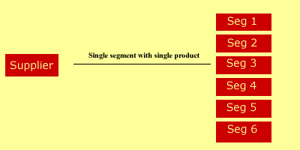
BMSW 4006
Market Segmentation

Slide 11
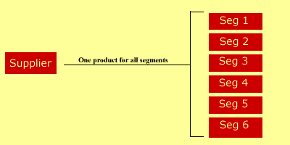
BMSW 4006
Market Segmentation

Slide 12
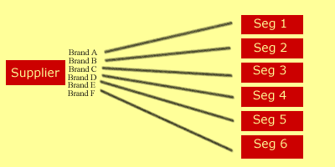
BMSW 4006
Market Segmentation

Slide 13
Market Segmentation
BMSW 4006
Marketers have developed four basic ways to segment the market:
Market Segmentation
Geographic
Demographic
Psychographic
Behavioral

Slide 14
Market Segmentation
BMSW 4006
Demographic segmentation; Focus on group of customers that share similar profile such as; age, gender, marital status, education, income and religion.
Behavioural segmentation; Focus on groups that may share similar profile like; sharing same lifestyles or sharing same behaviour of buying habits.
Geographic segmentation; Focus on country, region, county, city, community or education institutions.
Psychographic segmentation; Focus on group of customers according to their attitudes, opinions and lifestyles.

Slide 15
BMSW 4006
Market Segmentation
Let’s Watch a video
https://www.youtube.com/watch?v=wFxIzCtw8QU

Slide 16
BMSW 4006
Market Segmentation
Activity 20-25 minutes
Can you break down the market of your business idea and identify the different segments?
Work in your groups

Slide 17
BMSW 4006
Customer profiling- Target Marketing
We looked how companies segment their market…
Now we will explore what companies need to do to identify and group their customers within their market segments

Slide 18
BMSW 4006
Customer profiling- Target Marketing
Defining your ideal customer shouldn’t be a difficult process. You do not need serve everyone, but your customers’ needs should be well-defined.
Make sure you gather (through primary and secondary research) specific information about customers, as it will help you understand them better.

Slide 19
BMSW 4006
Customer profiling- Target Marketing
Questions to ask.......
What qualities do your customers value most about your product/s or service/s?
Do they value selection, convenience, service, reliability, availability, or affordability?
What qualities or features do you think customers want you to change about your product/s or service/s? What are the advantages and consequences for modifying your product/s or service/s?

Slide 20
BMSW 4006
Customer profiling- Target Marketing
Questions to ask.......
What is your current customer base based on for example; age, sex, income, and geographic location?
What habits do your customers share? Where do they shop, what do they read, watch, or listen to? Are there any commonalities between them?
Which customers are you currently not reaching & How can you reach them?

Slide 21
BMSW 4006
Customer profiling- Target Marketing
Activity- 20-25 minutes
Can you define your customers?
Work in your groups

Slide 22
BMSW 4006
Target Marketing strategies
We looked how companies segment their market…
We explored what companies need to do/ ask themselves in order to identify and group their customers within their market segments.
Now we will learn… the strategies that companies use to reach their selected markets & customers.

Slide 23
BMSW 4006
Target Marketing strategies
Mass marketing (undifferentiated marketing)
Segmented marketing (differentiated marketing)
Concentrated marketing (niche marketing)
Micromarketing

Slide 24
BMSW 4006
Target Marketing strategies
Mass marketing (undifferentiated marketing)
Mass marketing strategy. Under this strategy, the organization decide to ignore the market segmentation/s and sell their product/ service to the entire market.
This is suitable for productions such as garment and necessary food.

Slide 25
BMSW 4006
Target Marketing strategies
Differentiated Marketing strategy
is also known as the segmented marketing strategy. The company select several target markets in the industry and produce customized product/s or/and service/s for each market segment.
offering separate product types for each market segment, the organization is expecting to achieve a higher market share in each market segment

Slide 26
BMSW 4006
Target Marketing strategies
Concentrated marketing
is known as Niche marketing as well.
under the concentrated marketing strategy, the organization focuses on a large share of one or more small segments (niches).
through concentrated marketing, the organization is planning to achieve a strong market share and create brand loyalty in the customers.

Slide 27
BMSW 4006
Target Marketing strategies
Micromarketing strategy
is about producing the product/ service and the marketing method to suit the taste of a specific individual or specific location.
rather than producing for every customer, micromarketing concentrates on satisfying the needs of specific, prestigious customers.

Slide 28
BMSW 4006
Target Market strategies
Activity- 20-25 minutes
Can you explain the strategy you will use to attract your customers within your markets?
Work in groups

Slide 29
Summary
BMSW 4006
Market Segmentation.
Targeting & Marketing Strategies.

Slide 30

BMSW 4006
Any ……

Slide 31
BMSW 4006
THANK YOU

Slide 32
References
Burns, P. (2014). New Venture Creation: A Framework for Entrepreneurial Start-ups. Basingstoke: Palgrave-Macmillan.
Drucker, P. (1985) Innovation and Entrepreneurship: Practice and Principles, London: Heinemann
Mariotti, S. and Glackin, C. (2016). Entrepreneurship: Starting and Operating A Small Business, 4th Edition, Global Edition, Pearson.
Maund, A. Schriek, M. and Tinkler, P. (2017). Certificate in Higher Education: Skills for the Workplace Student Yearbook. Sage Publications.

Slide 33
Next Week….
4Ps of Marketing

