Slide 1
Entity relationship Diagrams
ACCA7002-Database Systems (DBS)
Dr Suresh Shanmugasundaram

Slide 2
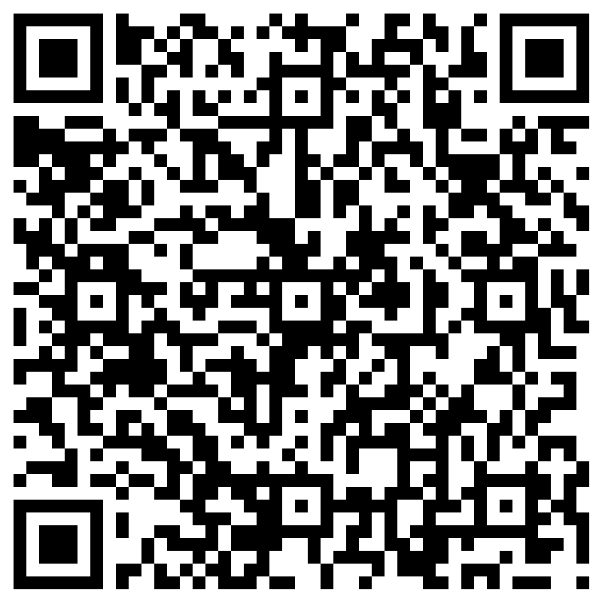
Recap Quiz

Slide 3
Activity
Describe the functionalities of the database components

Slide 4
DML Pre-processor
Syntax Verification
Semantic Checking
Query Optimization
Access Path Selection
Transaction Handling
Security Verification
Error Handling
Data Integrity Enforcement

Slide 5
Query processor
Parsing and Lexical Analysis
Semantic Analysis
Query Optimization
Logical Plan Generation
Physical Plan Generation
Execution Plan Execution
Result Formation and Presentation
Notes:
ensuring that user queries are transformed into efficient execution plans, resulting in optimal performance and accurate results from the database system.
Result Formation and Presentation
Present the results in the desired output format (e.g., tabular results, JSON, XML).
JSON (JavaScript Object Notation) alternative to XML
XML (eXtensible Markup Language) is a markup language that defines rules for encoding documents in a format that is both human-readable

Slide 6
DDL Compiler
Syntax and Semantic Analysis
Schema Validation
Query Optimization
Transaction Handling
Metadata Update
Error Handling
Execution of DDL Statements
Notes:
A DDL (Data Definition Language) compiler is a component of a database management system (DBMS) that processes and executes DDL statements. DDL statements are used to define, modify, and manage the structure and schema of the database, including tables, views, indexes, constraints, and other database objects.
The DDL compiler translates DDL statements into low-level instructions.
The compiled DDL statements are then executed to create, modify, or delete database objects and define their properties.
DDL compiler is a crucial component for ensuring the integrity and consistency of the database schema

Slide 7
Program Object Code
Storage and Retrieval
Dependency Tracking
Metadata Management
Access Control and Security
Query and Analysis
Integration with Build Systems
Notes:
"program object code" typically refers to the compiled, machine-executable version of a software program or application.
while program object code itself is not a traditional database component, managing and storing object code and related metadata within a database can provide various benefits in terms of versioning, history tracking, dependency management, and security.

Slide 8
Database Manager
Storage and Retrieval
Query Processing and Optimization
Transaction Management
Concurrency Control
Data Integrity and Constraints
Database Backup and Recovery
Metadata Management
Optimization of Database Performance
Notes:
The database manager, as a key component,
plays a central role in coordinating and overseeing the functions related to the management of databases.
specialized software application that allows users to interact with the database, manage data, and
ensure its integrity, security, and efficient retrieval.

Slide 9
Database Manager
Metadata Storage
Metadata Retrieval
Metadata Update and Maintenance
Metadata Search and Query
Data Relationship and Dependency Management
Notes:
t enables efficient management and utilization of metadata,
helping users and administrators understand and work with the database effectively.

Slide 10
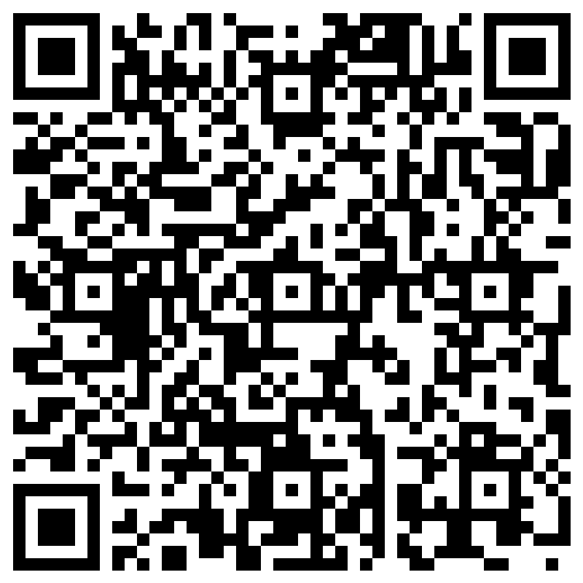
Activity - Database Schema Design
Choose a real-life example of database
design a database schema for the scenario,
(identifying tables, columns, and relationships)
Present it with justification of your choice
https://forms.office.com/e/C1e1iLGPJ1
Notes:
eCommerce platforms, healthcare systems, social media platforms, online banking systems, hotel booking systems, airline reservation systems, HRMS, email services, ride-hailing applications, and online learning platforms.
https://forms.office.com/e/C1e1iLGPJ1

Slide 11
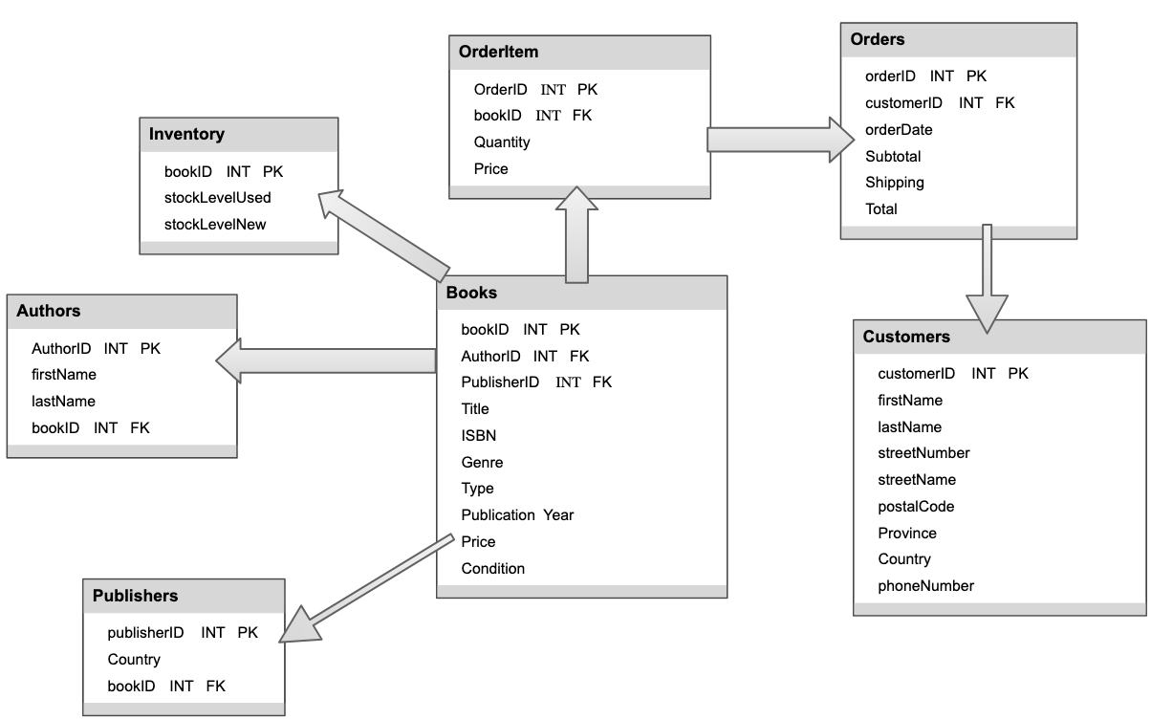
Activity - Database Schema Design
Notes:
Relationships:
Authors and Books have a one-to-many relationship where an author can have multiple books, but each book is written by a single author.
Genres and Books have a one-to-many relationship where a genre can have multiple books, but each book belongs to a single genre.
Customers and Orders have a one-to-many relationship where a customer can place multiple orders, but each order is placed by a single customer.
Orders and OrderItems have a one-to-many relationship where an order can have multiple order items (representing multiple books), but each order item belongs to a single order.
This schema provides a foundation for managing essential data in a bookstore, including information about authors, genres, books, customers, orders, and order items. Further refinements and additional tables can be added based on the specific requirements and functionalities of the bookstore system.

Slide 12
Objectives
How to use Entity–Relationship (ER) modeling in database design.
Basic concepts associated with ER model.
Diagrammatic technique for displaying ER model using Unified Modeling Language (UML).
How to identify and resolve problems with ER models called connection traps.
How to build an ER model from a requirements specification.

Slide 13
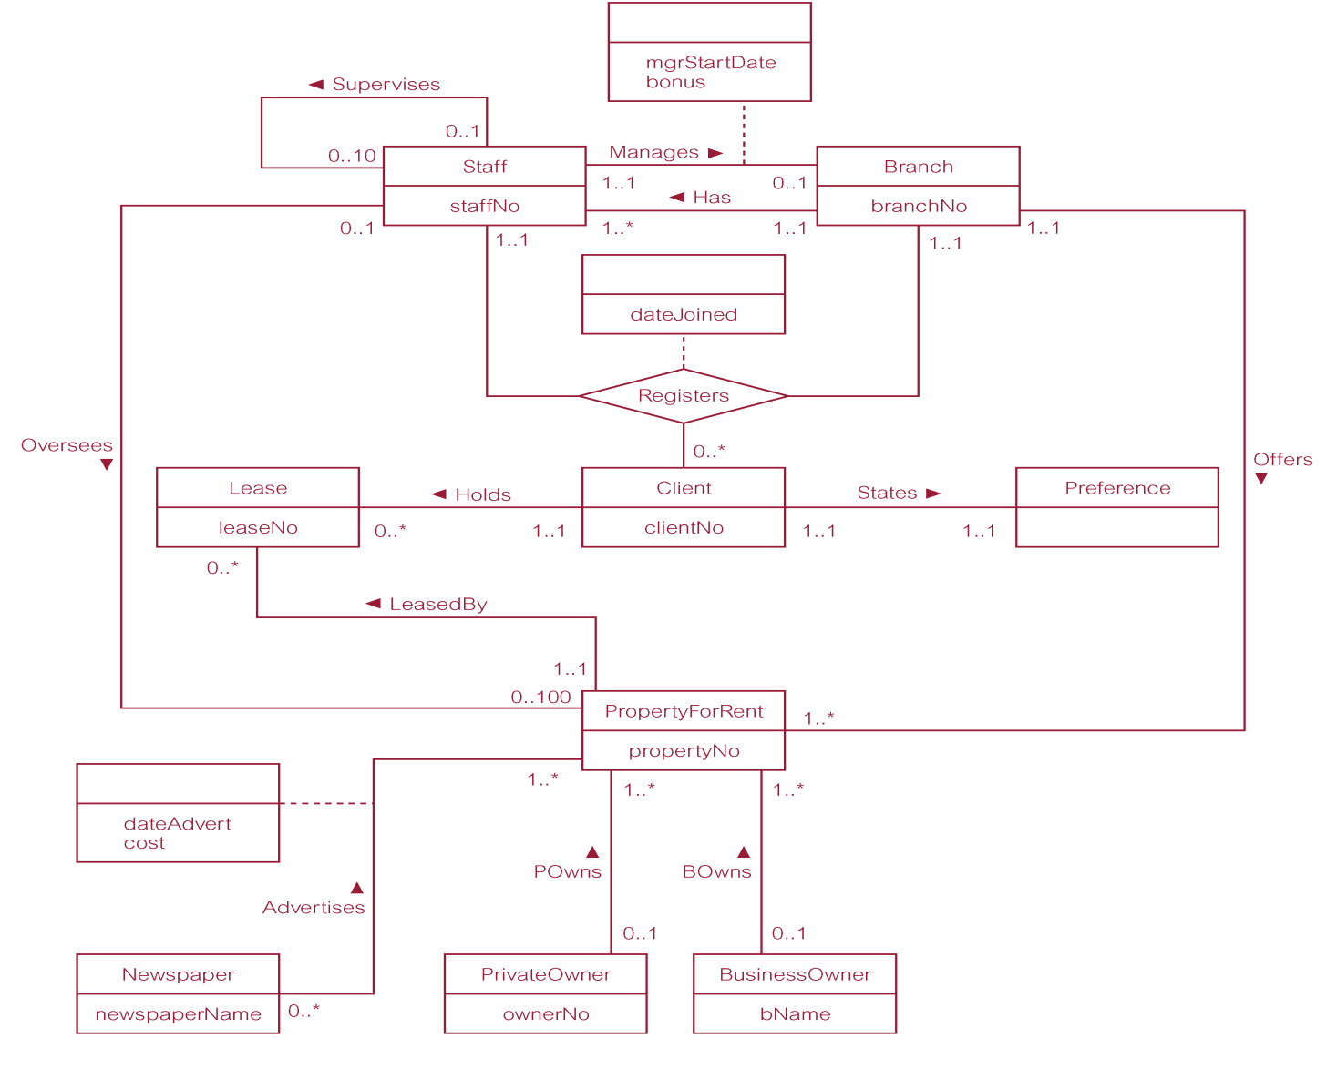
ER diagram of Branch user views of DreamHome

Slide 14
Database Design Process
What happens after DB design is done? How apps use it, how to restrict access to relations and implement access rules
Requirement Analysis
Conceptual Design
Logical DB Design
Schema Refinement
Physical DB Design
Application Security & Design
Analyse relations and identify any potential problems and refine it. Normalisation comes here
Develop high level description of Data & its Constraints, ER modelling comes here
Understand the application, identify what data & what operations should be stored
Choose a DBMS to implement the design and convert the ER model to DB Schema
DB Design refined to ensure that it meets performance criteria. Indexing, clustering etc comes here

Slide 15
Principal Elements
Three principal element types:
Entity Sets
Entity-abstract object of some sort
Entity Sets-a collection of similar entities
Attributes
Properties of the entities in that set
Assumptions: attributes are of primitive types, such as strings, integers, or reals
Relationships
Connections among two or more entity sets

Slide 16
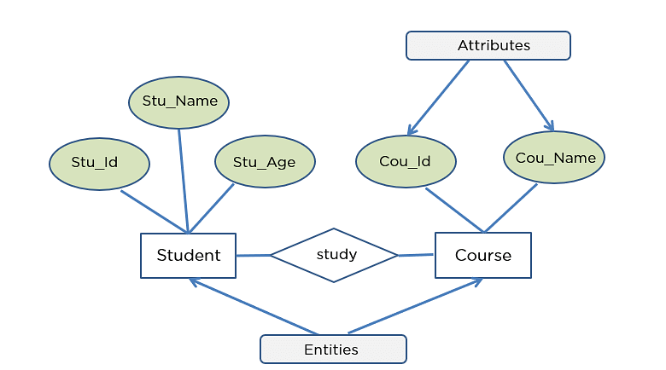
Concepts of the ER Model
Entity types
Relationship types
Attributes

Slide 17
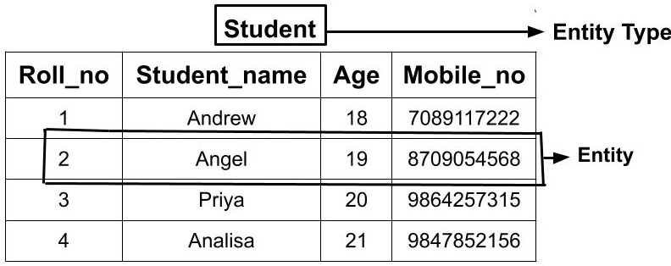
Entity Type
Entity type
  Group of objects with same properties, identified by enterprise as having an independent existence.
Entity occurrence
  Uniquely identifiable object of an entity type.
Notes:
Student entity has groupf students with same properties.
each student in that table is an entity and can be uniquely identified by their Roll Number

Slide 18
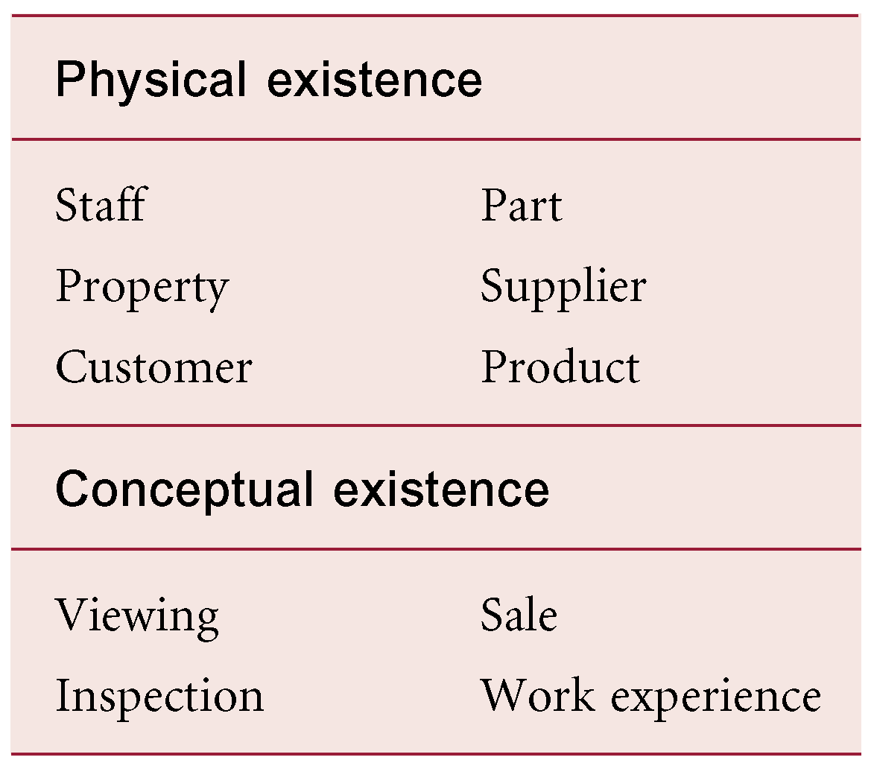
Examples of Entity Types
Tangible Entity
Intangible Entity
Notes:
Tangible Entities are those entities which exist in the real world physically. Example: Person, car, etc.
Intangible Entity: Intangible Entities are those entities which exist only logically and have no physical existence. Example: Bank Account,

Slide 19
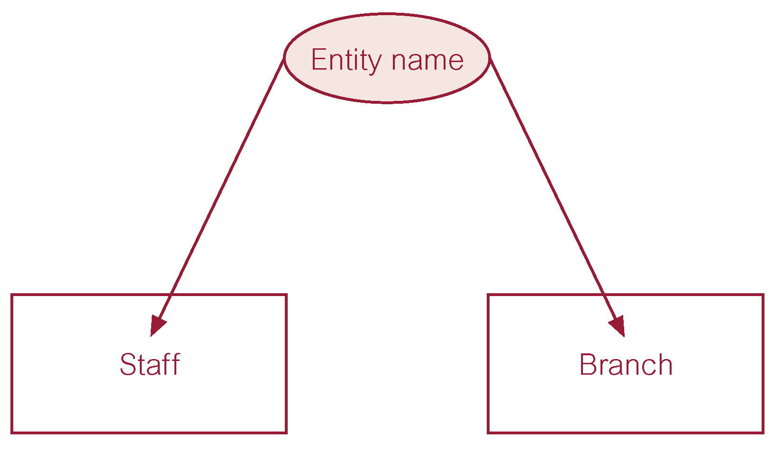
ER diagram of Staff and Branch entity types
Notes:
The E-R representation of the above Staff and Branch Entity Type
We use a rectangle to represent an entity type in the E-R diagram, not entity.

Slide 20
Relationship Types
Relationship type
  Set of meaningful associations among entity types.
Relationship occurrence
  Uniquely identifiable association, which includes one occurrence from each participating entity type.
Works for

Slide 21
Strong and Weak entity types
Customer
Address
A strong entity is an entity that can exist independently
A weak entity is an entity that depends on another entity for its existence.

Slide 22
Types of Entities
Regular Entities
Called as Strong Entities.
Independent Entities
Weak Entities
Its existence depends on some other entity
E.g. Employee
E.g. EmployeeDependants
If an Employee Instance is deleted, then the dependants too are deleted. They do not exist without the employee.
Notation for a Regular Entity
Notation for a Weak Entity
Employee
EmpDependant

Slide 23
Strong and Weak entity types
Strong Entity Type
Weak Entity Type
Customer
Address
Parent
Children
Building
Room
Notes:
Address can only be associated with the customer.
There can be children only if the parent exits.
There can be no independent existence of children.
There can be a room only if building exits.
There can be no independent existence of a room.
A weak entity is represented by a double outlined rectangle.

Slide 24
Relationship between Strong and Weak entity types
identifying relationship
Strong Entity Type
Weak Entity Type
Customer
has
Address
Notes:
The relationship between a weak entity type and strong entity type is called an identifying relationship
shown with a double outlined diamond instead of a single outlined diamond
Now what are the attributes of customer and address entity type

Slide 25
Relationship between Strong and Weak entity types
Customer
has
Address
Notes:
The relationship between a weak entity type and strong entity type is called an identifying relationship
shown with a double outlined diamond instead of a single outlined diamond
Now what are the attributes of customer and address entity type

Slide 26
Relationship between Strong and Weak entity types
Customer Id
Street
Customer
has
Address
Notes:
The relationship between a weak entity type and strong entity type is called an identifying relationship
shown with a double outlined diamond instead of a single outlined diamond
Now what are the attributes of customer and address entity type
Can you find the other possible attributes and complete this

Slide 27
Relationship between Strong and Weak entity types
Customer Id
Street
Customer Name
Phone number
Customer
has
Address
City
Postal Code
Gender
Age
DateofBirth
Notes:
The relationship between a weak entity type and strong entity type is called an identifying relationship
shown with a double outlined diamond instead of a single outlined diamond
Now what are the attributes of customer and address entity type
Can you find the other possible attributes and complete this
https://www.tutorialspoint.com/dbms/er_diagram_representation.htm

Slide 28
Attribute Types
Each entity has attributes – properties that describe it.
A particular entity will have values for its attributes.
E.g. an employee entity may have name, age, home address, home phone etc as their attributes.
Keys: Unique value in the context.
Attribute Types
Simple vs Composite
Single vs Multivalued
Stored vs Derived
Null vs Complex

Slide 29
Attributes Notation
Attribute Domain: The set of allowable values for one or more attributes.
Each attribute is associated with a set of values called a domain.
Notation: Attributes are represented by ovals.
Notation for an Attribute
Notation for an Key Attribute
Name
ID

Slide 30
Attribute Types - 1
Type | Description | Example
Simple Attribute | An attribute composed of a single component with an independent existence. Also called as atomic attributes. | Employee entity: Position, salary etc.
Composite Attribute | An attribute composed of multiple components, each with an independent existence. | Employee entity: Address → can be made up of street, town, country, postcode

Slide 31
Attribute Types - 2
Type | Description | Example
Single Valued Attribute | An attribute that holds a single value for each occurrence of an entity type. | Employee entity: Salary → can be only one value. Cannot draw more than one salary.
Multi Valued Attribute | An attribute that holds multiple values for each occurrence of an entity type. | Employee entity: PhoneNo → A person can have one or more mobile phone number, landline etc.

Slide 32
Attribute Types - 3
Type | Description | Example
Stored Attribute | An attribute that holds a value provided as is. | Employee entity: Name → can be set by the user as used as is.
Derived Attribute | An attribute that represents a value that is derivable from the value of a related attribute or set of attributes, not necessarily in the same entity type. | Employee entity: Age → can be derived from dateOfBirth and currentDate.

Slide 33
Attribute Types - 4
Type | Description | Example
NULL Attribute | An attribute that means either the value is unknown or inapplicable. It does not mean zero or blank. | Employee entity: Commission → can be NULL
Complex Attribute | An attribute that is formed by nesting composite attributes and multi-valued attributes in arbitrary way. We can say this as the both are in the attribute. | Employee entity: A person can have many phone numbers, many e-mail addresses, home addresses etc. So if there is an attribute in the name of 'Contact detail’, it can be a complex attribute.
(…)

Slide 34
Relationship between Strong and Weak entity types
Customer Id
Street
Customer Name
Phone number
Phone Number
Customer
has
Address
City
Postal Code
Gender
Age
DateofBirth
Notes:
Revised showin the attribute types
CustomerId – Key underlined
Customername , gender , city etc are single valued attribute
Phone number – multi valued attribute
Address – weak entity
Relation ‘has’ – idendifying relation
In this example address is an entity- there is another way where Address can be an attribute.

Slide 35
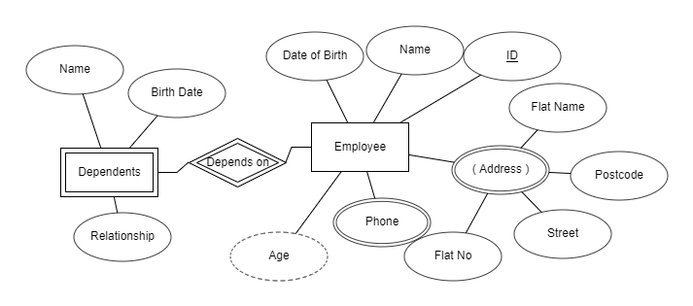
Entity & Attributes
In the ERD, identify regular entities, weak entities, identifying relationship, key attribute, multivalued attribute, composite, complex, derived attribute.
Notes:
Employee – Entity,
Dependents – Weak Entity,
ID – Key, Name – single valued attribute, Address is a composite attribute, Phone is a multi valued attribute, Age is a derived attribute

Slide 36
Exercise- ERD
Construct an E-R diagram for a car-insurance company whose customers own one or more cars each. Each car has associated with it zero to any number of recorded accidents.

Slide 37
Exercise- Possible Solution
Construct an E-R diagram for a car-insurance company whose customers own one or more cars each. Each car has associated with it zero to any number of recorded accidents.
Entities:
Customer:
  Attributes: CustomerID (Primary Key), First Name, Last Name, Address, Phone Number, Email, etc.
Car:
  Attributes: CarID (Primary Key), Make, Model, Year, License Plate, VIN (Vehicle Identification Number), etc.
Accident:
  Attributes: ReportId (Primary Key), Date, Location, Description, Damage Amount, etc.

Slide 38
Exercise- Possible Solution
Construct an E-R diagram for a car-insurance company whose customers own one or more cars each. Each car has associated with it zero to any number of recorded accidents.
Relationships:
Owns:
  Relationship between Customer and Car.
  One customer can own one or more cars.
  One car is owned by one and only one customer.
  Cardinality: One (Customer) to Many (Car).
Has:
  Relationship between Car and Accident.
  One car can be associated with zero to many accidents.
  One accident is associated with one and only one car.
  Cardinality: Zero or Many (Car) to One (Accident).

Slide 39
Exercise- Possible Solution
Id
ReportId
CarID
Make
FName
LName
Date
Location
Customer
owns
Car
has
Accident
Phone
Email
Model
Year
Desciption
Damage_Amount
<<Address>>
VIN
Notes:
CarID (Primary Key), Make, Model, Year, License Plate, VIN (Vehicle Identification Number), etc.
ReportNo (Primary Key), Date, Location, Description, Damage Amount

Slide 40
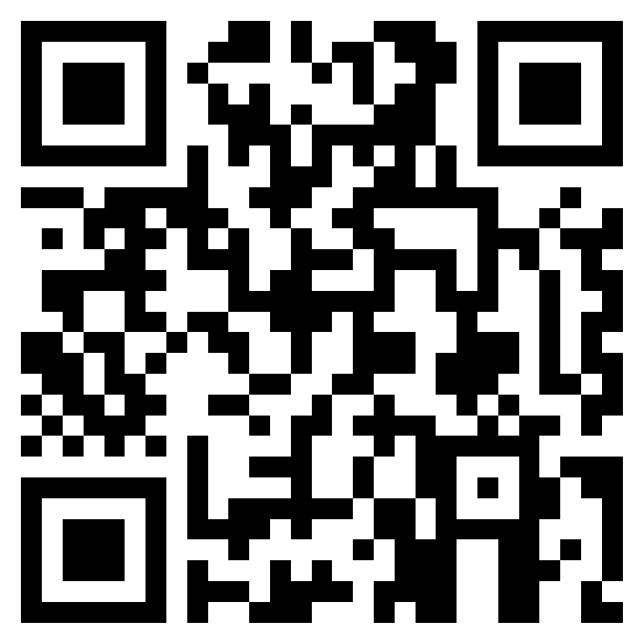
Recap Quiz
https://forms.office.com/e/m9qpwFPCYX
Notes:
https://forms.office.com/e/m9qpwFPCYX

Slide 41
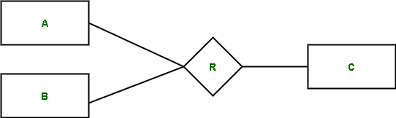

Diagrammatic Notation for Relationships
Notes:
Relationship is represented by a diamond shaped box.
Rectangle represents participating entities.
Rectangle of the entity is connected to the diamond of the relationship by a line.
The names of entities and relationships is written in their specified shapes.

Slide 42
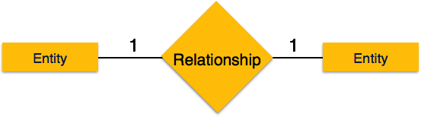
Binary Relationship and Cardinality
One-to-one
Person
Has
Passport
Notes:
A relationship where two entities are participating is called a binary relationship.
Cardinality is the number of instance of an entity from a relation that can be associated with the relation.
One-to-one − When only one instance of an entity is associated with the relationship, it is marked as '1:1

Slide 43
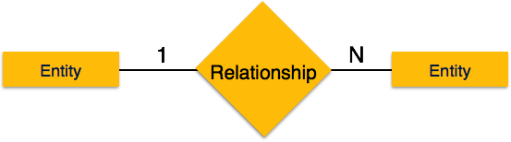
Binary Relationship and Cardinality
One-to-many
N
Instructor
teaches
Course
Notes:
One-to-many − When more than one instance of an entity is associated with a relationship, it is marked as '1:N’.
The following image reflects that only one instance of entity on the left and more than one instance of an entity on the right can be associated with the relationship.
It depicts one-to-many relationship.

Slide 44
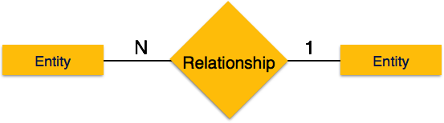
Binary Relationship and Cardinality
Many-to-one
N
1
Course
taught by
Instructor
Notes:
Many-to-one − When more than one instance of entity is associated with the relationship, it is marked as 'N:1’.
The following image reflects that more than one instance of an entity on the left and only one instance of an entity on the right can be associated with the relationship.
It depicts many-to-one relationship.

Slide 45

Binary Relationship and Cardinality
Many-to-many
N
N
1
Author
writes
Book
Notes:
reflects that more than one instance of an entity on the left and more than one instance of an entity on the right can be associated with the relationship. It depicts many-to-many relationship.

Slide 46
Relationship
Customer
owns
Car
has
Accident
Notes:
Owns and has are the relationship to show how the entities are associated to each other.
Relationships:
Owns:
Relationship between Customer and Car.
One customer can own one or more cars.
One car is owned by one and only one customer.
Cardinality: One (Customer) to Many (Car).
Has:
Relationship between Car and Accident.
One car can be associated with zero to many accidents.
One accident is associated with one and only one car.
Cardinality: Zero or Many (Car) to One (Accident).

Slide 47
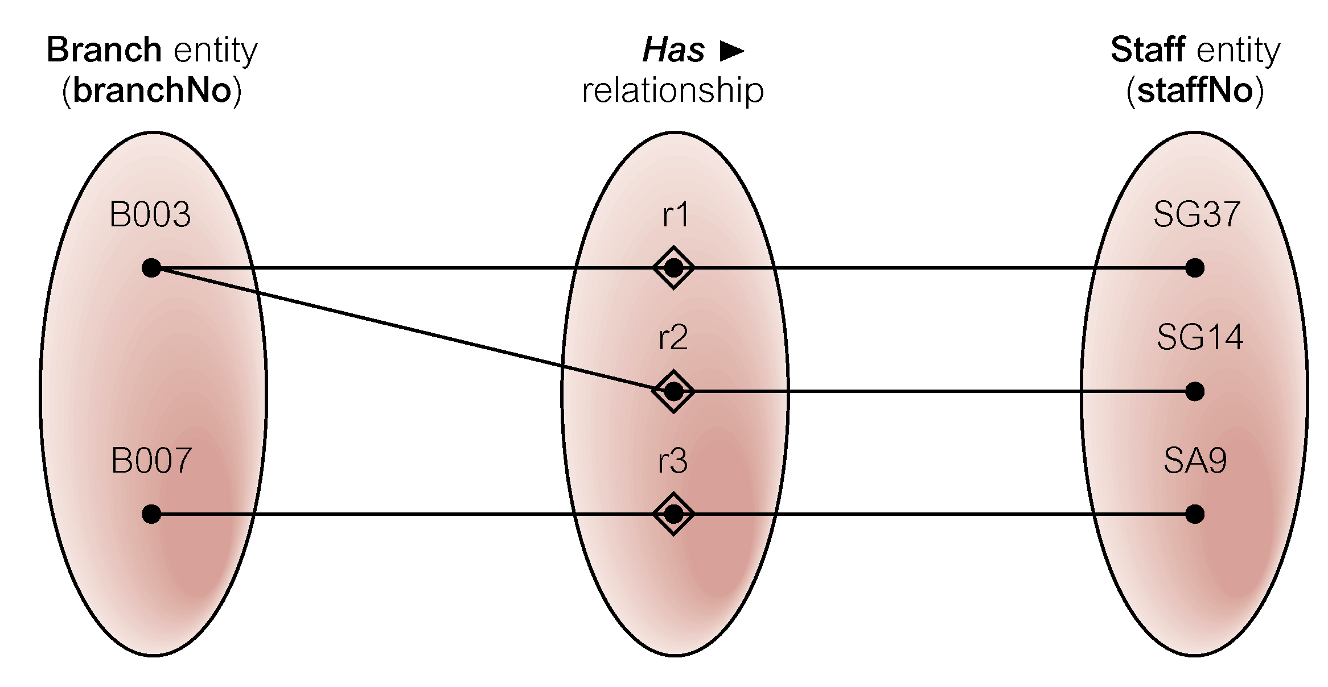
Semantic net of Has relationship type

Slide 48
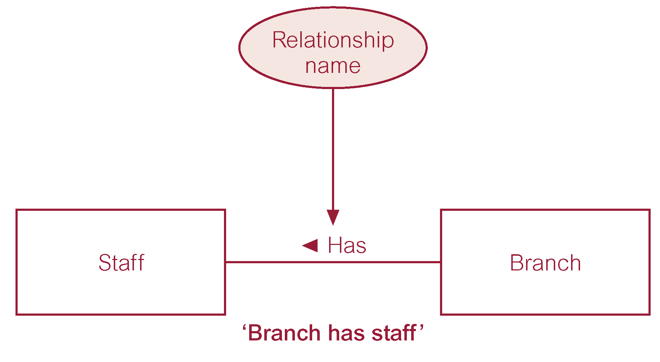
ER diagram of Branch Has Staff relationship

Slide 49
Relationship Types
Degree of a Relationship
  Number of participating entities in relationship.
Relationship of degree :
  two is binary
  three is ternary
  four is quaternary.

Slide 50
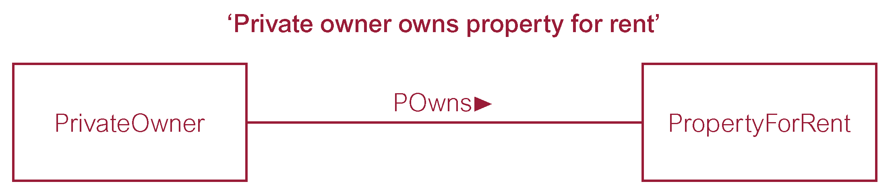
Binary relationship called POwns

Slide 51
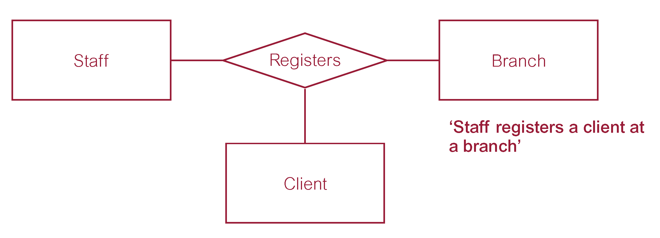
Ternary relationship called Registers

Slide 52
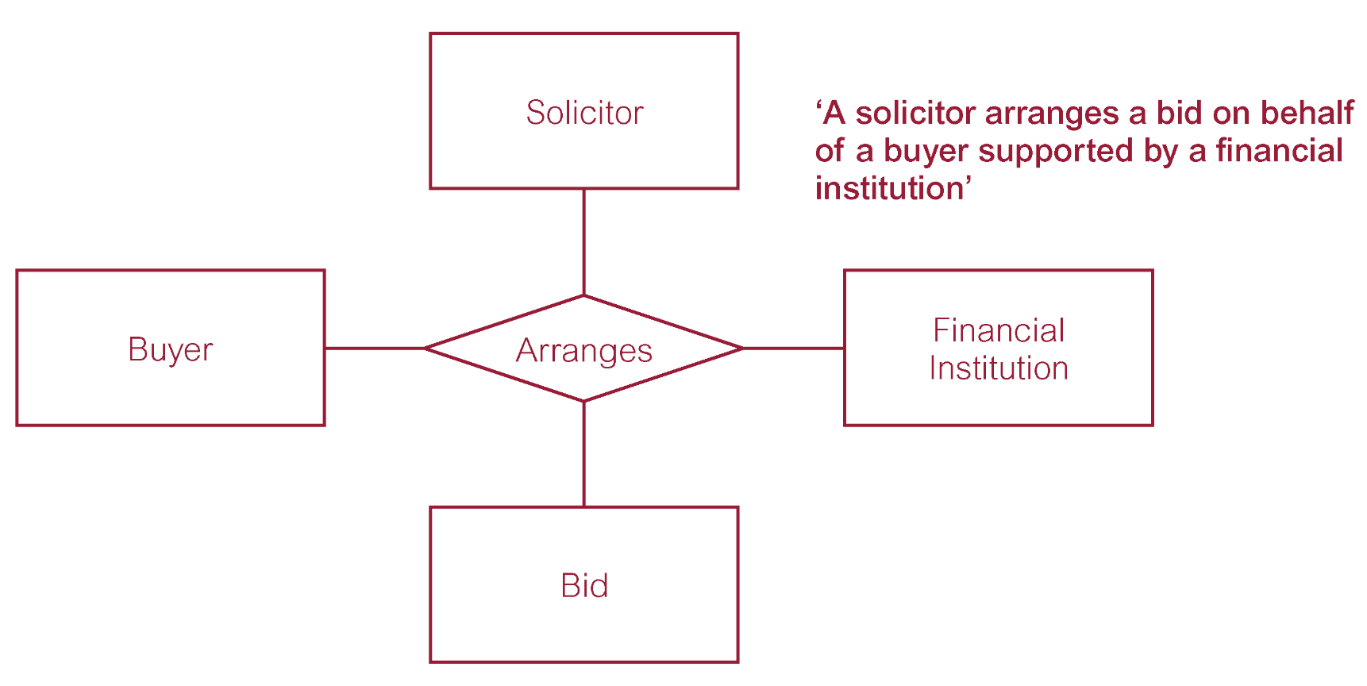
Quaternary relationship called Arranges

Slide 53
Try this
Student enrolls for a course along with instructor teaching the course and the classroom where it is taught

Slide 54
Try this
Student is enrolls for a course along with instructor teaching the course and the classroom where it is taught
Course
Student
Enrolls
Instructor
Classroom

Slide 55
Relationship Types
Recursive Relationship
  Relationship type where same entity type participates more than once in different roles.
Relationships may be given role names to indicate purpose that each participating entity type plays in a relationship.

Slide 56
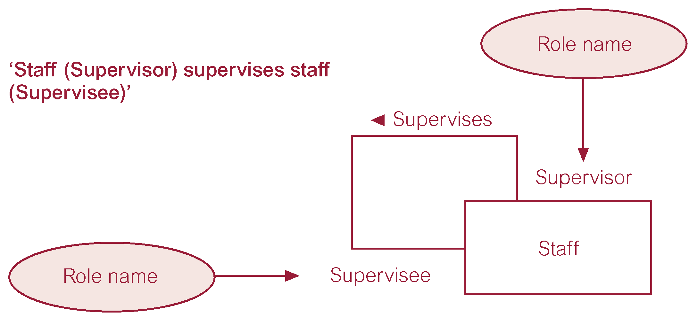
Recursive relationship called Supervises with role names
Notes:
A recursive relationship in an Entity-Relationship Diagram (ERD) involves an entity that is related to itself.
This is also known as a self-referencing or unary relationship.
we have an staff entity where each staff may have a supervisor who is also an staff within the organization.
In the ”supervises" relationship, a staff can supervise another staff, and
each staff can have at most one supervisor.

Slide 57
Recursive relationship – How will the table(s) look like?
Staff Table Data:
+------------------+--------------------------+-------------+-----------------+
| StaffID | Name | Position | SupervisorID |
+------------------+--------------------------+-------------+-----------------+
| 1 | John Doe | Manager | NULL |
| 2 | Alice Smith | Team Lead | 1 |
| 3 | Bob Johnson | Staff. | 1 |
| 4 | Eve Davis | Staff. | 2 |
+------------------+--------------------------+--------------+-------------+
Supervisor Table Data:
+------------------+----------------+---------------+-------------+--------------+
| RelationshipID| StaffID. | SupervisorID| StartDate | EndDate |
+------------------+----------------+---------------+-------------+--------------+
| 1 | 2 | 1 | 2023-01-01 | NULL |
| 2 | 3 | 1 | 2022-12-15 | NULL |
| 3 | 4 | 2 | 2023-02-01 | NULL |
+------------------+----------------+---------------+----------------+------------+
Notes:
In the staff table, we have staff details, including their staffID, Name, Position, and SupervisorID (where applicable).
In the Supervisor table, we define the relationships where a staff (StaffID) is supervised by another staff (SupervisorID).
The StartDate indicates when the supervisor relationship started, and EndDate would be populated if the relationship ended,
but in this example, it's left as NULL to signify ongoing relationships.
In the example shown we have Alice Smith and Bob supervisd by John Doe
And Eve Davies supervised by Alice Smith

Slide 58
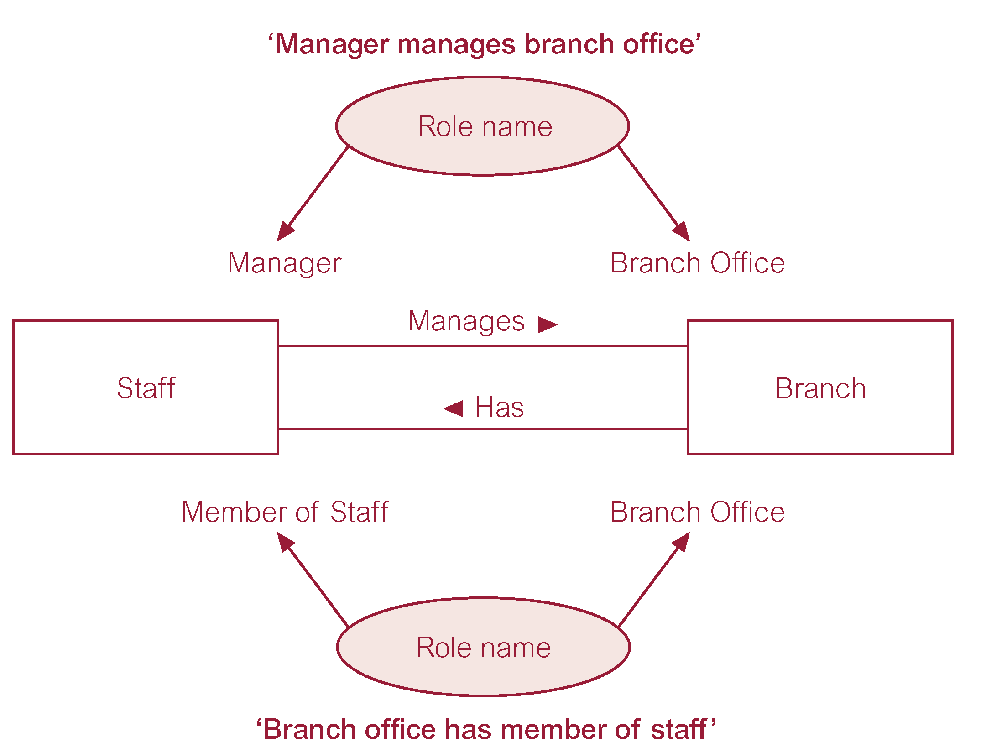
Entities associated through two distinct relationships with role names

Slide 59
Recap: Attributes
Attribute
  Property of an entity or a relationship type.
Attribute Domain
  Set of allowable values for one or more attributes.

Slide 60
Recap: Attributes
Simple Attribute
  Attribute composed of a single component with an independent existence.
Composite Attribute
  Attribute composed of multiple components, each with an independent existence.

Slide 61
Recap: Attributes
Single-valued Attribute
  Attribute that holds a single value for each occurrence of an entity type.
Multi-valued Attribute
  Attribute that holds multiple values for each occurrence of an entity type.

Slide 62
Recap: Attributes
Derived Attribute
  Attribute that represents a value that is derivable from value of a related attribute, or set of attributes, not necessarily in the same entity type.

Slide 63
Recap: Keys
Candidate Key
  Minimal set of attributes that uniquely identifies each occurrence of an entity type.
Primary Key
  Candidate key selected to uniquely identify each occurrence of an entity type.
Composite Key
  A candidate key that consists of two or more attributes.

Slide 64
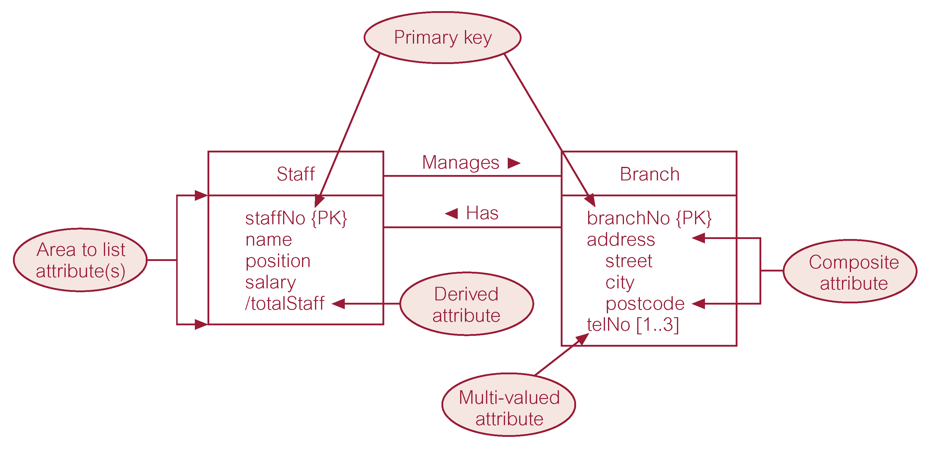
ER diagram of Staff and Branch entities and their attributes
Notes:
Identify primary key, derived attribute, composite attribute and multivalued attribute and represent them using their respective notations.

Slide 65
ER diagram of Staff and Branch entities and their attributes

Slide 66
Entity Type
Strong Entity Type
  Entity type that is not existence-dependent on some other entity type.
Weak Entity Type
  Entity type that is existence-dependent on some other entity type.

Slide 67
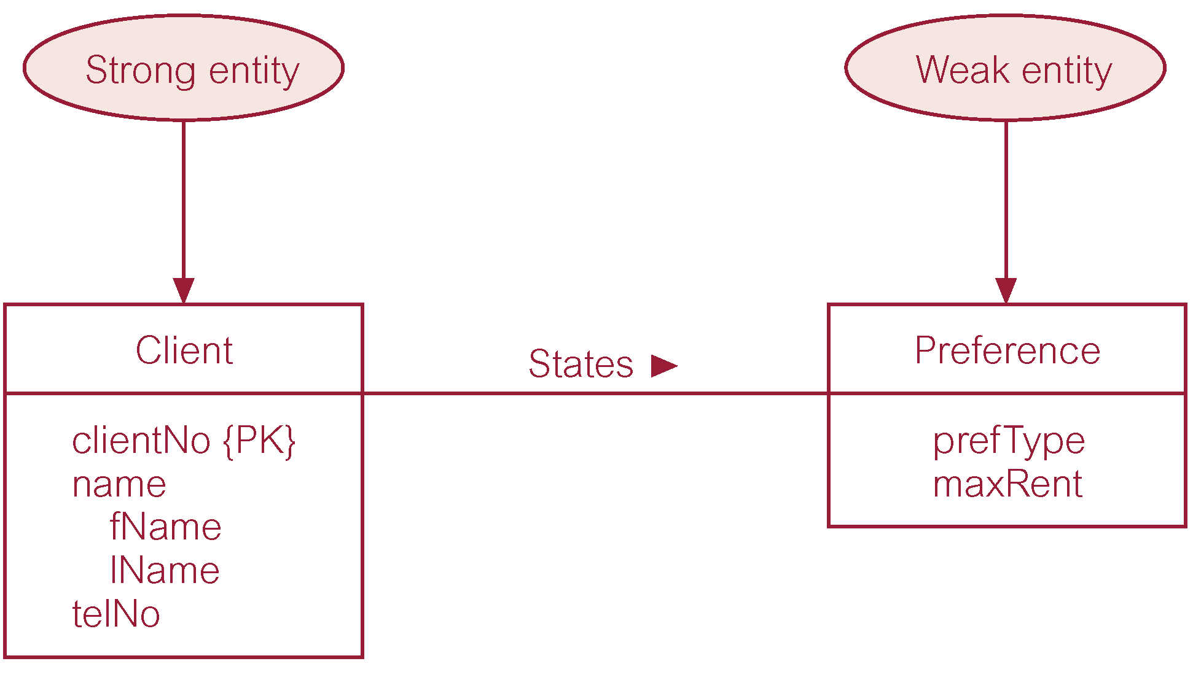
Strong entity type called Client and weak entity type called Preference

Slide 68
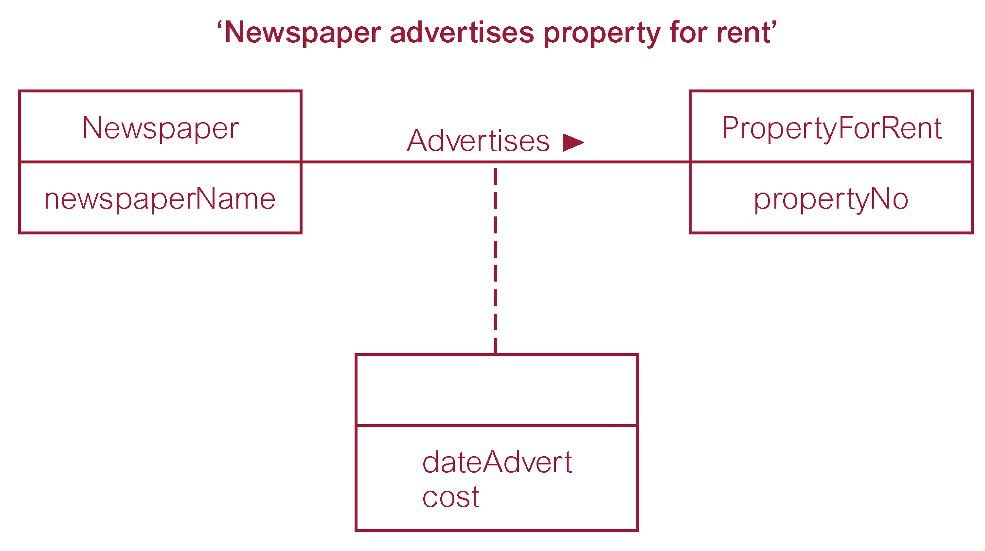
Relationship called Advertises with attributes

Slide 69
Structural Constraints
Main type of constraint on relationships is called multiplicity.
Multiplicity - number (or range) of possible occurrences of an entity type that may relate to a single occurrence of an associated entity type through a particular relationship.
Represents policies (called business rules) established by user or company.

Slide 70
Structural Constraints
The most common degree for relationships is binary.
Binary relationships are generally referred to as being:
  one-to-one (1:1)
  one-to-many (1:*)
  many-to-many (*:*)

Slide 71
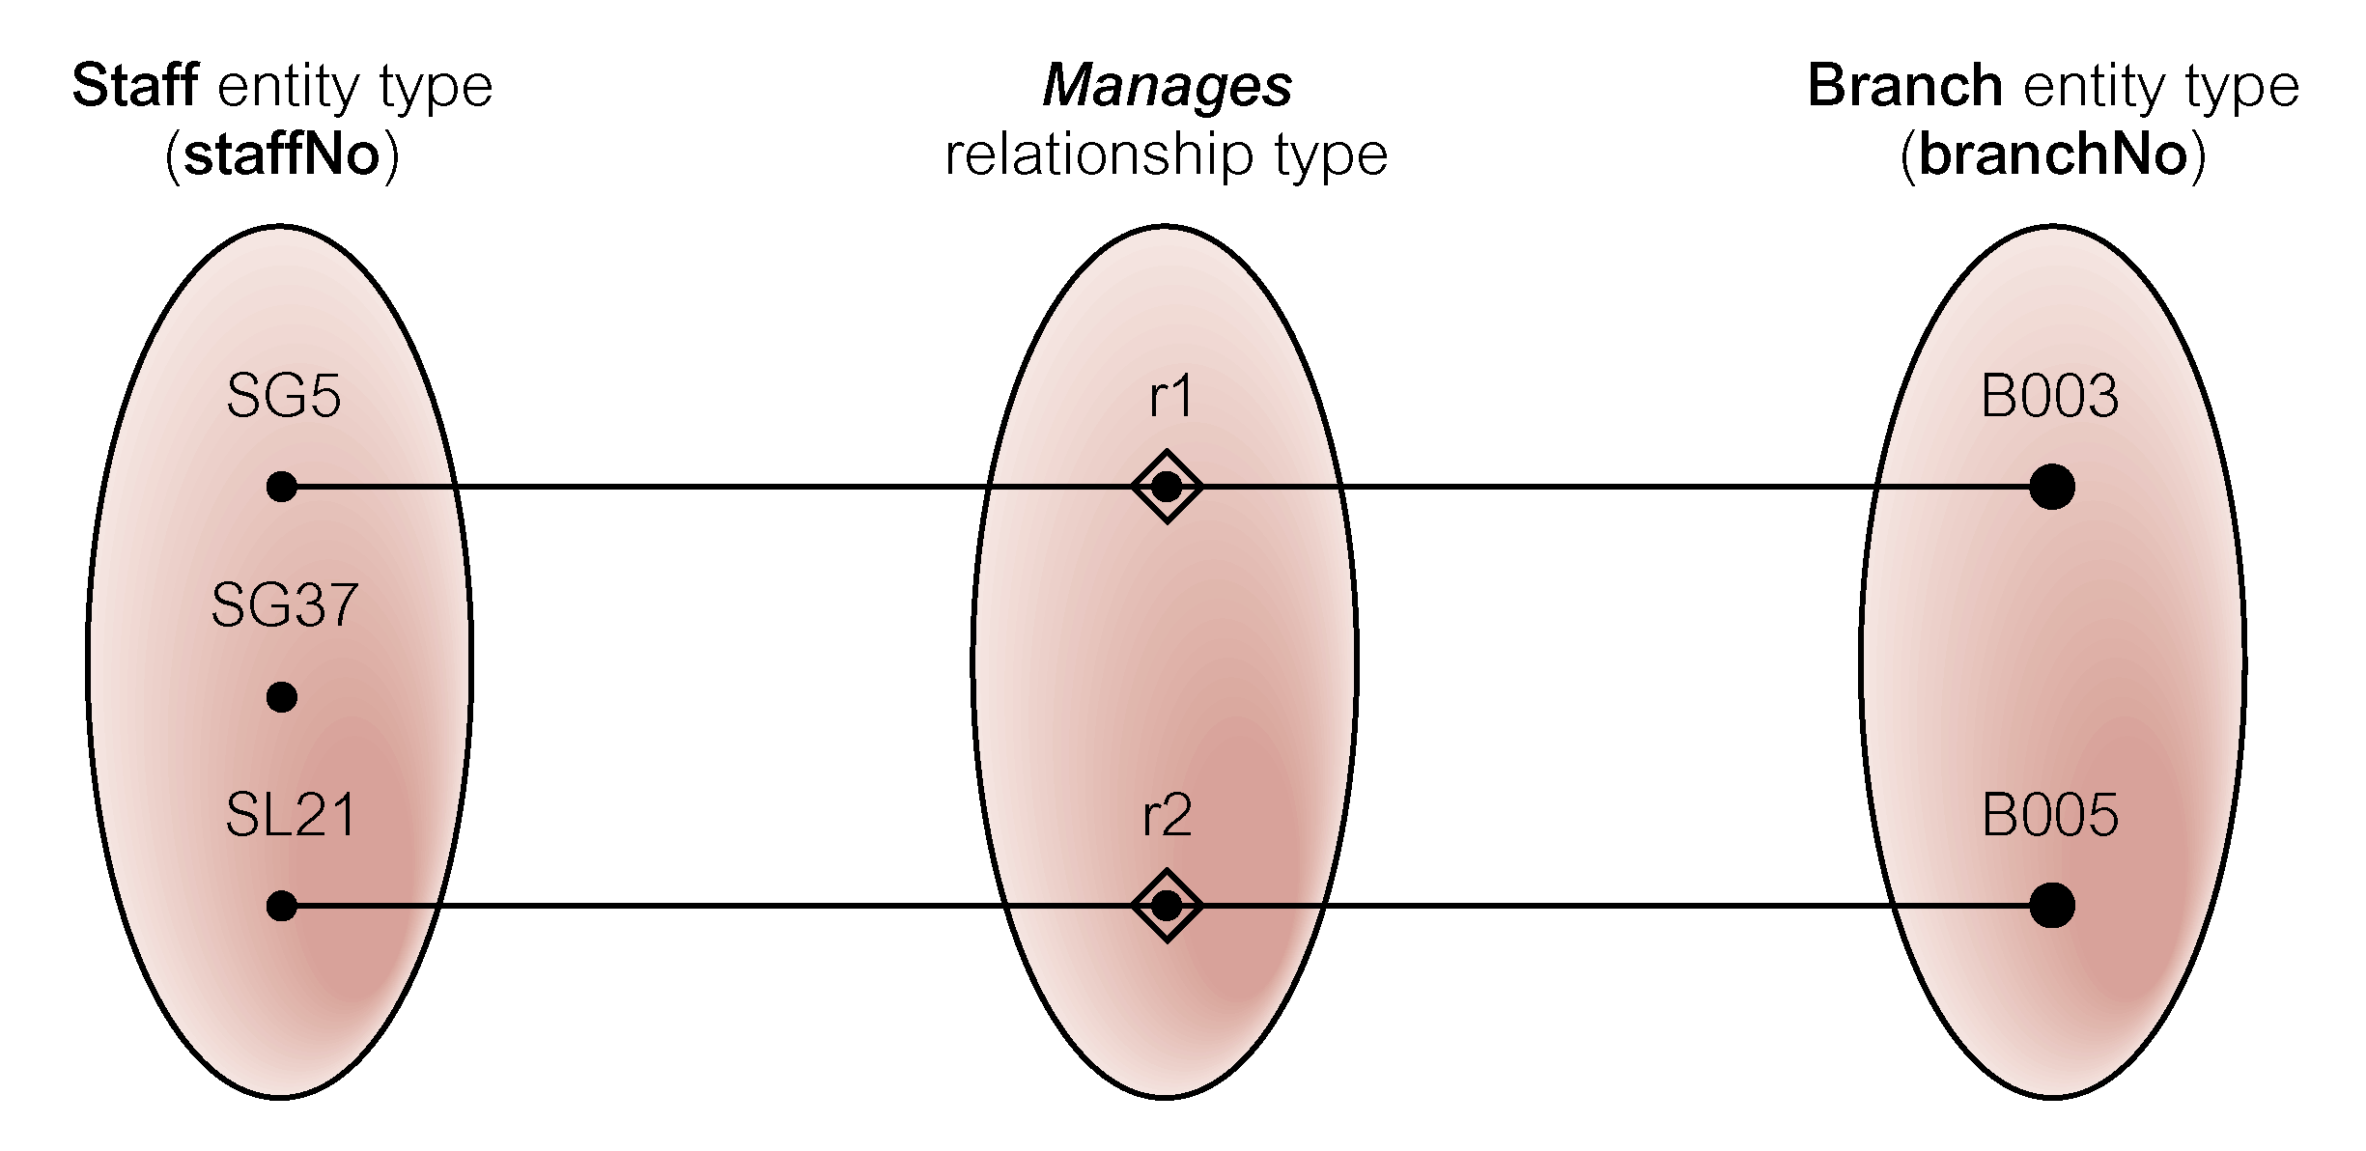
Semantic net of Staff Manages Branch relationship type

Slide 72
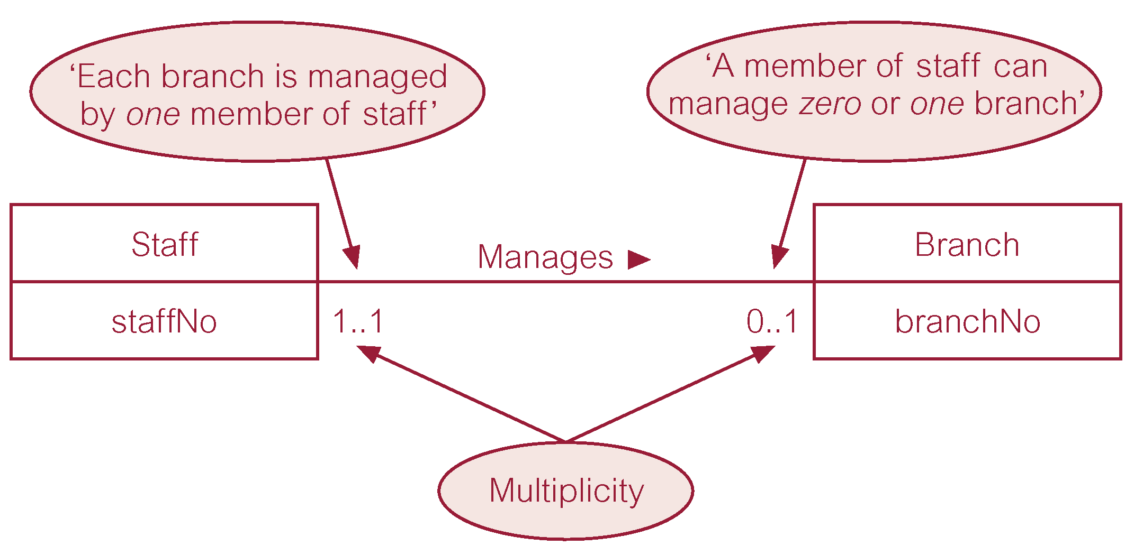
Multiplicity of Staff Manages Branch (1:1) relationship

Slide 73
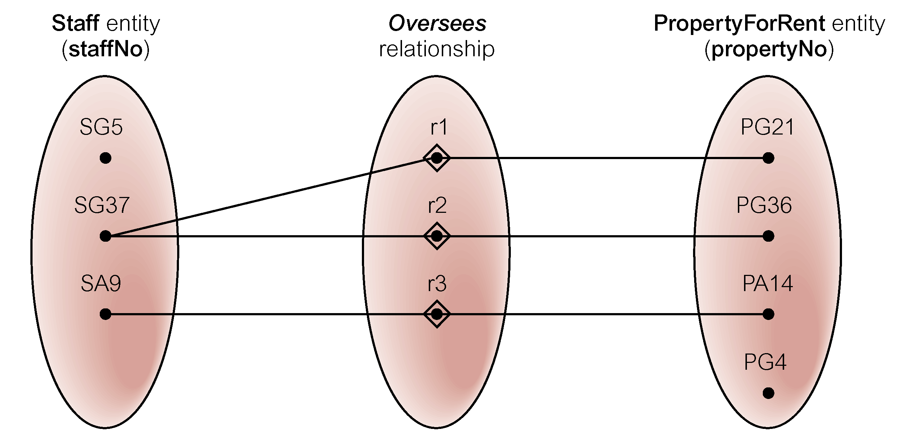
Semantic net of Staff Oversees PropertyForRent relationship type

Slide 74
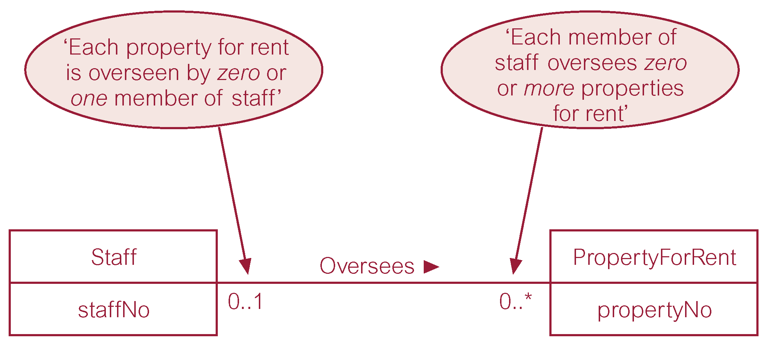
Multiplicity of Staff Oversees PropertyForRent (1:*)relationship type
Notes:
A staff can over see zero or mor eproperties
A property for rent can be associated with 0 or 1 staff.

Slide 75
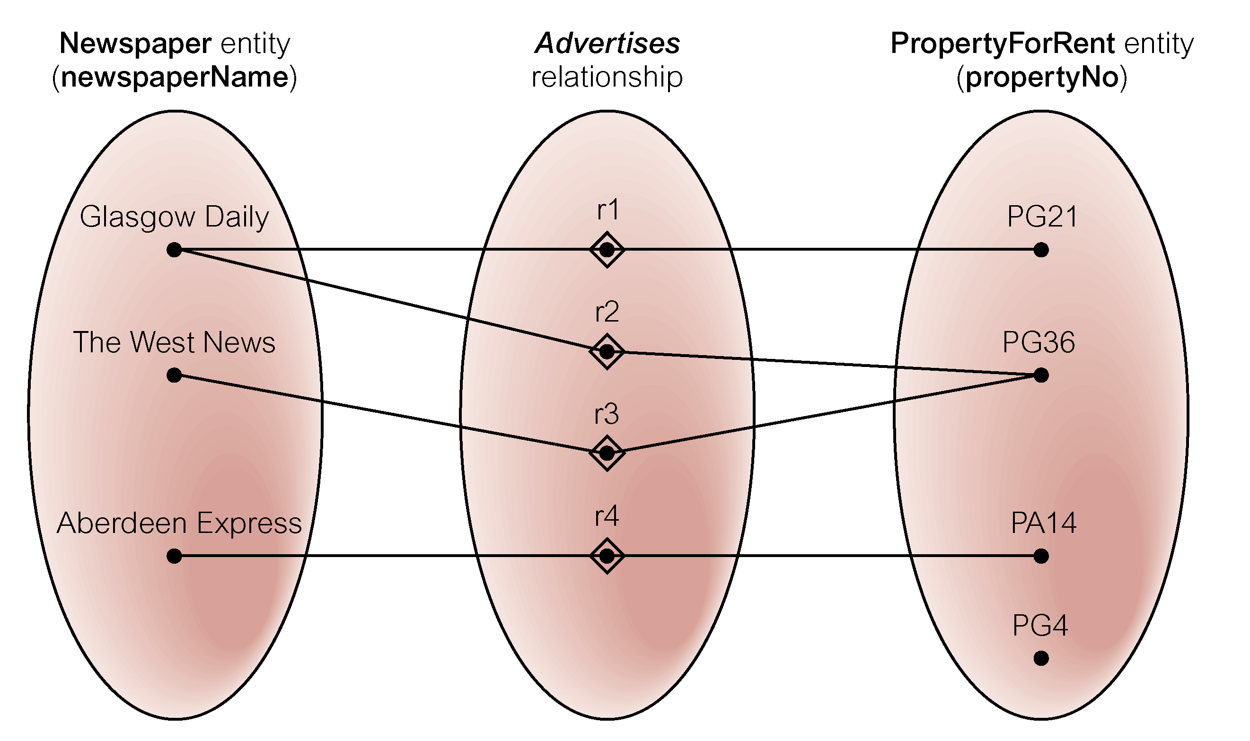
Semantic net of Newspaper Advertises PropertyForRent relationship type
Notes:
a semantic net, visually represents the relationships and connections between concepts or entities in a domain.
In this case, we'll create a simple semantic network to represent the "newspaper advertisements" domain with a focus on the "property for rent" relationship type.

Slide 76
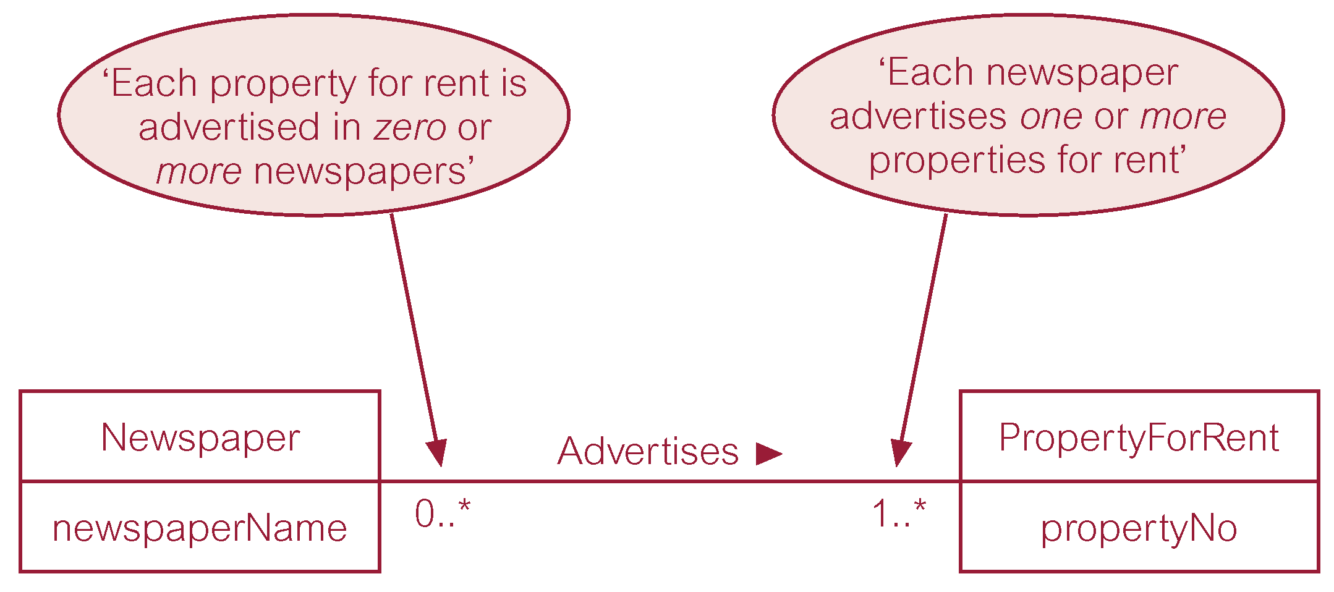
Multiplicity of Newspaper Advertises PropertyForRent (*:*) relationship

Slide 77
Structural Constraints
Multiplicity for Complex Relationships
  Number (or range) of possible occurrences of an entity type in an n-ary relationship when other (n-1) values are fixed.

Slide 78
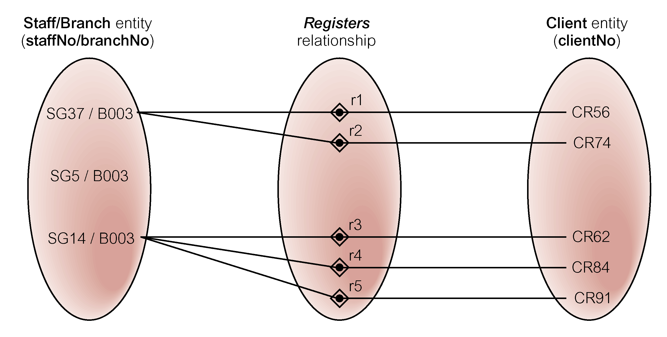
Semantic net of ternary Registers relationship with values for Staff and Branch entities fixed

Slide 79
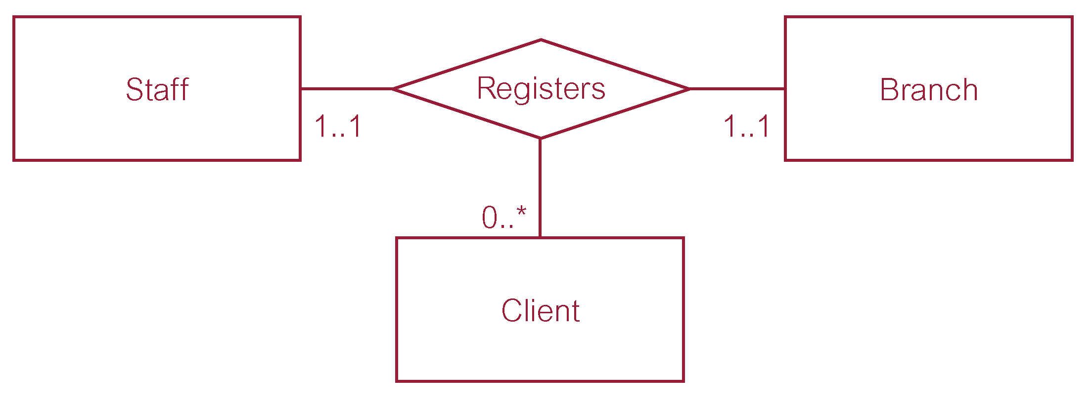
Multiplicity of ternary Registers relationship

Slide 80
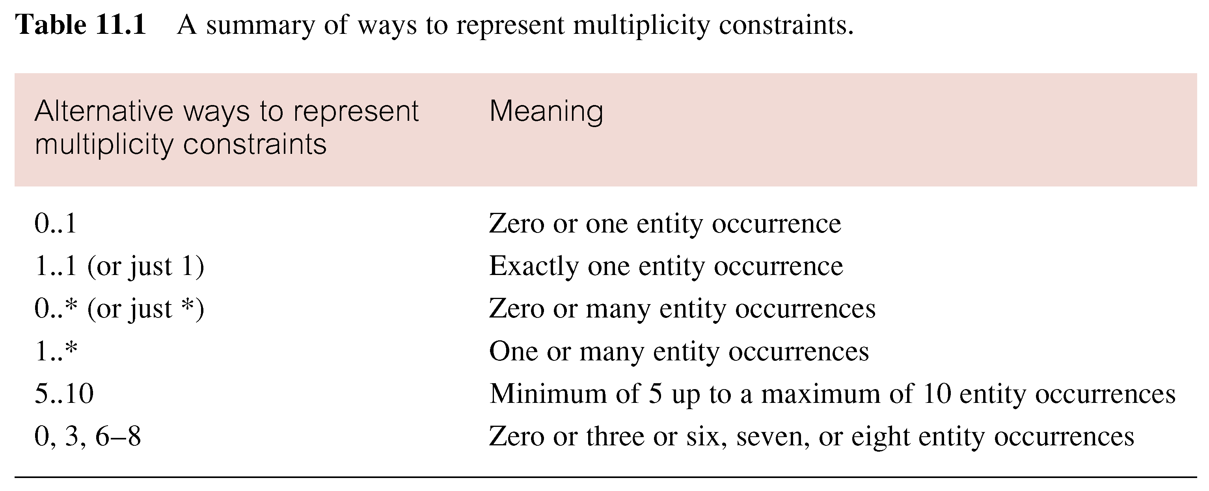
Summary of multiplicity constraints

Slide 81
Structural Constraints
Multiplicity is made up of two types of restrictions on relationships: cardinality and participation.

Slide 82
Structural Constraints
Cardinality
  Describes maximum number of possible relationship occurrences for an entity participating in a given relationship type.
Participation
  Determines whether all or only some entity occurrences participate in a relationship.

Slide 83
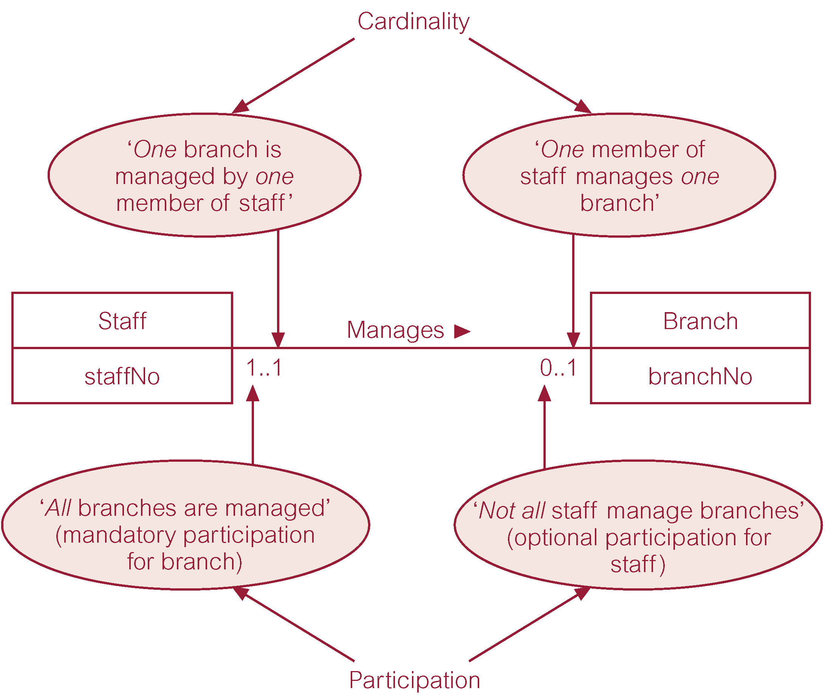
Multiplicity as cardinality and participation constraints

Slide 84
Problems with ER Models
Problems may arise when designing a conceptual data model called connection traps.
Often due to a misinterpretation of the meaning of certain relationships.
Two main types of connection traps are called fan traps and chasm traps.
Notes:
Fan redundancy occurs when an entity is related to multiple other entities,
and querying this relationship can result in redundant or ambiguous information.
Chasm – ka sum

Slide 85
Problems with ER Models
Fan Trap
  Where a model represents a relationship between entity types, but pathway between certain entity occurrences is ambiguous.
Chasm Trap
  Where a model suggests the existence of a relationship between entity types, but pathway does not exist between certain entity occurrences.
Notes:
Chasm - gap

Slide 86
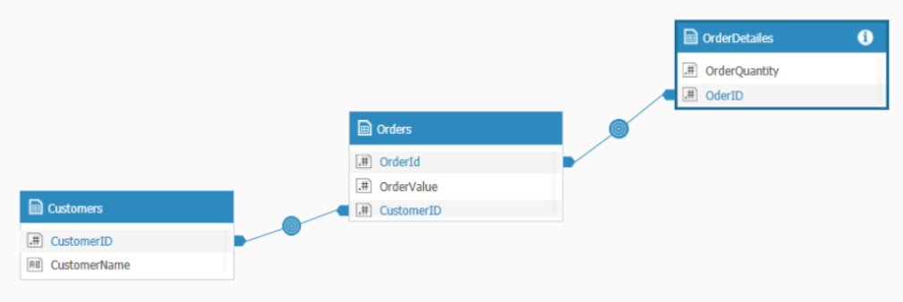
Problems with ER Models
Fan Trap
  Where a model represents a relationship between entity types, but pathway between certain entity occurrences is ambiguous.
Notes:
Consider three entities: Customer, Order, and OrderItem.
Customer places Orders (1 to many relationship).
Order contains Orderdetails (1 to many relationship).
If we connect Customer to OrderItem directly (Customer -> OrderItem), it can create a fan redundancy fan trap.

Slide 87
Problems with ER Models
Fan Trap
+----------------+--------------------+
| CustomerID | CustomerName|
+----------------+--------------------+
| 101 | John Doe |
| 102 | Alice Smith. |
+---------------+---------------------+
+----------+-----------------+---------------+
| OrderID| CustomerID | OrderDate |
+----------+-----------------+---------------+
| 1 | 101 | 2023-10-10|
| 2 | 102 | 2023-10-11|
+----------+-----------------+---------------+
+------------+--------------+
| OrderQty | OrderID |
+------------+------------- |
| 100 | 1 |
| 210 | 1 |
| 100 | 2 |
+------------+-------------+
Notes:
Consider three entities: Customer, Order, and OrderItem.
Customer places Orders (1 to many relationship).
Order contains Orderdetails (1 to many relationship).
If we connect Customer to OrderItem directly (Customer -> OrderItem), it can create a fan redundancy fan trap.

Slide 88

An Example of a Fan Trap

Slide 89
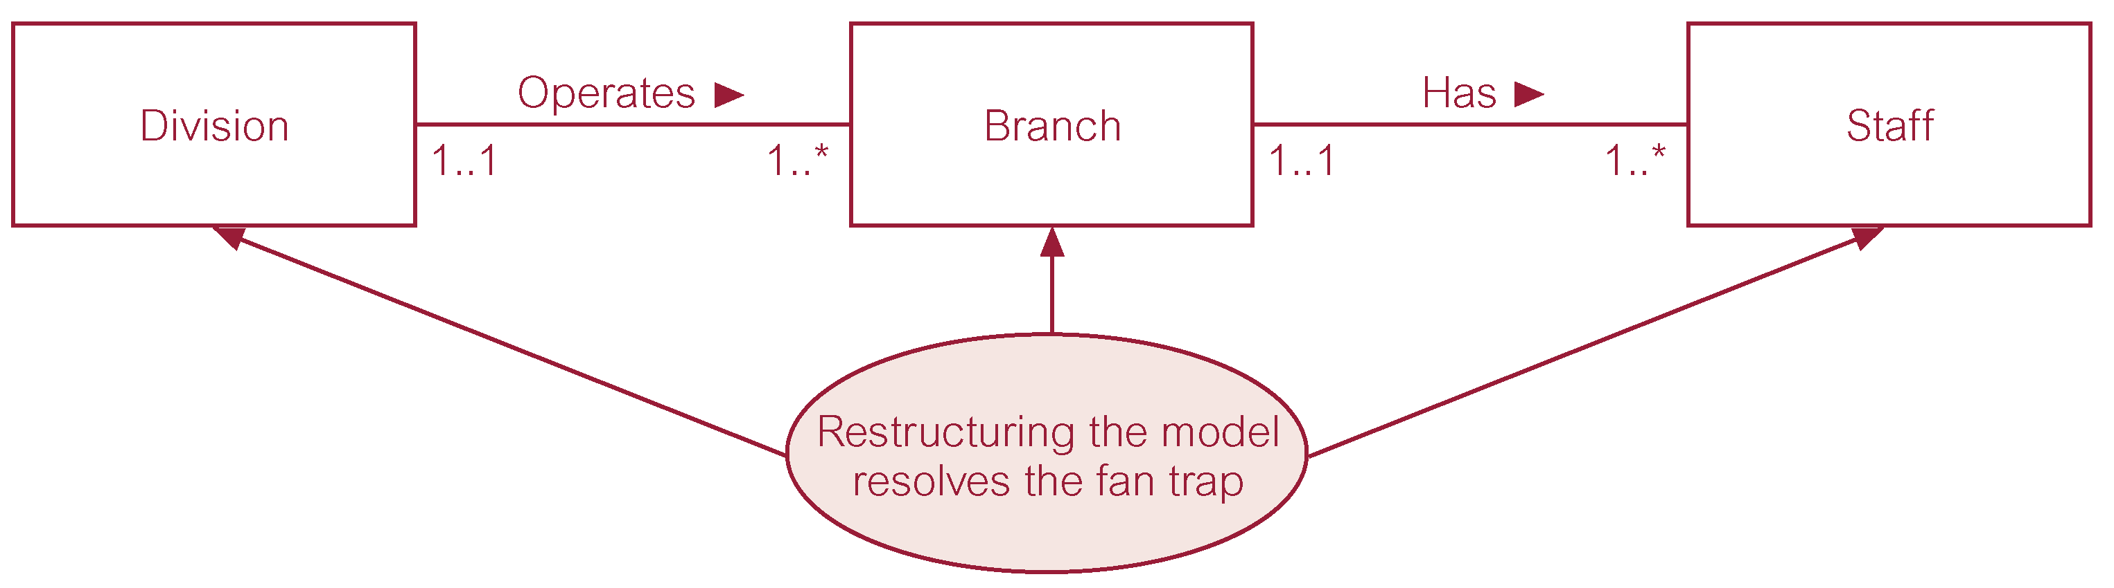
Restructuring ER model to remove Fan Trap

Slide 90
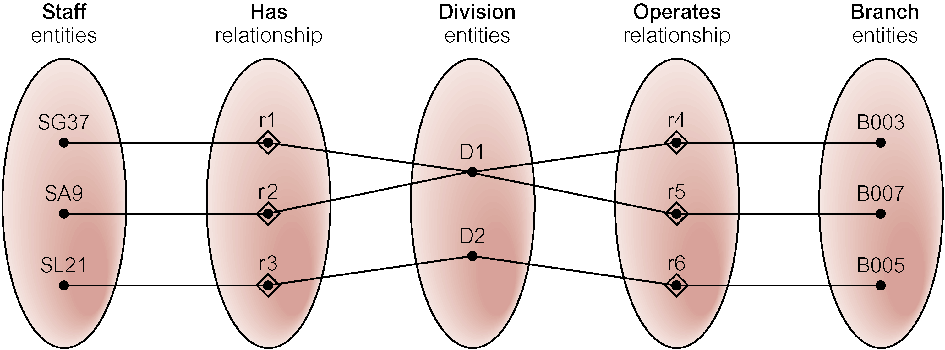
Semantic Net of ER Model with Fan Trap
At which branch office does staff number SG37 work?

Slide 91
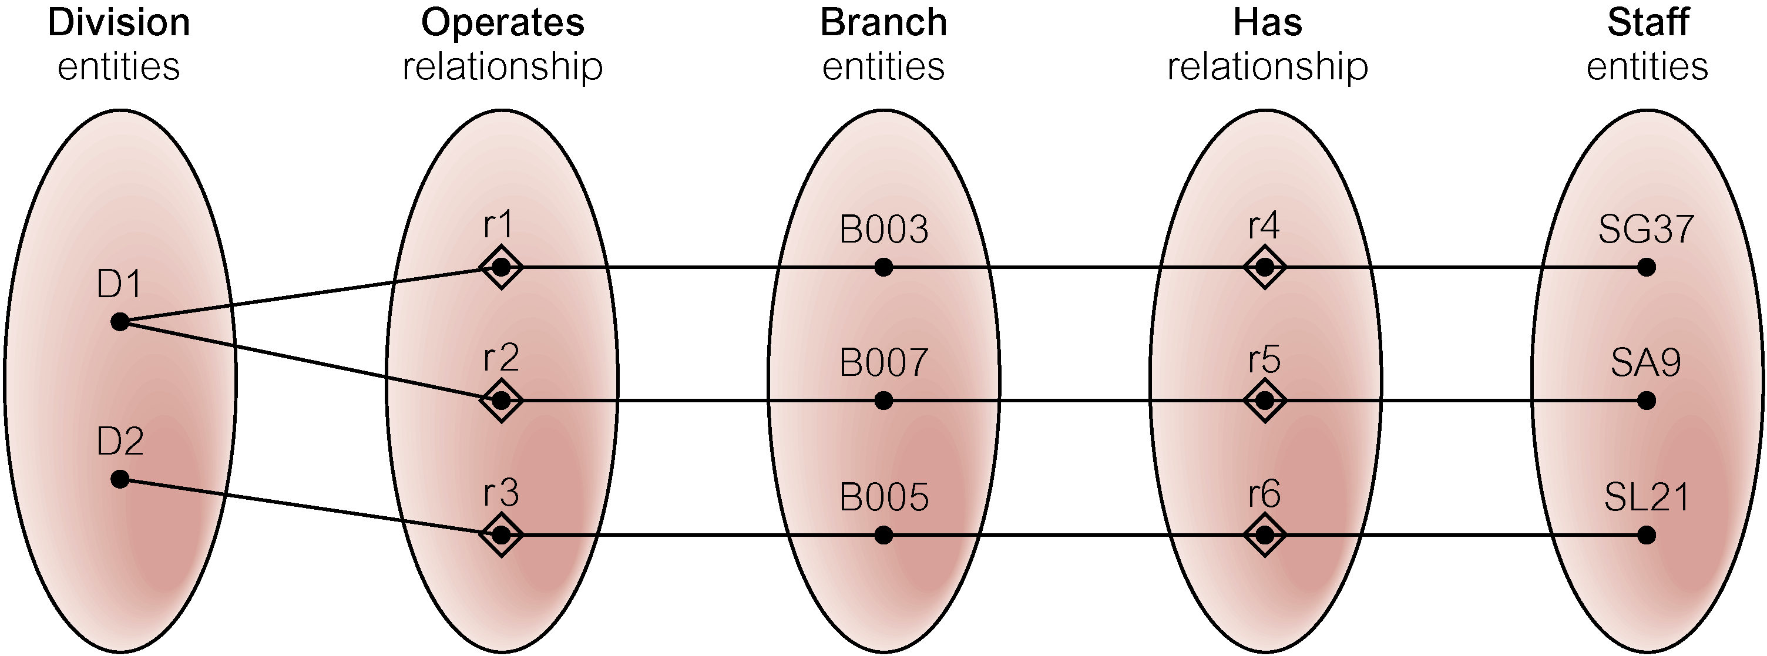
Semantic Net of Restructured ER Model with Fan Trap Removed
SG37 works at branch B003.

Slide 92

An Example of a Chasm Trap

Slide 93
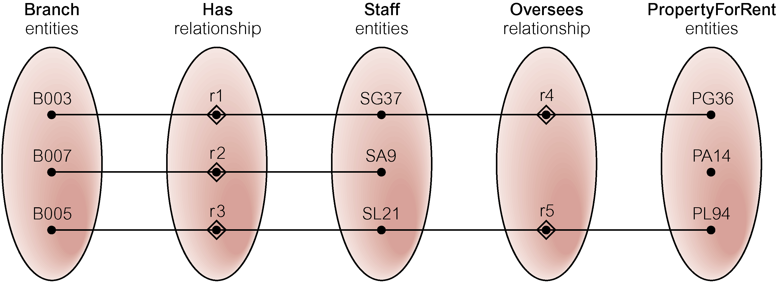
Semantic Net of ER Model with Chasm Trap
At which branch office is property PA14 available?

Slide 94
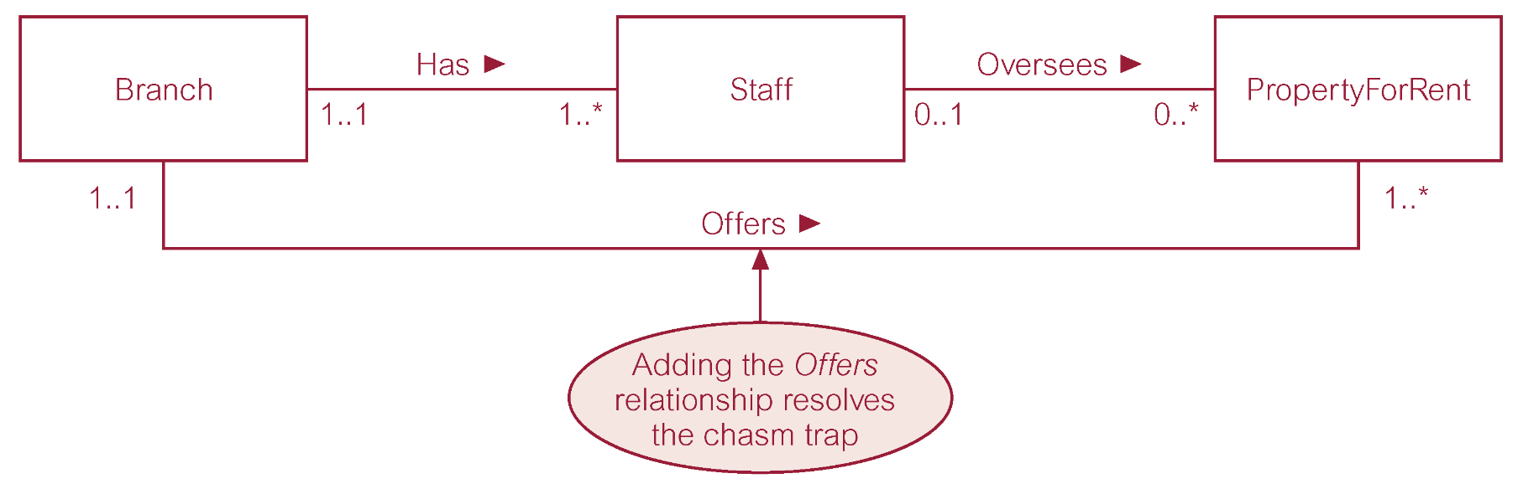
ER Model restructured to remove Chasm Trap

Slide 95
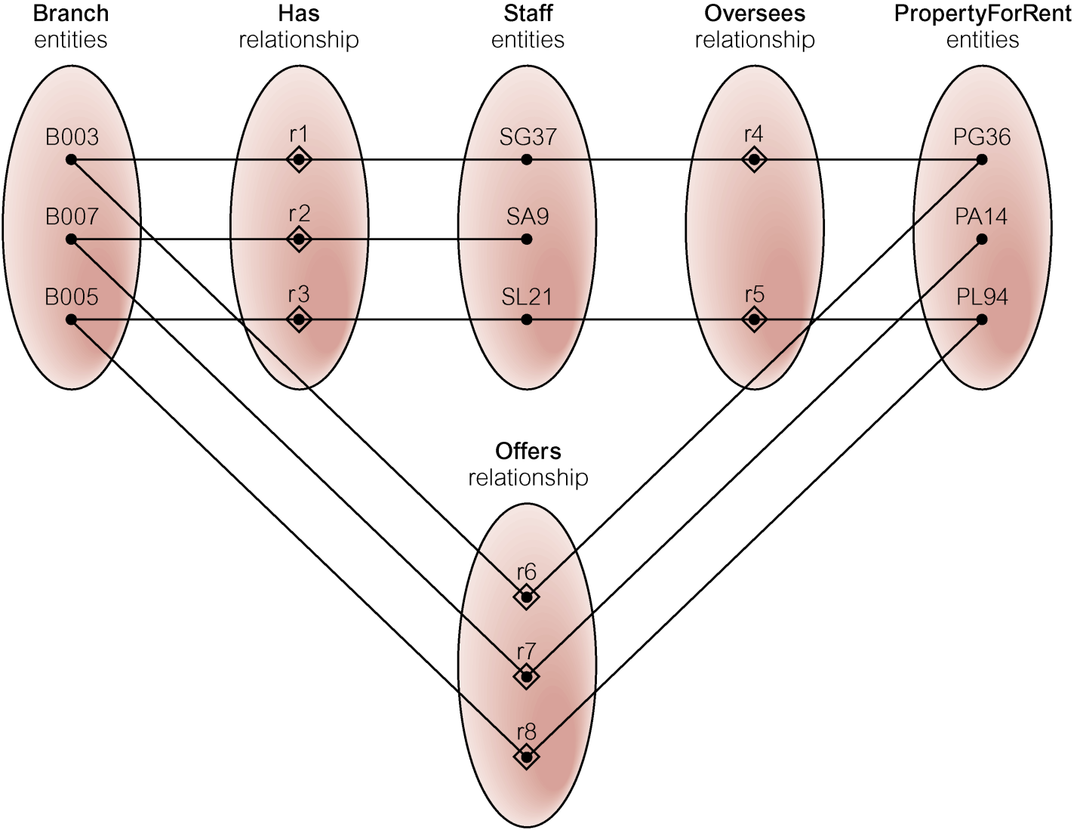
Semantic Net of Restructured ER Model with Chasm Trap Removed

Slide 96
Coming up
Normalisation

