Slide 1
ADVANCED DIPLOMA IN LOGISTICS
Level 6
ELEMENT 1
CILT (UK)

Slide 2
Element 1 – Global Environment
Indicative Content
Global factors
Theories and Models
Characteristics of management information
External Information
Global markets
International agreements and conventions.

Slide 3
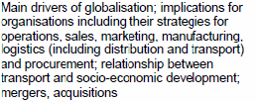
Element 1 – Global Factors

Slide 4
Element 1 – Global Factors
Main Drivers of globalisation
  Increased trade between nations
  Lower transport costs
  Increased liquidity in capital allowing investors in developing nations to invest in developed nations.
  Increased flow of communications.
  Greater ease and speed of movement of goods and people.
  Reduction of cultural barriers
  Reduces the likelihood of conflict between developed nations.
  Increases environmental protection in developed nations.
  http://www.tutor2u.net/business/strategy/globalisation_drivers.html

Slide 5
Element 1 – Global Factors
Implications for organisations
  Strategy for operations, sales, marketing, manufacturing, logistics (distribution & transport) and procurement
    Establishment of production sites overseas
    Joint Ventures
    Franchising
    Offshore-Outsourcing
    Selling directly to overseas markets – with either sales agents or distribution agreements or through ecommerce.
    Licence technology & other intellectual property.
    Potentially higher profits and stronger market position, market access.
    Reduced technological barriers to the movement of goods, services and factors of production.
    Costs – shift production overseas, lower labour costs.
    Establishment of production platforms in low cost countries for the construction of intermediate parts in to completed items at lower costs.
    Transport costs avoidance and avoidance of tariff and non tariff bariiers.
    Extending product life cycles by producing and marketing products in new countries.
Relationships between transport, socio-economic development, mergers and acquisitions.

Slide 6
Element 1 – Global Factors
Relationships between transport, socio-economic development, mergers and acquisitions.
http://www.irfnet.ch/files-upload/pdf-files/irf_ruraltransport2_r4.pdf
Relationships between transport, socio-economic development, mergers and acquisitions.
http://www.irfnet.ch/files-upload/pdf-files/irf_ruraltransport2_r4.pdf

Slide 7
Element 1 – Theories & Models
STEEPLE
Convergence theory
Impact analysis
Hines
Porter
Deming
SWOT

Slide 8
Element 1 – Theories & Models
STEEPLE analysis is often conducted by firms to get a detailed overview on what external factors determine the trends. It also helps to predict what might happen in the future. STEEP is basically an acronym which stands for Social, Technological, Economical, Environmental, and Political. It is also known around the world as PEST, PESTEL, PESTLE, STEPJE, STEP, STEEPLED, and LEPEST.
Social: The social developments include factors like consumer behavior demographics, religion, lifestyles, values, and advertising.
Technological: The technology aspect of STEEP analysis focuses highly on technological advancements. It includes factors like innovation, communication, energy, transport, research and development, patent regulations and life-cycle of products.
Economic: The economic condition is strongly associated with the consumers’ buying position. In this step, factors such as interest rates, international trade, taxes, savings, inflation, subsidies, availability of jobs and entrepreneurship are considered.
Environmental: Environmental developments involve ecosystem factors such as water, wind, food, soil, energy, pollution and environmental regulations.
Political: The Political developments can highly influence individuals and organizations. It is important to be aware of likely upcoming shifts in power. Political developments can affect environmental, antitrust, financial markets, trade, and other kinds of laws. Factors to be considered include political stability, regulation of monopolies, tax policies, price regulations consumer protection, jurisdiction and trade unions.

Slide 9
Element 1 – Theories & Models
Convergence Theory
Definition. Convergence, as used in the theory of economic growth, refers to the tendency of less developed economies to grow more quickly than more mature economies.
The theory is based on the idea that the growth rate will slow as an economy approaches the steady state level of capital per worker. Absolute convergence predicts that poor countries will grow more quickly regardless of their eventual steady state level of output. Conditional convergence predicts this pattern only if the countries have similar steady state levels of output.
Stephen Kinsella. Department of Economics. University of Limerick Ireland
http://www.stephenkinsella.net/2008/11/11/economics-for-business-lecture-16-growth-and-convergence/

Slide 10
Element 1 – Theories & Models
Impact Analysis
Assessment of the pros and cons of pursuing a course of action in light of its possible consequences, or the extent and nature of change it may cause.
http://www.businessdictionary.com/definition/impact-analysis.html
Business impact analysis
(BIA) is an essential component of an organization's business continuance plan; it includes an exploratory component to reveal any vulnerabilities, and a planning component to develop strategies for minimizing risk.
The result of analysis is a business impact analysis report, which describes the potential risks specific to the organization studied.
One of the basic assumptions behind BIA is that every component of the organization is reliant upon the continued functioning of every other component, but that some are more crucial than others and require a greater allocation of funds in the wake of a disaster.
For example, a business may be able to continue more or less normally if the cafeteria has to close, but would come to a complete halt if the information system crashes.
http://searchstorage.techtarget.com/definition/business-impact-analysis

Slide 11
Element 1 – Theories & Models
Professor Tony Hines, PhD
Department: Marketing, Operations and Digital Business Centre: MMU Business School
Publications( among others)
Hines, T. (2013). Supply chain strategies: Demand driven and customer focused. Oxford: Routledge.
[Hines,T. (2004), *Supply Chain Strategies: Customer Driven and Customer Focused,* Oxford: Elsevier ISBN 0750655518
Supply Chain Strategies The book makes very good use of management and supply-chain research from the last 30 years, as well as being very in tune with current issues. This book is a useful aid to graduates and postgraduates of the supply-chain and operations management disciplines. In conclusion, while having large sections of classical management theory, this book is modern and covers customer-driven supply-chain issues with great clarity and in a balanced way demonstrated through case studies with links to modern research." (Chartered Institute of Purchasing and Supply)
The USA Institute of Supply Management Review, The Supply Chain Strategies book was by far the most comprehensive and complete book on current strategies. - Written in a style to suit the novice and satisfy the expert Supply Chain Strategies lives up to its title and I would strongly recommend you add it to your reading list... Hines succeeds in compiling an excellent and comprehensive study of supply chain management"
http://www.business.mmu.ac.uk/staff/staffdetails.php?uref=106

Slide 12
Element 1 – Theories & Models
Igor Ansoff (1918-2002) was the originator of the strategic management concept, and was responsible for establishing strategic planning as a management activity in its own right.
His landmark book, Corporate strategy (1965), was the first text to concentrate entirely on strategy, and although the ideas outlined are complex, it remains one of the classics of management literature

Slide 13
Element 1 – Theories & Models
Key theories - Until the publication of Corporate strategy, companies had little guidance on how to plan for, or make decisions about, the future.
Traditional methods of planning were based on an extended budgeting system which used the annual budget, projecting it a few years into the future.
By its nature, this system paid little or no attention to strategic issues.
With the advent of greater competition, higher interest in acquisitions, mergers and diversification, and greater turbulence in the business environment, however, strategic issues could no longer be ignored.
Ansoff felt that in developing strategy, it was essential to systematically anticipate future environmental challenges to an organisation, and draw up appropriate strategic plans for responding to these challenges

Slide 14
Element 1 – Theories & Models
Components of strategy
Ansoff argued that within a company's activities there should be an element of core capability, an idea later adopted and expanded by Hamel and Prahalad.
To establish a link between past and future corporate activities, the first time such an approach was undertaken, Ansoff identified four key strategy components:
  1.Product-market scope: a clear idea of what business or products a company was responsible for (pre-dating the exhortations of Peters and Waterman to stick to the knitting)
  2.Growth vector: as explained in the section below on the Ansoff matrix, this offers a way of exploring how growth may be attempted
  3.Competitive advantage: those advantages an organisation possesses that will enable it to compete effectively, a concept later championed by Michael Porter
  4.Synergy: Ansoff explained synergy as 2+2=5, or how the whole is greater than the mere sum of the parts, and it requires an examination of how opportunities fit the core capabilities of the organisation.
http://www.mbsportal.bl.uk/taster/subjareas/busmanhist/mgmtthinkers/ansoff.aspx

Slide 15
Element 1 – Theories & Models
Economist Michael Porter, a Harvard University professor and advisor for both the public and private sectors, first defined National Competitive Advantage (NCA). The Competitive Advantage of Nations. Porter M (1990).
Also known as the Porter Competitive Advantage, NCA is basically an evaluation of how competitively a nation participates in international markets.
Porter offers a diamond-shaped diagram to outline the framework of four key factors that can modify four ingredients to become more competitive.
The four ingredients are the availability of resources, the information used in deciding which opportunities to pursue for the company, the goals of individuals in companies, and the innovation and investment pressure on companies.

Slide 16
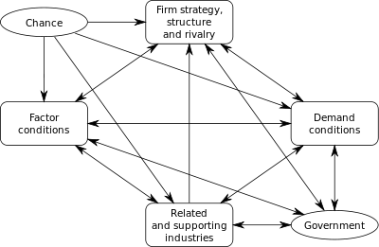
Element 1 – Theories & Models

Slide 17
Element 1 – Theories & Models
Porter's Diamond of National Advantage –
Factor Conditions are general sets of factors that make a nation competitive.
These factors can be anything from human resources and material resources to infrastructure and the quality of research at universities.
Although a nation may have an abundance of factor conditions (i.e. low-cost labour and lush vegetation), the usage of these factors is more important than their mere existence.
Likewise, when a nation lacks a factor, they use innovation to make up for it, which usually leads to an increase in NCA.
For example, Japan is a small nation that lacks enough land fit for agriculture; in order to make up for this and become more competitive in the international markets, however, Japan has exploited its wealth of human resources to become a global leader in technology.
http://internationalrelationsonline.com/national-competitive-advantage-theory.

Slide 18
Element 1 – Theories & Models
W Edwards Deming The System of Profound Knowledge (SoPK) is the culmination of Dr. W. Edwards Deming’s lifelong work.
It is an effective theory of management that provides a framework of thought and action for any leader wishing to transform and create a thriving organization, with the aim for everybody to win.
By management appropriately applying the principles and practices of SoPK, a business can simultaneously reduce costs through reducing waste, rework, staff attrition and litigation, while increasing quality, customer loyalty, worker satisfaction and, ultimately, profitability .

Slide 19
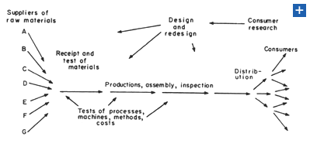
Element 1 – Theories & Models
https://www.deming.org/theman/theories/profoundknowledge

Slide 20
Element 1 – Theories & Models
W. Edwards Deming offered 14 key principles for management to follow for significantly improving the effectiveness of a business or organization.
Many of the principles are philosophical. Others are more programmatic.
All are transformative in nature

Slide 21
Element 1 – Theories & Models
1. Create constancy of purpose toward improvement of product and service, with the aim to become competitive and to stay in business, and to provide jobs.
2. Adopt the new philosophy. We are in a new economic age. Western management must awaken to the challenge, must learn their responsibilities, and take on leadership for change.
3. Cease dependence on inspection to achieve quality. Eliminate the need for inspection on a mass basis by building quality into the product in the first place.
4. End the practice of awarding business on the basis of price tag. Instead, minimize total cost. Move toward a single supplier for any one item, on a long-term relationship of loyalty and trust.
5. Improve constantly and forever the system of production and service, to improve quality and productivity, and thus constantly decrease costs.
6. Institute training on the job.
7. Institute leadership (see Point 12 and Ch. 8). The aim of supervision should be to help people and machines and gadgets to do a better job. Supervision of management is in need of overhaul, as well as supervision of production workers.
8. Drive out fear, so that everyone may work effectively for the company.
9. Break down barriers between departments. People in research, design, sales, and production must work as a team, to foresee problems of production and in use that may be encountered with the product or service.

Slide 22
Element 1 – Theories & Models
10. Eliminate slogans, exhortations, and targets for the work force asking for zero defects and new levels of productivity. Such exhortations only create adversarial relationships, as the bulk of the causes of low quality and low productivity belong to the system and thus lie beyond the power of the work force.
•Eliminate work standards (quotas) on the factory floor. Substitute leadership.
•Eliminate management by objective. Eliminate management by numbers, numerical goals. Substitute leadership.
11. Remove barriers that rob the hourly worker of his right to pride of workmanship. The responsibility of supervisors must be changed from sheer numbers to quality.
12. Remove barriers that rob people in management and in engineering of their right to pride of workmanship. This means, inter alia, abolishment of the annual or merit rating and of management by objective.
13. Institute a vigorous program of education and self-improvement.
14. Put everybody in the company to work to accomplish the transformation. The transformation is everybody's job.
https://www.deming.org/theman/theories/fourteenpoints

Slide 23
Element 1 – Theories & Models
Strengths, Weaknesses, Opportunities and Threats
Albert Humphrey was an American business and management consultant.
During his work at the Stanford Research Institute (1960 – 1970), he produced a team method for planning which was named SOFT analysis, this has developed into what we now know as a SWOT analysis.
The theory seems simple enough, you use it to evaluate the Strengths, Weaknesses, Opportunities and Threats that is involved in a marketing or business project.
You will specify the objective for the project and then identify the internal and external factors that will have a positive as well as negative impact on the objective.
It is worth noting that you should set the final objective after completing the SWOT analysis.
The reason for this is to ensure that the objectives are achievable and not unrealistic given the current internal and external environments.

Slide 24
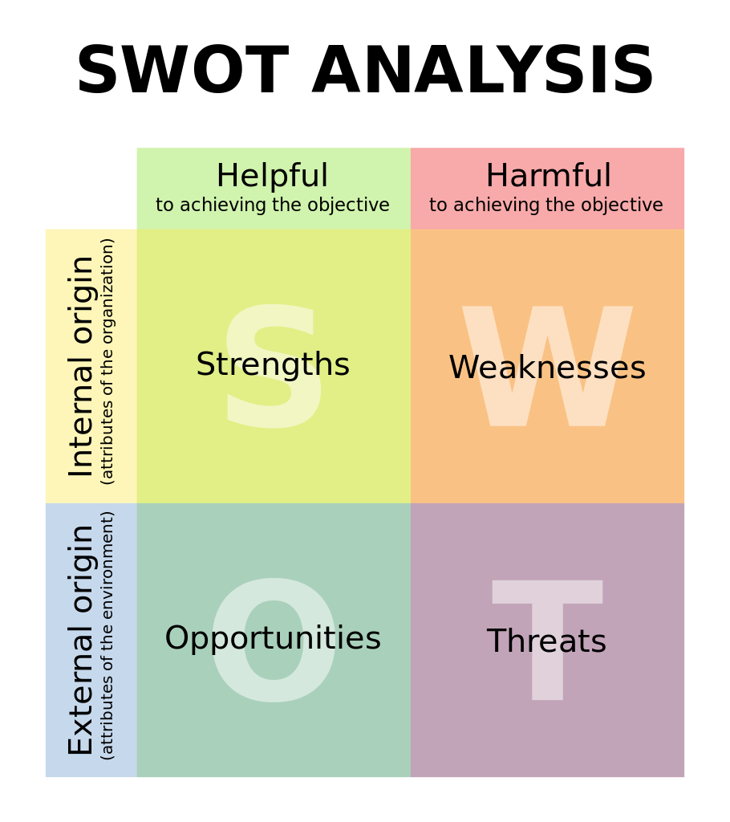
Element 1 – Theories & Models

Slide 25
Element 1 – Theories & Models
Strengths (Internal factor / Positive influence)
What are we best at?
What intellectual property do we own that can help us with this objective?
What specific skills does the current workforce have that can contribute to this objective?
What financial resources do we have for reaching this objective?
What connections and alliances do we have?
What is our bargaining power with both suppliers and intermediaries?
Opportunities (External factor / Positive influence)
What changes in the external environment can we exploit?
What weaknesses in our competitors can we use to our advantage?
What new technology might become available to us?
What new markets might be opening to us?

Slide 26
Element 1 – Theories & Models
Weaknesses (Internal factor / Negative influence)
What are we worst at doing?
Is our intellectual property outdated?
What training does our workforce lack?
What is our financial position?
What connections and alliances should we have, but don’t?
Threats (External factors / Negative influence)
What might our competitors be able to do to hurt us?
What new legislation might damage our interests?
What social changes might threaten us?
How will the economic cycle affect us?
You can also turn a threat into an opportunity or something that is a weakness today might be turned into a strength with some effort.
http://www.professionalacademy.com/news/marketing-theories-swot-analysis

Slide 27

Element 1 – Characteristics of Management Information
For information to be useful to the decision maker, it must have certain characteristics and meet certain criteria.

Slide 28
Element 1 – Characteristics of Management Information
Understandable: Since information is already in a summarized form, it must be understood by the receiver so that he will interpret it correctly. He must be able to decode any abbreviations, shorthand notations or any other acronyms contained in the information.
Relevant: Information is good only if it is relevant. This means that it should be pertinent and meaningful to the decision maker and should be in his area of responsibility.
Complete: It should contain all the facts that are necessary for the decision maker to satisfactorily solve the problem at hand using such information. Nothing important should be left out. Although information cannot always be complete, every reasonable effort should be made to obtain it.
Available: Information may be useless if it is not readily accessible ‘ in the desired form, when it is needed. Advances in technology have made information more accessible today than ever before.
Reliable: The information should be counted on to be trustworthy. It should be accurate, consistent with facts and verifiable. Inadequate or incorrect information generally leads to decisions of poor quality. For example, sales figures that have not been adjusted for returns and refunds are not reliable.

Slide 29
Element 1 – Characteristics of Management Information
Concise: Too much information is a big burden on management and cannot be processed in time and accurately due to “bounded rationality”. Bounded rationality determines the limits of the thinking process which cannot sort out and process large amounts of information. Accordingly, information should be to the point and just enough – no more, no less.
Timely: Information must be delivered at the right time and the right place to the right person. Premature information can become obsolete or be forgotten by the time it is actually needed. Similarly, some crucial decisions can be delayed because proper and necessary information is not available in time, resulting in missed opportunities. Accordingly the time gap between collection of data and the presentation of the proper information to the decision maker must be reduced as much as possible.
Cost-effective: The information is not desirable if the solution is more costly than the problem. The cost of gathering data and processing it into information must be weighed against the benefits derived from using such information.
http://www.yourarticlelibrary.com/management/8-characteristics-of-good-management-information-systems-explained/3483/

Slide 30
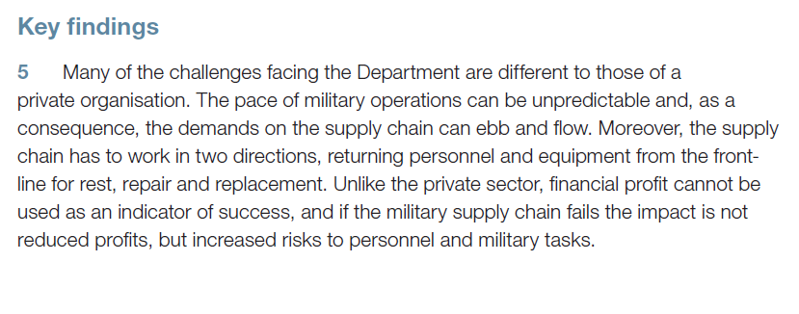
Element 1 – Characteristics of Management Information

Slide 31
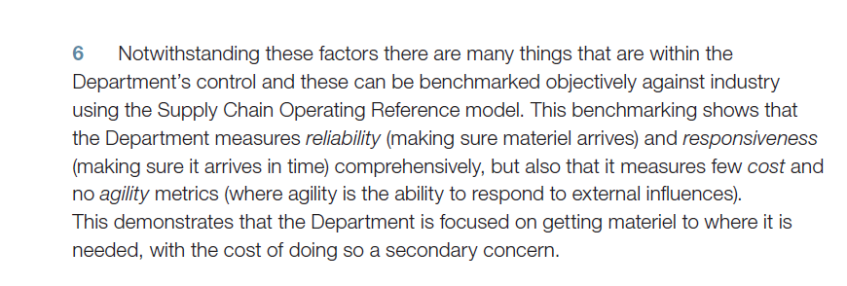
Element 1 – Characteristics of Management Information

Slide 32
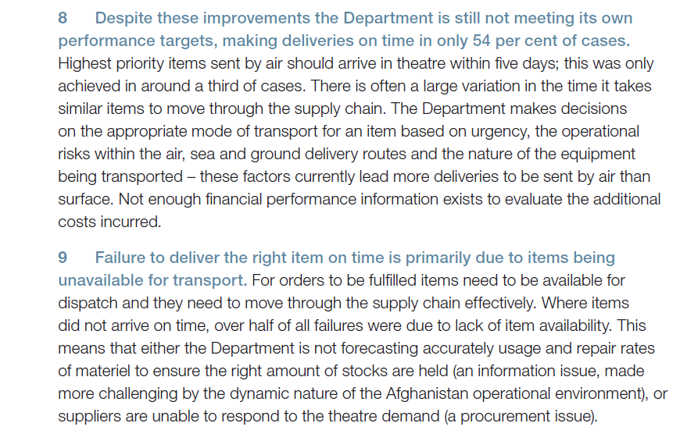
Element 1 – Characteristics of Management Information
Source: NAO Report 2011. Use of Information to manage the Logistics Supply Chain

Slide 33
Element 1 – External Information
Main requirements of environmental scanning process
Roles in organisational learning
Types of information

Slide 34
Element 1 – External Information
Environmental scanning is the acquisition and use of information about events, trends, and relationships in an organisation's external environment, the knowledge of which would assist management in planning the organization's future course of action.
Depending on the organisation's beliefs about environmental analysability and the extent that it intrudes into the environment to understand it, four modes of scanning may be differentiated: undirected viewing, conditioned viewing, enacting, and searching. We analyze each mode of scanning by examining its characteristic information needs, information seeking, and information use behaviours.
In addition, we analyse organisational learning processes by considering the sense making, knowledge creating and decision making processes at work in each mode.
Aguilar, 1967, Choo & Auster, 1993

Slide 35
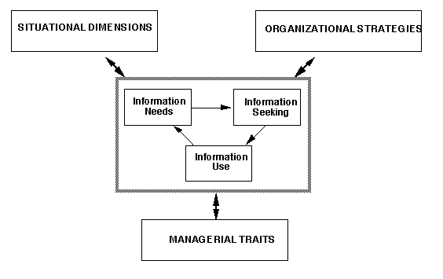
Element 1 – External Information
Conceptual Framework for Environmental Scanning (Choo 2001: 86

Slide 36
Element 1 – External Information
Situational dimensions are often examined by measuring the perceived uncertainty of the external environment, typically in terms of the complexity and rate of change of the environment
Organizational strategies refer to the pattern of organizational actions vis-a-vis the outside environment, and two examples of well-known strategy typologies are those developed by Miles & Snow (1978) (defender, prospector, analyzer), and Porter (1985) (overall cost leadership, differentiation, focus).
Managerial traits that have been studied include the managers' functional specialty, hierarchical level, and cognitive style.
Scanning as a form of information behaviour is composed of information needs, information seeking, and information use.
In the context of environmental scanning, information needs often refer to the focus and scope of scanning, particularly the environmental sectors where scanning is more intense. Information seeking has been examined in terms of the sources that are used to scan the environment as well as the organizational methods and systems deployed to monitor the environment.
Finally, information use is usually looked at in relation to decision making, strategic planning, or equivocally reduction.

Slide 37
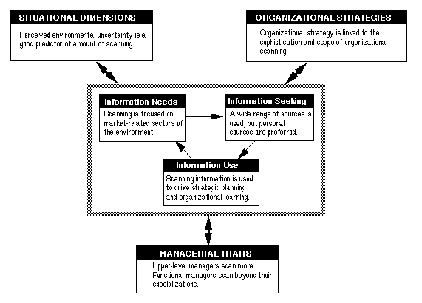
Element 1 – External Information
Summary of Principal Findings from Research on Environmental Scanning (Choo, 2001)

Slide 38
Element 1 – External Information
Environmental scanning as information seeking and organizational learning.
In the ensuing sections, we will analyse each mode of scanning by examining its characteristic information needs, information seeking, and information use behaviours. In addition, we analyse organizational learning processes by considering the sense making, knowledge creating and decision making processes at work in each mode.
An organisation processes information to make sense of its environment, to create new knowledge, and to make decisions (Choo, 1998).
Sense making is induced by changes in the environment that create discontinuity in the flow of experience engaging the people and activities of an organisation. People enact or actively construct the environment that they attend to by bracketing experience, and by creating new features in the environment (Weick, 1995).

Slide 39
Element 1 – External Information
Organisational sense making can be driven by beliefs or by actions (Weick, 1995).
In belief-driven processes, people start from an initial set of beliefs that are sufficiently clear and plausible, and use them as nodes to connect more and more information into larger structures of meaning.
People may use beliefs as expectations to guide the choice of plausible interpretations, or they may argue about beliefs and their relevance when these beliefs conflict with current information. In action-driven processes, people start from their actions and grow their structures of meaning around them, modifying the structures in order to give significance to those actions.
People may create meaning to justify actions that they are already committed to, or they may create meaning to explain actions that have been taken to manipulate the environment.

Slide 40
Element 1 – External Information
Tacit knowledge is the personal knowledge that is learned through extended periods of experiencing and doing a task, during which the individual develops a feel for and a capacity to make intuitive judgements about the successful execution of the activity.
Explicit knowledge is knowledge that is expressed formally using a system of symbols, and may be object-based or rule-based. Knowledge is object-based when it is represented using strings of symbols (documents, software code), or is embodied in physical entities (equipment, substances).
Explicit knowledge is rule-based when the knowledge is codified into rules, routines, or operating procedures.

Slide 41
Element 1 – External Information
Cultural knowledge consists of the beliefs an organization holds to be true based on experience, observation, reflection about itself and its environment.
Over time, an organisation develops shared beliefs about the nature of its main business, core capabilities, markets, competitors, and so on.
These beliefs then form the criteria for judging and selecting alternatives and new ideas, and for evaluating projects and proposals.
In this way an organisation uses its cultural knowledge to answer questions such as 'What kind of an organisation are we?' 'What knowledge would be valuable to the organization?' and 'What knowledge would be worth pursuing?'
Organisations continuously create new knowledge by converting between the personal, tacit knowledge of individuals who develop creative insight, and the shared, explicit knowledge by which the organization develops new products and innovations (Nonaka & Takeuchi, 1995)
http://www.informationr.net/ir/7-1/paper112.html

Slide 42
Element 1 – External Information
Types of Information. ICT - Sources of information
  Author: Jim Riley
Data and information come from many sources - both internal (inside the business) and external. This revision note summarises the main sources

Slide 43
Element 1 – External Information
External Information
As the term implies, this is information that is obtained from outside the business.
There are several categories of external information:
Information relating to way a business should undertake its activities
E.g. businesses need to keep records so that they can collect taxes on behalf of the government.
So a business needs to obtain regular information about the taxation system (e.g. PAYE, VAT, Corporation Tax) and what actions it needs to take. Increasingly this kind of information (and the return forms a business needs to send) is provided in digital format.
Similarly, a business needs to be aware of key legal areas (e.g. environmental legislation; health & safety regulation; employment law). There is a whole publishing industry devoted to selling this kind of information to businesses.

Slide 44
Element 1 – External Information
Information about the markets in which a business operates
This kind of external information is critically important to a business. It is often referred to as "market" or "competitive intelligence".
Most of the external information that a business needs can be obtained from marketing research.
Marketing research can help a business do one or more of the following:
  Gain a more detailed understanding of consumers’ needs – marketing research can help firms to discover consumers’ opinions on a huge range of issues, e.g., views on products’ prices, packaging, recent advertising campaigns
  Reduce the risk of product/business failure – there is no guarantee that any new idea will be a commercial success, but accurate and up-to-date information on the market can help a business make informed decisions, hopefully leading to products that consumers want in sufficient numbers to achieve commercial success.
  Forecast future trends – marketing research can not only provide information regarding the current state of the market but it can also be used to anticipate customer needs future customer needs. Firms can then make the necessary adjustments to their product portfolios and levels of output in order to remain successful.
The information for marketing research tends to come from three main sources:

Slide 45
Element 1 – External Information
Internal Company Information – e.g. sales, orders, customer profiles, stocks, customer service reports
Marketing intelligence – this is a catch-all term to include all the everyday information about developments in the market that helps a business prepare and adjust its marketing plans. It can be obtained from many sources, including suppliers, customers and distributors.
It is also possible to buy intelligence information from outside suppliers (e.g. Mintel, Dun and Bradstreet) who will produce commercial intelligence reports that can be sold profitably to any interested organisation.
Market Research – existing data from internal sources may not provide sufficient detail. Similarly, published reports from market intelligence organisations cannot always be relied upon to provide the up-to-date, relevant information required.
In these circumstances, a business may need to commission specific studies in order to acquire the data required to support their marketing strategy.
http://www.tutorialspoint.com/management_information_system/management_information_system.htm

Slide 46
Element 1 – Global Markets
Range of stakeholders – actual/potential
Global sourcing
Global marketing
Products, services and commodities
Legal, political & culture issues
Financial indicators
Regulatory mechanisms
Time, quality, safety, practicality

Slide 47
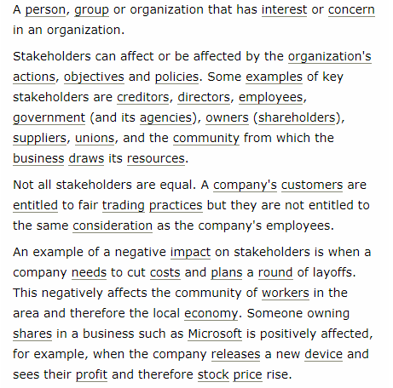
Element 1 – Global Markets

Slide 48
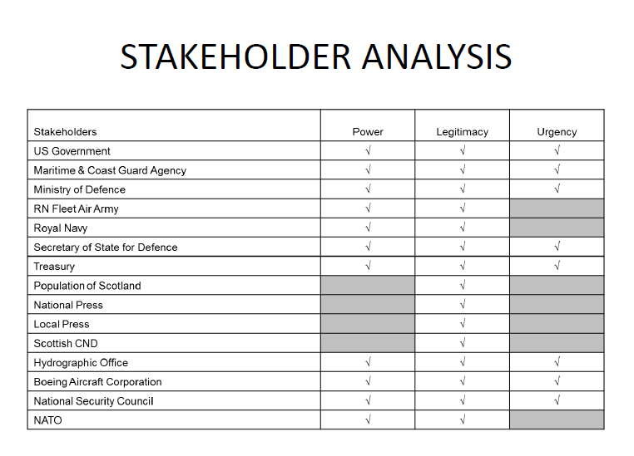
Element 1 – Global Markets
Example: Source MASTIC presentation Cranfield 2013 [DAM] Author |G A EDWARDS

Slide 49
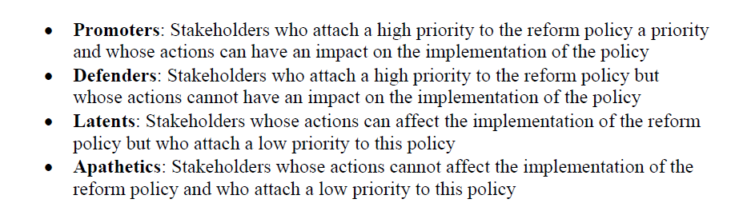
Element 1 – Global Markets

Slide 50
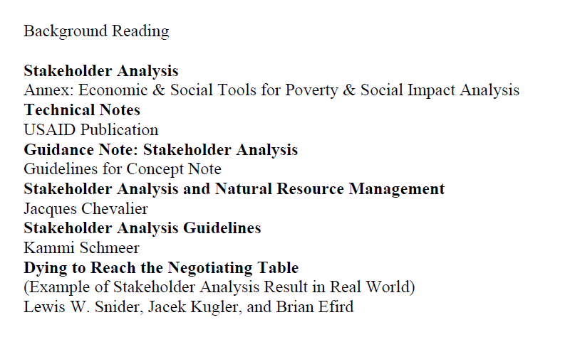
Element 1 – Global Markets

Slide 51
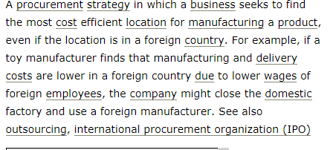
Element 1 – Global Markets
Global Sourcing:
  Definition
http://www.businessdictionary.com/definition/global-sourcing.html

Slide 52
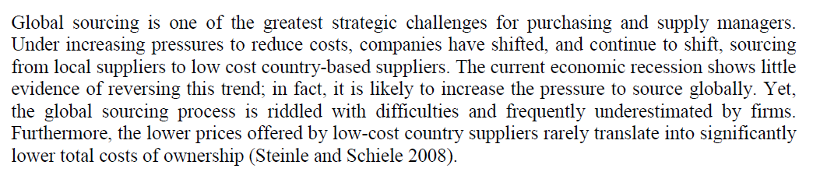
Element 1 – Global Markets

Slide 53
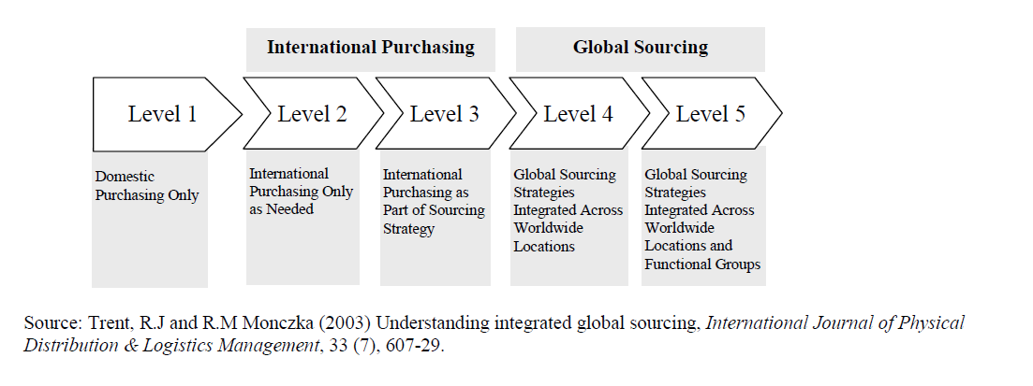
Element 1 – Global Markets

Slide 54
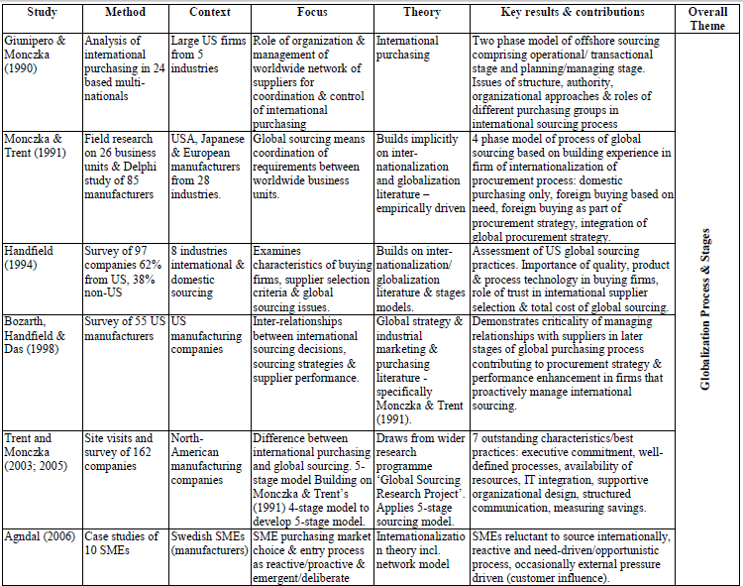
Element 1 – Global Markets

Slide 55
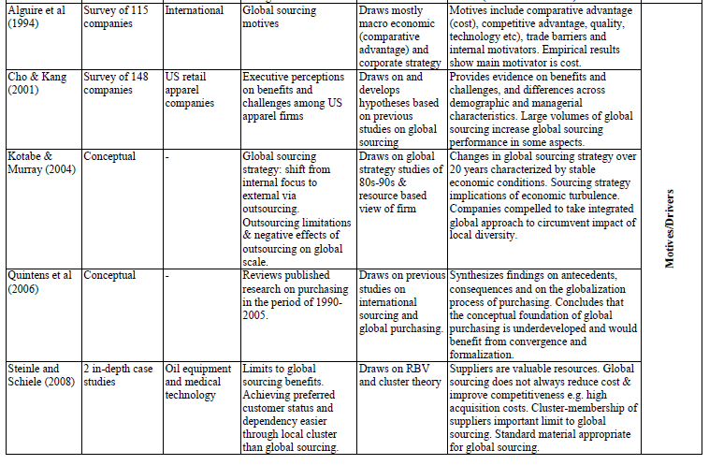
Element 1 – Global Markets

Slide 56
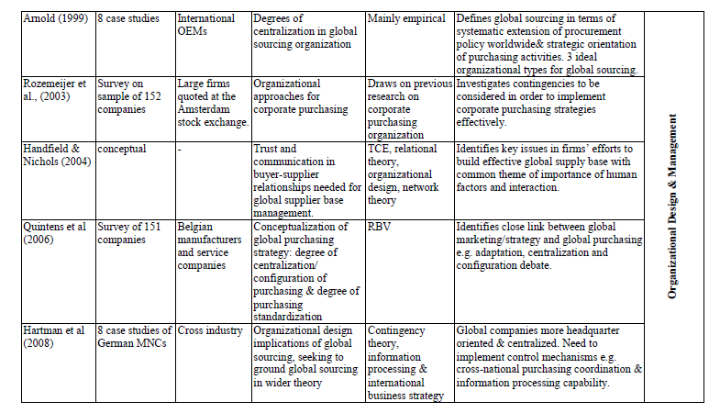
Element 1 – Global Markets

Slide 57
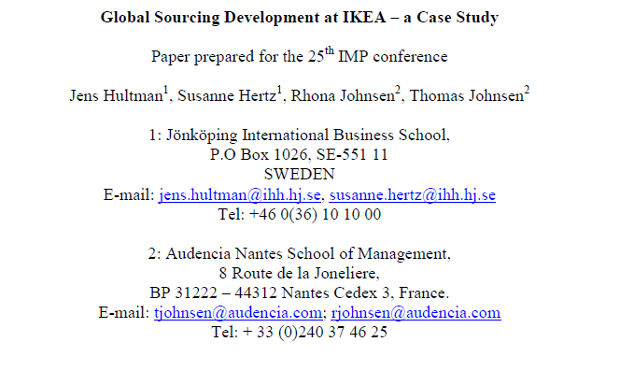
Element 1 – Global Markets

Slide 58
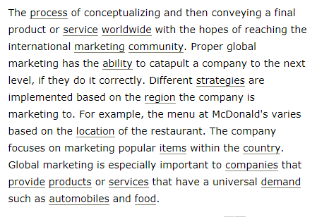
Element 1 – Global Markets
Global Marketing
  Definition
http://www.businessdictionary.com/definition/global-marketing.html

Slide 59
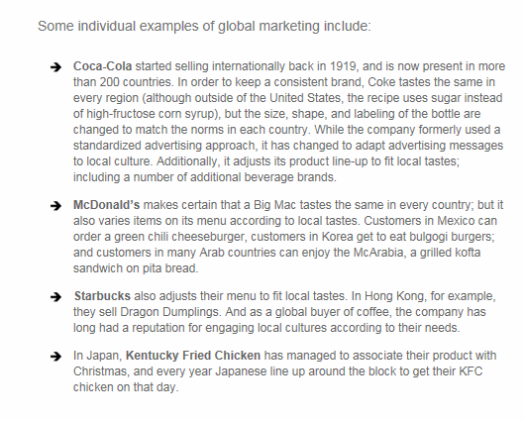
Element 1 – Global Markets
http://www.marketing-schools.org/types-of-marketing/global-marketing.html

Slide 60
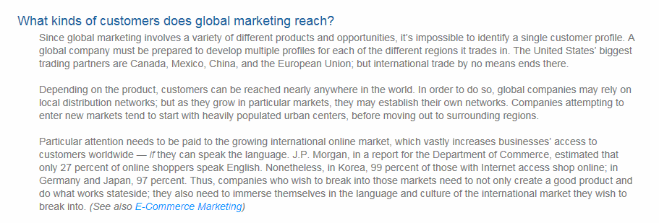
Element 1 – Global Markets
http://www.marketing-schools.org/types-of-marketing/global-marketing.html

Slide 61
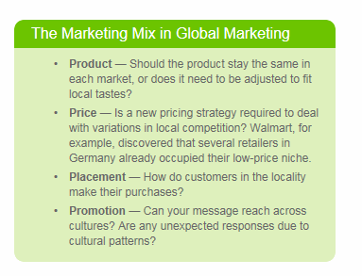
Element 1 – Global Markets

Slide 62
Element 1 – Global Markets
Products, services and commodities
  For these to succeed overseas within the Global Market, they need to appeal to their wider international audience.
  If the appeal is not there then they will fail or cost significant amounts to rebrand for a place in the market.
Examples:

Slide 63
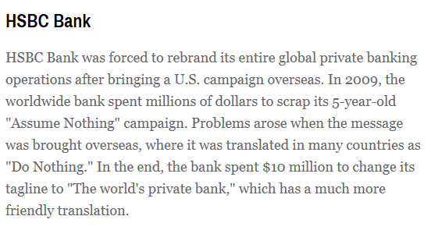
Element 1 – Global Markets
http://www.businessnewsdaily.com/5241-international-marketing-fails.html

Slide 64
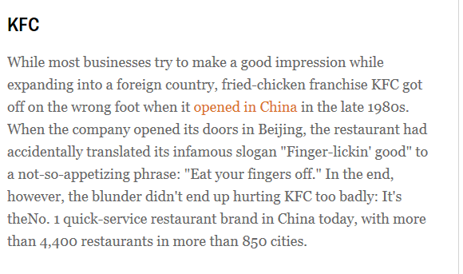
Element 1 – Global Markets

Slide 65
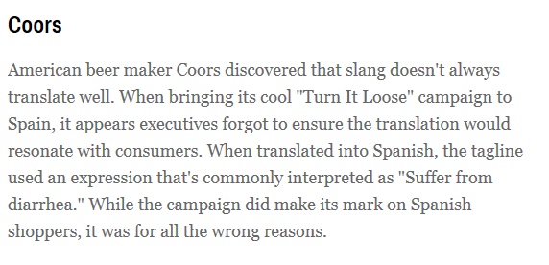
Element 1 – Global Markets

Slide 66
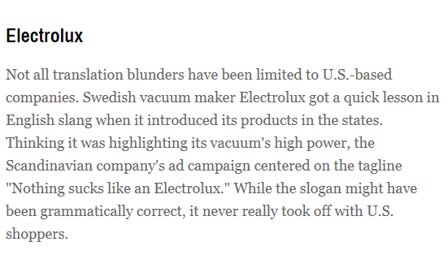
Element 1 – Global Markets

Slide 67
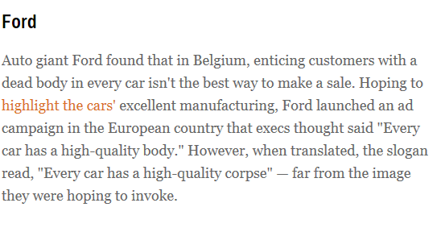
Element 1 – Global Markets
http://www.businessnewsdaily.com/5241-international-marketing-fails.html

Slide 68
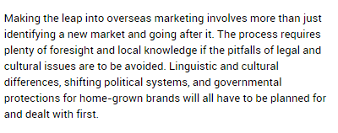
Element 1 – Global Markets
Legal, political & culture issues
http://smallbusiness.chron.com/legal-cultural-issues-marketing-foreign-country-58165.html

Slide 69
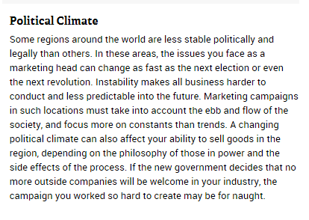
Element 1 – Global Markets
http://smallbusiness.chron.com/legal-cultural-issues-marketing-foreign-country-58165.html

Slide 70
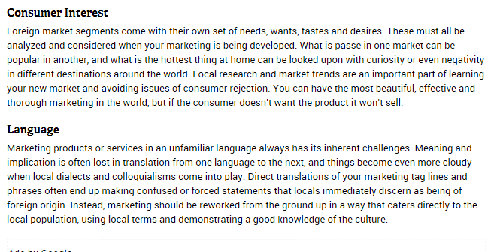
Element 1 – Global Markets
http://smallbusiness.chron.com/legal-cultural-issues-marketing-foreign-country-58165.html

Slide 71
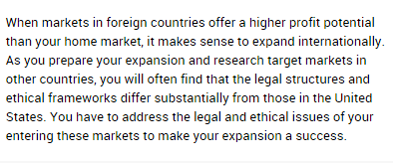
Element 1 – Global Markets

Slide 72
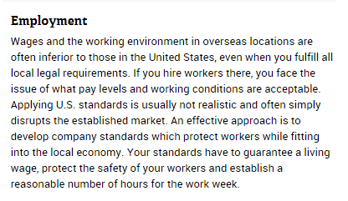
Element 1 – Global Markets

Slide 73

Element 1 – Global Markets

