Slide 1
Module and Code: Managing People LCBB5004
Individual Presentation

Slide 2
Table of Contents
Introduction
The Importance of Technology in Training and Development
The Benefits of Technology-based Training Programmes for Employees
The Benefits of Technology-based Training Programmes for Employers
Conclusion
References

Slide 3

Introduction
Technology use in training and development is no longer an option but a requirement for any firm willing to remain competitive in modern markets and match the evolving expectations.
The aim of the study is to shed some light on how technological progress is changing the face of corporate learning and development, therefore posing new possibilities and threats for the business that takes seriously the cultivation of a talented and flexible workforce.
Notes:
Technology use in training and development is no longer an option but a requirement for any firm willing to remain competitive in modern markets and match the evolving expectations. This presentation looks into the role of technology in learning and development. The first section of the paper discusses the role of technology in learning and development by highlighting some of the ways through which it has revolutionised traditional modes of training and introduced innovate channels of information dissemination. The paper then explores the benefits of technology-based employee training programs for both employees and employers respectively. Each discussion is supported by examples in the real world from renowned organisations.
The aim of the study is to shed some light on how technological progress is changing the face of corporate learning and development, therefore posing new possibilities and threats for the business that takes seriously the cultivation of a talented and flexible workforce.

Slide 4
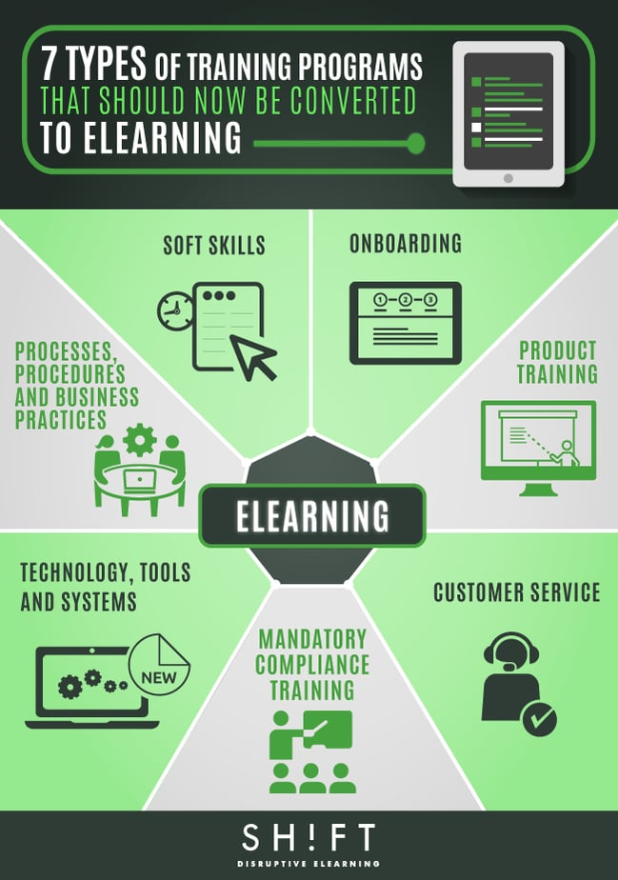
The Importance of Technology in Training and Development
Employees now have 24/7 access to training materials due to e-learning platforms, mobile learning apps, and virtual classrooms.
57% of learning and development professionals anticipate increasing their expenditure on online learning in the near future (Rachmad, 2019).
VR simulations have several applications in healthcare, such as providing a risk-free environment for specialists to practise complex procedures (Markova, et al., 2019).
Notes:
Given the quickly changing nature of the workplace now, the use of technology in training and development deserves special attention. First and foremost, technological advancements have greatly increased the availability and adaptability of educational opportunities. Employees now have 24/7 access to training materials due to e-learning platforms, mobile learning apps, and virtual classrooms. When it comes to remote work and worldwide teams, this flexibility is invaluable. Reports show that 57% of learning and development professionals anticipate increasing their expenditure on online learning in the near future (Rachmad, 2019). Because of the rise of online education, students are able to study at their own speed, according to their own preferences and learning styles, and their academic schedules are more flexible.
Virtual and augmented reality (VR/AR) technologies are revolutionising the training and practice of complicated skills. As an example, VR simulations have several applications in healthcare, such as providing a risk-free environment for specialists to practise complex procedures (Markova, et al., 2019). Also, augmented reality can help with equipment maintenance in the manufacturing sector by providing real-time instructions. These immersive technologies enhance confidence, practical skill application, and information retention.

Slide 5
The Importance of Technology in Training and Development (contd.,)
With the help of these sophisticated instruments, people can now evaluate each user's progress, find out where they are lacking knowledge, and personalise our courses accordingly.
Training programs can be evaluated for efficacy and insights can be gleaned for ongoing enhancement with the help of advanced analytics tools.
Companies may better meet the requirements of their employees and achieve their business goals by using data to optimise their training content, delivery methods, and L&D initiatives as a whole.
Notes:
In addition, AI and adaptive learning systems make it possible for students to have individualised educational experiences. With the help of these sophisticated instruments, people can now evaluate each user's progress, find out where they are lacking knowledge, and personalise our courses accordingly. Businesses that implemented adaptive learning technology witnessed a 20% uptick in engagement and a 50% boost in productivity (Stone, et al., 2015).
Moreover, learning initiatives can now be informed by data-driven decisions made possible by technology. Training programs can be evaluated for efficacy and insights can be gleaned for ongoing enhancement with the help of advanced analytics tools. A significant portion of learning and development professionals rank analytics as a major priority (Noe, 2020). Companies may better meet the requirements of their employees and achieve their business goals by using data to optimise their training content, delivery methods, and L&D initiatives as a whole.

Slide 6
The Benefits of Technology-based Training Programmes for Employees
Immersive technologies and gamification enhance engagement and interactivity.
Information gleaned from data that allows for the enhancement of training programs and the creation of unique learning pathways.
As a result of this worker learning at their own pace and convenience is made possible.
Notes:
Investing in training programs that leverage technology can greatly benefit employees. Immersive technologies and gamification enhance engagement and interactivity. Information gleaned from data that allows for the enhancement of training programs and the creation of unique learning pathways. As a result of this worker learning at their own pace and convenience is made possible. These benefits will be examined with the help of four distinct organisations' case studies.

Slide 7
The Benefits of Technology-based Training Programmes for Employees (contd.,)
As seen by IBM's digital learning platform, at any time, from any location, users have access to the platform's more than 300,000 courses.
It is clear that the platform is user-friendly because 90% of IBM's employees use mobile devices to access business learning resources (Okbagaber, 2019).
A 30% higher retention rate was observed in personnel trained through VR compared to traditional methods, according to Walmart.
In addition, test scores for 70% of employees who received VR training were higher than those for employees who received more conventional training (Kabir, et al., 2023).
Notes:
Flexibility and Accessibility
As seen by IBM's digital learning platform, at any time, from any location, users have access to the platform's more than 300,000 courses. With this kind of freedom, workers can juggle their work commitments with opportunities to advance their careers. It is clear that the platform is user-friendly because 90% of IBM's employees use mobile devices to access business learning resources (Okbagaber, 2019). In this case, the use of technology in training increased employee engagement and self-directed learning by 40%.
Personalisation and Adaptive Learning
A VR training package that can be customised to each employee's needs has been introduced by Walmart. When it comes to teaching more advanced skills, including management and customer service, the program has really shined. A 30% higher retention rate was observed in personnel trained through VR compared to traditional methods, according to Walmart. In addition, test scores for 70% of employees who received VR training were higher than those for employees who received more conventional training (Kabir, et al., 2023).

Slide 8
The Benefits of Technology-based Training Programmes for Employees (contd.,)
In their Plantville game, players take on the role of plant managers and go through simulated scenarios, honing their skills in a safe, controlled setting.
There was a considerable improvement in participants' self-confidence when it came to applying what they had learnt in real-life scenarios.
The L&D team at Airbub is able to polish the course material and delivery techniques because of their learning management system, which monitors employee progress, preferences, and performance.
The time it takes for new recruits to become proficient has been cut in half thanks to this data-driven strategy, and employee satisfaction with training programs has increased by 15% (Turnsek & Ladkin, 2024).
Notes:
Enhanced Engagement and Interactivity
As evident by Siemens' training programs, they now include gamification elements to increase participation and enthusiasm. In their Plantville game, players take on the role of plant managers and go through simulated scenarios, honing their skills in a safe, controlled setting. The results of this strategy have been remarkable: a 45% improvement in information retention and a 50% rise in course completion rates (Biehl, 2024). There was a considerable improvement in participants' self-confidence when it came to applying what they had learnt in real-life scenarios.
Data-Driven Insights and Continuous Improvement
Airbnb uses learning analytics in its tech-based training programs. The L&D team is able to polish the course material and delivery techniques because of their learning management system, which monitors employee progress, preferences, and performance. The time it takes for new recruits to become proficient has been cut in half thanks to this data-driven strategy, and employee satisfaction with training programs has increased by 15% (Turnsek & Ladkin, 2024). Even more encouraging for Airbnb's professional development is the fact that 88% of workers believe the data-driven suggestions have helped them advance in their careers.

Slide 9
The Benefits of Technology-based Training Programmes for Employers
Training strategies that are immersive have evidently increased productivity and performance among employees that has benefitted the company as a whole.
Management of compliance and improved tracking lead to less administrative work and fewer legal dangers.
With technology put into action, the development of standardised skills is ensured by the consistent and scalable delivery of training across all worldwide activities.
Notes:
Companies might enhance their capacity to build a competent staff in a cost-effective and efficient manner with the help of technology-based training programs. Training strategies that are immersive have evidently increased productivity and performance among employees that has benefitted the company as a whole. Moreove, management of compliance and improved tracking lead to less administrative work and fewer legal dangers. With technology put into action, the development of standardised skills is ensured by the consistent and scalable delivery of training across all worldwide activities. This analysis will go into these benefits by exploring four different organisations' instances to back up the assertions.

Slide 10
The Benefits of Technology-based Training Programmes for Employers
Microsoft company doubled the amount of employees trained while cutting training expenses in half by moving away from classroom-based training and towards online learning.
They were able to react swiftly to evolving skill demands thanks to a 75% decrease in time-to-market for new training programs (Tony-Okeme, 2021).
For workers at risk on oil rigs and other dangerous sites, Shell instituted virtual reality (VR) training.
In addition to accelerating onboarding and increasing overall productivity, they found that VR-trained staff attained proficiency levels 40% quicker than those trained using traditional methods.
Notes:
Cost-Effectiveness
Microsoft's shift to an online-only learning platform proves that training through technology is the most economical option. The company doubled the amount of employees trained while cutting training expenses in half by moving away from classroom-based training and towards online learning. By doing away with the need for expensive venues, travel, and printed materials, the platform enables scaled training delivery. More importantly, they were able to react swiftly to evolving skill demands thanks to a 75% decrease in time-to-market for new training programs (Tony-Okeme, 2021).
Improved Productivity and Performance
Without putting workers in harm's way, tech-based method provides accurate simulations of risky situations. As an example, for workers at risk on oil rigs and other dangerous sites, Shell instituted virtual reality (VR) training. Because of this, the company was able to boost operational efficiency by 20% and record a 40% decrease in safety occurrences (Low, 2020). In addition to accelerating onboarding and increasing overall productivity, they found that VR-trained staff attained proficiency levels 40% quicker than those trained using traditional methods.

Slide 11
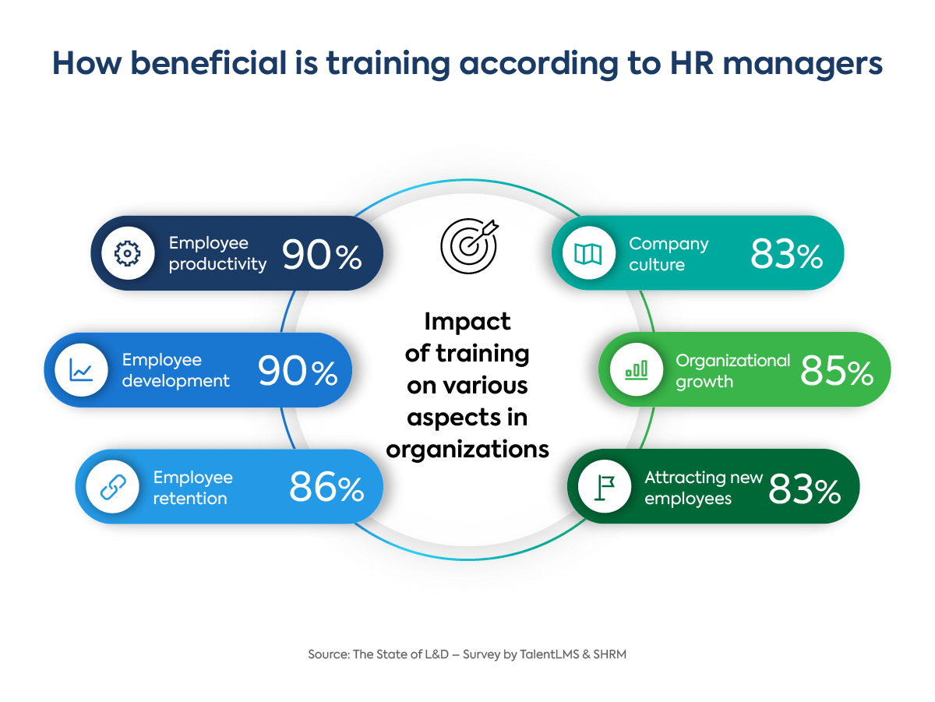
The Benefits of Technology-based Training Programmes for Employers (contd.,)
Deloitte's prior manual tracking system had a compliance rate of 70%; this technology has increased that to 95%.
Additionally, HR personnel were able to devote more time to strategic endeavours after Deloitte documented a 30% decrease in administrative time devoted to training management (Mitchel, 2023).
The scalability of technology-based solutions was demonstrated by McDonald's, who said that they were able to roll out new training modules to more than 1.9 million employees in 100 countries in just two weeks (Puleka, et al., 2018).
Notes:
Enhanced Tracking and Compliance
Employers can reap the benefits of technology-based training in terms of tracking and compliance, as demonstrated by Deloitte's installation of an advanced learning management system (LMS). The business is able to remain in compliance with regulations by keeping accurate records and simply monitoring employee progress using the LMS. Their prior manual tracking system had a compliance rate of 70%; this technology has increased that to 95%. Additionally, HR personnel were able to devote more time to strategic endeavours after Deloitte documented a 30% decrease in administrative time devoted to training management (Mitchel, 2023).
Global Consistency and Scalability
Digital training platforms like used by McDonald's global learning platform make it possible to provide consistent instruction in different parts of the world. Because the platform offers standardised training content in several languages, it guarantees that all employees, no matter where they are, receive training of the same high quality. On a worldwide scale, this strategy has increased customer satisfaction by 25%. The scalability of technology-based solutions was demonstrated by McDonald's, who said that they were able to roll out new training modules to more than 1.9 million employees in 100 countries in just two weeks, all because of the platform (Puleka, et al., 2018).

Slide 12

Conclusion
This research provides evidence that the organisational approaches to staff training and enhancement of their skills have changed drastically due to the integration of technology into learning and development.
These programs allow for a learning environment that is far more efficient, engaging, and successful.
This can present an organisation with a very great competitive advantage in talent development and retention if well utilised.
Notes:
This research provides evidence that the organisational approaches to staff training and enhancement of their skills have changed drastically due to the integration of technology into learning and development. These programs allow for a learning environment that is far more efficient, engaging, and successful. From the employee's perspective, the benefits are that it provides more individualised training, greater interactivity through technology, better information and skill retention, and accessibility and flexibility in learning. From the employer's side, technology-driven training programs can engender million-dollar savings and drive better performance metrics and efficiency, improved compliance management, scale, and consistent training across global operations. The research findings can, therefore, be used to stress the need for including technological advancements into learning and development strategies. This can present an organisation with a very great competitive advantage in talent development and retention if well utilised.

Slide 13
References
Biehl, E., 2024. Growth & collaboration: How Siemens Software enhances employee development with Growthspace. [Online] Available at: https://www.growthspace.com/post/how-siemens-software-enhances-employee-development-with-growthspace-2
Kabir, M. H., Sobur, A. & Amin, M. R., 2023. Walmart Data Analysis Using Machine Learning. International Journal of Computer Research and Technology (IJCRT), Volume 11.
Low, J. J., 2020. Shell will offer online AI training to thousands of workers. [Online] Available at: https://techhq.com/2020/02/shell-will-offer-online-ai-training-to-thousands-of-workers/
Markova, O. et al., 2019. Implementation of cloud service models in training of future information technology specialists. s.l., s.n., p. 499–515.
Mitchel, H., 2023. Role of Modern Technology in Employee Training & Development. [Online] Available at: https://www.edstellar.com/blog/role-of-modern-technology-in-employee-training
Noe, R. A., 2020. Employee training and development. s.l.:McGraw-Hill.
Okbagaber, T. B., 2019. The effect of human resources management on employees retention in IBM Corporation. Journal of Asian Business Strategy, Volume 9, p. 158.
Puleka, D., Kakade, D. & Pulekar, N., 2018. Comparative analysis of training and development practices in fast food segment–McDonalds and KFC. International Journal of Advance and Innovative Research, Volume 5, p. 174–191.
Rachmad, Y. E., 2019. Transforming Workforce Skills in the Era of Society 5.0: Integrating Technology and Artificial Intelligence in Competency Development.. s.l.:The Academic Professor Board Protocol 2019, United Nations Global Compact ….
Stone, D. L., Deadrick, D. L., Lukaszewski, K. M. & Johnson, R., 2015. The influence of technology on the future of human resource management. Human resource management review, Volume 25, p. 216–231.
Tony-Okeme, A. F., 2021. Microsoft Office Application Competencies Possessed by Office Technology and Management Students for Employability and Self-Reliance, s.l.: s.n.
Turnsek, M. & Ladkin, A., 2024. The Algorithmic Management: Reflecting on the Practices of Airbnb. In: Human Relations Management in Tourism. s.l.:IGI Global, p. 57–81.

