Slide 1

Reflective Practice and Self Care

Slide 2
Aims
To explore how we learn from our experiences
01
To become familiar with different reflective models
02
To reflect on both positive and negative experiences and how to learn from them
03
To also be aware of progress and regression
04

Slide 3
Models
I'd like to introduce you to several different models this week. They will help you for your assessments for this module.
ERA model
Driscoll's 'What?' Model
Kolb's experiential learning model
Gibb's model
We'll be looking at other models as we progress further into the module.

Slide 4

ERA Model (Jasper, 2014)
Sometimes it can be difficult to decide what to write and how to write reflectively.
A simple model can be helpful.
The ERA model (Jasper, 2013) stands for Experience, Reflection, Action.
It can be easy to remember this as you try to engage with your different activities.

Slide 5
ERA model
Experience
Reflection
Action

Slide 6
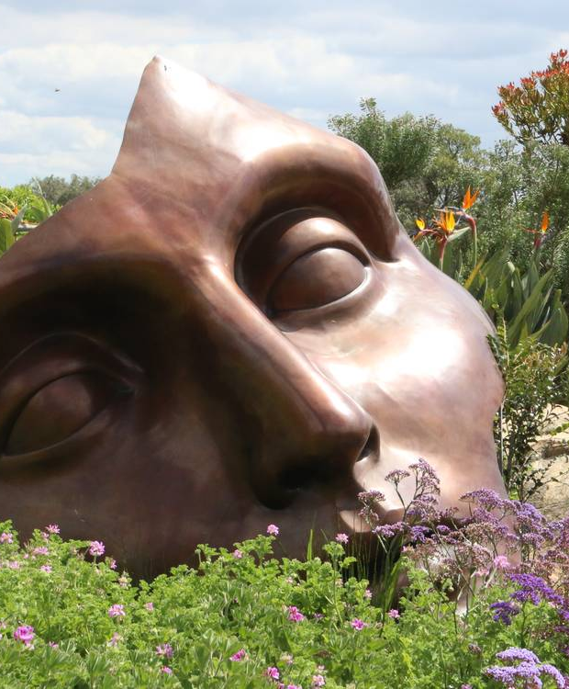
ERA explained
Experience: Any significant event that has happened recently. It could also be a past event that has now become important
Reflection: This happens after the event. How do we learn from the experience and how might we respond differently in the future
Action: This relates to the actions we take as a response to the reflection. What new perceptions might we have as we move forward?

Slide 7
Learning
We all start with an experience, it can be an old or new experience, it can also be positive or negative. It can be related to our work, or something entirely different.
Once the event has occurred, we then start to think about it, or reflect on what has happened . We examine our feelings, reflect on the experience and then try to decide what happens next.
We then act. The process builds our knowledge and understanding and is cyclical. Our perceptions and ideas change, and we take this forward into the next experience.

Slide 8
Driscoll's 'What?' model
Driscoll's (2007) model can also be a useful starting point when engaging with reflection.
It's based on three questions: What? So What? And Now What?
It's often circular and is depicted as three stages following each other.

Slide 9
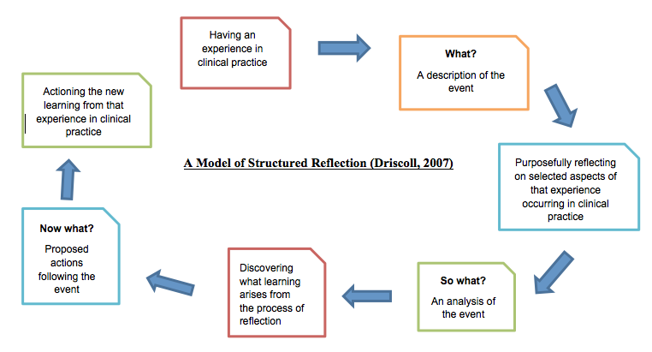

Slide 10

Driscoll's model
The three questions help us to analyse our experiences and learn from them. It also allows us to see the experience in context and assess the experience by asking 'so what?' What was our learning and what action will we take.
It's also about considering our own behaviour and thinking about whether we will change it or carry on as before.
If you can't think of a reason to change, then this is also valid.

Slide 11
Good starting points
The ERA model and Driscoll's model are good starting points for reflection.
They are straight forward, easy to remember and help the reflective process.
After a time however, you may find that you need to add further depth to your reflection and might want to move on to a different model.

Slide 12
Kolb's Learning Cycle
Kolb's model is a deeper reflective cycle. Like many reflective models it is cyclical and explores how we learn from our experiences.
It contains four important stages and helps us to understand our process as well as take the learning forward and develop learning and professional practice.

Slide 13
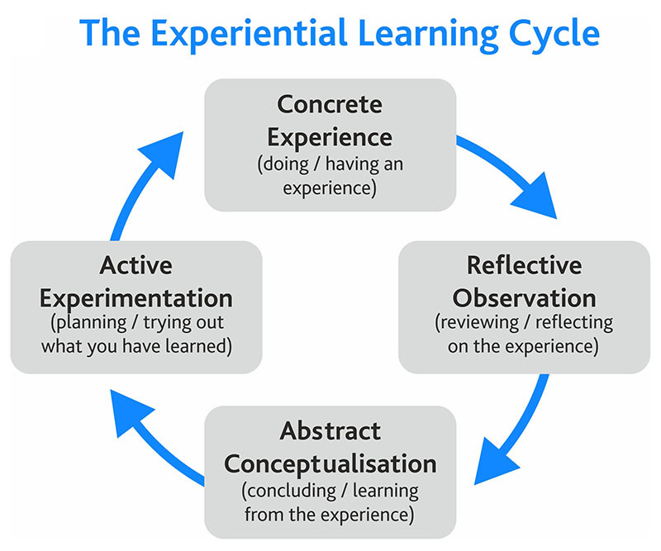
Kolb's Experiential Learning Cycle
Kolb suggests that this cycle usually starts with an experience, which is then explored and looked at through a reflective, observation lens. It is followed with abstract conceptualisation (when new ideas emerge), these are then tried out in active experimentation ready for the next experience.
This might be a quick process, or it can take time.

Slide 14
Gibb's Reflective Model
The final model that we're going to look at this week is Gibb's reflective model. This builds on the other models and adds further stages to the reflective process.
It is more complex, but one perhaps that you're familiar with if you are working in teaching and nursing, it adds further elements to explore as you examine an experience.

Slide 15
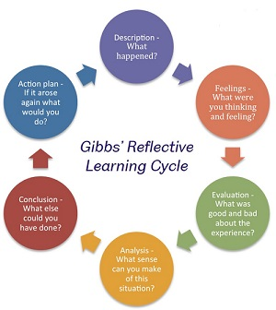
Gibb's reflective model: 6 stages
Description
Feelings
Evaluation
Analysis
Conclusion
Action Plan

Slide 16
Models of Reflection: Activity Two
Choose one of the models discussed in this lecture and apply it to a recent situation or experience.
Once you have worked through the model think about the following points:
How useful was the model?
What were the strengths and weaknesses of the model?

Slide 17
Critiquing the Models.
We must use models with caution, each of the models have strengths and limitations and we must be mindful of this as we use them.
Hopefully, you've had a chance to do activity two and are already thinking about the pros and cons of a model, but it can be useful to take a quick overview of all models and consider their positives as well as their downsides.

Slide 18
Strengths and Limitations of Models
Strengths | Limitations
Can be helpful to use a model when reflecting on a situation | They all suggest that each stage must be completed in the same way
They can be a helpful starting point if you are unsure where to begin | Do we ever really start at the beginning of any situation?
They allow you to reflect and assess at each stage | These models may not work in every experience of situation
You will know when the model is complete and you're ready to move onto the next experience | Reflective process does not begin and end, it's a continual process

Slide 19
Moving forward and going backwards..
We can often assume that if we complete and reflect on an experience we will then learn and move on...but as you can probably guess that is often not the case.
We can all probably think of times when we haven't learnt from experience and still repeat the same patterns of behaviour.
It can often feel like we're going backwards and not moving forwards.

Slide 20
Why does this happen?
Illeris (2014) suggests that this can happen for two reasons:
  It can happen if we're expected to learn too quickly or too much in a short time. The demands on us are heavy and we cannot take the time to learn.
  In these situations we can often feel uncertain, daunted and question our abilities and capabilities.
  It is a common experience and can often happen at the early stage or a training programme when we're trying to learn a lot of things at once.

Slide 21
Why does this happen?
It can also happen when we know that we need to change something, but it feels risky and scary, and we'd prefer to remain with the safer option. At times the risk might just be too high, and it can simply feel too uncertain.
Many of us dislike change, particularly if the change causes risk and too much uncertainty.
In these cases, we can often feel like we're not moving forward and might even feel like we're regressing.
If you find that you're in a situation where the risk or uncertainty is too high, it might be a better option to just withdraw.

Slide 22

Activity Three
Think of a recent situation where you did struggle to learn from the experience.
Describe the situation and see if you can critically evaluate it. Consider why you might not have learnt from the experience. Consider the context of the situation.
Does Illeris' (2014) theory make sense to you?
Perhaps there are other reasons why you didn't learn from this situation.

Slide 23
Do we learn from difficult situations or positive situations?
Which experience do you think you learn most from?
Authors question this and often differ in their thinking.

Slide 24
Do you learn more from problematic experiences?
Osterman and Kottkamp (2004) suggest that we learn most from difficult situations.
They suggest that we need to explore the problematic experiences and their cycle (which is based on Kolb) asks us to explore, observe and analyse the situation.
The third part of the model that they put forward asks us to search for new ideas and strategies.

Slide 25
Or positive experiences?
Ghaye (2011) suggests that just focusing on negative or problematic experiences can be unhelpful and we should also look at positive situations. His ideas are based on Positive Psychology and ask us to consider the following questions:
What is successful right now ?(Appreciate)
What do we need to change to make things better? (Imagine)
How can we achieve this? (Design)
Who needs to take action and what will the consequences be? (Act)

Slide 26
What do you think?
Do you tend to focus on the negative experiences, or do you have a balance of both?
Whichever way you work, it is all a process of reflection and will allow growth and development. Being mindful however, that focusing too much on either the positive or the negative might be unhelpful in the long run.
A balance of both seems perhaps to make the most sense?

Slide 27

Aims
We are now going to be exploring resilience and exploring the importance of self-care.
As we work with CYP it is important that we know how to ensure that we are looking after ourselves. It is not unusual for individuals working in childcare to experience burnout during their career.
In this lesson, I will be supporting you to explore how you can look after yourself and consider what you need to build your own resilience.

Slide 28

What is resilience?
Spend a few minutes just reflecting on your own ideas of resilience.
What does the term mean to you?
Reflect on your own ability to demonstrate resilience.

Slide 29
Resilience
Resilience is the ability to overcome difficult situations, or to renew one's strength.
Resilience begins at an early age and is part of our childhood development. For children who are not experiencing adverse childhood experiences, resilience should be a natural part of childhood. For example, you may remember difficult moments during childhood, which you were able to overcome and move beyond.
You might like to spend a few moments thinking about these.

Slide 30
Four points to building resilience
Bassot (2020) suggests that there are four points to building resilience:
Risk
Support
Feedback
Being ready for change

Slide 31
Four points to building resilience
Exposure to risk: To be resilient we need to have exposure to risk. However, we do not want to put ourselves in situations where there is little chance of success, however avoiding risk all the time can hinder our development and learning.
So, to develop resilience we need to have a little bit of risk, but not too much.

Slide 32

Finding support
When things become difficult in our life it is important that we have someone we can turn to for support.
This can be a relative, a friend, or a professional.
We need people who will listen, who will also support, but also gently challenge and help us to think through situations.

Slide 33

Feedback
Feedback can support us, to help us to correct our mistakes, or change our behaviours.
It can be helpful if given appropriately. Sometimes we need to ask for good feedback.
Weak or limited feedback can also hinder our development.

Slide 34

Being ready for change
We are always experiencing new situations and different challenges, however we need to learn from these. We can have set-backs but we need to learn from these. If we can't learn we can't move forward.
So, we need to be ready to accept change and work with it.

Slide 35
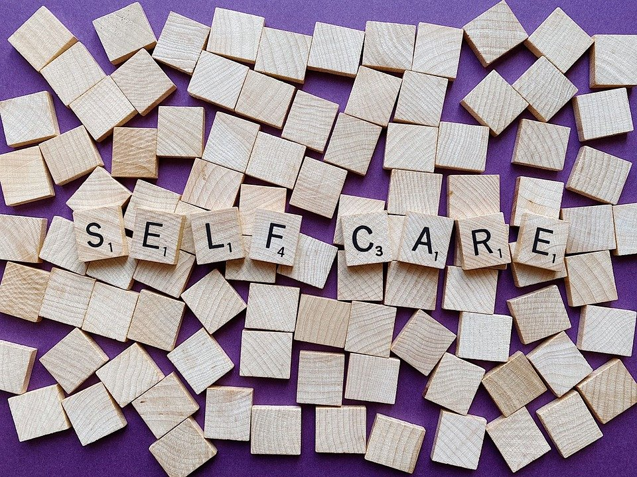
Self-Care
As CYP workers we work with many children and young people who are in crisis. We support them and listen to them at a very deep level.
It is also important that we recognise our own need for self-care.
We need to ensure that we take time for ourselves, to ensure our well-being to avoid burn-out.
So how can we ensure that we do look after ourselves?

Slide 36
FInk-Samnick (2007) Self Care
Fink-Samnick suggested that there were six strategies that can be employed to support self-care.

Slide 37

Strategy One
Speak to colleagues. Look for support with your work.
If we are working deeply with our children and young people, we can have regular supervision. With our supervisors we can discuss client work but also look for guidance and support with our well-being.
It is not therapy, but professional support. Good supervisors will notice when there are issues of self-care and highlight this to the therapist.

Slide 38

Strategy two
Don't make rash decisions. Think things through carefully and give yourself time to pause and reflect.
This is particularly true of when working with CYP. Boundaries are important. Giving yourself time to think will prevent any rash decisions from being made.

Slide 39

Strategy Three
Being able to have fun, without feeling guilty.
As carers it can often provoke feelings of guilt if we take time out for ourselves. Are we being selfish if we do something for ourselves?
Strategy three is to have fun and not feel guilty. For many, this is a difficult strategy to master.

Slide 40

Strategy four
Take time out.
Even though we are working with clients who may be in crisis, it is still important that we take time out. This means that we take holidays, we take breaks. We can work with clients to enable them to prepare for the short break in their support work.
If we are exhausted, we cannot support our children and young people.

Slide 41

Strategy five
Treat yourself to revitalise.
Consider what this means for you. What do you need to do to revitalise? It might be taking a walk, taking a long bath, going shopping?!

Slide 42

Strategy six
Use your strength and frustration to support your profession.
If you are feeling a sense of frustration, perhaps you can engage in discussion with others within the CYP profession.

Slide 43
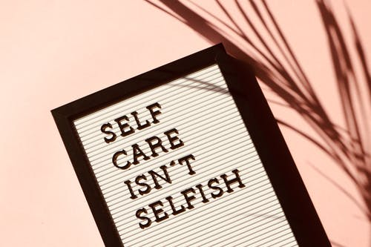
Self Care
As empathic workers we often feel that we need to deeply support each client and not take time for ourselves.
However, by not taking care of ourselves we are risking an early exit from the profession, through exhaustion and burnout.
Self-care is important, it is not a selfish act, it is as necessary as supervision and professional development.

Slide 44
Memories and feelings
When we're working with clients it can often happen that we hear stories that our like our own.
It can trigger memories and emotions and sometimes these can be difficult to manage.
Reflecting on these memories and emotions is important. But sometimes we may need professional help to explore them further.
Supervision can also be useful in working out what the triggers are.

Slide 45

Activity three
Consider a time when you experienced something, and you were surprised by how you responded to it.
Can you discover the trigger to this?

Slide 46
Processing feelings
In addition to previous reflective models, there is also another model that encourages you to consider your feelings.
Boud, Keough and Walker (1985) suggest the following cycle:
Return to the experience: This means thinking about the event, perhaps discussing it with others and re-telling the story
Attend to the feelings: Whilst re-telling the story you think about the feelings and emotions that are being re-kindled, but you attend to the positive emotions and remove the negative ones.
Re-evaluating the experience: There should now be new knowledge, which should be added to the old existing knowledge.

Slide 47
Summary
Within this week's topics we've considered resilience and self care. We've also briefly explored some of the key aspects of support that can be found when working as a therapist.
As a final activity, just spend a few minutes reflecting on the points here. Think about your own support methods, and also reflect on your own methods of self care. Think about what you do when you need to take time out. Consider also, who you turn to when in a crisis.

Slide 48

References
Bassot, B. (2020). The Reflective Journal. 3rd ed. Red Globe Press.
Boud, D., Keogh, R. & Walker, D. (1985). Reflection: Turning Experience into Learning. Routledge Falmer.
Notes:
Reflection: Turning Experience into Learning, Boud, Keogh and Walker (1985)
Bassot, Barbara. The Reflective Journal (p. 67). Macmillan Education UK. Kindle Edition.

Slide 49
References
Driscoll, J. (ed.) (2007). Practicing Clinical Supervision: A Reflective Approach for Healthcare Professionals. Elsevier.
Ghaye , T. (2011). Teaching and Learning Through Reflective Practice: A practical guide for positive action. Routledge.
Jasper, M. (2013). Beginning Reflective Practice. Cengage Learning
Illeris, K. (2014). Transformative Learning and Identity. Routledge
Osterman, K.F. & Kottkamp, R.B. (2004) Reflective Practice for Educators, 2nd ed. Corwin Press.

