Slide 1
Title “A child’s experience between the ages of 0 – 5 years can affect the rest of their lives”
Student Name: Mohamad Sediq Ehssan
Student ID: 2017880
Module Title: Psychology in Health and Social Care
Module Number: BMHP4019_BIRM
Assignment section: Task1 Presentation Lecturer’s name: Rebecca Kavanagh

Slide 2
What is Psychology?
What are Theories Of Development
describe
explain
predict
Piaget’s theory of cognitive development
Vygotsky’s theory of social constructivism.

Slide 3
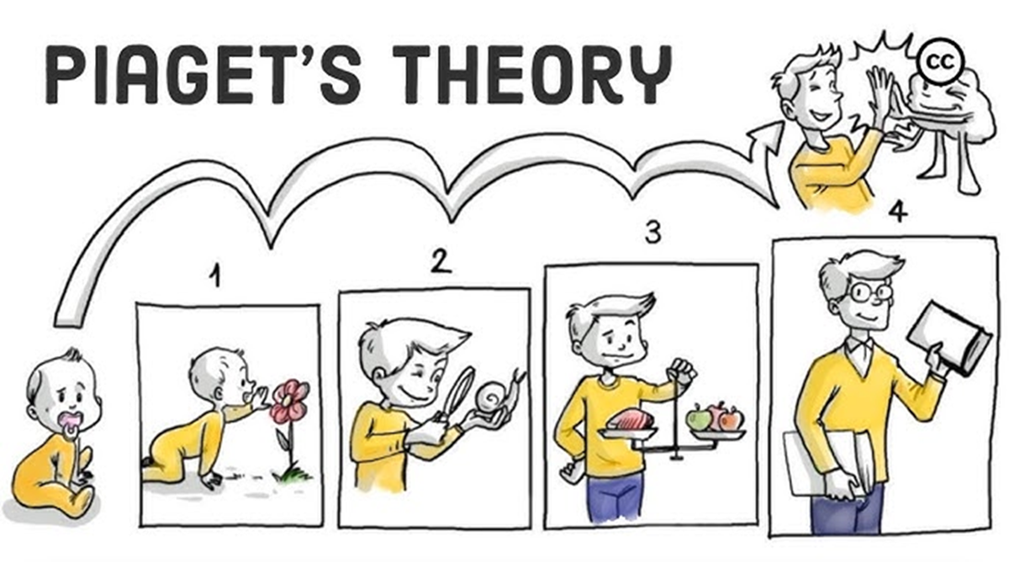
Piaget’s theory of cognitive development
Piaget’s Four Stages of cognitive development
Stage Age Goal
Sensorimotor Birth to 18-24 months Object permanence
Pre-operational 2 to 7 years Symbolic thought
Concrete operational 7 to 11 years Logical thought
Formal operational Adolescence to adulthood Scientific reasoning
Assimilation
Equilibrium
New experiences
Disequilibrium
Accommodation
Development on new schemas

Slide 4
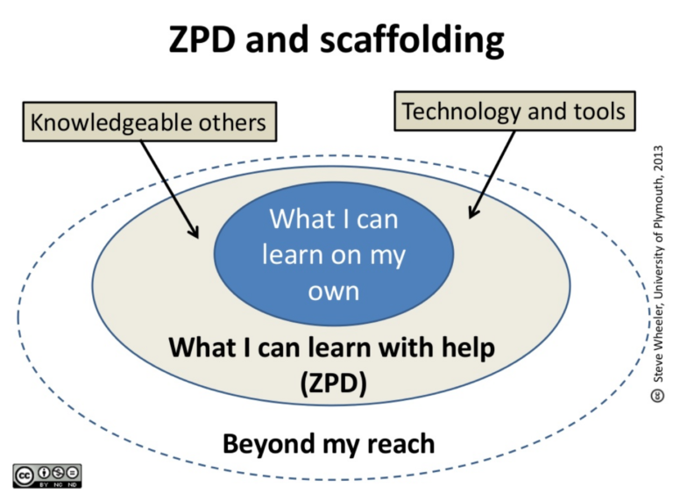
Vygotsky’s theory of social constructivism.
Three Vygotskian themes
Culture
Language
Thought

Slide 5


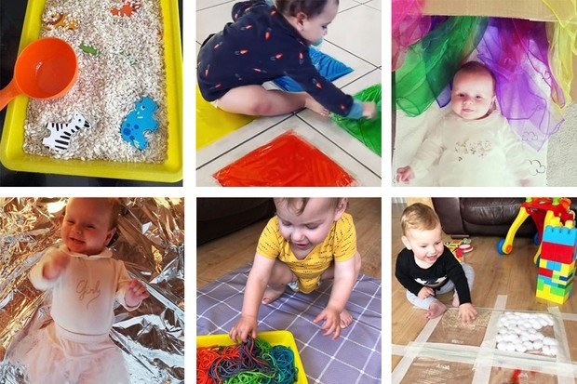

Slide 6

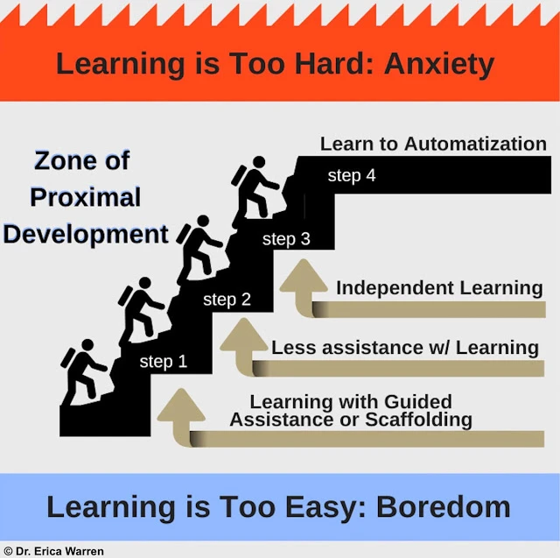




Slide 7
References
McLeod, S. A. (2018, June 06). Jean Piaget's theory of cognitive development. Simply Psychology. https://www.simplypsychology.org/piaget.html
McLeod, S. A., 2018, August 05, Lev Vygotsky. Simply Psychology. https://www.simplypsychology.org/vygotsky.html
Parrila, R. K. (1995) ‘Vygotskian Views on Language and Planning in Children’, School Psychology International, 16(2), pp. 167–183. doi: 10.1177/0143034395162007.
Lev Vygotsky’s Social Development Theory | DECedu (discoverearlychildhoodedu.org)

