Slide 1

Module: Digital Skills and Research Methods
Module code: LCHS4007
Lecturer Bianca Dodgen ​
Rahela Mandache – 2521115
Malgorzata Zieman – 2521409
Vida Takyi - 2518018
Figure 1

Slide 2

Agenda
Task 1 – Rahela
Task 2 - Malgorzata
Task 3 - Vida
Figure 2

Slide 3
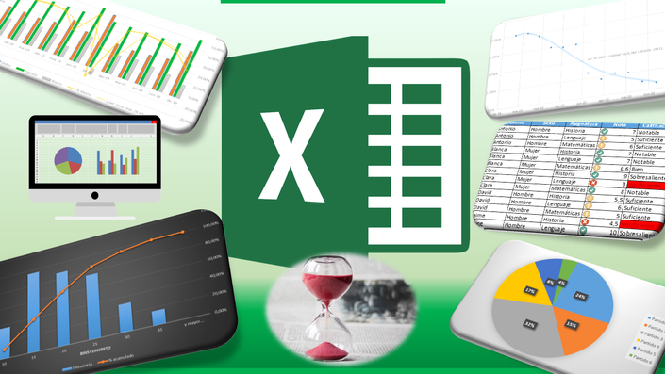
Task 1 – Using Excel to Improve Work Efficiency
Using Excel, staff can create digital templates for scheduling, medication tracking, and service records.
These templates are easy to update and share using OneDrive or SharePoint.
Formulas and data validation in Excel can automate calculations, highlight errors, and reduce mistakes, saving time and improving accuracy (Alalwan, 2020).
Real-time collaboration allows multiple staff members to access and update information at the same time, which is important for carers working in different locations.
How They Use Excel:
Staff use Excel for scheduling, medication logs, and service records. Files are shared via OneDrive or SharePoint, allowing real-time updates and collaboration. Excel’s formulas automate calculations and highlight errors, improving accuracy. It also generates reports and dashboards for quick insights.
Figure 3

Slide 4

Task 1 – part 2
Excel can also create reports and dashboards to give quick insights into staffing levels and client needs, supporting better decision-making.​
Staff will need training to use advanced Excel features effectively. ​Security measures, such as access controls, are necessary to protect sensitive data and ensure GDPR compliance (Williams & Parker, 2021).​
Benefits:
Saves time with automation
Reduces errors
Enables teamwork with shared access
Provides quick data insights
Accessible from anywhere
Limitations:
Requires staff training
Needs strong security for sensitive data
Can become complex and hard to manage
Depends on user skill levels
Not suitable for very complex data management
Figure 4
In summary, Excel streamlines administrative tasks, enhances data accuracy, and improves coordination, which ultimately increases efficiency at Greenfield.

Slide 5

Task 2 – Microsoft 365 communication and collaboration tool
ADVANTAGES OF USING MS TEAMS
The MS Teams app allows you to set up meetings with other staff members. They can use a link to attend scheduled MS Teams meetings.
MS Teams allows opening channels for specific topics: Staff announcement, training reminders, and cover request.
Using the Teams app within the care agency enables staff to communicate across locations and shifts.
Allows staff to communicate even when they are unable come to the office via video or audio. ( Withee, 2021)
Figure 5

Slide 6
Task 2 – Microsoft 365 communication and collaboration tools
DISADVANTAGES OF USING MS TEAMS
Some staff members can have problems engaging with other colleagues.
Staff can miss valuable information or messages and may not respond in time. (Feitosa, 2021)
Some staff can find it difficult to switch to a voice or video call. Or face problems with internet connections
Using more than one tool: MS Teams, email, and NHS platforms can be very difficult for staff to manage. (Warmoth, 2022)
Staff need time and support to learn how to use Microsoft Teams. Extra training may be needed. (Warmoth, 2023)

Slide 7
Task 2 - Microsoft 365 Communication and Collaboration Tools
HOW TEAMS HELP STAFF COMMUNICATE BETWEEN DIFFERENT LOCATIONS
•Quick real-time messages / Very quick reply, updates about the resident or any problem.
•Video-voice call / Quick meetings across locations.
•Share channels and documents, files / Updates, and documentation.
•Training and education delivery / remote trainings and updates from multiple locations. ( NHS England, 2023)
Figure 6

Slide 8

Digital Safety- for Greenfield Home Agency Staffs
Greenfield Home Agency needs a strong password setting to secure asses . Is very important to use password to protect patient record and important documents (Davis, Chowdhury and Rift,2022)
Staff need to be competent in opening or receiving and sending email, they need to be train with awareness to protect malware sped and viruses.
Data Management is key part in collecting of data ,storage and cleaning data, so that information staff use stay accurate and protected.
Staff needs training with confidentiality and compliancy to help in protecting sensitive information , while involves observing laws and regulations (Zaidi 2025)
Figure 7

Slide 9

Action Plan
Secure Access; Goals, sensitive system can be accessing by right people.
Action; Introduce role-access control.
Implementation; configure system permission to staff role
Data Management; Action; data storage must be secured
Implementation; SharePoint for controlled storage
Confidentiality And compliance; regular training , update policies
Greenfield Home Agency will improve digital safety by controlling who can access sensitive information, use strong passwords, and add extra security like multi-factor authentication. Staff will get regular training on email safety, malware, and keeping information private. Data will be stored securely on SharePoint, with clear rules for managing it. The agency will update policies regularly and ensure staff follow laws and regulations. This plan will start within a few months, with ongoing training and reviews to keep everything safe and secure.
Figure 8

Slide 10
Conclusion
In conclusion, using Excel and Microsoft 365 tools like Teams and SharePoint helps Greenfield Home Agency work more efficiently and securely. Excel makes administrative tasks easier by automating work and allowing real-time data sharing, which reduces mistakes and supports better decisions. Microsoft Teams improves communication between different locations through messaging, online meetings, and remote training.
By focusing on strong security, staff training, and clear access controls, the agency keeps its data safe. Overall, these tools help create a more organised, secure, and effective working environment, leading to better care services.

Slide 11
Reference list
Alalwan, A. A., 2020. 'Digital transformation and healthcare: An overview.' Journal of Healthcare Information Management, 34(2), pp. 45-52.
Davis, D. K., Chowdhury, M. M. and Rifat, N. (2022) 'Password Security: What Are We Doing Wrong?', IEEE Xplore. Available at: https://ieeexplore.ieee.org/abstract/document/9814059?casa_token=OBe2UkjTwOcAAAAA:wsVabRqu00lBXixOFmydAzqEY16tcFCIx9Yzedt1CbukRuDjbJO10lyzn7fzvre0JRMd0OcR4I8fsqw (Accessed: 25 January 2020).
England, N. (2023). NHS England» Microsoft Teams and remote working. [online] England.nhs.uk. Available at: https://www.england.nhs.uk/long-read/microsoft-teams-and-remote-working/?utm_source=chatgpt.com.
Feitosa, J. and Salas, E. (2020). Today’s virtual teams: Adapting lessons learned to the pandemic context. Organizational Dynamics, [online] 50(1), p.100777. doi:https://doi.org/10.1016/j.orgdyn.2020.100777.
https://uk.pinterest.com/pin/microsoft-teams-icon-png-in-2023--1047086982095276123/
Warmoth, K., Lynch, J., Darlington, N., Bunn, F. and Goodman, C. (2022). Using video consultation technology between care homes and health and social care professionals: a scoping review and interview study during COVID-19 pandemic. Age and Ageing, [online] 51(2), p.afab279. doi:https://doi.org/10.1093/ageing/afab279.
Warmoth, K., Bennett, C., Lynch, J. and Goodman, C. (2023). Using Online Consultations to Facilitate Health and Social Care Delivery During COVID-19: An Interview Study of Care Home Staff. Journal of Long-Term Care, pp.100–109. doi:https://doi.org/10.31389/jltc.184.
Williams, P., & Parker, M., 2021. 'Implementing digital tools in social care.' Journal of Social Work Technology, 15(4), pp. 305-320.
Zaidi, Z. (2025) Compliance confidentiality: Overview, definition, and Example. Available at: https://www.cobrief.app/resources/legal-glossary/compliance-confidentiality-overview-definition-and-example/ (Accessed: 25 January 2026).

