Slide 1

Digital Skills and Research Methods
Component 1 Research Methods – Presentation
Module code:BMSW4003
University of Wales Saint David
Professor Abdi Rahmen

Slide 2

Student name: Shamim Abdullah
Student ID: 2110434

Slide 3
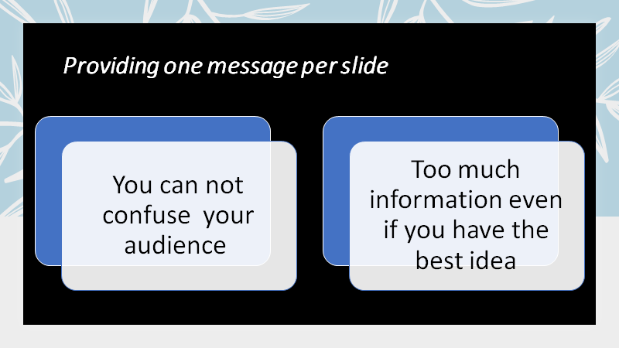

Slide 4


Slide 5


Slide 6

Student name : Salah Mheidean
Student ID : 2109425

Slide 7





SIZE

Slide 8
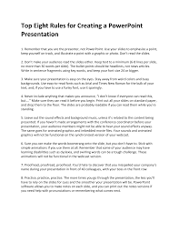
Six
1. Remember that you are the presenter, not PowerPoint
2. Don’t make your audience read the slides either
3. Make sure your presentation is easy on the eyes.
4. Sure you can make the words boomerang onto the slide, but you don’t have to.
5. Proofread, proofread, proofread.
6. Practice, practice, practice.

Slide 9

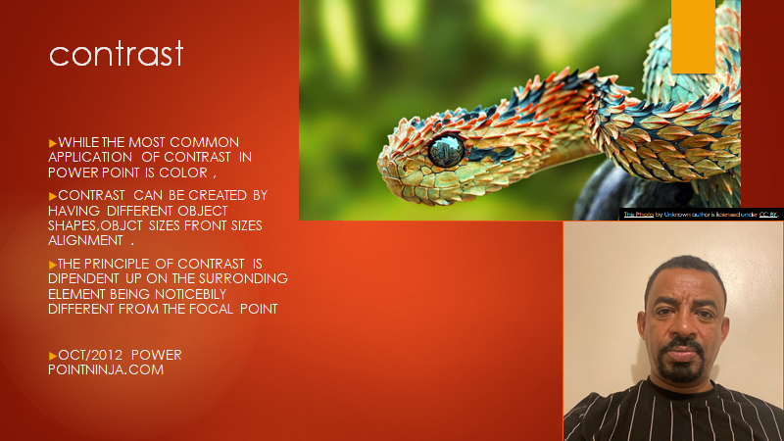

Slide 10


Slide 11

OBJECTS
Objects are anything you can add to PowerPoint:
-A text tag is an object.
-An image is an objects
-Graphs and diagrams are objects
Any element in a slide show is an object
Cristina Anton (2110293 )
Class, 2019)

Slide 12


