Slide 1
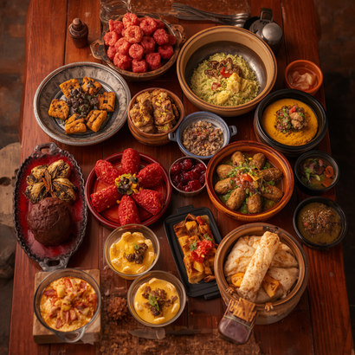
AUTHENTIC FILIPINO RESTAURANT BUSINESS PLAN
Bringing 'Cooked with Love' Filipino Flavors to London
Ma Corazon MacAspac | Student #2509848
Enterprise and Entrepreneurship (LCLM4005) | Lecturer: Shengfeng Mai | August 4, 2026

Slide 2
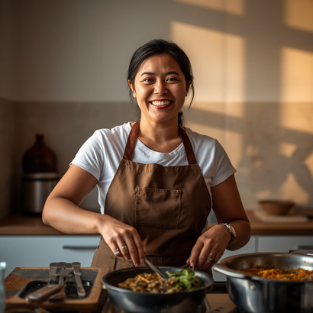
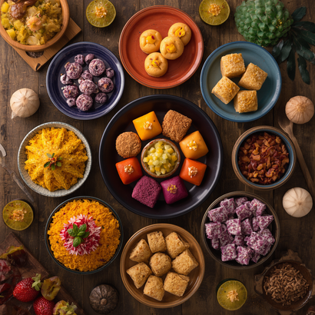
Founder Background
Ma Corazon MacAspac brings 10+ years of international experience in London as a nanny, cook, and housekeeper — with a deep passion for authentic Filipino dishes and desserts including biko, ube kalamay, leche flan, turon, and halo-halo.
Business Vision & Concept
Establish a Filipino brand known for quality, affordability, and excellent service — serving authentic Filipino meals and desserts "cooked with love," bringing the warmth of Filipino home cooking to the heart of London.

Slide 3
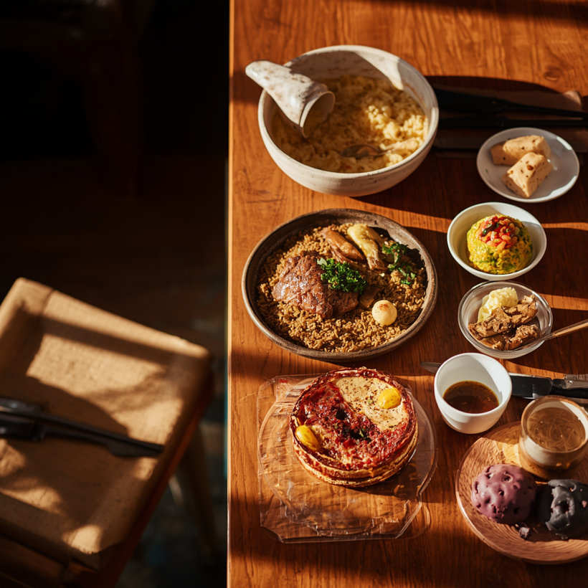
Market Overview
The global Filipino restaurant market is valued at $28.4B, projected to reach $52.7B by 2034 at a 7.1% CAGR. Europe holds 11.4% of revenue share, with the UK as a major hub supported by a large and growing Filipino community. Traditional Filipino cuisine dominates 47.3% of the market segment, while online food delivery is expanding rapidly at 11.3% CAGR — presenting a strong opportunity for authentic Filipino dining in London.

Slide 4



Legal Structure
Management Setup
Key Benefits
Registered as a sole trader, providing full independence, flexibility, and personal ownership. This structure allows direct family involvement and keeps operations simple and cost-effective.
Owner-operated by Ma Corazon MacAspac, with the ability to hire trusted family members and reliable staff as the business grows and demand increases.
Easier decision-making, direct operational control, and a strong connection to the local Filipino community — fostering loyalty, trust, and a welcoming family atmosphere.

Slide 5
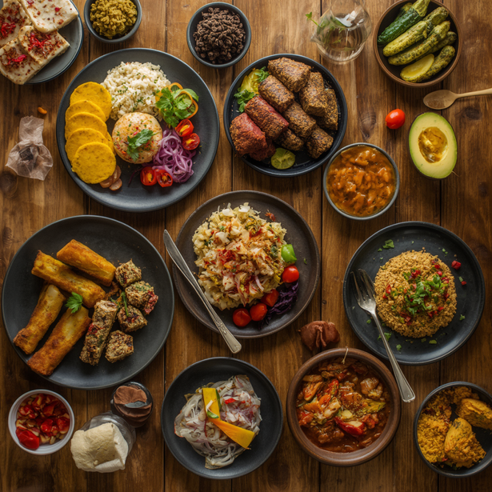
Political
Economic
Compliance with local permits and business licenses, adherence to food safety regulations, and full compliance with UK tax laws and reporting requirements.
Sensitive to customer spending habits and cost-of-living pressures. Affordability is key — rising food costs managed through smart sourcing and value-driven menu pricing.
Social
Technology
Growing interest in authentic Filipino cuisine in London. Key segments include Filipino families, students, and food explorers seeking genuine homemade flavors and cultural dining experiences.
Leveraging online ordering platforms, food delivery apps, and active social media marketing to reach the UK Filipino community and broader London food lovers.

Slide 6





Environmental
Legal
Committed to responsible waste management, eco-friendly packaging, and sourcing fresh ingredients from local suppliers to reduce carbon footprint and support the community.
Full compliance with food safety standards, labor laws, fire safety regulations, and mandatory employee training to ensure a safe and lawful restaurant operation.

Slide 7




Students
Workers & Professionals
Seeking affordable, authentic Filipino meals that feel like home. Budget-conscious students looking for hearty, satisfying food near universities and colleges in London.
Busy professionals seeking quick, wholesome homemade Filipino lunches and dinners. Convenient online delivery and takeaway options for weekday meals.
Families
Tourists & Food Lovers
Filipino and multicultural families wanting a warm, cultural dining experience. A family-friendly atmosphere celebrating authentic flavors and community togetherness.
Tourists and Filipino cuisine enthusiasts seeking authentic desserts like halo-halo, biko, and leche flan — a unique culinary adventure in London.

Slide 8



Social media engagement targeting the UK Filipino community and food lovers — sharing authentic recipes, behind-the-scenes stories, and promotions on Facebook, Instagram, and TikTok to build a loyal and growing online following.
Marketing Strategies
Our marketing approach centres on the heart of our brand — "Cooked with Love." We build genuine connections through authentic Filipino flavours, warm hospitality, and a community-first mindset that resonates with both the Filipino diaspora and food lovers across London.
Online delivery partnerships with platforms such as Deliveroo and Uber Eats, supported by seasonal promotions and introductory discounts to drive trial, repeat orders, and wider reach across London.
Community events and a family-friendly atmosphere — hosting Filipino cultural celebrations, food tasting events, and festive gatherings to foster loyalty, word-of-mouth referrals, and a welcoming dining experience for all.

Slide 9


Startup Costs – £18,000 Total
Furniture: £8,000 | Accessories: £4,000 | Renovation: £5,000 | Toiletries: £1,000. One-time investment to create a warm, authentic Filipino dining atmosphere in London.
Monthly Fixed & Variable Costs
Fixed costs: £5,550/month (Rent £1,500, Business Rate £300, Gas £150, Salaries £3,500, Accountant £100). Variable costs grow from £700 (Jan) to £2,450 (Jun) as operations scale up.

Slide 10


Financial Forecast & Breakeven
6-month revenue forecast: Jan £3,000 → Jun £9,500, showing steady growth each month. Breakeven is achieved in April (Month 4), with early losses covered by initial investment. Total funding needed: £25,000 — comprising £18,000 startup costs and £7,000 to cover cumulative losses before breakeven. This plan demonstrates a clear and achievable path to profitability.

Slide 11


SALAMAT!
THANK YOU!
Ma Corazon MacAspac | Student #2509848 | Enterprise & Entrepreneurship (LCLM4005)

