Slide 1
INTRODUCTION TO PUBLIC HEALTH
Covid-19 an infectious disease
Example
LCHS4004
Semester 1 2021/22
Dr Aishat Bakre

Slide 2
Learning outcomes
Upon successful completion of this module, you should be able to:
Understand different approaches and strategies used to measure, monitor and control the incidence of disease in communities
Investigate the implications of illness and disease in communities for the provision of health and social care services
Understand the factors influencing the health and wellbeing of individuals in health or social care settings.

Slide 3
Module Summary
The module aims overall to raise learners’ awareness and critical evaluation of factors influencing public health and the different approaches taken to reduce incidence of disease and illness in communities.

Slide 4
Lesson objectives
At the end of this session, students will be able to understand:
The meaning of Covid19
The different Covid-19 variants
Means of transmission of Covid19
History of Covid19
Sub-populations vulnerable to Covid19
Prevention of Covid-19

Slide 5
What is the meaning of Covid-19?

Slide 6
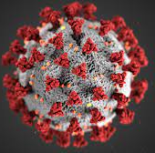
Meaning of Covid-19
Coronaviruses are a family of viruses that can cause respiratory illness in humans.
Coronavirus disease (COVID-19) is an infectious disease caused by the “severe acute respiratory syndrome coronavirus 2” (SARS-CoV-2 virus)
(WHO, 2022)

Slide 7
Meaning of Covid19
Coronaviruses (CoVs) are positive-stranded RNA(+ssRNA) viruses with a crown-like appearance under an electron microscope (coronam is the Latin term for crown) due to the presence of spike glycoproteins on the envelope
CO = Corona; VI = Virus; D = Disease; 19 =year 2019
(Cascella et al., 2022).

Slide 8
Meaning of Covid-19
They are called “corona” because of the crown-like spikes on the surface of the virus.
Severe acute respiratory syndrome (SARS), Middle East respiratory syndrome (MERS) are examples of coronaviruses that cause illness in humans.
The new strain of coronavirus — SARS-CoV-2 — was first reported in Wuhan, China in December 2019.
It has since spread to every country around the world.
(WHO, 2022)

Slide 9

Where does the coronaviruses come from?

Slide 10
Origin of the Coronaviruses
Coronaviruses are often found in bats, cats and camels.
The viruses live in but do not infect the animals.
Sometimes these viruses then spread to different animal species.
The viruses may change as they transfer to other species.
Eventually, the virus can jump from animal species and begin to infect humans.
In the case of SARS-CoV-19, the first people infected are thought to have contracted the virus at a food market that sold meat, fish and live animals.

Slide 11
Activity
Working in a group of 4, research the means of transmission of Covid19
(5 minutes)
Discuss your findings with the rest of the members of the class
Notes:
Transmission of Covid19

Slide 12
What are the Mode of transmission of Covid19?

Slide 13
Mode of transmission of Covid-19
The virus can spread “from an infected person’s mouth or nose in small liquid particles when they cough, sneeze, speak, sing or breathe”.
These “particles range from larger respiratory droplets to smaller aerosols”.
(WHO, 2022)

Slide 14
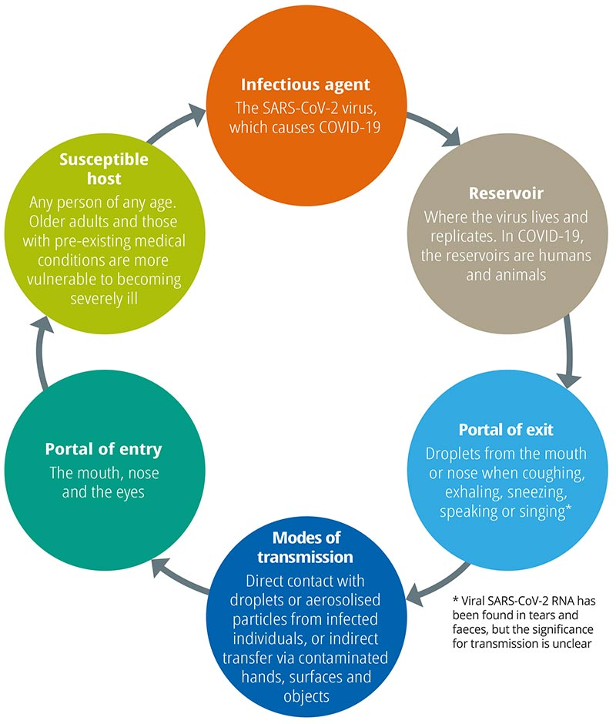
Means of Transmission of Covid19
(Watts, Leck, and Hu, 2020)

Slide 15
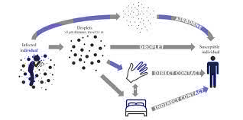
Means of Transmission of Covid19
(Conly, 2020)

Slide 16
Activity
In a group of 4, identify and discuss the subpopulations that are at higher risks of Covid19
Why are those sub-populations at higher risks?
(15 minutes)
Feedback your findings to the whole class

Slide 17
What Subpopulations are at higher risks of Covid-19?

Slide 18
Subpopulations at higher risks of Covid19
Older people and
Those with underlying medical conditions like cardiovascular disease, diabetes, chronic respiratory disease, or cancer are more likely to develop serious illness.
Those with weakened immune system.
Those that have lived in or have recently travelled to any area with ongoing active spread.
Have had close contact with a person who has a laboratory-confirmed or a suspected case of the COVID-19 virus.
(WHO, 2022)

Slide 19

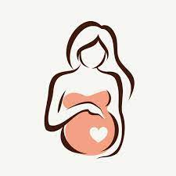
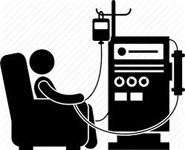

Sub-population at higher risks of Covid19
Elderly people
Pregnant women
Long-term health condition e.g. diabetes, cancer, cardiovascular disease
Minority-ethnic groups
(Cascella, 2022)

Slide 20
Population at risks of Covid19
Most people infected with the virus will experience mild to moderate respiratory illness and recover without requiring special treatment.
However, some will become seriously ill and require medical attention.
Anyone can get sick with COVID-19 and become seriously ill or die at any age.
(WHO, 2022)

Slide 21
Activity
Working in a group of 4, research the different variants of Covid-19
(5 minutes)
Share your findings with the rest of the class
(10 minutes)

Slide 22
What are the Variants of Covid19?

Slide 23
Variants of Covid19
SARS-CoV-2, while adapting to their new human hosts, is prone to genetic evolution with the development of mutations over time, resulting in mutant variants
Variants of concern (VOCs): Potential to cause enhanced transmissibility or virulence, reduction in neutralization by antibodies obtained through natural infection or vaccination, the ability to evade detection, or a decrease in therapeutics or vaccination effectiveness
(Cascella et al., 2022).

Slide 24
Activity
Working in a group of 4, research the term mutation
Share your findings with the rest of the class
(5 minutes)

Slide 25
Mutation
The act or process of mutating; change; alteration.
That is a change or alteration, that is a change in the chromosomes or genes of a cell.
The changing of the structure of a gene, resulting in a variant form that may be transmitted to subsequent generations, caused by the alteration of single base units in DNA, or the deletion, insertion, or rearrangement of larger sections of genes or chromosomes.

Slide 26
Five SARS-CoV-2 Variants of Concerns
Five SARS-CoV-2 Variants of concerns have been identified. These include
Alpha variants
Beta variants
Gamma variants
Delta variants
Omicron
(Cascella et al., 2022)

Slide 27
Variants of covid-19
Eight variants of interest have been identified:
Variants of interest: is defined as variants with specific genetic markers that have been associated with changes that may cause enhanced transmissibility or virulence, reduction in neutralization by antibodies obtained through natural infection or vaccination, the ability to evade detection, or a decrease in the effectiveness of therapeutics or vaccination (Cascella et al., 2022).

Slide 28
Eight variants of interest identified include:
Epsilon
Zeta
Eta
Theta
Iota
Kappa
Lambda
Mu
(Cascella et al., 2022)

Slide 29
What are the symptoms of Covid19?

Slide 30
Symptoms of COVID-19
COVID-19 affects different people in different ways.
Majority of the people infected will develop mild to moderate illness and may recover without hospitalisation.
Most common symptoms include
fever
cough
tiredness
loss of taste or smell.
(WHO, 2022)

Slide 31
Symptoms of COVID-19
Less common symptoms include
Sore throat
Headache
Aches and pains
Diarrhoea
A rash on skin, or discolouration of fingers or toes
Red or irritated eyes.
(WHO, 2022)

Slide 32
Symptoms of COVID-19
Serious symptoms include
Difficulty breathing or shortness of breath
Loss of speech or mobility, or confusion
Chest pain.
(WHO, 2022)

Slide 33
Activity
Watch the video below then discuss
https://www.youtube.com/watch?v=i0ZabxXmH4Y
https://www.youtube.com/watch?v=plw-ySLS-lI
https://www.youtube.com/watch?v=aFPyYoGViZs
Feedback to the whole class
(Youtube, 2021)
Notes:
Coronavirus disease (COVID-19) – YouTube
MERS-CoV and SARS-CoV-2 (COVID-19) – YouTube
Introduction to Coronaviruses (SARS, MERS, COVID-19): Hosts, Symptoms, History of SARS and MERS - YouTube

Slide 34
Activity
Watch the video below then discuss
https://www.youtube.com/watch?v=dLKMgS-WCDc
Feedback to the whole class
(Youtube, 2021)
Notes:
Where did the coronavirus come from? | COVID-19 Special - YouTube
History of covid19
Coronavirus disease (COVID-19) - YouTube

Slide 35
How can CoVID-19 be prevented?

Slide 36
Prevention of Covid-19
The best way to prevent and slow down transmission is to be
Well informed about the disease and how the virus spreads.
Cover mouth and nose when sneezing or coughing
Protect yourself and others from infection by staying at least 1 metre apart from others,
Choose open, well-ventilated spaces over closed ones. Open a window if indoors.
Wear a properly fitted mask, and
Wash your hands with soap and water regularly or using an alcohol-based rub frequently.
If you feel unwell, stay home and self-isolate until you recover.
Get vaccinated when it’s your turn and follow local guidance.
Clean and disinfect frequently touched surfaces.
(WHO, 2022)

Slide 37
References
Cascella, M., Rajnik, M., Aleem, A., Dulebohn, S., C., Di Napoli, R (2022) Features, Evaluation, and Treatment of Coronavirus (COVID-19).Available at: https://www.ncbi.nlm.nih.gov/books/NBK554776/. (Accessed date 11th August 2022)
Cleveland clinic (2022) Coronavirus disease Available at:https://my.clevelandclinic.org/health/diseases/21214-coronavirus-covid-19#prevention (Accessed at 11th August 2022).
Conly, J (2020) Sars-Cov-2 mode of transmission and related IPC measures. Available at: https://www.who.int/infection-prevention/campaigns/clean-hands/webinar2_JohnC_28Apr.pdf. (Accessed date 11th August 2022)
TheBMJ (2022) What is epidemiology. Available at: https://www.bmj.com/about-bmj/resources-readers/publications/epidemiology-uninitiated/1-what-epidemiology. (Accessed date 10
YouTube (2021) Where did the coronavirus came from?:Covid-19 special. https://www.youtube.com/watch?v=dLKMgS-WCDc
WHO (2022) Coronavirus disease (Covid-19).Available at https://www.who.int/health-topics/coronavirus#tab=tab_1 (Accessed date 9th August 2022).

