Slide 1
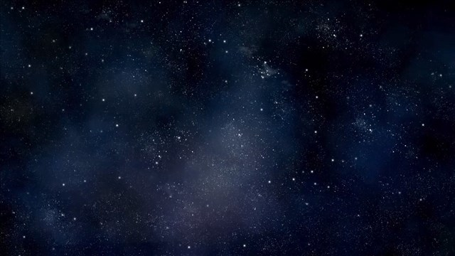
The Cosmological Argument

Slide 2
The Cosmological Argument - a rough sketch
Why are things as they are? / Why is there something rather than nothing?
The universe is the totality of contingent things.
The best explanation for the existence of contingent things is a necessary thing / a primary mover.

Slide 3
A Contingent Truth: Something which happens to be true but could have been false.
A Necessary Truth: Something which has to be true and can’t be false.

Slide 4
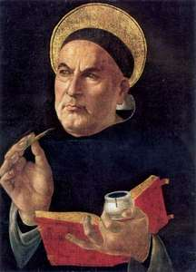
The Argument from Motion
It is evident to our senses that things are moving.
Whatever is moved by something else.
Everything that is in motion must have been set in motion by something which itself is moving.
There must be a primary mover otherwise there would be no motion (there is no potential without the actual)
Thomas Aquinas
1225-1274

Slide 5
The Argument from Causation
It is evident that some things are caused
Things which are caused must be caused by something else as things cannot cause themselves
There cannot be a infinite regress
Therefore, there must have been a first cause which cannot itself have been caused (an uncaused cause)
Thomas Aquinas
1225-1274

Slide 6
Infinite Regress
Principle of Sufficient Reason
A sequence of justifications that never come to an end.
Therefore, there is no justification.
Everything that exists must have a reason or cause

Slide 7
The Argument from Contingency
There are contingent beings
Contingent beings require a cause
The cause of the contingent being is something other than the contingent being
The cause of contingent beings must be other contingent beings or a necessary being
The existence of contingent beings alone does not provide a complete explanation for the existence of contingent beings
Therefore, there must be a necessary being
The universe is a totality of contingent things
Therefore, the necessary being must be external to the universe

Slide 8
Objections
Hume & Russell - We cannot derive how the universe came about from our experience of the world.
The Fallacy of Composition - The constitutive parts may not have the same properties as the whole
  Sometimes the property of the parts is the same as the property of the whole
The universe doesn’t require an explanation

Slide 9
The Kalām Cosmological Argument
Based on the ideas of Al-Ghazali (1058-1111)
Contemporary defender: William Lane Craig (1949 - )

Slide 10
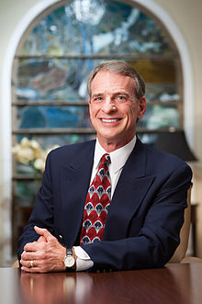
The Kalām Cosmological Argument
1. Everything that begins to exist must have a cause for its existence
2. The universe began to exist
3. Therefore, the universe has a cause of its existence
4. Science cannot provide us with a causal account of the beginning of the the universe, therefore it must have a personal cause
William Lane Craig

Slide 11
Did the Universe have a beginning?
2nd Law of Thermodynamics
The expanding universe from a finite point

Slide 12
The Fallacy of Equivocation
The universe - the totality of all that there is
The universe - the collection of planets

Slide 13
Object from Quantum Physics
The first premise, ‘everything that begins to exist must have a cause for its existence’ can be challenged
Craig - There are still prior necessary conditions
Is this enough to constitute a cause

Slide 14
The Impossibility of Infinity

