Slide 1
Visions of Empire: The Donations of Alexandria and Hellenistic Territorial Ambitions

Slide 2
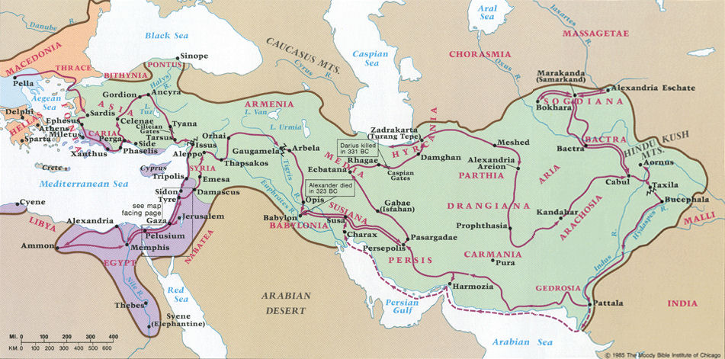

Slide 3
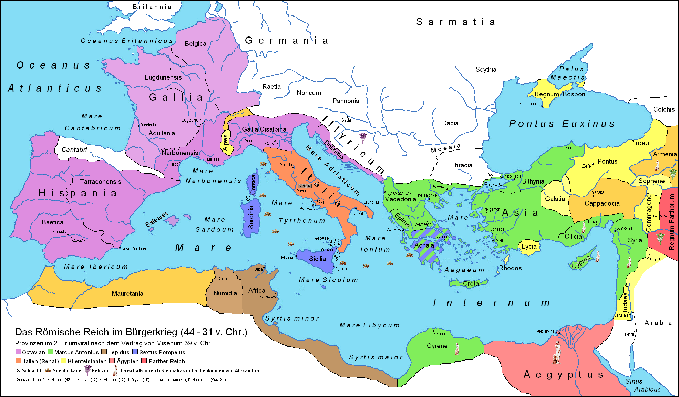

Slide 4
‘Donations of Alexandria’ – Cassius Dio 41.49
After this Antony feasted the Alexandrians, and in the assembly made Cleopatra and her children sit by his side; also in the course of his address to the people he commanded that she should be called Queen of Kings, and Ptolemy, whom they named Caesarion, King of Kings. And he then made a new distribution of provinces, giving them Egypt and Cyprus in addition; for he declared that in very truth one was the wife and the other the son of the former Caesar, and he professed to be taking these measures for Caesar's sake, though his purpose was to cast reproach upon Caesar Octavianus because he was only an adopted and not a real son of his. Besides making this assignment to them, he promised to give to his own children by Cleopatra the following districts: to Ptolemy, Syria and all the region west of the Euphrates as far as the Hellespont; to Cleopatra, the Cyrenaica in Libya; and to their brother Alexander, Armenia and the rest of the countries east of the Euphrates as far as India; for he even bestowed the last-named regions as if they were already in his possession.

Slide 5
‘Donations of Alexandria’ – Plutarch Life of Antony 54
He was hated, too, for the distribution which he made to his children in Alexandria; it was seen to be theatrical and arrogant, and to evince hatred of Rome. For after filling the gymnasium with a throng and placing on a tribunal of silver two thrones of gold, one for himself and the other for Cleopatra, and other lower thrones for his sons, in the first place he declared Cleopatra Queen of Egypt, Cyprus, Libya, and Coele Syria, and she was to share her throne with Caesarion. Caesarion was believed to be a son of the former Caesar, by whom Cleopatra was left pregnant. In the second place, he proclaimed his own sons by Cleopatra Kings of Kings, and to Alexander he allotted Armenia, Media and Parthia (when he should have subdued it), to Ptolemy Phoenicia, Syria, and Cilicia. At the same time he also produced his sons, Alexander arrayed in Median garb, which included a tiara and upright head-dress, Ptolemy in boots, short cloak, and broad-brimmed hat surmounted by a diadem. For the latter was the dress of the kings who followed Alexander, the former that of Medes and Armenians. And when the boys had embraced their parents, one was given a bodyguard of Armenians, the other of Macedonians. Cleopatra, indeed, both then and at other times when she appeared in public, assumed a robe sacred to Isis, and was addressed as the New Isis.

Slide 6
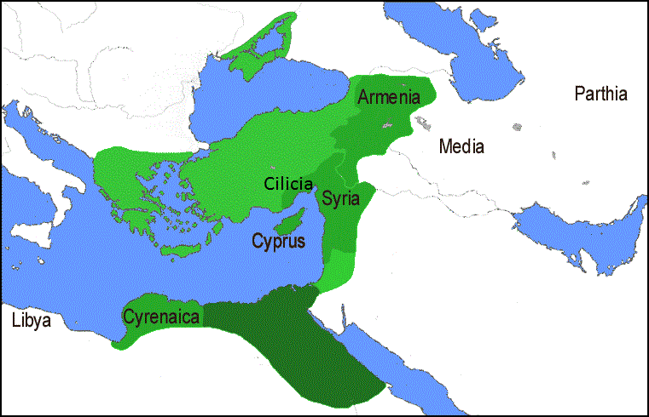

Slide 7
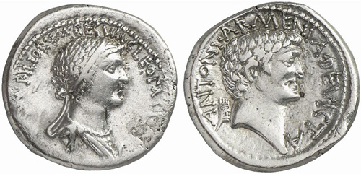
CLEOPATRA[E REGINAE REGVM]FILIORVM REGVM / ANTONI ARMENIA DEVICTA

