Slide 1
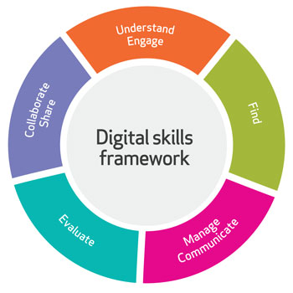
BMSW4013 ACADEMIC SKILLS FOR THE DIGITAL ERA
Component 3 (Individual Presentation)

Slide 2
Table Of Content
Introduction
Importance of Time Management
Common Challenges Students Face
Practical Strategies and Tools
Conclusion
Reference

Slide 3

Introduction
Good time management makes it easier for students to focus more, perform well, and lessen their stress levels.

Slide 4
Importance of Time Management
Managing time well is essential for students to do well in their studies.
It allows students to handle schoolwork, homework, and their personal life without too much stress.
It has been found that organizing time effectively can allow students to get better results in school and feel better overall (Demirdag, 2024).
If students make a plan and set priorities, they won’t procrastinate and can stay on track with their work, improving their learning and results at school

Slide 5
Common Challenges Students Face
While time management is very important, a lot of students still struggle with it.
Participants in the study said that digital temptations such as social media sites often break up their efforts to study (le Roux, et al., 2023).
Also, managing more assignments at once can become too much for students, preventing them from planning their studies and leaving them with things to complete at the last minute.
Some people also struggle with self-control, which makes it harder for them to organize their work properly.

Slide 6
Practical Strategies and Tools
Students can try a number of methods to become more efficient with time.
The Pomodoro Technique involves doing work in small spurts, with breaks to help improve your focus (Cirillo, 2018).
With a technique like the Eisenhower Matrix, it is easier to determine which tasks should be done first (Covey, 2020).
I can use Google Calendar, Trello, and Todoist to manage your personal and work tasks. Applying all of these strategies helps students become better organized and less stressed.

Slide 7
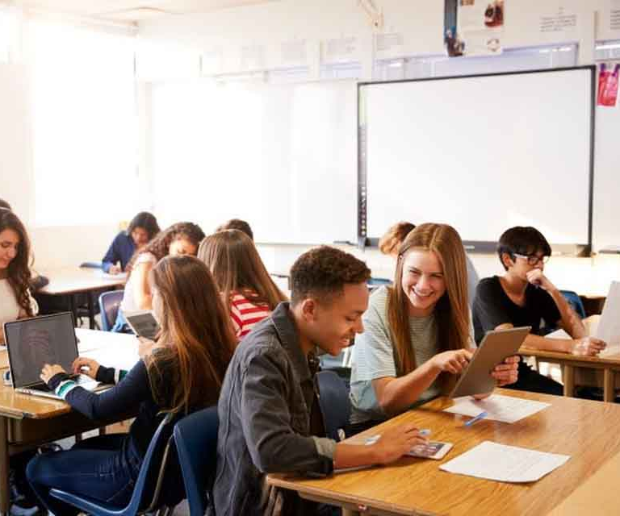
Conclusion
All in all, managing time effectively prepares students to handle their courses more easily and raise their standards of performance and health.
It is necessary to use methods and tools from both the digital and practical world in today’s flexible learning environments.

Slide 8
References
Books and Journals
Cirillo, F. (2018). The Pomodoro technique: The acclaimed time-management system that has transformed how we work. Crown Currency.
Covey, S. R. (2020). The 7 habits of highly effective people. Simon & Schuster.
Demirdag, S. (2024). The mediating role of life satisfaction in the relationship between graduate students’ time management and motivation. Asia Pacific Journal of Education, 44(4), 930-945.
le Roux, D. B., Finsterbusch, B., Saunders, J., and De, B. (2023, October). Increasingly Forgetful and Distracted? A cross-temporal meta-analysis of everyday cognitive failures among university students. In Proceedings of 52nd Annual Conference of the Southern African Computer Lecturers’ Association (SACLA 2023) (p. 125).

