Slide 1
Introduction to Learning Theory
Behaviourism

Slide 2
Schools of Learning Theory (Merriam and Caffarella, 1991 )
Behaviourism
Humanistic
Cognitivism
Constructivism

Slide 3
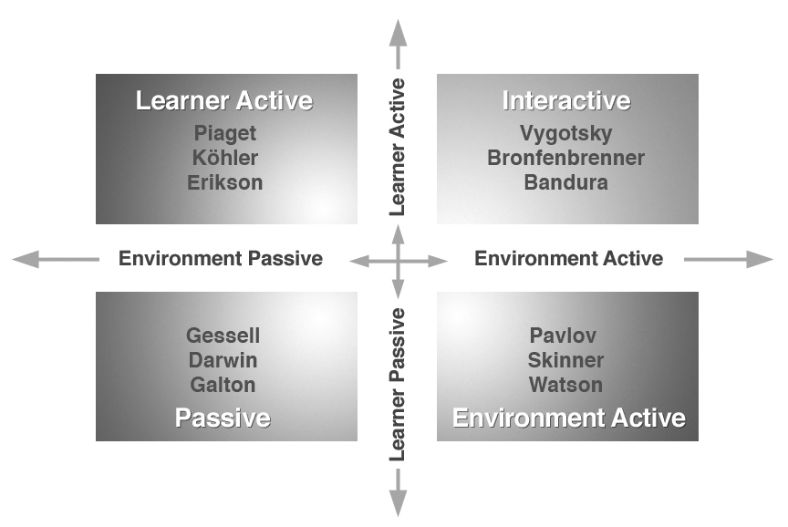
Matrix of perspectives
Annan et al (2011)

Slide 4
Behaviourism
Founders and proponents: Classical -Pavlov, Thorndike & Watson in the early 20th Century and Neo- Skinner later 20th Century
Basic idea: Stimulus response S=R
All behaviour is effected by external stimuli -operant conditioning
Behaviours can be explained without consideration of internal mind states
Learner is Passive, responds to environmental active stimulus
Behaviour may result in reinforcement and the increased likely hood that behavior will occur in the future , or in punishment

Slide 5
Humanistic
Founders and proponents: Maslow, Rogers and others
Basic idea: Learning is a personal act to which the learner is motivated to fulfil one’s potential
Learner viewed holistically engaging the affective and cognitive domains to meet own needs
Emphasis on freedom, dignity and potential of humans, this Learner active , environment passive

Slide 6
Cognitivism
Founders and proponents: Challenged behaviourism in 1960’s as dominant paradigm
Basic idea : Mental function can be understood
Cognitivism focuses on the learner's inner mental activities –the ‘black box’ of the human mind.
Processes such as thinking, memory , knowing , problem solving.
People are not ‘programmed animals’ that merely respond to environmental stimuli; people are rational beings whose actions are a consequence of thinking.
Learner viewed as Information processor , learner active and environment also active
Metaphor is the mind as a computer: information comes in, is being processes and leads to certain outcomes

Slide 7
Constructivism
Founders and proponents : John Dewey, Jean Piaget, Bruner, Vygotsky
Basic idea : Learning as an active process
Learner viewed as an information constructor
People actively construct their own subjective representations of objective reality. New information is linked to prior knowledge , thus mental representations are subjective

Slide 8
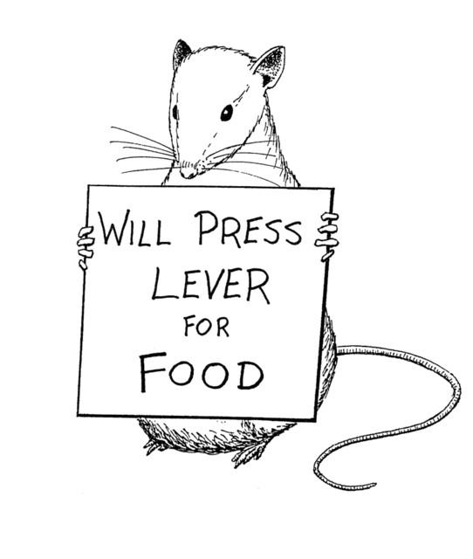
Behaviourism

Slide 9
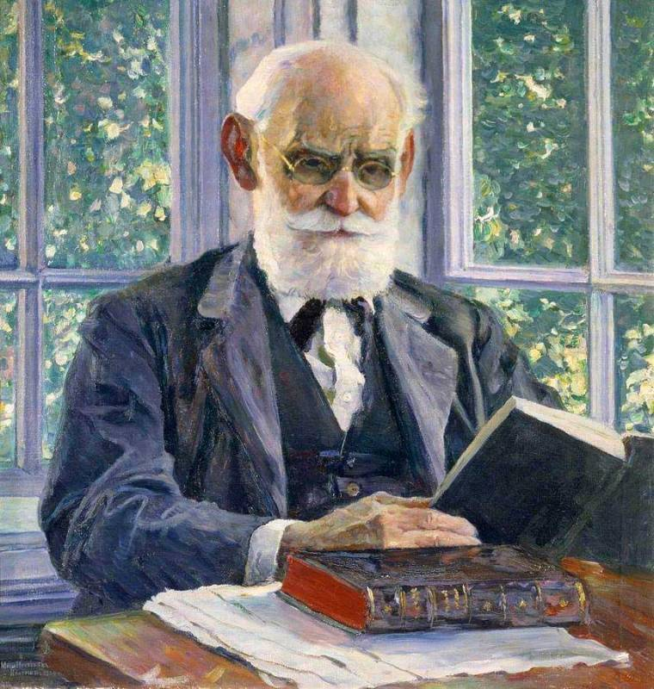
Pavlov ‘Stimulus response learning’
This Photo by Unknown Author is licensed under CC BY-SA

Slide 10

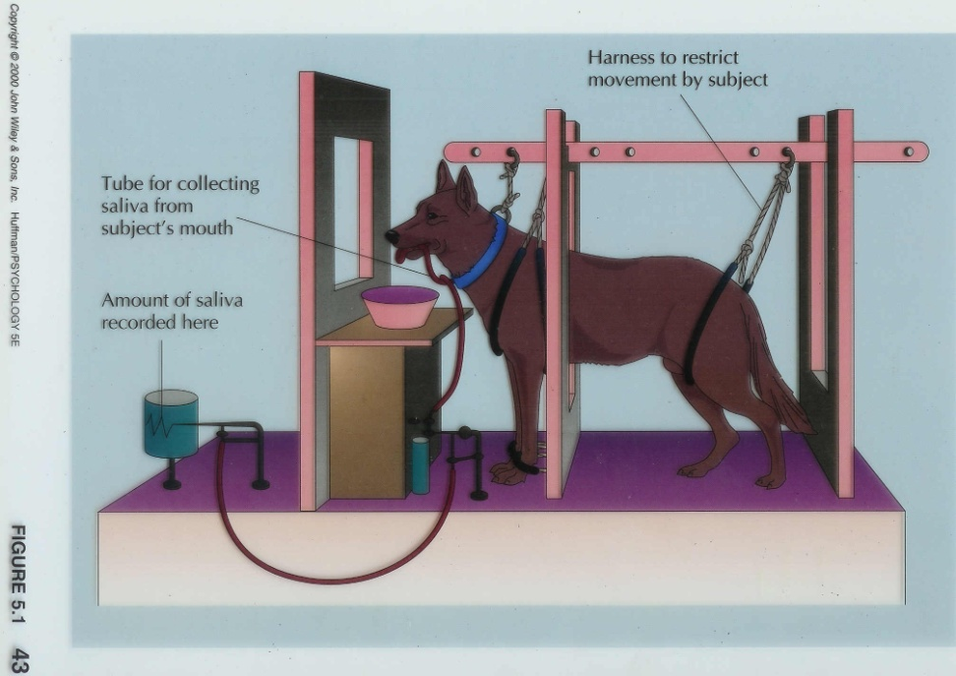
Pavlov’s dog experiment
The experiment involved Pavlov’s assistant giving the dog food and the dog learnt to associate food with the assistant.

Slide 11
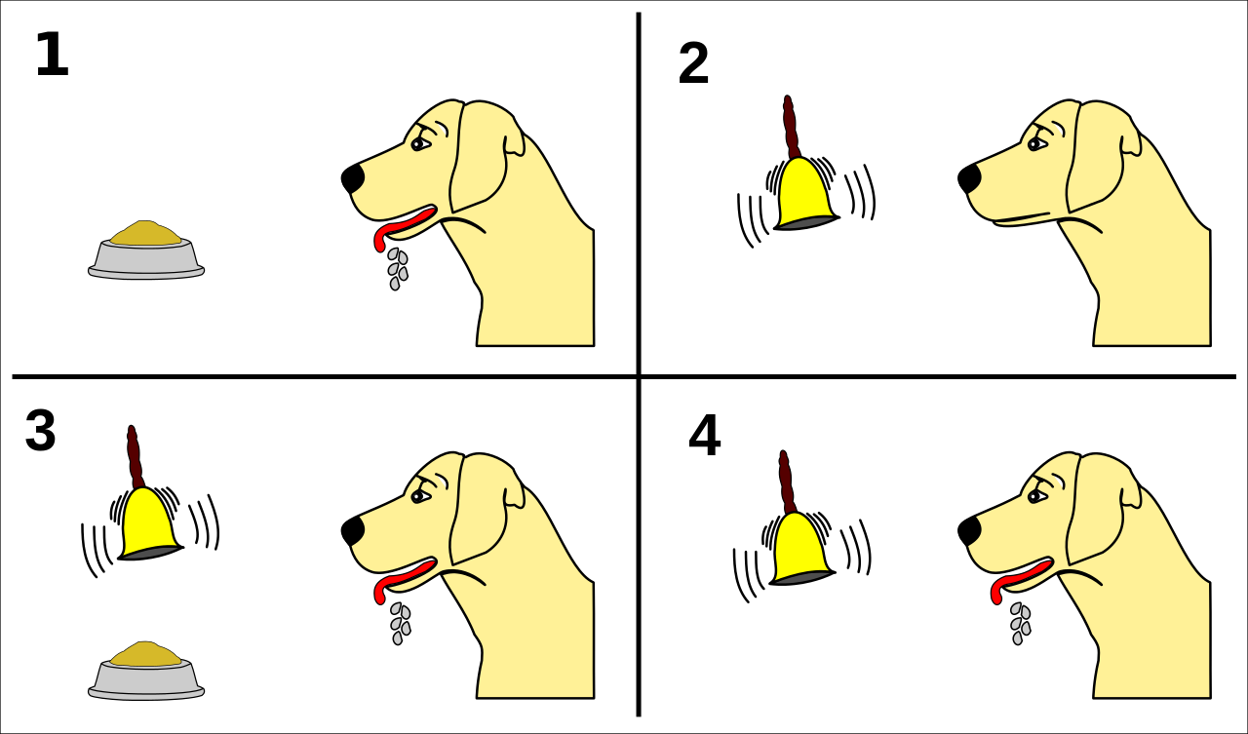
Pavlov’s dog experiment
The experiment involved Pavlov’s assistant giving the dog food and the dog learnt to associate food with the assistant.
Once this association was established in the dog to the stimuli so as to produce a reflex, Pavlov rang a bell every time he gave the dogs food. Therefore the dogs began to associate the bell with food.
When Pavlov removed the food and just rang the bell, the dogs carried on salivating.
So the neutral stimulus (the bell) had become a conditioned stimulus producing a conditioned response (salivation).
This Photo by Unknown Author is licensed under CC BY-SA

Slide 12
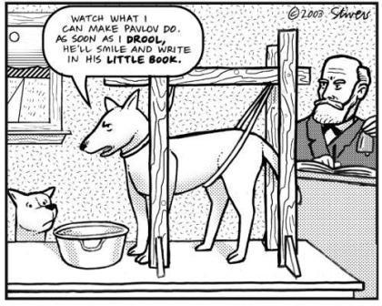
Pavlov Concludes
The neutral stimulus (Bell) had become associated with the unconditioned stimulus (the food), so triggering a reflex (salivating)
Behaviours are learnt or conditioned according to associations in our environment
Human beings can widen their associations using their imaginations.
Pavlov also concludes that conditioning and phobias were such that if a child is bitten by a dog, the normally neutral stimulus (dogs) has produced an association of pain and fear. This can be generalised to every dog, so the sight of any dog produces anxiety and fear. The neutral stimulus has become a conditioned stimulus to a conditioned reflex, fear.

Slide 13
YouTube video
A documentary segment describing Pavlov’s Experiments on YouTube . This is the link to that video : https://www.youtube.com/watch?v=asmXyJaXBC8

Slide 14
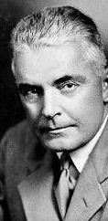
Watson
‘Behaviour shaped by environment’
We enter the world as a blank slate.
Our unique ways of behaving are a result of our environment and experiences.
Rejected Freud’s concept of the unconscious as unscientific.
Based his theories on observation alone.
J.B.Watson (1878-1958)

Slide 15
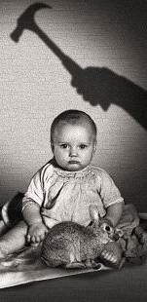
Little Albert Experiment
Watson attempted to show how humans could be conditioned.
He took an 8 month old baby, little Albert, who previously had no fear of rats.
His neutral stimulus was a loud sound just behind Albert’s head, which upset him.
Every time the rat appeared, Watson made the loud sound.
This Photo by Unknown Author is licensed under CC BY-SA-NC

Slide 16
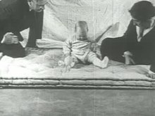
Little Albert Experiment
Watson presented Albert with the rat on his own, with no noise of a metal bar, and Albert started crying.
Albert had learnt to associate the rat with the upsetting noise, producing a conditioned reflex (crying).
He also found that Albert generalised his fear to all white furry objects.

Slide 17
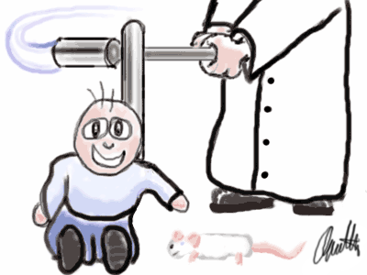
YouTube Video
There is some original footage of the Little Albert Experiment on YouTube .
This is the link to that video : http://www.youtube.com/watch?v=eZO7TwS-sGw

Slide 18
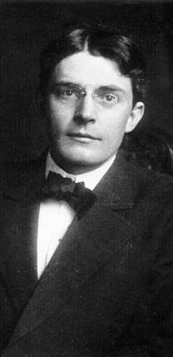
What Watson concluded..
Humans learn by a process of conditioning.
He believed you could take any child and turn them into whoever you wanted.
He stated ….
“I’ll guarantee to take anyone at random and turn them into the specialist which I select”.
This Photo by Unknown Author is licensed under CC BY-SA

Slide 19

Conditioning and phobias
Watson explained fear and phobia with conditioning
If a child is bitten by a dog, the normally neutral stimulus (dogs) has produced an association of pain and fear.
This can be generalised to every dog, so the sight of any dog produces anxiety and fear.
The neutral stimulus has become a conditioned stimulus to a conditioned reflex, fear.

Slide 20
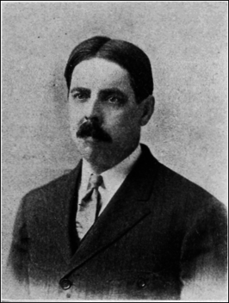
Thorndike
The law of effect principle developed by Edward Thorndike suggested that: "responses that produce a satisfying effect in a particular situation become more likely to occur again in that situation, and responses that produce a discomforting effect become less likely to occur again in that situation (Gray, 2011, pp 108–109)."
Edward Thorndike 1874-1949

Slide 21
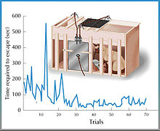
Experiments
Thorndike studied learning in animals (usually cats). He devised a classic experiment in which he used a puzzle box (see fig. 1) to empirically test the laws of learning.
He placed a cat in the puzzle box, which was encourage to escape to reach a scrap of fish placed outside.
Thorndike would put a cat into the box and time how long it took to escape.
The cats experimented with different ways to escape the puzzle box and reach the fish

Slide 22
Thorndike concludes , the law of effect
Edward Thorndike put forward a “ Law of effect” which states that any behavior that is followed by pleasant consequences is likely to be repeated, and any behavior followed by an unpleasant consequence is likely to cease.

Slide 23
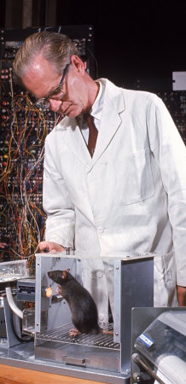
Skinner’s Experiments
Skinner put rats in a cage
When the rat accidentally pressed a bar on the wall, a food pellet (the reinforcer) was released
In no time the rat was furiously tapping away at the bar
If you stop giving pellets the rat quickly stops pushing the bar
The rat resumes its behaviour much more quickly when the pellets are reintroduced. It has learned by experience.

Slide 24
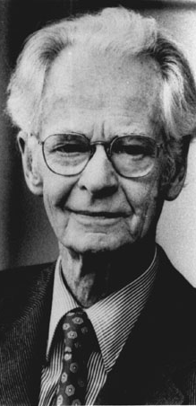
Skinner
Operant Conditioning
We learn by positive and negative feedback.
These feedbacks are called reinforcements.
The more positive reinforcement we receive, the more we will voluntarily repeat that behaviour (praise, prizes, rewards, satisfaction).
By operant Skinner means “behaviour occurring just before the stimulus”.
So…operant conditioning means causing repeat behaviour patterns just before a stimulus occurs.
B.F. Skinner (1904-90)

Slide 25
Skinner’s conclusions
Skinner thought free will, consciousness, the unconscious were “mentalist constructs”, unobservable and so useless for scientific enquiry.
The problem with society, he argued, is that our positive and negative reinforcers are out of control. Governments need to take control of society so good is rewarded and bad punished, so we can “design our culture” by operant conditioning.
A behaviour followed by reinforcement causes the behaviour to be repeated
If the reinforcement is withdrawn, the behaviour diminishes
So frequency and nature of reinforcements are vital to sustain a desired behaviour

Slide 26
End of part one

