Slide 1

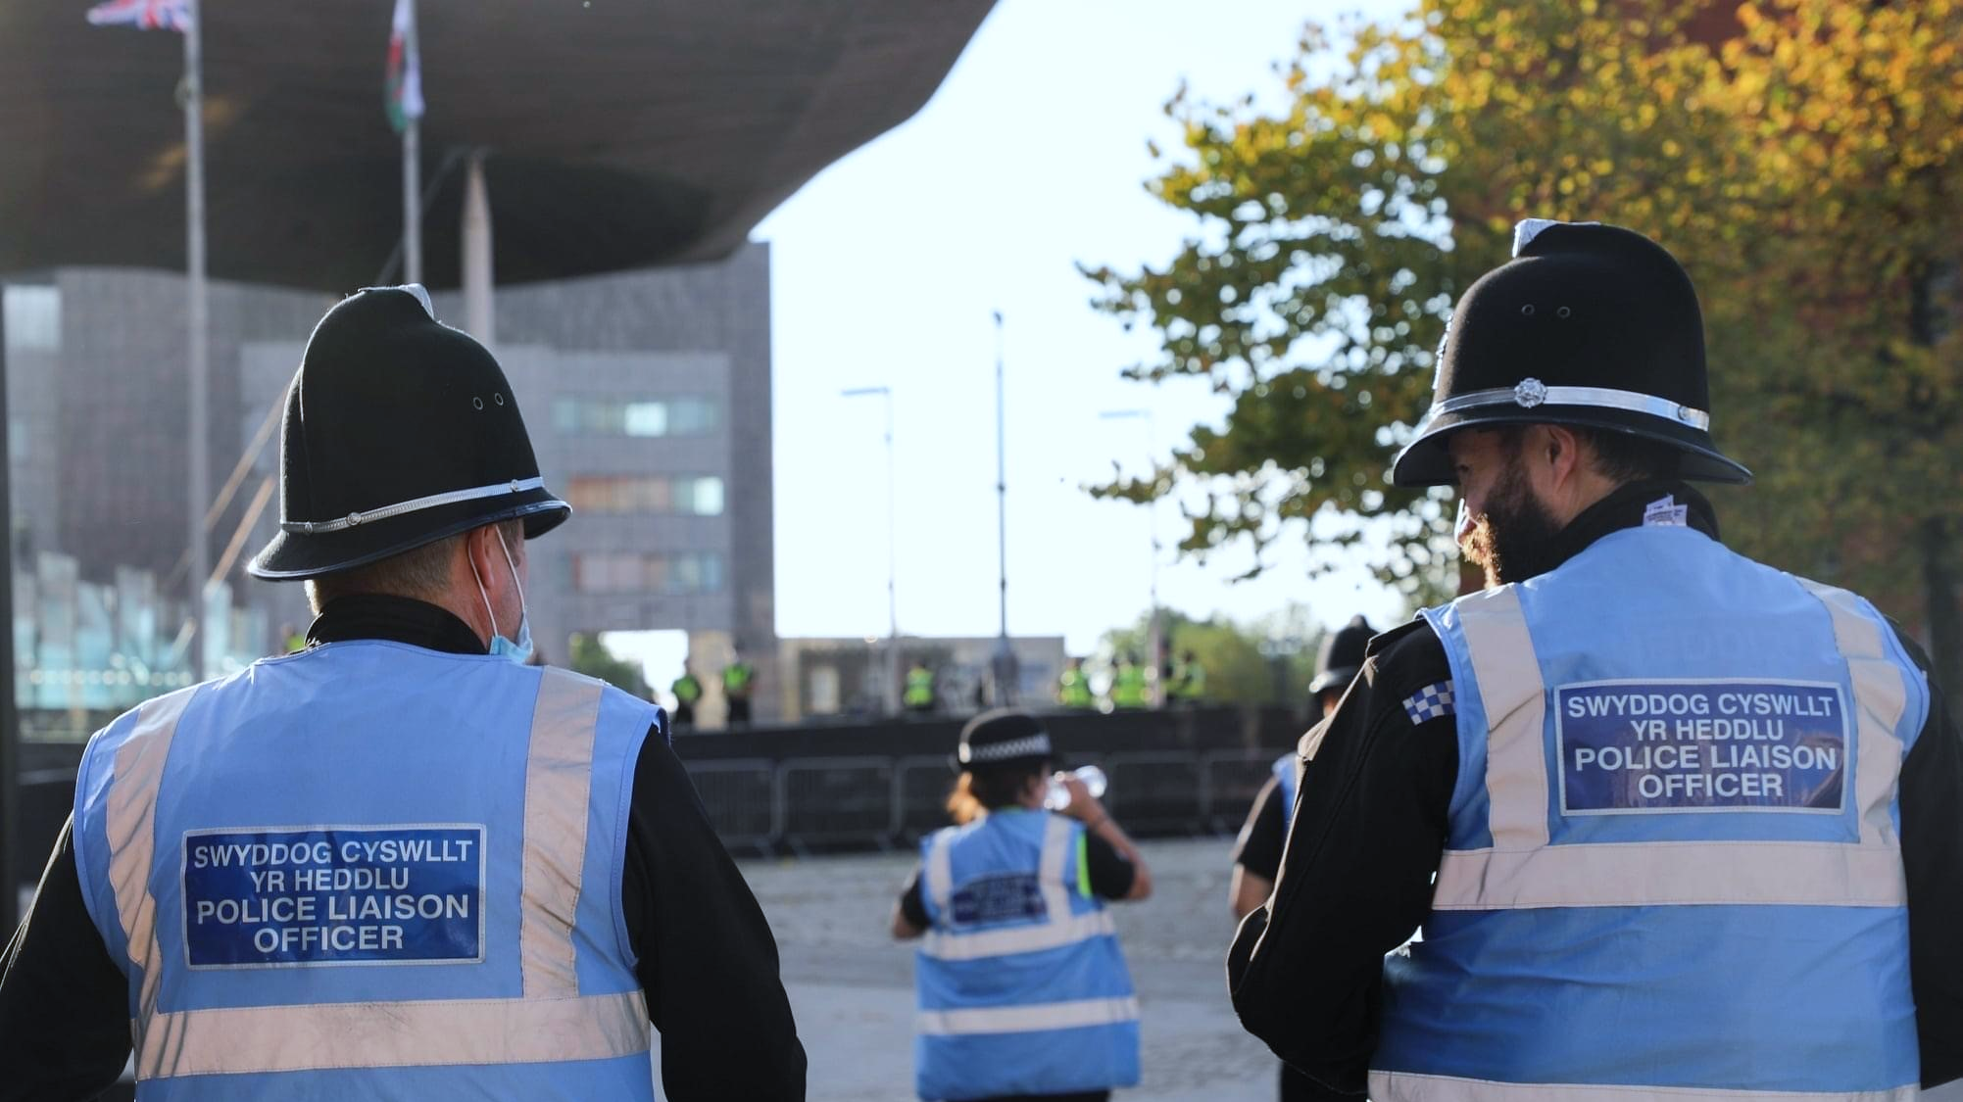
Communication Skills
Communication
V4.0
Notes:
By the end of this lesson, you will be able to:
Explain the importance of effective communication in policing
Identify the barriers to communication
Identify examples of Cognitive Dissonance
Summarise the essential elements of communication and questioning
Explain how communication styles can be adapted for different audiences
Identify the impact that different communication styles can have on individuals and their communication
Identify examples of cognitive dissonance
Identify the 7 elements of effective negotiations to help deal with differences and conflict
Identify ways to manage difficult conversations
All of us are constantly in a state of giving and receiving communications. Problems arise when one does not receive, or understand, the message sent in the communication as it was intended, or when one subconsciously sends a nonverbal message that contradicts the spoken word. This session attempts to help understand the importance of good communications skills at work.

Slide 2





https://www.youtube.com/watch?v=Q7LKJXvf_do
Notes:
Images to be used as a ‘Hook’ for the lesson
Q. What do you see?
Image 1 could be a young cowboy looking away whereas it could be an older cowboy (chin or nose respectively)
Image 2 what are the 2 people in the foreground wearing? The male is wearing the blue top and white jeans…….or not?
We see and interpret things differently and this can complicate communication. Things aren’t always what they seem – this is important for a police officer!

Slide 3
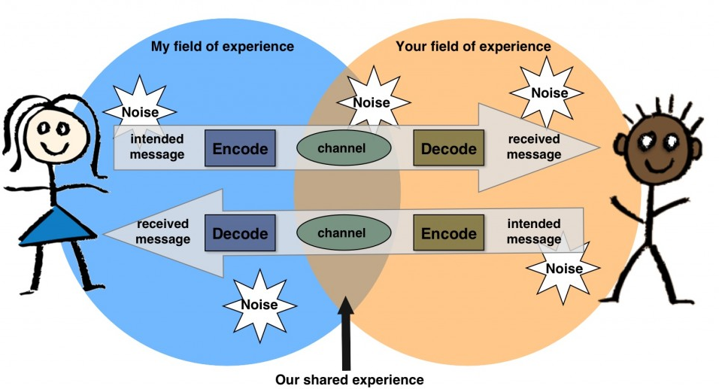
The Communication Process
Definition: ‘The imparting or exchanging of information by speaking, writing, or using some other medium.’
Heatherplett.com
Notes:
Board blast 1:
Q. What are the 3 main methods we use to communicate?
Verbal - face-to-face, telephone, radio or television and other media
Non-verbal - body language, gestures, how we dress or act, where we stand, and even our scent. There are many subtle ways that we communicate (perhaps even unintentionally) with others. For example, the tone of voice can give clues to mood or emotional state, whilst hand signals or gestures can add to a spoken message.
Written - letters, e-mails, social media, books, magazines, the Internet and other media
QTS – Can you give me some examples of verbal, non-verbal and written communication? Trainer to note student responses and record on whiteboard
Each of these methods involve the communication process. Trainer to show PPT slide and explain the model as follows:
Communication occurs when a sender expresses an emotion or a feeling, creates an idea, or senses the need to communicate.
The sender has a message, which they encode (i.e. decides what to send – words, pictures etc.
They then decide which communication channel is the best method to send the message through receiver (e.g. letter, email, phone etc.)
The receiver gets the message and decodes it (i.e. makes sense/interprets it)
The receiver the encodes a message to send back to the receiver (i.e. gives feedback)
This feedback allows the sender of the original message to check whether the receiver interpreted the message correctly or not.
This is known as 2-way communication or effective communication.
Board blast activity:
Q. How does the organisation communicate? E.g. letters, memos, newsletters, bulletin board notices, signs, emails, presentations, telephones, radios, other audio media etc.
Image from: heatherplett.com

Slide 4
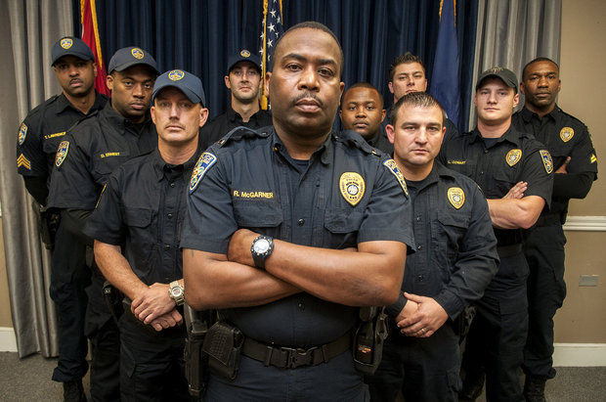
Police Communications
‘Cops too often view communication as a one-way activity meant to direct and control others.’ Right or wrong?
Poor communication impacts on trust, co-operation and ultimately the consent of the public thus hampering our effectiveness as police officers. Effective communication is of significance to the success of policing.
Notes:
Activity 1: ‘Cops too often view communication as a one-way activity meant to direct and control others.’
Q. What is right about this statement? Discuss
Q. What is wrong with this statement? Discuss
QTS
What dealings have you had with police officers/staff?
Was the communication effective or not?
Why is effective communication essential in policing?
Without the cooperation of the public, policing in developed democracies would become essentially unworkable. In simple terms, the police service would cease to function without the active support of the communities it serves.
Evidence has shown that effective community engagement, targeted foot patrols and collaborative problem solving can significantly increase public confidence in policing activity.
By improving public perceptions and increasing trust through fair decision making and positive public interaction, the police service can enhance its legitimacy.
Policing by consent requires public support for policing activity at every level. The purpose of engagement and the level at which people and communities are to be involved should be clear.
How does effective communication encourage future cooperation with local communities?
Online technology and communications has had a profound effect on the way communities interact. This is creating a shift from understanding communities as solely limited to geographical areas towards communities of shared interest or background. In understanding the complexity of communities, it is important to understand the ways in which people network, communicate and interact and how this influences the formation of communities in both geographic and virtual terms.
Benefits of effective communication
Evidence has indicated that the potential benefits of effective community communication and engagement include:
an increase in public perceptions of safety
a tendency towards a reduction in disorder and anti-social behaviour
an increase in confidence and trust, and in community perceptions of the police
an improvement in police officers’ attitudes and job satisfaction.
All of these benefits can have a positive impact on the ability of the police to tackle crime and anti-social behaviour.
Failing to engage and communicate
a loss of public confidence in the police
a loss of legitimacy in the eyes of the public
a negative impact on strategic policing as the police are unable to predict changes in community profile, needs and priorities
increased vulnerabilities around threat, risk and harm
withdrawal of the public from participation and problem solving, leading to services that are less responsive to the needs of the public and require increased policing resources
unrealistic public expectations regarding policing services
lack of awareness of changes in the community and tensions not being identified, leading to a negative impact upon tactical policing

Slide 5
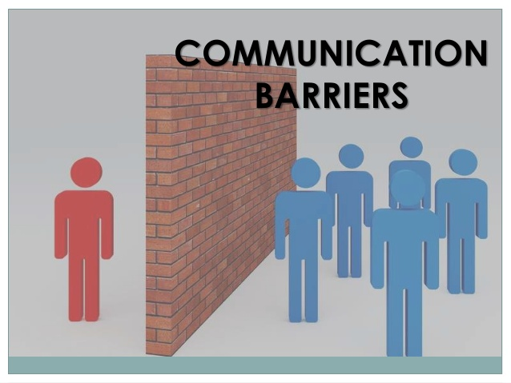
Barriers to Communication
Semantic: meaning Organisational: culture, relationships, structure etc. Psycho- sociological: emotional & psychological status of sender and receiver Cultural: values, beliefs, traditions, interpretations etc. Physical: noise, time, distance, defects in technology etc.
Notes:
Before showing the PPT slide, the trainer to explain that there are always potential barriers to effective communication. Barriers are the factors, which influence the clarity, accuracy and effectiveness of the message, by acting upon any or all of the basic elements of the communication process.
Recognising barriers to effective communication is the first step in improving communication style.
Board blast:
What are some of the potential barriers to effective communication?
Answers may include:
language itself can be a barrier—unclear wording, slang, technical words, jargon (e.g. overuse of acronyms and abbreviations) etc.
body language might contradict the spoken message.
tone of voice
the channel used to convey the message might be wrong e.g. you would not use the telephone to relay a lot of statistical information; you would need to write that message on paper or put it on a PPT presentation
poor listening skills can be a barrier
accents and dialects
Trainer to show PPT slide and discuss the 5 main barriers to effective communication in organisations. These are:
Semantic barriers: Semantics: the science of meaning
Disruptions in understanding the meaning of words and information exchanged. Use of technical jargons (e.g. USP)
Words having similar pronunciation but different meanings.(homophones) e.g.. Sight, site, cite
Words with different Meanings e.g.
He is facing a problem
Your face is oval shape
Organizational barriers: Communication can be affected by the different factors in organisation :
Organization Culture
Status relationship
Complexity in structure
Inadequate facilities
Psycho-Sociological barriers: The meaning assigned to a message depends upon the emotional and psychological status of both sender and receiver.
Style (i.e. accent, humour etc. )
Selective perception
Halo & horns effect
Inattention
Status relationship
Cultural Barriers: Different cultural norms, values, traditions and cultural behaviour.
Examples:
When the Japanese say “Yes”, they mean “Yes, I am listening”. The Americans may take it to mean, “Yes , I agree.”
Many Americans take an informal approach towards their colleagues, referring to nearly everyone by their first names, a practice that people from more Asian cultures may find disrespectful or even offensive.
In Israel, people are generally more accustomed to speaking loudly than in America.
Physical Barriers: Physical distractions and defects in the medium/ channel involved.
Environmental factors like noise, temperature, lighting, room size , arrangement of seating, distance between participants, voice and visual qualities.
Defects in the medium: the telephone, postal system, courier service or electronic media may fail or break down.

Slide 6
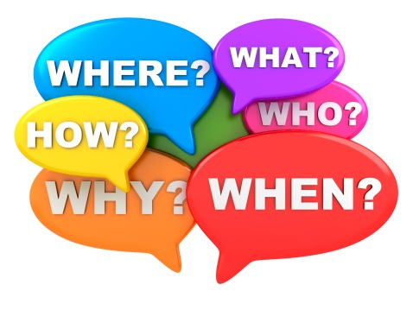
Overcoming Barriers to Communication
Sender: 5WH
Receiver: Active Listening
Be attentive
Ask questions
Get clarification
Paraphrase
Summarise
Notes:
Before showing PPT slide, trainer to facilitate board blast activity:
Q. How can we overcome barriers when sending and receiving communications?
sending information? The sender should consider:
Who? (the audience)
When? (the right time to send information)
Where? (if face to face, then somewhere with minimal disruptions)
What? (the idea. Information, message – what to say …)
Why? (motive for sending the information/message)
How? (the media to ensure clarity)
b) receiving information? The receiver should actively listen by:
Paying attention:
Asking questions:
Clarifying:
Paraphrase:
Summarise:
Q. What other things can we do to show that we are actively listening? e.g. nodding, smiling, eye contact, mirroring etc.
Q. Why is it important to actively listen? e.g. it makes the sender feel valued and so they are likely to share more in depth detail with you. It also helps to build rapport and therefore trust more likely to be achieved.

Slide 7

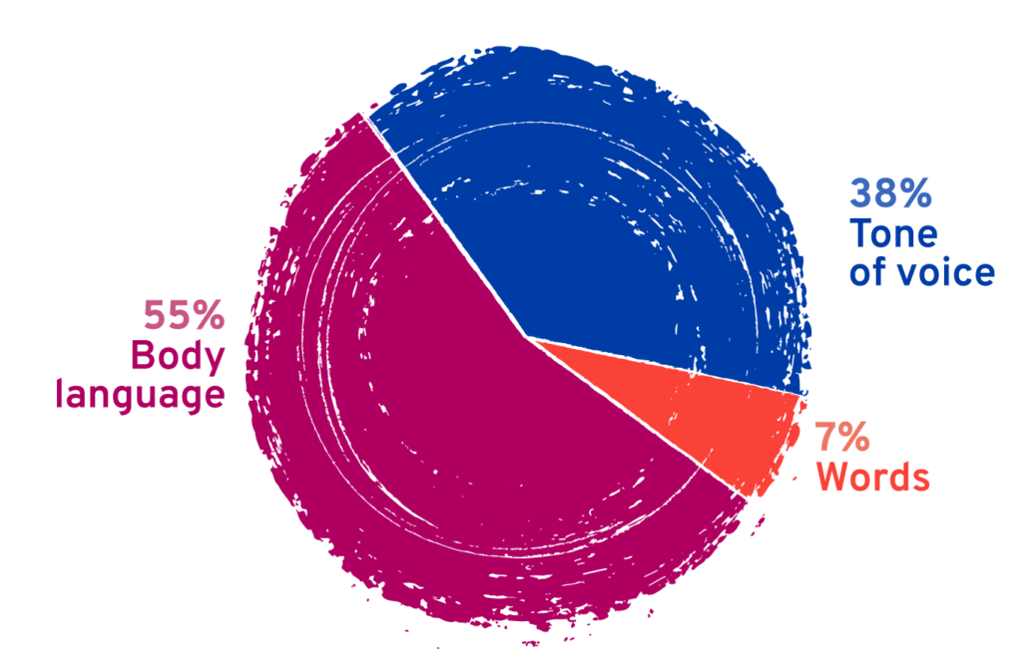
Non-verbal Communication
Mehrabian Communication
Model
Why should I care? Shouldn’t I just be myself?
Notes:
Non-verbal communication is communication without using words. Body language is a branch of this communication focusing mainly on the different body gestures and facial expressions. Non-verbal communication is the largest area of our communication.
According to Mehrabian, approx. 55% of all our communication is non-verbal.
Remember ‘Blink’ by Malcolm Gladwell - the book which describes how we instantly make a decision about someone on limited information. This comes from non-verbal communication.
Board blast:
Q. Can you give examples of non-verbal communication?
Answers should include:
Facial expressions
Gestures
Posture
Touch
Tone of voice
Rate of speech
Volume of voice
Physical appearance
Stress of voice
Personal space
Clothes
Hair style
Hygiene
Engagement with others (such as how long do you keep eye contact)
Q. So why is body language so important in communication?
Firstly, to understand how we come across to other people and be able to send the right message – “Trust me, I’m not out to get you!”
Secondly be able to read the signals that another person is sending back.
By adjusting the way we stand, move, dress and interact we can make encounters with other human beings (and probably most animals too!) much easier and smoother.

Slide 8
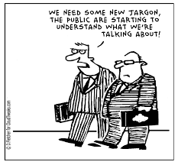
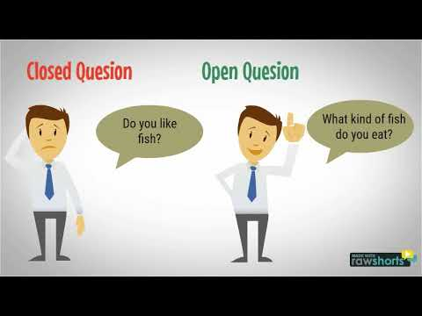
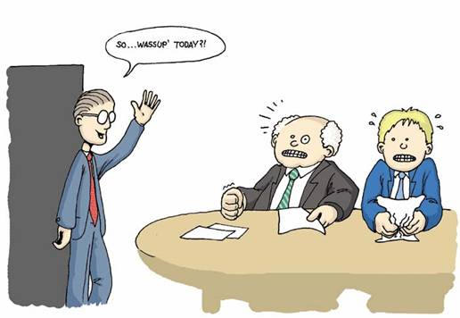
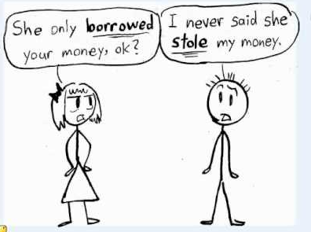
Other Elements of Effective Communication
Ask open questions
Avoid jargon
Speak clearly
Intonation
Notes:
Speak clearly and avoid jargon:
Q. What do we mean by speak clearly? (speed, volume & tone PLUS language and choice of words)
Q. What do we mean by avoid jargon? (words or expressions used by professions or groups, which are difficult for others to understand).
Pay particular attention to this as police officers communicate in a specific language, using culturally accepted terminology such PNC, PND, PCSO etc.
Ask open questions: questions: ‘
Open questions:
require longer answers
Are often descriptive and explanatory
Begin with words such as how, what and why
Closed questions:
Require shorter answers
Are often factual
Begin with words such as who, which, when and where
Q. Can you give me some examples of open and closed questions you might use as a police officer?
Ideally you should use open questions when communicating as these have the best chance of obtaining a full answer.
Open questions are TED questions:
Tell
Explain
Describe
Closed questions are to be avoided. However, they can be used in limited circumstances such as time pressured or highly emotive situations.
Intonation: This is the way the voice rises and falls while you speak. Very often it changes the main idea of what is said, going beyond the exact meaning of the words to indicate how the speaker feels.
Activity 2: Intonation and meaning.

Slide 9
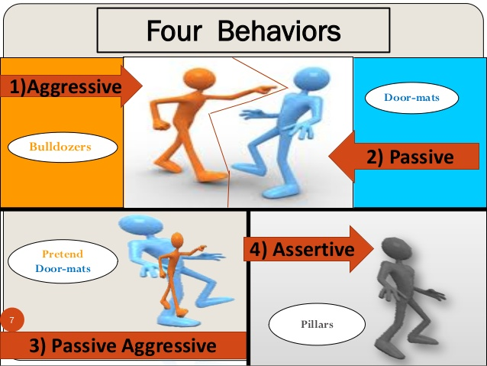
The 4 Basic Communication Styles
Notes:
Every person has a unique communication style, a way in which they interact and exchange information with others. There are four basic communication styles: passive, aggressive, passive-aggressive and assertive.
QTS – How would you communicate with each of the individuals in the photos?
QTS - What factors influence how you communicate with them?
The impact of passive communication is that these individuals:
often feel anxious because life seems out of their control
often feel depressed because they feel stuck and hopeless
often feel resentful (but are unaware of it) because their needs are not being met
often feel confused because they ignore their own feelings
are unable to mature because real issues are never addressed.
The impact of aggressive communication is that these individuals:
become alienated from others
alienate others
generate fear and hatred in others
always blame others instead of owning their issues, and thus are unable to mature.
The impact of passive-aggressive communication is that these individuals:
become alienated from those around them
remain stuck in a position of powerlessness
discharge resentment while real issues are never addressed so they can't mature.
The impact of assertive communication is that these individuals:
feel connected to others
feel in control of their lives
are able to mature because they address issues and problems as they arise
create a respectful environment for others to grow and mature.

Slide 10
The 4 Basic Communication Styles
Passive: fail to assert for themselves allow others to deliberately or inadvertently infringe on their rights fail to express their feelings, needs, or opinions tend to speak softly or apologetically exhibit poor eye contact and slumped body posture | Aggressive: try to dominate others use humiliation to control others criticize, blame, or attack others have low frustration tolerance speak in a loud, demanding voice not listen well & interrupt frequently use “you” statements
Passive-Aggressive: mutter to themselves rather than confront the person or issue have difficulty acknowledging their anger use sarcasm deny there is a problem appear cooperative while purposely doing things to annoy and disrupt | Assertive: state needs and express feelings clearly, appropriately, and respectfully use “I” statements listen well without interrupting have good eye contact have a relaxed body posture stand up for their rights
Notes:
Every person has a unique communication style, a way in which they interact and exchange information with others. There are four basic communication styles: passive, aggressive, passive-aggressive and assertive. Trainer to discuss the 4 styles using the table on the PPT presentation.
Activity 3: Trainer to put students into 4 groups. Each group to make a list of the potential impact that their given style of communication may have on individuals.
Group 1: Passive
Group 2: Aggressive
Group 3: Passive-Aggressive
Group 4: Assertive
Each group to record answers on flip chart paper and feedback to other groups.
Potential answers should include:
The impact of passive communication is that these individuals:
often feel anxious because life seems out of their control
often feel depressed because they feel stuck and hopeless
often feel resentful (but are unaware of it) because their needs are not being met
often feel confused because they ignore their own feelings
are unable to mature because real issues are never addressed.
The impact of aggressive communication is that these individuals:
become alienated from others
alienate others
generate fear and hatred in others
always blame others instead of owning their issues, and thus are unable to mature.
The impact of passive-aggressive communication is that these individuals:
become alienated from those around them
remain stuck in a position of powerlessness
discharge resentment while real issues are never addressed so they can't mature.
The impact of assertive communication is that these individuals:
feel connected to others
feel in control of their lives
are able to mature because they address issues and problems as they arise
create a respectful environment for others to grow and mature.

Slide 11


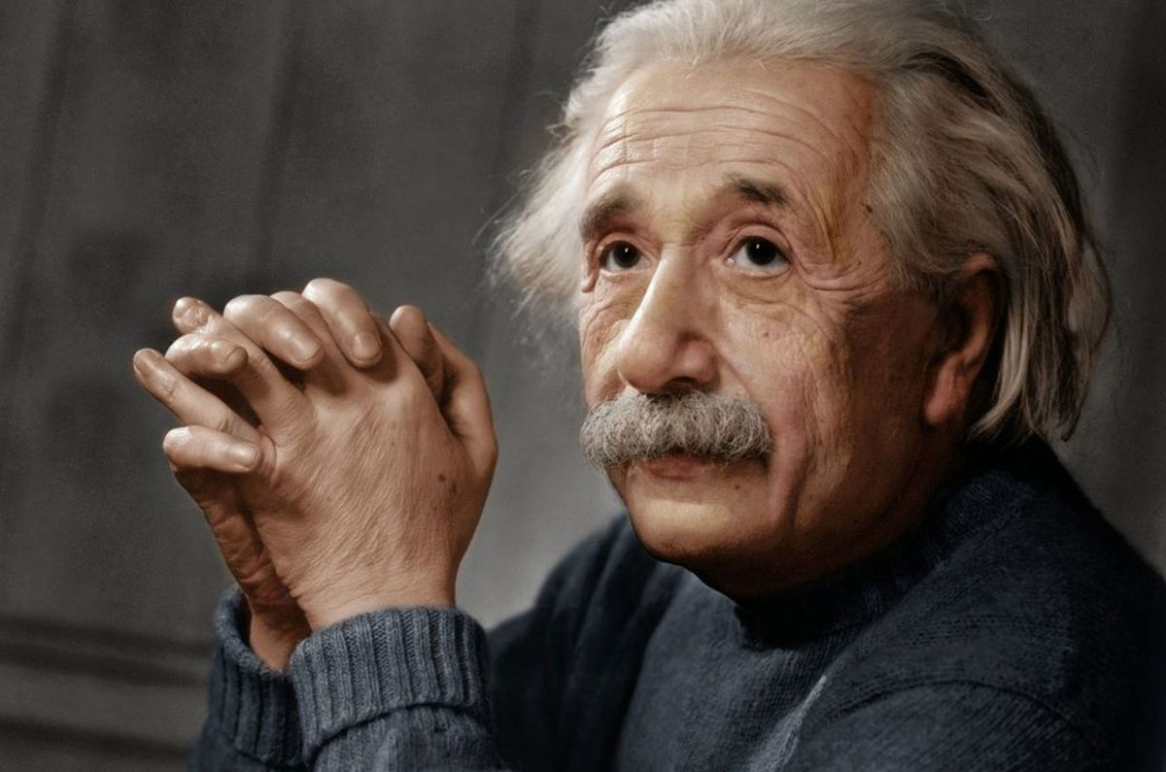

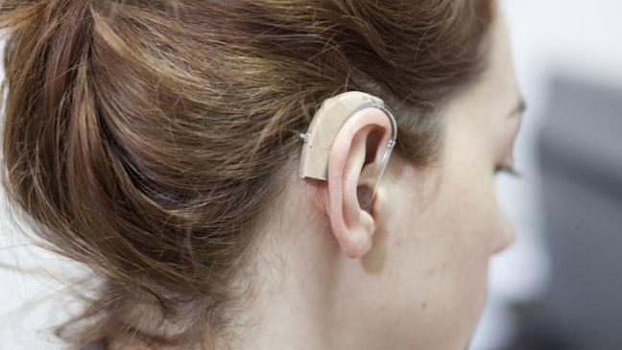

Adapting Communication Style to Suit Different Audiences
Notes:
Q. Would you communicate with each of the individuals in the photos in the same manner? No.
Image 1:- Cultural
Image 2:- Language
Image 3:- Children
Image 4:- Disability
Image 5:- Autism (Neurodiversity)
Image 6:- ADHD (Neurodiversity)
Split class into groups and get students to discuss the impacts in communication with these groups at an incident. Groups to be prepared to discuss findings with rest of class.
Q. What factors influence how you communicate with them?
Answers could include:
Know your audience: a) Adapt your style to suit your audience e.g. formal or informal, personal, language etc. b) Match your vocabulary to the audience
Mirroring: Mirror some of the gestures and words used by your audience
Tone of voice: Adjust the tone of your voice to suit the situation e.g. serious, encouraging, casual
Neurodiversity
Neurodivergent people may have problems with ‘normal’ forms of communication. Some people on the autistic spectrum, for example, have difficulties in reading other people’s facial expressions, body language or nuances within conversations. There is a vast range of conditions covered by the term Neurodiversity such as: DLD, DCD, Dyslexia, Cerebral Palsy, Tic Disorders, ASD, ADHD, Depression, Anxiety, MS, OCD, Epilepsy and many more. They all have their own strength and weakness. How people convey their difficulties will also vary depending on their past experiences and present circumstances and can change with changing demands.
You will have to treat each one differently and according to their needs which will involve finding these out from them or the person they are with. Some generic suggestions to aid communication include:
try to avoid using jokes, sarcasm or ambiguous statements;
be clear and direct, using concise sentences;
use short sentences in written communications;
sometimes diagrams are better than written communications or instructions;
where appropriate, use closed rather than open questions;
ADAPTING COMMUNICATION STYLES
For an autistic person, communicating with an allistic (non-autistic) colleague – or perhaps several at once – can be confusing and exhausting. Whether consciously or not, autistic people often feel the need to mask their differences in order ‘to fit in’ with the allistic people around them. But effective communication is a two-way process.
Ask
All changes need to be person-centred. What works for one autistic person may not work for another. It is always best to ask others how they prefer to communicate with you rather than just assume. This is true of all Neurodiverse persons not just those who identify as autistic.
Slow down
Most of us are probably guilty of speaking too quickly. This can be overwhelming for some autistic people. But getting the pace and tone right can be difficult – you don’t want your conversation to sound unnatural or patronising. Try adding pauses. This will give your communication partner the extra time they may need to process and sort what you are saying. It may feel a little awkward to begin with but it will have a positive effect on your communication.
Give clear instructions
Clarity is important, particularly when giving instructions. Begin with the person’s name so they know that you are addressing them directly. Avoid abstract or generic terms, which may have little meaning for your communication partner. Keep instructions short and precise, and prioritise them in the order of importance. Give neurodiverse people time to process information.
While being direct can be helpful, you need to judge the situation. If an individual seems stressed or anxious, then it is best to avoid demanding language, such as ‘must’ or ‘now’.
Limit small talk
It is common in most settings to begin or end a conversation or encounter with small talk. It is often how we bond with people and build mutual understanding. For autistic people, however, small talk can be confusing and tiring, especially if it is on a topic which seems out of context or irrelevant. Try to find out about your communication partner’s interests, and invite them into the conversation by asking them a direct question. Keep small talk short, and make it easy for them to exit a conversation or remain quiet, if they wish to.
Written communication
Many autistic people prefer written communication, such as emails or text chat, to speaking on the telephone. Written communication can be easily referred back to and there is time for processing information and structuring a response. Just like spoken communication, however, it is important that written information is clear and to the point.
Avoid ambiguous or vague language. Many time expressions, such as ‘let’s talk about this later’ or ‘I need this done ASAP’, might be part of everyday language, but actually provide the autistic person with very little information. Does later mean later today, tomorrow, or later this week? Does ASAP mean in five minutes or by the end of the day? Use accurate time phrases instead, for example, ‘Let’s talk about this when we meet at 4pm’ or ‘This needs to be completed by midday’.
Too many filler words and phrases, such as ‘actually’ or ‘to be honest’, can also be confusing for autistic people as they make your message less clear and harder to understand. Highlight important information at the beginning of any emails or written correspondence. Use bullet points or numbering to separate out information. Consider using visual aids where possible.
Phone calls
Autistic people often find speaking on the phone stressful, particularly if it is an unscheduled call. It may take time for your communication partner to switch their attention away from the task they were working on to the topic of discussion. It can also be difficult for the autistic person to know when to speak without the aid of visual clues.
If possible, arrange calls in advance and provide information about what you would like to discuss, or provide alternative channels of communication where possible. Also offer to follow up the call with a written summary of what was discussed.

Slide 12
Communication
Notes:
Trainer to click on the link to show a short video on British sign language and some basic words and phrases that links into the previous slide.

Slide 13
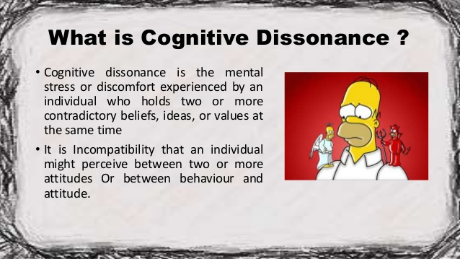
Cognitive Dissonance
Cognitive dissonance is the mental stress or discomfort experienced by an individual who holds two or more contradictory beliefs, ideas or values at the same time.
Festinger’s (957) cognitive dissonance theory suggests that we have an inner drive to hold all our beliefs, ideas & values in harmony & avoid disharmony (dissonance).
As the experience of dissonance is unpleasant, we are motivated to reduce or eliminate it & achieve consonance (harmony).
Notes:
Trainer to use PPT slide to explain what cognitive dissonance is. Trainer to use the example below to help.
Example: The classical version of this idea is expressed in the Aesop fable The Fox and the Grapes, in which a fox sees some high-hanging grapes and wishes to eat them. Unable to think of a way to reach them, he surmises that the grapes are probably not worth eating anyway (that they are not yet ripe or that they are too sour). The dissonance of the desire for something unattainable versus the lack of fulfilment is reduced by irrationally deciding that the grapes must be flawed.
Q. What other examples of cognitive dissonance can you think of?
Answers could include:
Smoking (I smoke but I know it is unhealthy)
Lying: (I told a lie but I know that lying is wrong)
Dieting: (I’m on a diet but that donut doesn’t have that many calories or I’ll skip lunch to make up for the extra calories etc.)
Educational theories e.g. learning styles: (1 theory tells us that we all have a learning style that helps us to learn better but a new theory has disproved this saying that we only have learning preferences i.e. a preferred way of learning and that there is no scientific evidence to show that my referred style of learning will actually improve my learning to any other style)
There are also external forces, such as advertising and marketing that can cause cognitive dissonance too. After all, the main job of these industries is to influence the views and behaviours of consumers.
Marketing: Getting people to buy products for a worthy cause e.g. percentage going to some charity etc. – you may not want the product but my want to support the charity ……..
Advertising: We believe in the advertising that promotes the products to the detriment of trying other, perhaps cheaper products, believing that they are not as good e.g. when Aldi’s first opened ..... Also when another brand comes up with a better advertising campaign than our current brand, we may want to try it but feel we need to stay loyal to our current brand ….
Trainer to used next PPT slide to explain how we deal with cognitive dissonance.

Slide 14
How do we deal with Cognitive Dissonance?
Smoking
I smoke regularly
Change a behaviour
Rationalise
Trivialise
Smoking is unhealthy
Change a belief/value
However, by encouraging openness & debate in a decision-making process, & making a real effort to hear arguments & process information that conflicts with our beliefs, we can improve our chance of success.
Particularly prevalent in law enforcement - Automated Mindset
Notes:
Let’s use ‘smoking’ as an example:
I smoke regularly and smoking is unhealthy (this is your dissonance) – we do not like to feel this tension, discomfort, disharmony … we want to feel better (in harmony - we like consistency).
So what do we do to restore this harmony and consistency? Well we can do 1 of 4 things. We can:
Change one of our beliefs/values e.g. It’s not that unhealthy and the chances of becoming ill are quite small.
Change our behaviour e.g. stop smoking
Rationalise (add a new thought) e.g. Yes I smoke and yes smoking is bad for you but I do lots of other healthy things as well to balance it out!!!!!
Trivialise e.g. Yes I smoke and yes smoking is bad for you but I don’t care.

Slide 15
Communication & the ‘Procedural Fairness Effect’
Achieving Fairness
Respect
Voice
Neutrality
Trust
Fair procedures are interpreted as indicators of respect & value & lead to cooperation & voluntary compliance with police & with the law.
Unfair procedures are perceived to show disrespect, exploitation of authority, & lead to noncooperation, distrust, & non-compliance.
(Tyler, 1990; Braithwaite and Makkai, 1994)
Notes:
Studies have demonstrated that most citizens care more about the treatment they receive from authorities than a favourable outcome (Tyler and Huo 2002).
An unexpected finding was that being treated in a fair way with respect, dignity, and concern for their individual views was more influential in shaping the citizens’ impressions of justice than was a favourable outcome—a phenomenon called the ‘procedural fairness effect.’
Q. Do you think that how you are treated by police is more important than the outcome? Discuss
4 Key ingredients to ‘achieving fairness’:
Trustworthiness: this refers to the degree to which the public perceive that authorities are motivated to be sincerely helpful and caring, give priority to the best interests of the community, and are honest and open (Tyler, 2008). Trust is the extent to which people believe that an authority is concerned about their well-being and acts to serve the best interests of the public (Tyler and Huo, 2002). Circumstances in which the police and the public engage in interpersonal contact are opportunities for the police to build a relationship of trust. Trust is widely acknowledged as a critical issue in policing, shown by a virtual explosion in the trust literature. Police behaviours that diminish trust in police, such as neglect, indifference, incompetence, and venality, as well as behaviours that engender and build trust in the police, have been extensively analysed (Goldsmith, 2005).
Respectful treatment: this referes to behaviour by police that demonstrates that they are protective of citizens’ rights, treat individuals with dignity, take them seriously, and attend to and value their input (Tyler and Lind, 1992). Of the four GVRM elements, respectful treatment can most clearly be paraphrased as “professional behaviour.”
Neutrality: this is conveyed by police procedures that demonstrate the absence of bias by principled conduct and decisions, consistency, even-handedness, and transparency (Tyler, 2008). The treatment that police accord to members of minority groups is used as a gauge of police neutrality.
Voice: this refers to the ability of community members to participate by expressing a viewpoint (Tyler, 2008). Being listened to by the police conveys that one has some social standing in the community and shows that the authorities value community members and their opinion. Voice has a symbolic value in building procedural justice: by being involved and consulted in the police investigative or decision-making process, citizens infer that they are valued by the authorities.

Slide 16
7 Elements of Effective Negotiations to address differences & conflict
1. Relationship: Am I prepared to deal with the relationship?
2. Communication: Am I ready to listen and talk effectively?
3. Interests: What do people really want?
4. Options: What are the possible agreements or bits of an agreement?
5. Alternatives: What will I do if we do not agree?
6. Legitimacy: What criteria will I use to persuade us both that we are not being ripped off?
7. Commitment: What commitments should I seek or make?
Conclusion: What is a good outcome?
Notes:
Reference: https://hms.harvard.edu/sites/default/files/assets/Sites/Ombuds/files/HMS.HHSD_.HSPH_.OmbudsOffice.SEVEN%20ELEMENTS%20OF%20EFFECTIVE%20NEGOTIATIONS.pdf [Accessed 4 May 2018]
7 Elements of Effective Negotiations: Fisher, R & Ury, W. (2008)
Jerome Slavik. Adapted from ‘Getting To Yes: Negotiating Agreements Without Giving In’. R. Fisher and W. Ury
RELATIONSHIP: AM I PREPARED TO DEAL WITH THE RELATIONSHIP?
A good negotiating relationship is needed to address differences and conflicts.
Separate people issues from substantive issues.
Plan and prepare to build and maintain a good working relationship.
Be respectful, trustworthy and unconditional constructive.
COMMUNICATION: AM I READY TO LISTEN AND TALK EFFECTIVELY? CREATING A LEARNING CONVERSATION
Core Skills – Basic Communication Skills in Negotiation
Active listening – To do active listening, we must overcome some of our tendencies and habits that interfere with good listening. Acknowledging what has been said and felt – Have you effectively demonstrated to the other negotiators that you have heard and UNDERSTOOD what they have said? Use paraphrasing and summarizing. Listen to understand, speak to be understood – Have you thought about ways to communicate with the other party by using words (and at the right time) in a way that they will understand? Speak about yourself, not them – Have you let them know what are the crucial issues for you and your community and how you feel about the problem at hand? Use “I” statements. Speak for a purpose – Have you thought through the timing and impact of what you wish to say? Be clear and concise.
b) Core Skills – Communications to Gather Knowledge and Learn About Their Interests
i. Clarifying and Probing Skills
Have you thought about basic questions for clarification (including empathetic questions) you might ask to draw out the interests from the other negotiators? E.g. can you explain...?
Could you use consequential questions to draw out the other side? E.g. what would you need to...?
ii. Integrative Framing Skills
Paraphrasing – Have you given feedback in your own words or what you understand the key concerns and interests on the other side to be?
Summarizing – Can you accurately draw together the main points of the discussion up to that point in time?
INTERESTS: WHAT DO PEOPLE REALLY WANT?
Collectively identify and articulate the interests, concerns, and needs of all relevant parties (mine, yours, theirs). Remember: most parties do not know all their interests or necessarily agree on their interests.
Identify and prioritize community interests together. Get on the same page.
Probe for your and their unarticulated or underlying interests.
Share and clarify the respective interests of the parties. Move beyond speculation about to acknowledgement of their interests.
Identify and share common interests as a basis to develop options.
Interests from the agenda.
OPTIONS: WHAT ARE THE POSSIBLE AGREEMENTS OR BITS OF AN AGREEMENT?
Design options, not positions.
Create options to meet interests of both parties.
Remember when designing options they also must transparently meet their interests. Find ways to maximize joint gains for both.
ALTERNATIVES: WHAT WILL I DO IF WE DO NOT AGREE?
Do we need to negotiate or can we satisfactorily meet our interests in other ways?
Identify and articulate our best/doable alternatives to a negotiated agreement.
Fully understand the implication, consequences, risks and costs of your and their BATNA.
Select and improve our BATNA
Identify the best and worst alternatives open to the other side.
How can we make their BATNA worse for them? (i.e. keep them at the table)
LEGITIMACY: WHAT CRITERIA WILL I USE TO PERSUADE EACH OF US THAT WE ARE NOT BEING RIPPED OFF?
Fairness is a governing consideration.
Use external criteria and objective standards as a basis to legitimize your preferred options and as a shield against unreasonable proposals from the other side.
Use demonstrable “fairness” of the process and outcome to persuade them of the merits of a proposal.
Offer their negotiator an attractive way to explain his decision to his principals (see number 8).
COMMITMENT: WHAT COMMITMENTS SHOULD I SEEK OR MAKE?
Get commitments at the end not the beginning.
Identify all of the implementation issues to be included in the agreement. No post- argument surprises?
Plan the timeframe and steps to implement the agreement.
CONCLUSION: WHAT IS A GOOD OUTCOME?
Meets interests.
Demonstrably fair.
Better than BATNA.
Doable.
s:\jns-r\files\jerome\2008 neg. workshop\seven elements of effective negotiations nov. 19-08.doc

Slide 17
Having Difficult Conversations: Dos & Don’ts
Choose a suitable time and place. | Procrastinate.
State your intent up front. | Start sentences with 'you'.
Gather evidence and stick to the facts. | Make assumptions or jump to conclusions.
Keep the lines of communication open. | Let your emotions get in the way.
Practise active listening. | Be afraid.
Be clear about next steps.
DO
DON’T
Notes:
Most people are lucky enough never to be in a position in which they deliver seriously bad news. As Police Officers you will have to deliver some form of difficult or unpleasant message at some point in your working lives. This can range from CPS NFA a serious domestic incident through to telling a family a loved one has died. Delivering this kind of news is never an enviable task, and unless we’ve received specific training in this, we’re unlikely to know how best to go about it. As Police Officers we must provide the facts, and this can sometimes come across badly which can cause reputational loss. In some cases, we can sometimes misplace our empathy as we must be removed from the situation to protect our own mental health, and this leads to a difficult message being delivered poorly.
Having difficult conversations may never be easy, but there are ways to make those conversations both productive and as painless as possible. This includes:
Dos:
Choose a suitable time and place. Whatever the nature of your difficult conversation, you should book a private room where you won't be interrupted, and ensure you allow sufficient time to explore both sides of the story.
State your intent up front. Use your opening sentences to outline what exactly you want to talk about; including why the conversation has to happen and what you would like to see as an outcome (if appropriate). This should help focus the conversation and allow you to steer it back on track if need be.
Gather evidence and stick to the facts. When conducting a difficult conversation, you should always rely on factual information and direct observations. Use these as specific examples to back up what you are saying whenever possible.
Keep the lines of communication open. Talk to your team members informally at first, giving them an opportunity to explain things and state their side of the story.
Practise active listening. Don't assume that everyone thinks like you: ensure you give the other person time to share their views without interruption, and really listen to what they are saying. Pay particular attention to non-verbal signals and body language.
Be clear about next steps. In your conversation, state clearly what will happen next, including likely consequences if things don't improve (if your difficult conversation is about problem behaviour).
Also:
Being direct
Being specific
Planning the conversation
Watching your language
Offering solutions
Managing your emotions
Being empathetic
Allowing the other person to ask questions
Don’ts:
Procrastinate. Resist the temptation to bury your head in the sand in the hope that the need to have a difficult conversation will just go away. It is likely to make things worse.
Start sentences with 'you'. For example, 'You are always late' or 'You never make deadlines' sounds like you are on the attack, and this will likely make the person you are speaking to defensive, which is not conducive to a productive conversation. Instead, criticise the behaviour, not the person, for example, 'The missed deadlines have a serious impact on our reputation.' You could also use 'we' in place of 'you'; for example, 'We need to talk about why the deadline was missed.‘
Make assumptions or jump to conclusions. If your difficult conversation is to address problem behaviour, remember that there may be mitigating circumstances which explain the negative behaviour, for example illness, stress or other factors, both inside and outside the workplace. Use active listening to try to draw these factors out, whilst being always respectful to your team member.
Let your emotions get in the way. Stay focused and objective, concentrating on facts and observable behaviours rather than hearsay or personal opinion.
Be afraid. If informal conversations are not having the desired effect, you may need to move to more formal measures such as disciplinary action or implementation of your organisation's capability procedure. If this is the case, you may wish to speak to your own manager, or take advice from your organisation's HR department (if you have one).
Also:
Label the news you need to deliver as a “difficult conversation” in your mind; instead, frame the discussion in a positive or neutral light
Bother writing a script for how you want the discussion to go; jot down notes if it helps, but be open and flexible
Ignore the other person’s point of view — ask your counterpart how he sees the problem and then look for overlaps between your perspectives
Image Credit: Flickr Greg Burkett (accessed 06 November 2014).

Slide 18
Challenging Inappropriate Behaviour/Comments
When you see or hear things that make you feel uncomfortable what can you do?
Step in
If you don’t feel able to call out the behaviour directly then interrupt it
Step up
If you do directly challenge someone use a calm voice and neutral body language
Set the tone
If we all ignore this behaviour from people we work with we let the minority set the tone for all of us
Notes:
QTS – when you see or hear things that make you feel uncomfortable, what can you do?
QTS – why is it so important to challenge this type of behaviour?
Trainer to note student responses and de-brief using PPT slide and handout ‘Call it Out’ which contains further detail on the strategies available to deal with inappropriate behaviour/comments in whatever form such as racist, sexist, homophobic, misogynistic and bullying.

Slide 19


