Slide 1
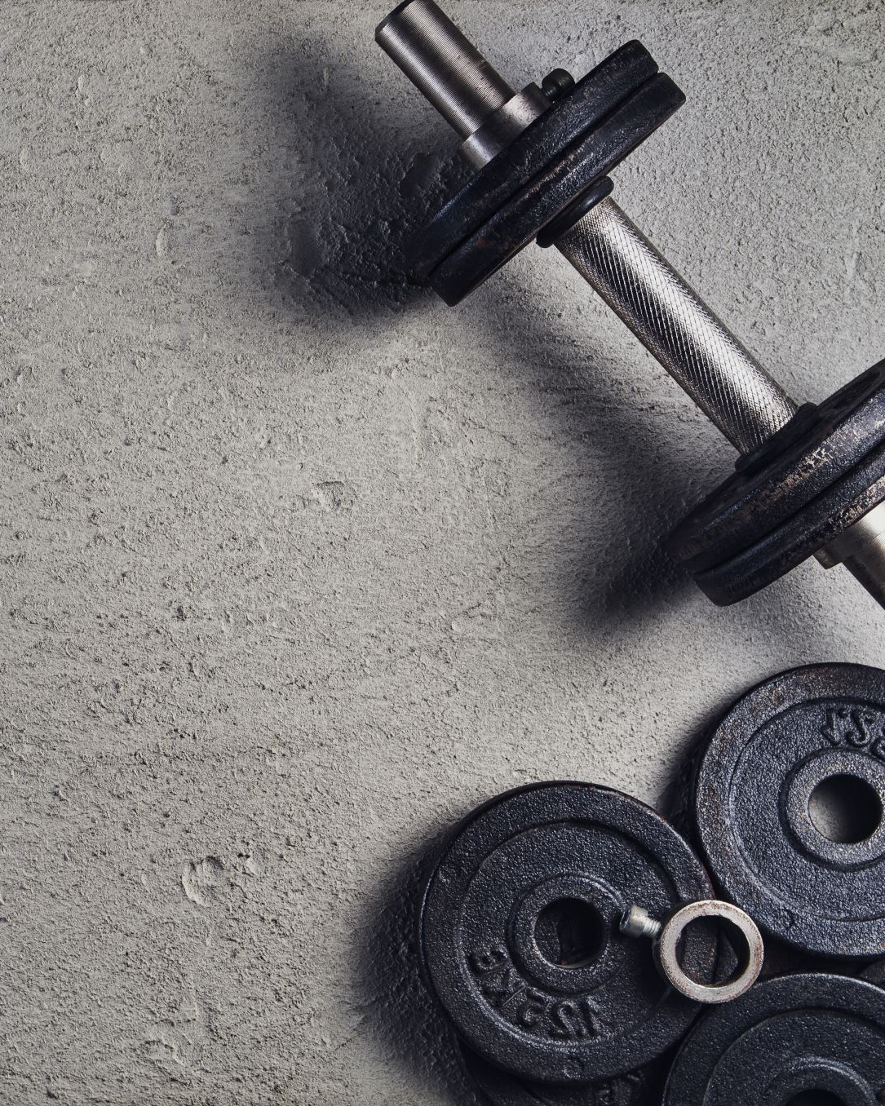
Current Issues in Sports Nutrition

Slide 2
What is happening ?
In this session we will look at
The new antidoping rules
Supplements that are being used
Ketogenic diets and low carb
Your chance to discuss anything you have seen

Slide 3
WADA
Wada have published new rules that come into force in January 2024
It is on Moodle
Major changes – addition of some further steroid type substances

Slide 4
Supplements
What is current
Collagen seems to be the one I keep hearing about
Collagen is a fibrous protein found in connective tissues such as tendons, ligaments, Cartlidge, bones and teeth
Also needed for wound healing and scar formation

Slide 5
Collagen
It keep the joints elastic and skin plump
Body production decreases with age – wrinkles
It is added to many cosmetics but the structure is to big to be absorbed via the skin!

Slide 6
Collagen in sport
Often taken prior to training – said to prevent damage to ligaments and repair injuries
Taken as a shot in some cases prior to training along with Vitamin C as this is required in its synthesis – proline and lysine are key amino acids
Is there any evidence it works?
Do we just digest it !
Look at the article on Moodle

Slide 7
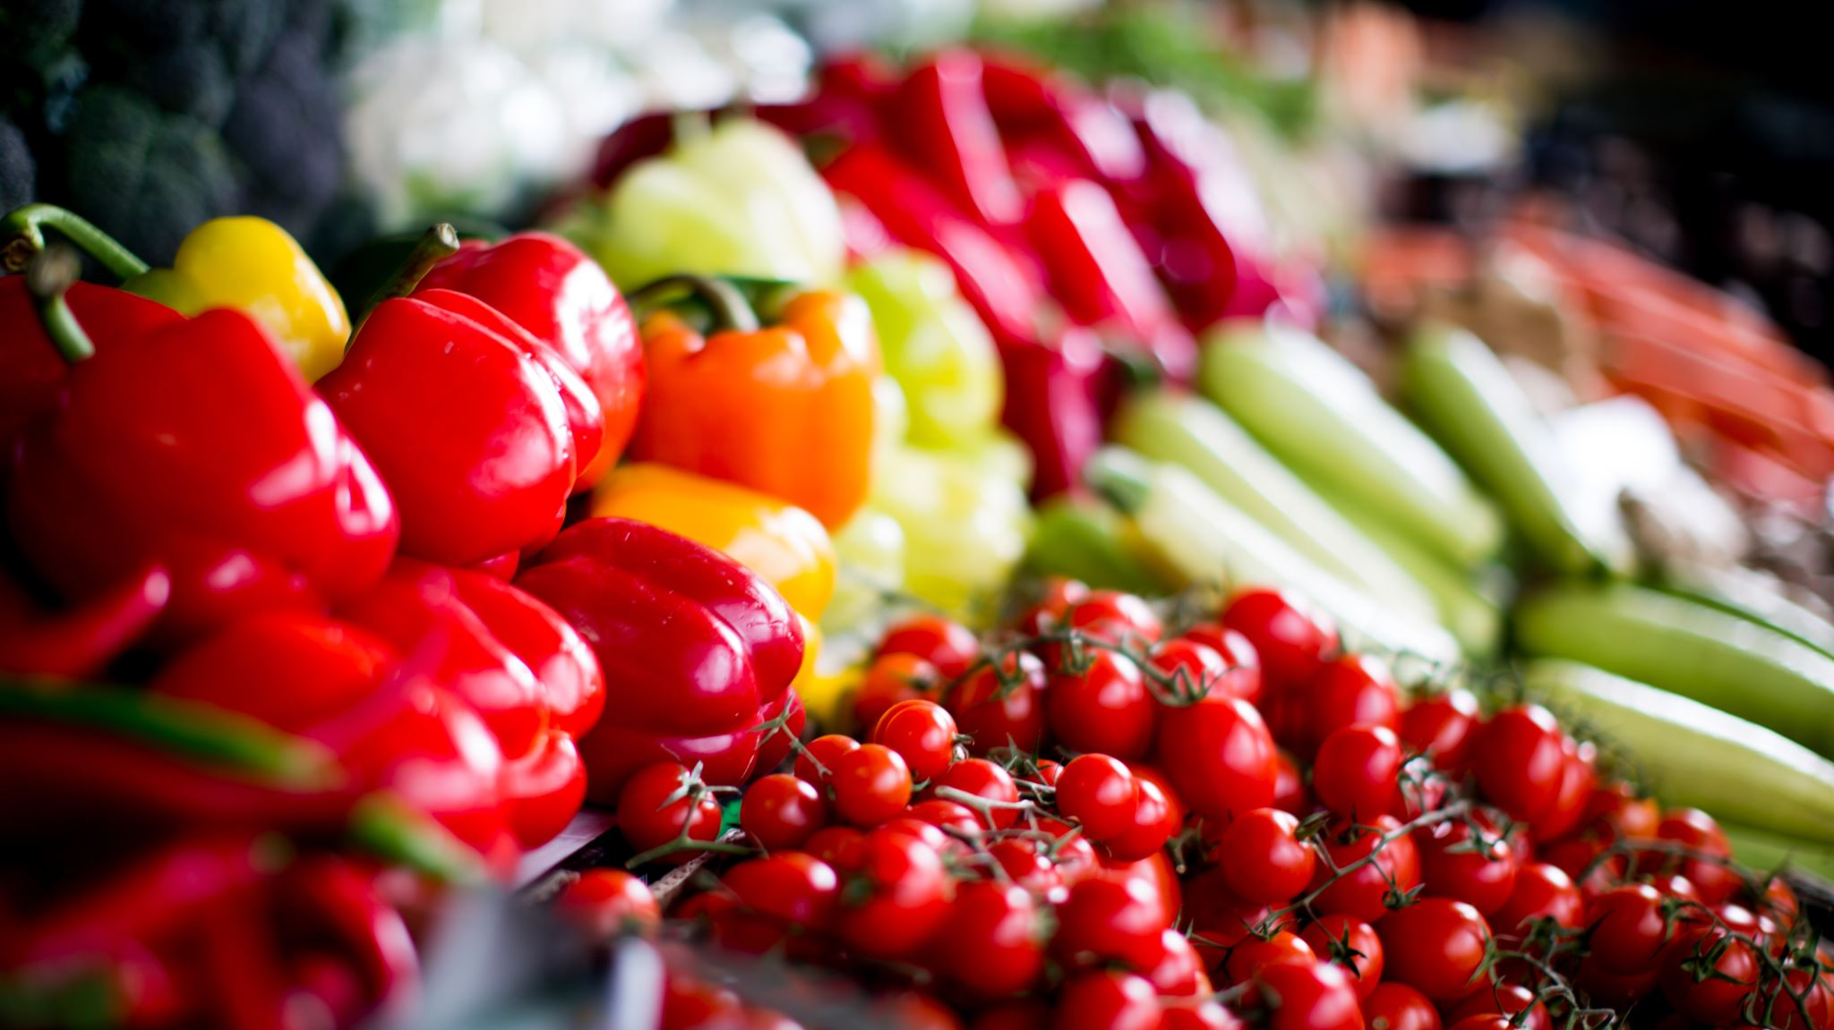
Ketogenic Diets or low carb diets
They remain popular

Slide 8
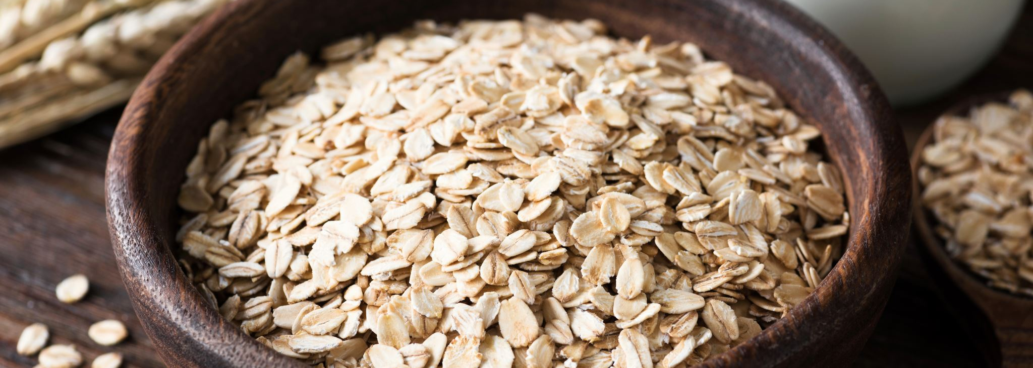
The diets
They range from 50g – 180gCHO
There is no clear definition
They tend to be high in Protein and/or Fat
They are limited - so many claims made for them
You can use them with clients – the plan must carefully ensure that it covers all nutrients.

Slide 9
Evidence
There is limited evidence
A couple of papers on Moodle
More conclusive evidence that it can help in Type 2 Diabetes
There are some reports from Diabetes UK and SACN on Moodle

Slide 10
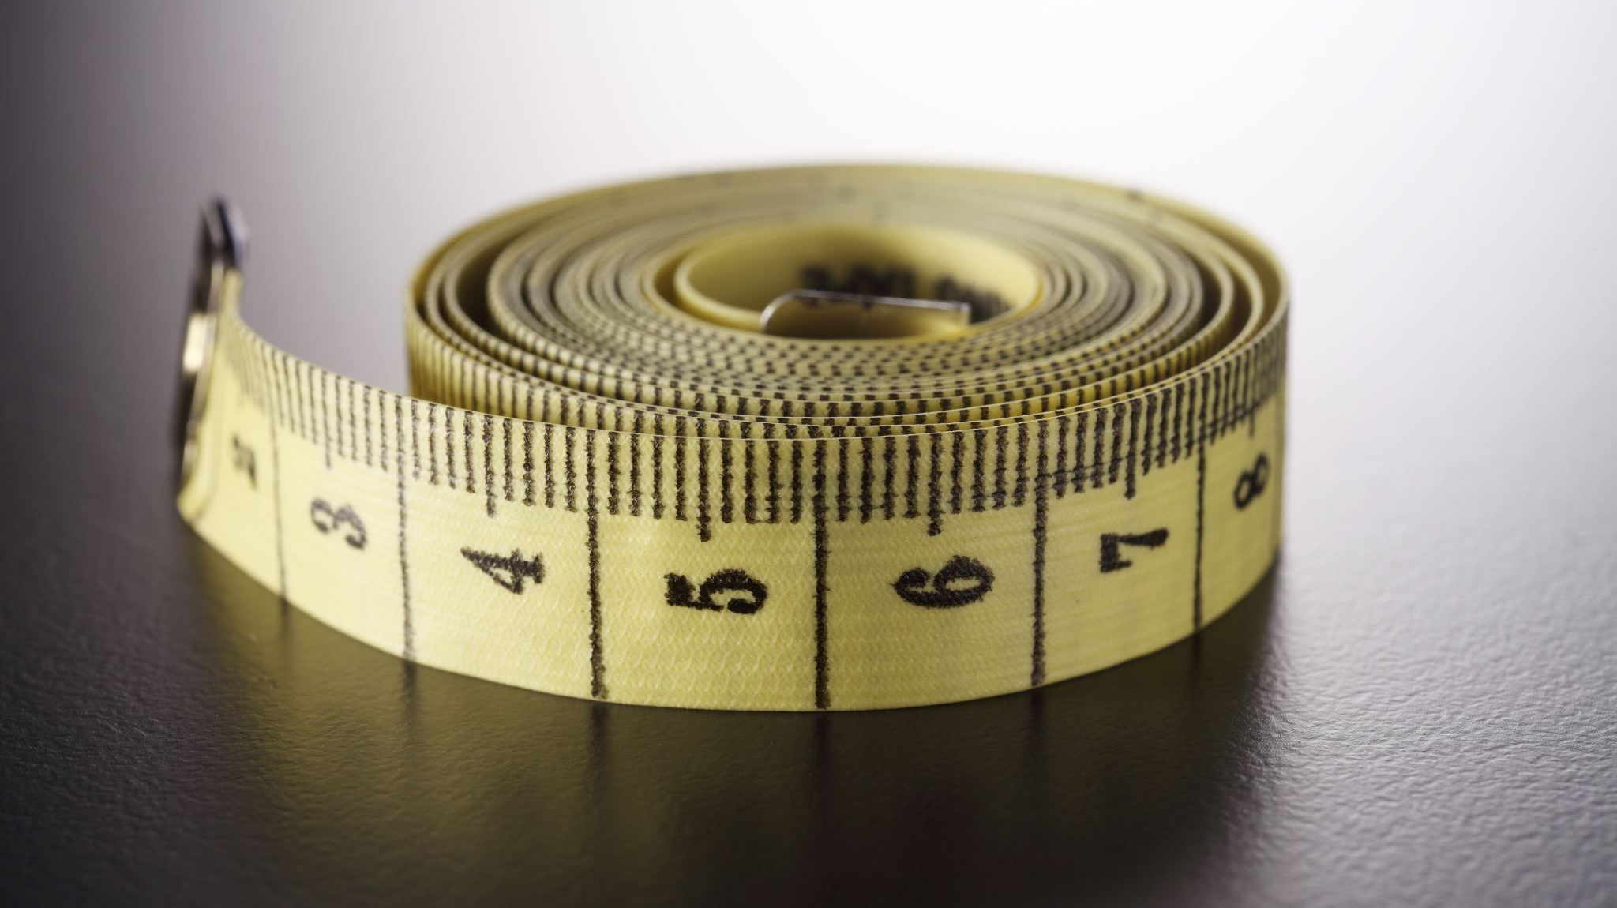
Measuring Body Fat

Slide 11

Where are we ?
Need an ISAK course
Paper by Close et al that questions this role
Comments?

Slide 12
Women and the menstrual cycle
Appears to be conflicting evidence but is certainly worth looking at
In practice are nutritionist doing anything?
We need more research – we have a PhD student here looking at it

Slide 13
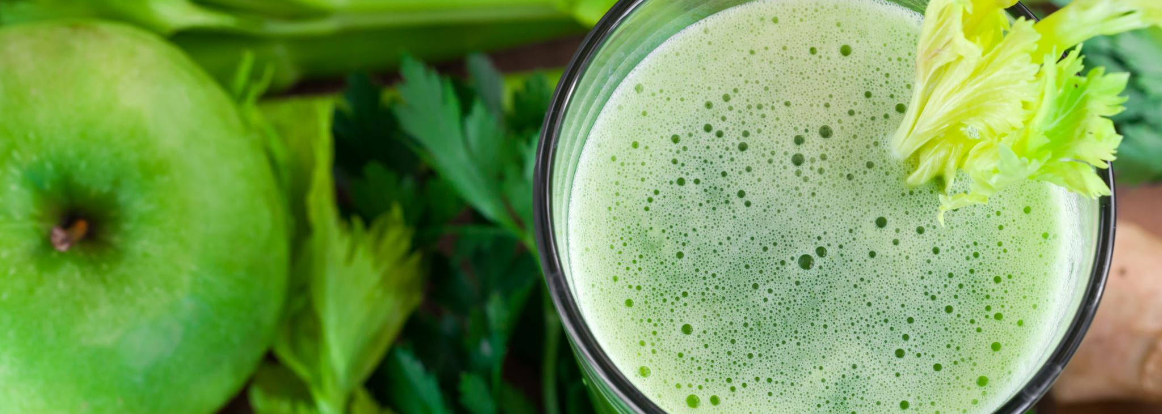
Other trends
Still plant based diets
Collagen
Gummies
No or low carb recovery drinks

Slide 14

Over to you ?

Slide 15
Research Methods
Next semester
Weekend attendance as usual
Nalda Wainright is the module lead with several other lecturers input
Leading on to Dissertation

