Slide 1
Electrical and Electronic
Principles
(ACDA4006)
Lecture - 4

Slide 2
Content
Voltage divider rule
Current divider Rule

Slide 3
Learning Outcome
The student upon completion of the lecture will be able to:
Define Current divider rule and Voltage divider rule.
Describe Current divider rule and Voltage Divider rule.

Slide 4
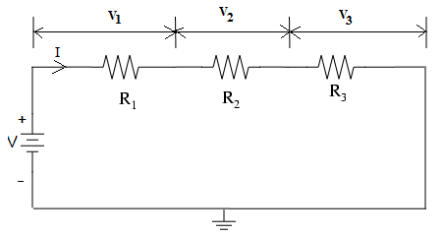
Voltage divider rule
Voltage divider rule
For easy calculation of voltage drop across each resistors in a series circuit, Voltage divider rule can be used. Consider the following circuit.

Slide 5
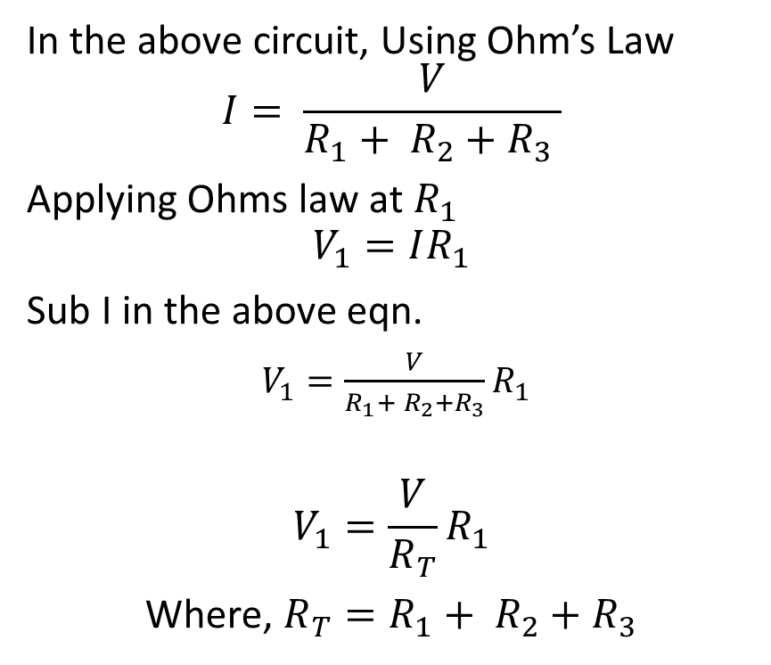
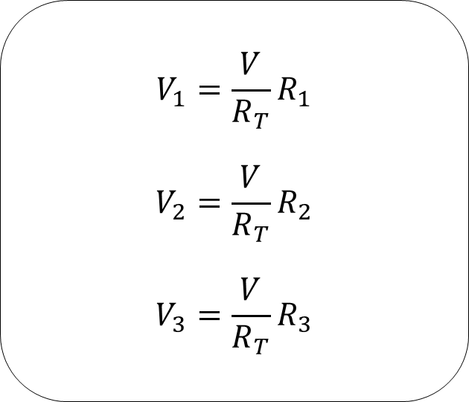
Voltage divider rule
In the above circuit, Using Ohm’s Law
$$I= \frac{V}{R_{1}+ R_{2}+R_{3} }$$
Applying Ohms law at $R_{1}$
$$V_{1}=IR_{1}$$
Sub I in the above eqn.
$V_{1}=\frac{V}{R_{1}+ R_{2}+R_{3}}R_{1}$
$$V_{1}=\frac{V}{R_{T}}R_{1}$$
Where, $R_{T}=R_{1}+ R_{2}+R_{3}$
$$V_{1}=\frac{V}{R_{T}}R_{1}$$
$$V_{2}=\frac{V}{R_{T}}R_{2}$$
$$V_{3}=\frac{V}{R_{T}}R_{3}$$
Lecture 4 / Electrical and Electronic Principles

Slide 6
Voltage divider rule
The voltage divider rule states that the voltage drop across any resistor in a series circuit is the ratio of the product of the total voltage and its own resistance to the total resistance of the series circuits.
Lecture 4 / Electrical and Electronic Principles

Slide 7
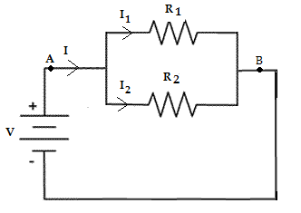
Current divider rule
Current divider rule:
Current divider rule is used in parallel circuits to find the branch currents, if the total current is known.

Slide 8
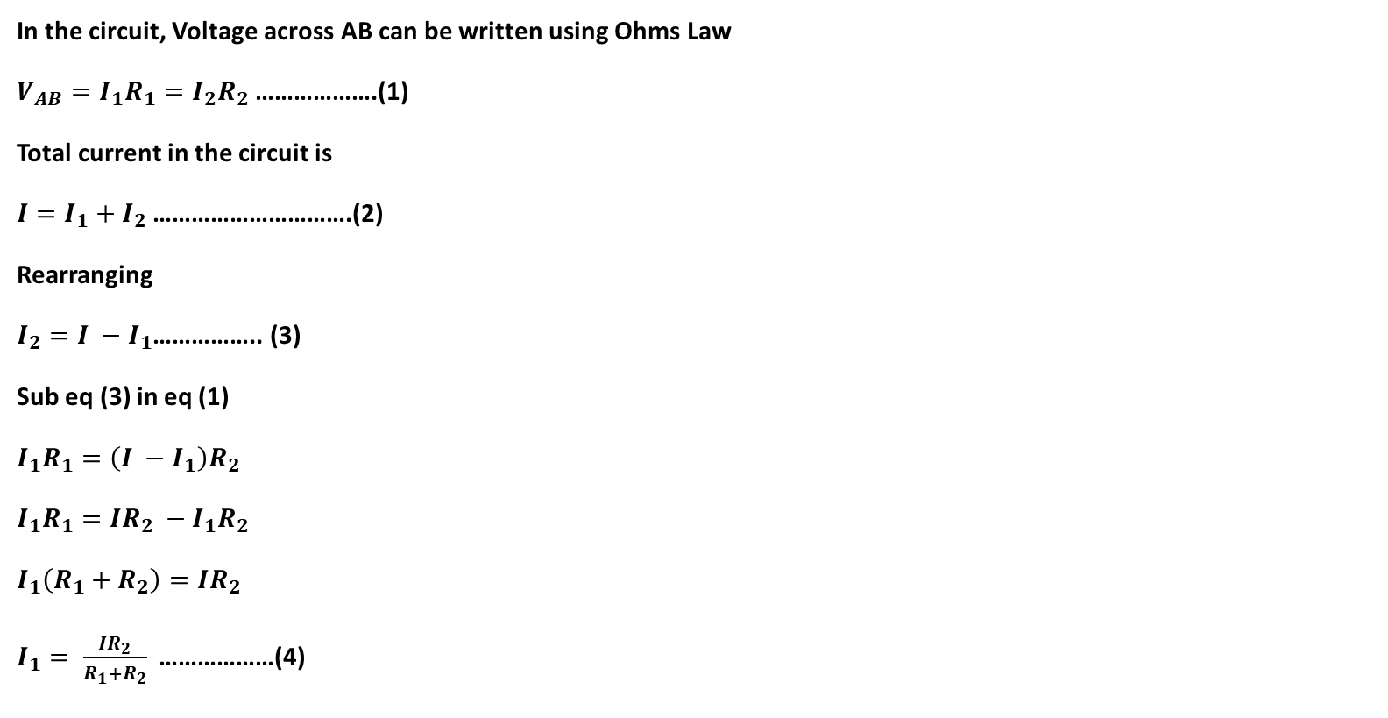
Current divider rule
In the circuit, Voltage across AB can be written using Ohms Law
$V_{AB}=I_{1}R_{1}=I_{2}R_{2}$ ……………….(1)
Total current in the circuit is
$I=I_{1}+I_{2}$ ………………………….(2)
Rearranging
$I_{2}=I −I_{1}$…………….. (3)
Sub eq (3) in eq (1)
$I_{1}R_{1}=\left(I −I_{1}\right)R_{2}$
$I_{1}R_{1}=IR_{2} −I_{1}R_{2}$
$I_{1}\left(R_{1}+R_{2}\right)=IR_{2}$
$I_{1}= \frac{IR_{2}}{R_{1}+R_{2}}$………………(4)

Slide 9
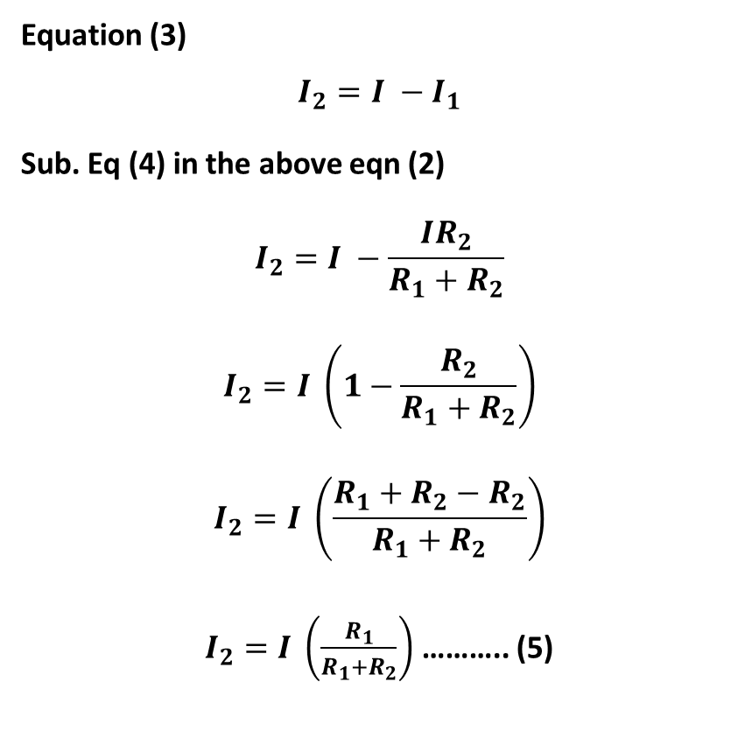
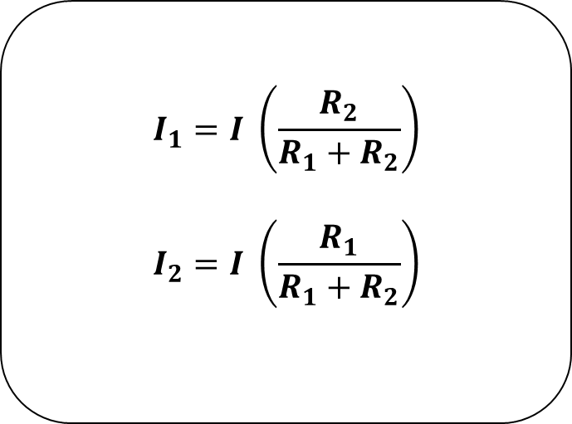
Current divider rule
Equation (3)
$$I_{2}=I −I_{1}$$
Sub. Eq (4) in the above eqn (2)
$$I_{2}=I −\frac{IR_{2}}{R_{1}+R_{2}}$$
$$I_{2}=I \left(1−\frac{R_{2}}{R_{1}+R_{2}}\right)$$
$$I_{2}=I \left(\frac{R_{1}+R_{2}−R_{2}}{R_{1}+R_{2}}\right)$$
$I_{2}=I \left(\frac{R_{1}}{R_{1}+R_{2}}\right)$ ……….. (5)
$$I_{1}=I \left(\frac{R_{2}}{R_{1}+R_{2}}\right)$$
$$I_{2}=I \left(\frac{R_{1}}{R_{1}+R_{2}}\right)$$
Lecture 4 / Electrical and Electronic Principles

Slide 10
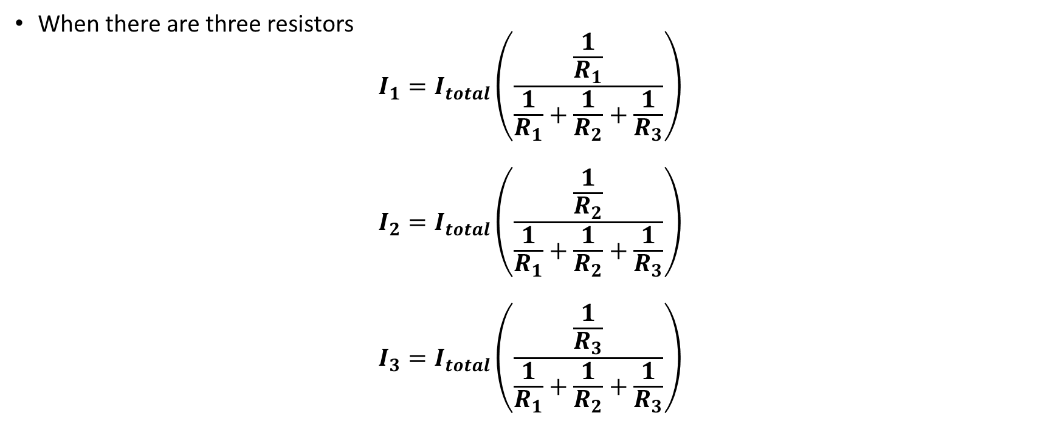
Current divider rule
When there are three resistors
$$I_{1}=I_{total}\left(\frac{\frac{1}{R_{1}}}{\frac{1}{R_{1}}+\frac{1}{R_{2}}+\frac{1}{R_{3}}}\right)$$
$$I_{2}=I_{total}\left(\frac{\frac{1}{R_{2}}}{\frac{1}{R_{1}}+\frac{1}{R_{2}}+\frac{1}{R_{3}}}\right)$$
$$I_{3}=I_{total}\left(\frac{\frac{1}{R_{3}}}{\frac{1}{R_{1}}+\frac{1}{R_{2}}+\frac{1}{R_{3}}}\right)$$
Lecture 4 / Electrical and Electronic Principles

Slide 11
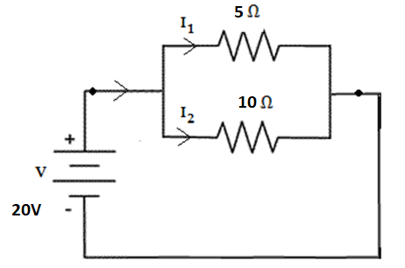
Exercise 1
Calculate the current flowing through the various resistors in the circuit.

Slide 12
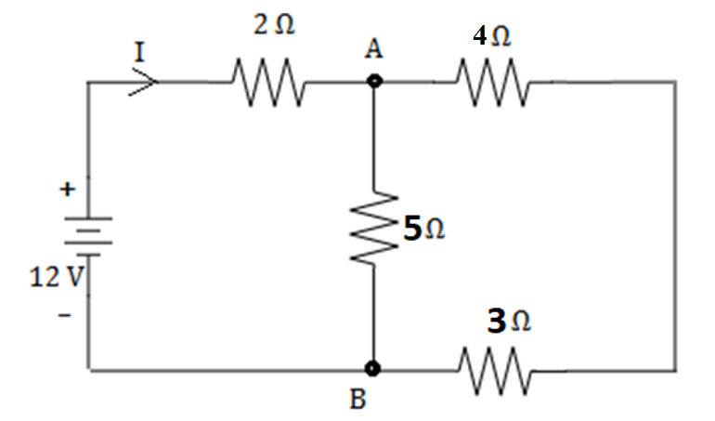
Exercise 2
Calculate the current flowing through the various resistors in the circuit.

Slide 13
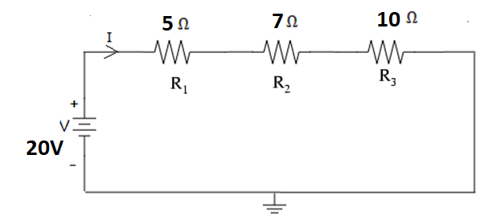
Exercise 3
Calculate the Voltage across various resistors in the circuit.

Slide 14
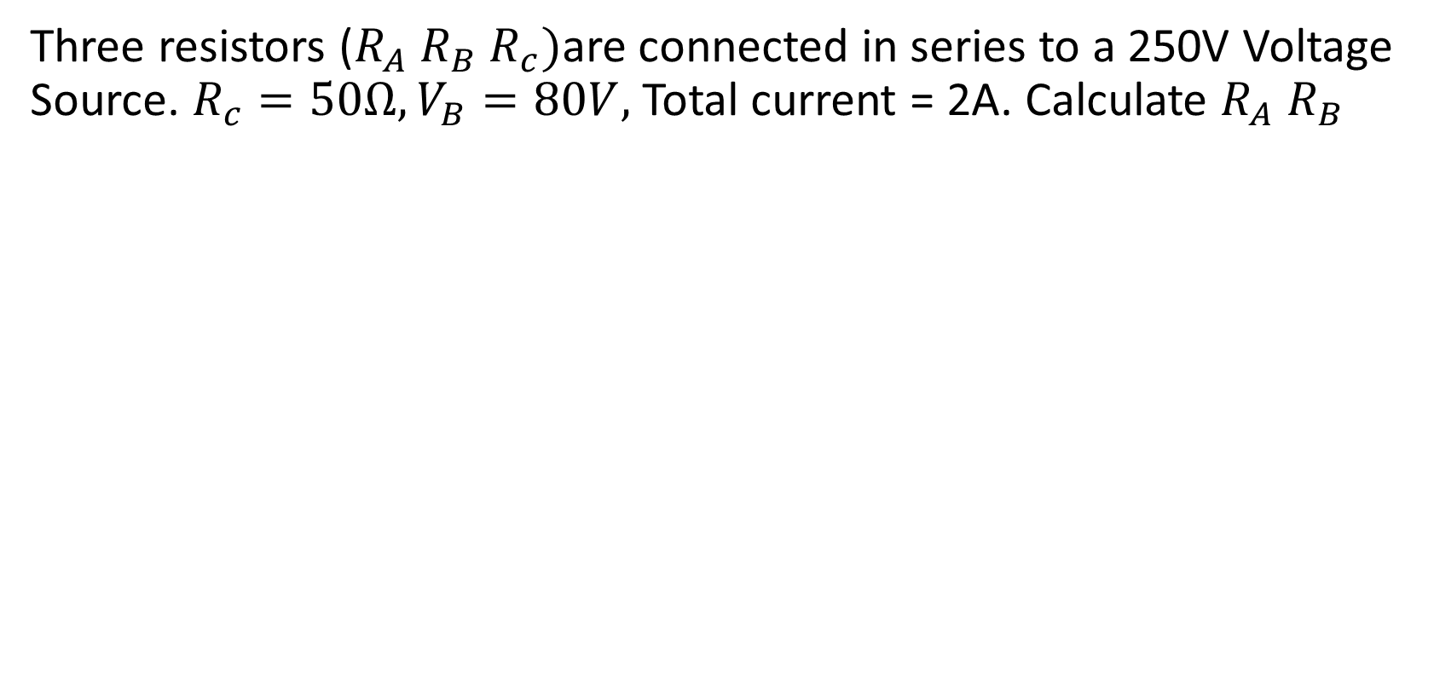
Exercise 4
Three resistors ($R_{A} R_{B} R_{c})$are connected in series to a 250V Voltage Source. $R_{c}=50Ω, V_{B}=80V,$ Total current = 2A. Calculate $R_{A} R_{B}$

Slide 15
Exercise 5
Three resistors 5Ω, 10Ω, and 15Ω are connected in parallel. If the Current in 10Ω resistor is 3A. Calculate the current in other resistors, total current and the voltage applied to the circuit.

Slide 16

Thank You

