Slide 1
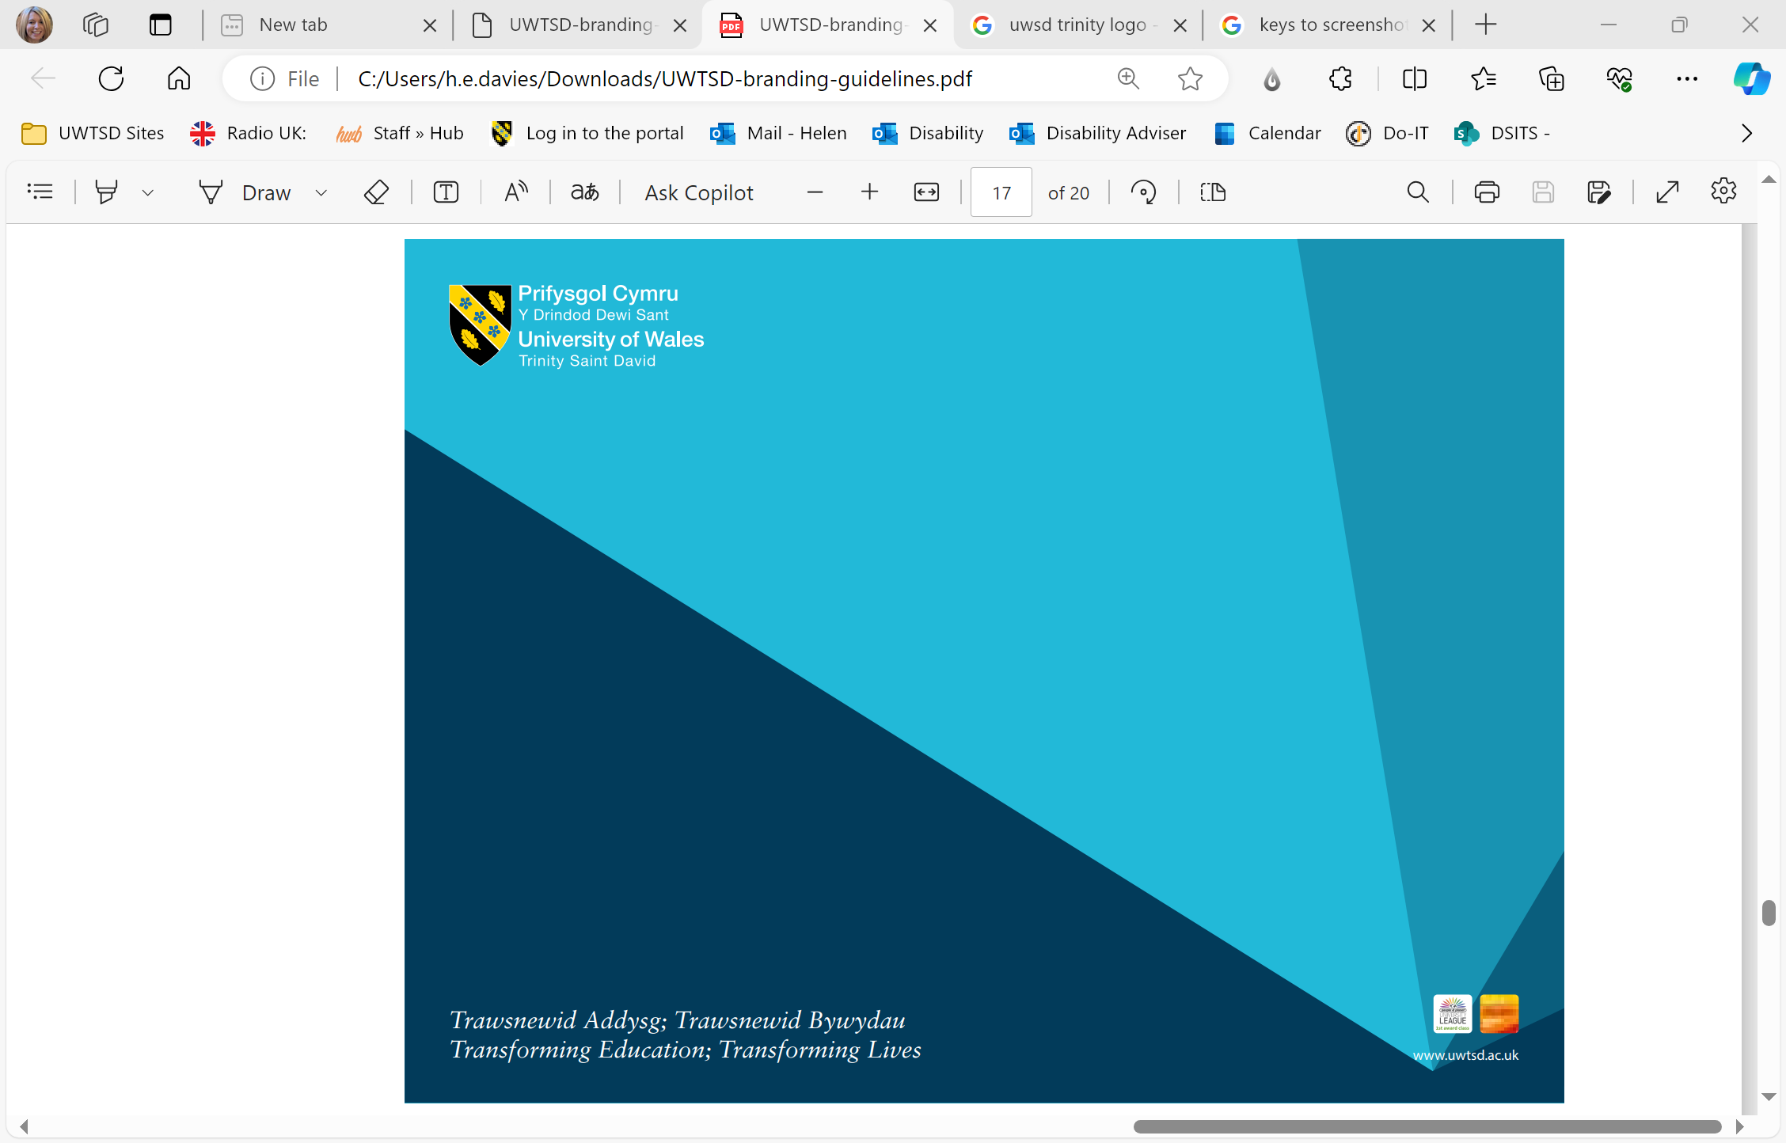
Eich cefnogi:
Gwasanaethau Myfyrwyr PCYDDS
Supporting you:
UWTSD Student Services

Slide 2
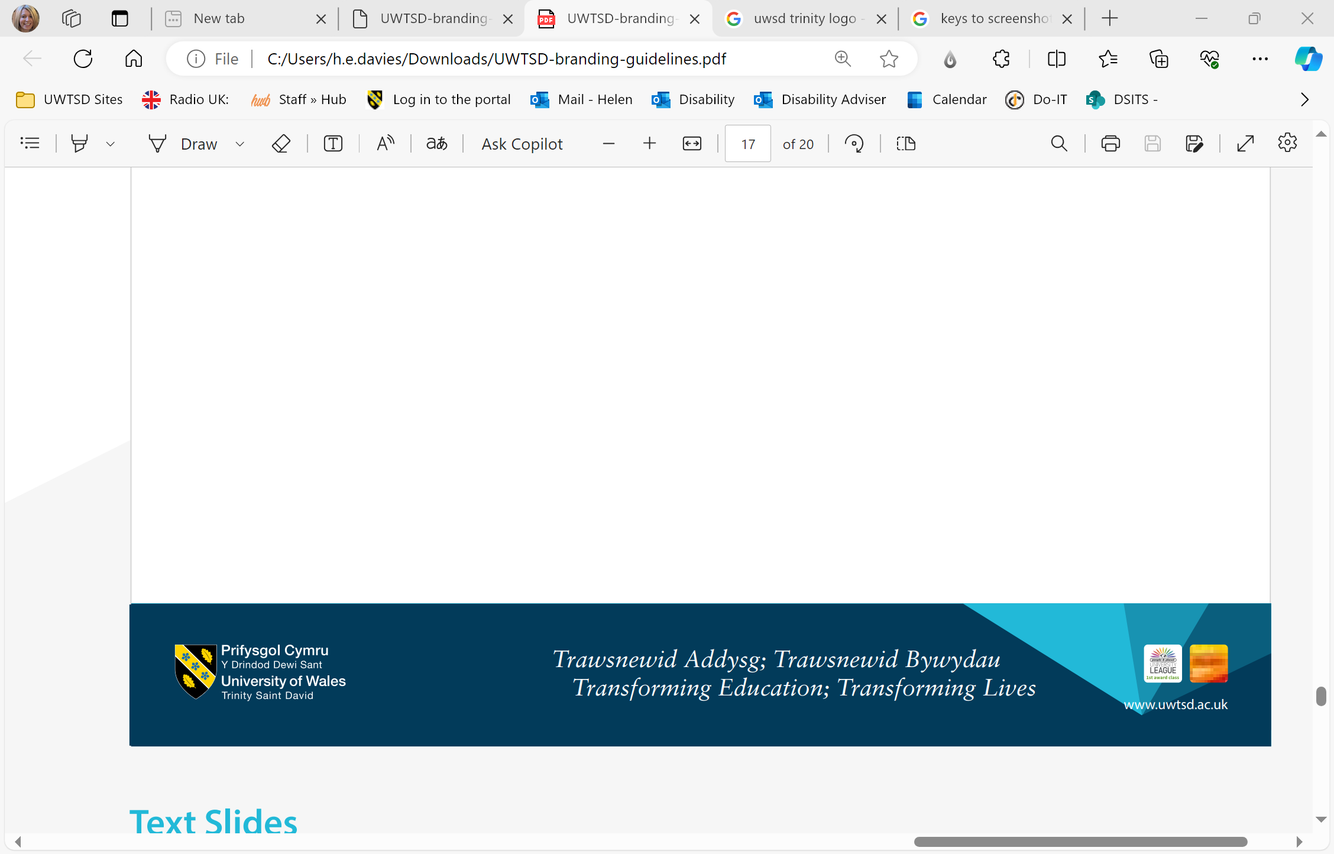
Sut?
Rydym yn canolbwyntio ar eich cefnogi i gyrraedd eich potensial llawn gyda gwybodaeth, cyngor ac arweiniad, cymorth ymarferol ac emosiynol o ansawdd uchel.
How?
We’re focused on supporting you to reach your full potential with high quality information, advice and guidance, practical and emotional support.

Slide 3
Pwy ydym ni
Gwasanaeth Gyrfaoedd
Cefnogaeth Llesiant
Cymorth Ariannol
Cymorth Dysgu
HWB
Who we are
Careers Service
Wellbeing Support
Money Support
Learning Support
HWB

Slide 4
Gwasanaethau Gyrfaoedd
Swyddogion gyrfaoedd proffesiynol
Arolwg Hynt Graddedigion
Adnoddau ar-lein: MyCareer
Y Prosiect Profiad Gwaith
Cyfleoedd swyddi, ffug gyfweliadau, datganiadau personol, ceisiadau am swyddi
Careers Service | University of Wales Trinity Saint David (uwtsd.ac.uk)​
Careers Service
Professionally qualified careers advisers
Graduate Outcomes survey
On-line resources: MyCareer
Work experience programme
Job vacancies, mock interviews, personal statements, job applications
Careers Service | University of Wales Trinity Saint David (uwtsd.ac.uk)​

Slide 5
Cymorth a Chyngor Ariannol
Swyddog cyllid myfyrwyr ar bob prif campws​
Ysgoloriaethau a bwrsariaethau i gynnwys:​
Bwrsari Cysylltedd​
Bwrsari Anabledd​
Bwrsari Gofal Plant​
Cyngor ymarferol ar reoli eich arian ​
Cronfa Cymorth Ariannol Myfyrwyr y Brifysgol​
Money Support and Advice
Dedicated student finance officer on each main campus​
Scholarships and bursaries to include:​
Connectivity Bursary​
Disability Bursary​
Childcare Bursary​
Practical advice on managing your money​
University’s Student Financial Support Fund​

Slide 6
Cefnogi myfyrwyr o gefndir gofal
Cyswllt penodol ar gyfer myfyrwyr o gefndir gofal
Bwrsari I fyfyrwyr o gefndir gofal
Cymorth ymarferol
Supporting care leavers
Key contact for care leavers/providers
Care leavers bursary
Practical support

Slide 7
Gwasanaeth Lles
Cwnselwyr proffesiynol
Cysylltiadau gydag asiantaethau arbenigol​
Gwybodaeth ar sut I cymorthwyo eich llesiant meddwl ac sut i gael mynediad i cymorth​
Ymgynghorwyr iechyd meddwl proffesiynol a mentoriaid arbenigol​
Gwasanaeth adrodd Achos Pryder​
I hunan-atgyfeirio I'r wasanaeth, ewch I'r wefan.
​
Wellbeing Service
Professional counsellors​
Links with specialist agencies​
Information on supporting wellbeing and accessing support​
Professional mental health advisers and specialist mentors​
Cause for Concern reporting service​
To self-refer into the service go to our website. ​

Slide 8
Cymorth Dysgu
Cymorth ar gyfer myfyrwyr ag anabl ​
Sgrinio ag asesu ar gyfer gwahaniaethu dysgu penodol​
Help i hawlio’r Lwfansau Myfyrwyr Anabl​
Tîm o staff arbenigol ​
Rheolwyr Cymorth Dysgu​ ac Ymgynghorwyr Anabledd​
Sesiynnau Sgiliau Dysgu
SoCom
Learning Support
Support for disabled students​
Specific learning differences: screening and assessment ​
Help to claim Disabled Students’ Allowances​
Team of specialist staff ​
Learning Support Managers and ​Disability Advisers​
Study Skills sessions
SoCom

Slide 9
Angen Cymorth
Ar ddechrau pob blwyddyn academaidd, rydym yn gwahodd pob myfyriwr i gymryd rhan yn sesiwn Sgrinio Cymorth PCYDDS.
Mae'r sesiwn hon yn cynnig cyfle i fyfyrwyr nad ydynt wedi datgelu bod angen cymorth arnynt eto wneud hynny.
Mae hefyd yn rhoi cyfle in ni nodi anghenion cymorth ag efallai fydd angen yn y dyfodol.
Need Support
At the start of each academic year, we invite all students to participate in the UWTSD Support Screening session.
This session offers students who haven't yet disclosed a need for support the chance to do so.
It also provides an opportunity for us to identify potential future support needs.

Slide 10
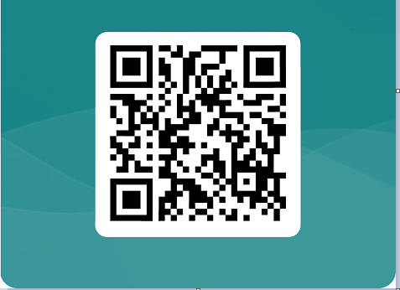
https://forms.office.com/e/ax0dSJMJ4B

