Slide 1
(re)
HPAR6001
visual candy, palatable theory
– the role of the promoter
archaeology, images and the media
(re)presentations – visual stereotyping
the responsibilities of the media

Slide 2
MEDIA

Slide 3
NON – STATIC
& REFOCUSING
SOCIALLY
EMBEDDED
POLITICALLY
VARIABLE
MEDIA
CULTURALLY
CONSTRUCTED

Slide 4
VARIED
LEVELS OF
INVOLVEMENT
CHANGING
FINANCIAL
IMPLICATIONS
NON – STATIC
& REFOCUSING
SOCIALLY
EMBEDDED
POLITICALLY
VARIABLE
MEDIA
VARIED
RANGES OF
AVAILIBILITY
VARIED
PLATFORMS OF
ENGAGEMENT
CULTURALLY
CONSTRUCTED

Slide 5
Author
(ACADEMIC)
PUBLISHED
WORK

Slide 6
Author
(ACADEMIC)
RESEARCH
ASSESSMENT
EXCERCISE
ACADEMIC
PROFILE
PUBLISHED
WORK

Slide 7
Author
(ACADEMIC)
RESEARCH R
ASSESSMENT E
EXCERCISE F
COMPARED
TO PREVIOUS
AND CURRENT
PUBLISHED
SOURCES
ACADEMIC
PROFILE
BASED ON
LOCATION
OF PUBLISHED
WORK
PUBLISHED
WORK

Slide 8
PUBLISHER
HOUSE
STYLE
PUBLISHED
WORK

Slide 9
PUBLISHER
MARKET
PLACE
IDENTITY
STABLE
&
PREDICTABLE
COSTINGS
HOUSE
STYLE
VIABILITY
VIABILITY
PUBLISHED
WORK

Slide 10
PUBLISHER
Author
RESEARCH
ASSESSMENT
EXCERCISE
RAE TARGETED
BY PUBLISHER
HOUSE
STYLE
PUBLISHED
WORK
PUBLISHER
TARGETED BY RAE
ACADEMIC
PROFILE
PUBLISHED
WORK

Slide 11
PUBLISHER
Author
RESEARCH
ASSESSMENT
EXCERCISE
RAE TARGETED
BY PUBLISHER
HOUSE
STYLE
PUBLISHED
WORK
PUBLISHER
TARGETED BY RAE
ACADEMIC
PROFILE
PUBLISHED
WORK

Slide 12
PUBLISHER
Author
RESEARCH
ASSESSMENT
EXCERCISE
RAE TARGETED
BY PUBLISHER
HOUSE
STYLE
PUBLISHED
WORK
PUBLISHER
TARGETED BY RAE
ACADEMIC
PROFILE
PUBLISHED
WORK

Slide 13
PUBLISHER
Author
RESEARCH
ASSESSMENT
EXCERCISE
RAE TARGETED
BY PUBLISHER
HOUSE
STYLE
PUBLISHED
WORK
PUBLISHER
TARGETED BY RAE
IMPACT ON RESEARCH DIRECTION AND FOCUS?
ACADEMIC
PROFILE
PUBLISHED
WORK

Slide 15
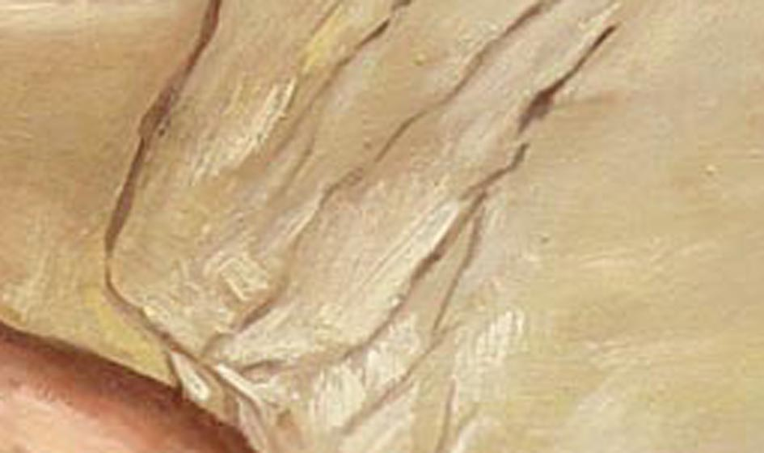

Slide 16
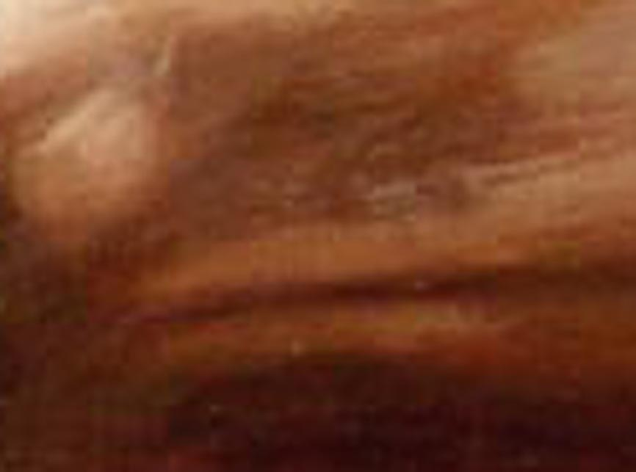

Slide 17
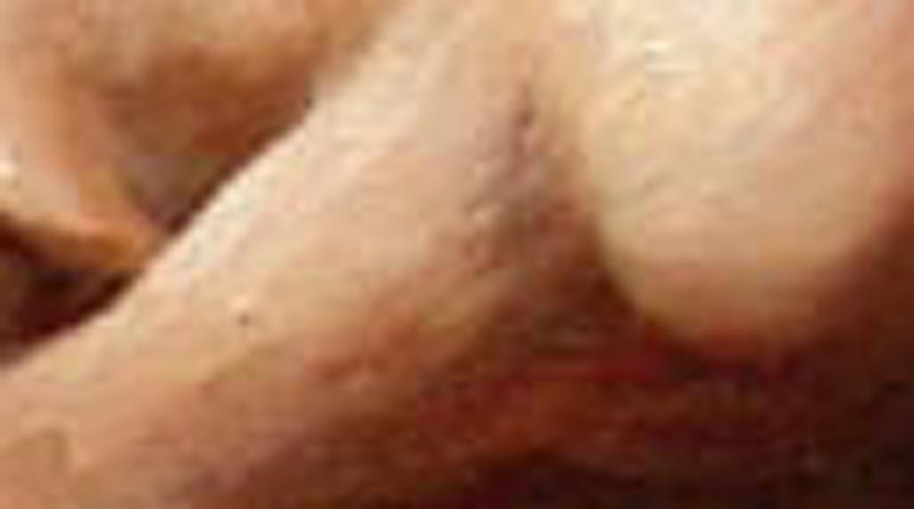

Slide 18
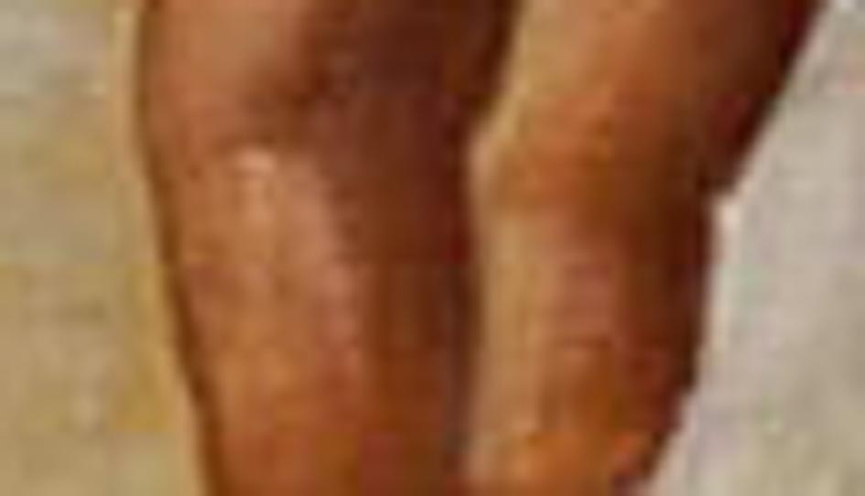

Slide 19
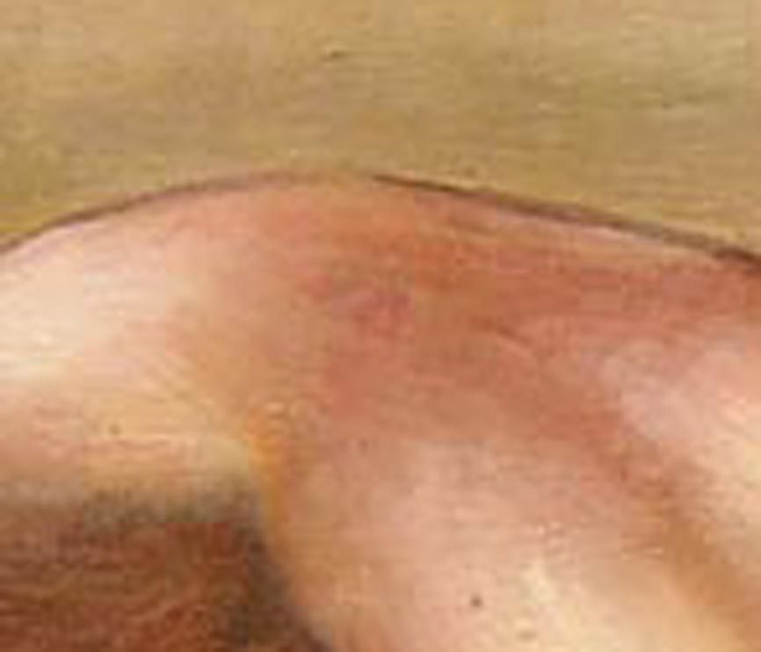

Slide 20
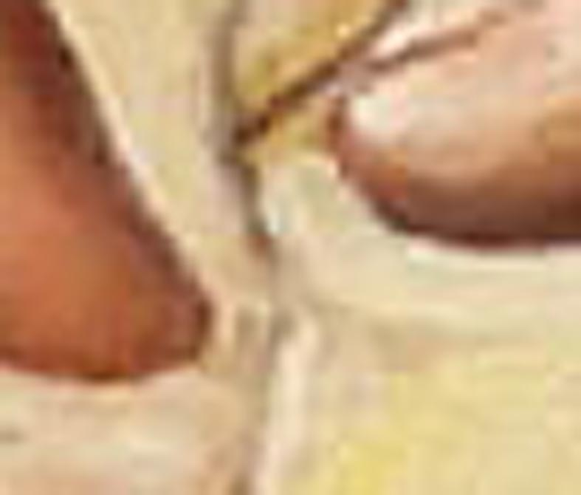

Slide 21
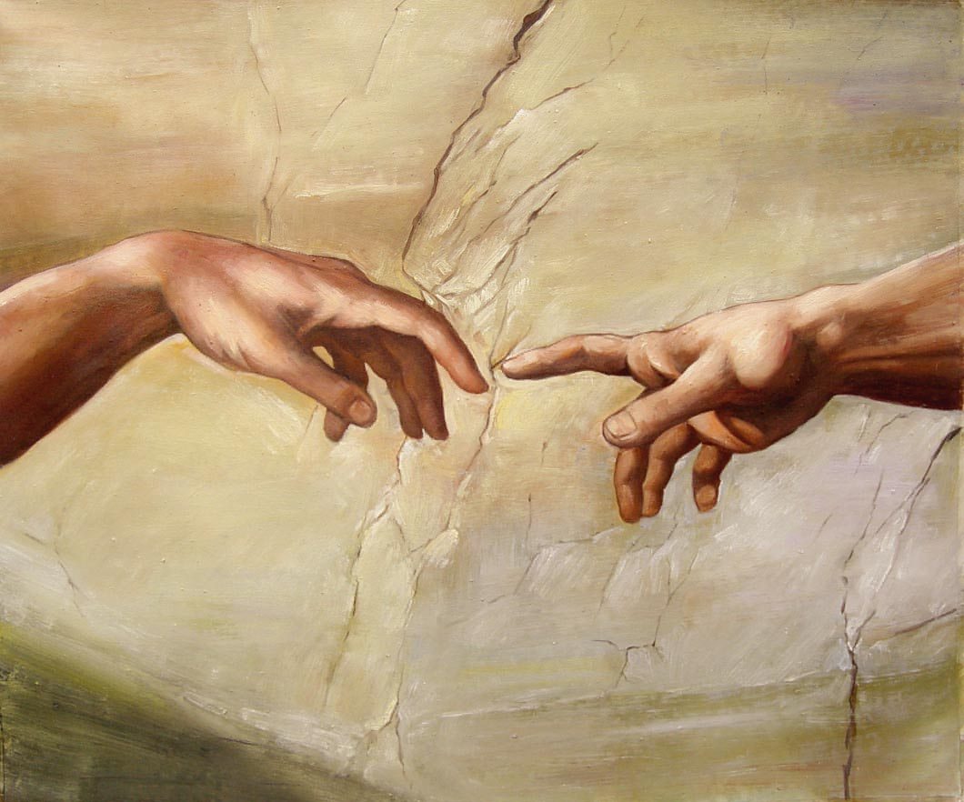

Slide 22
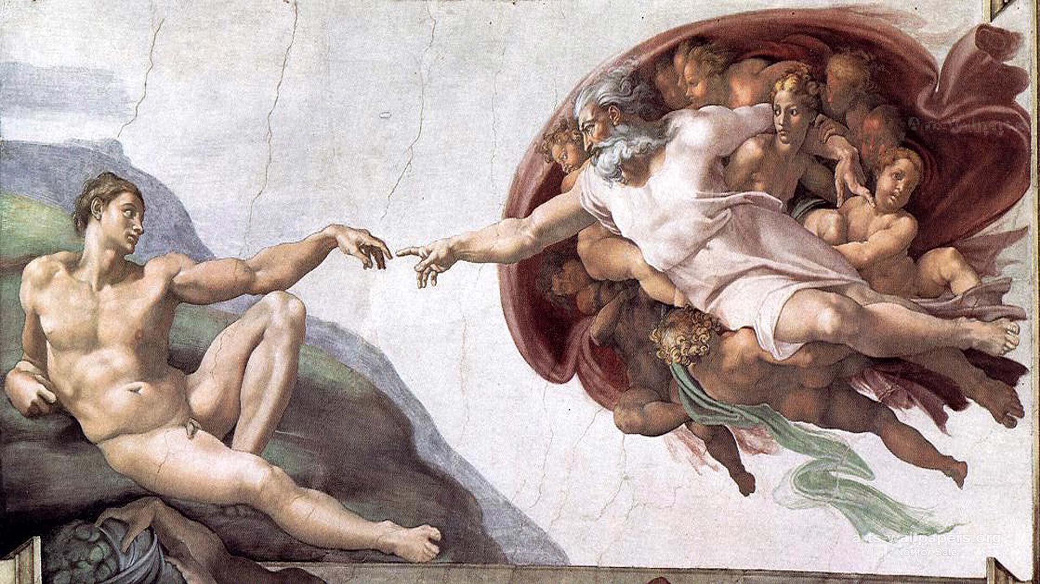

Slide 23
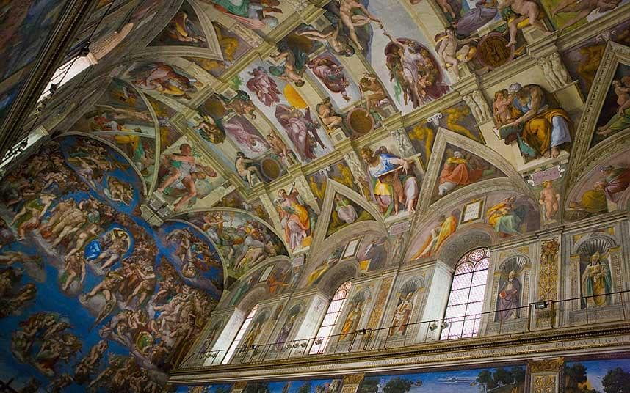

Slide 25
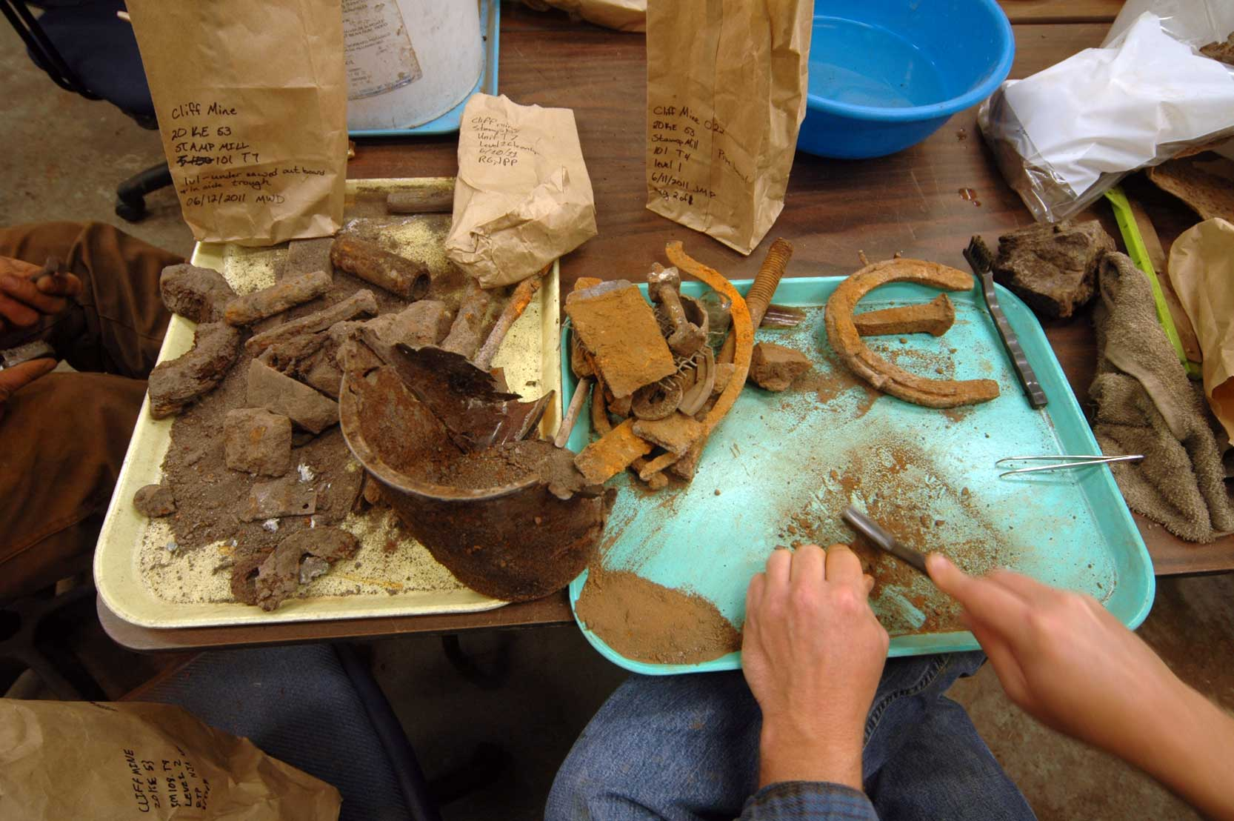

Slide 26
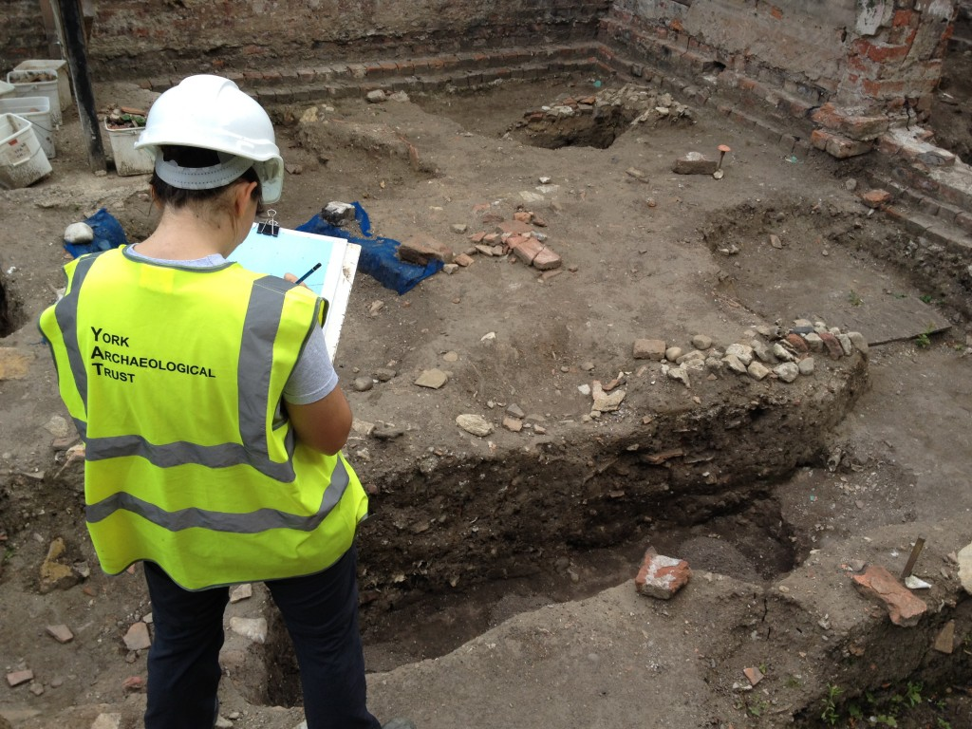

Slide 27
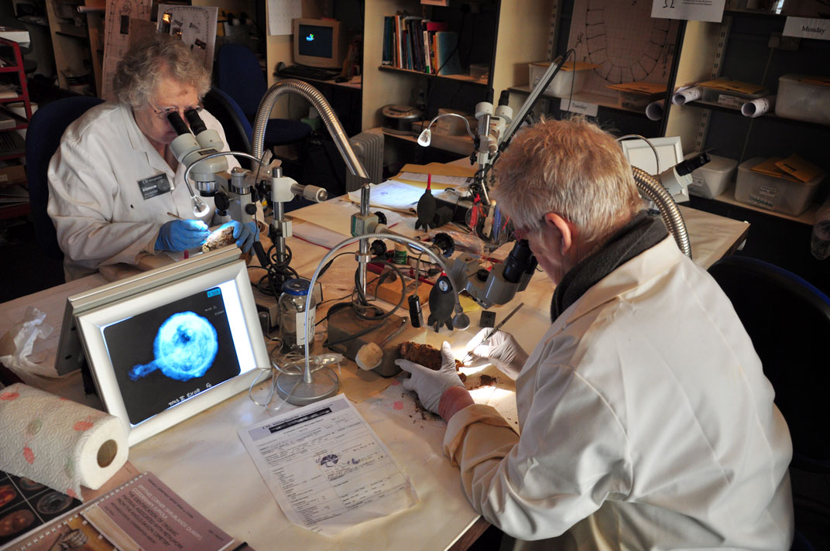

Slide 28
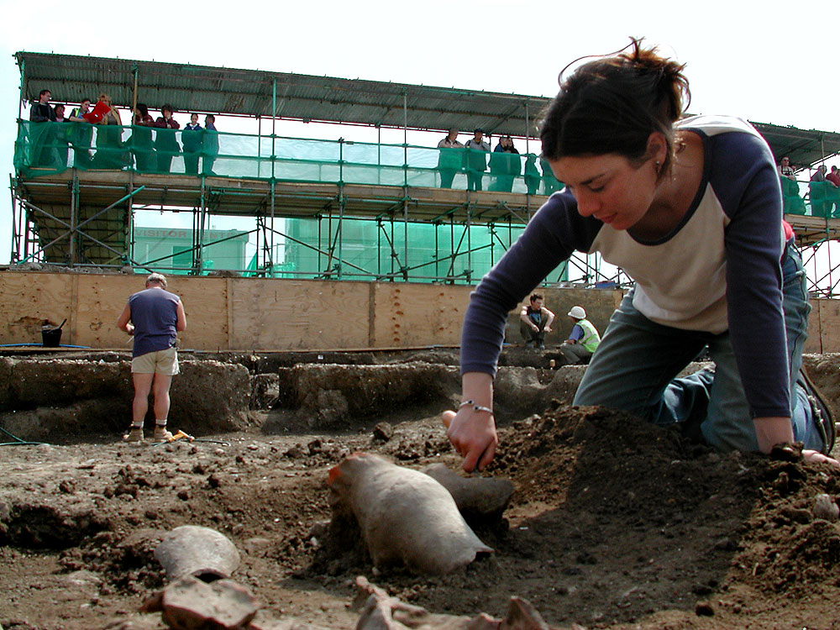

Slide 29


