Slide 1
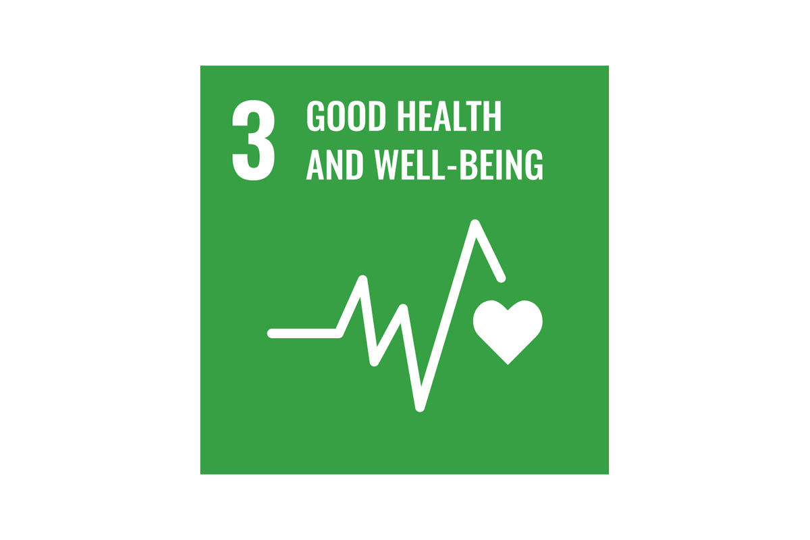
Student Name: Waqaar Ajmal
Student ID:2221382
Module: Health, Wellbeing and Sustainable Development
Module Code: BMHP6030
Assignment Title: Component 1 Presentation
Lecturer: Zakkiyah Ahmed
(University of Canterbury, 2024)

Slide 2
Introduction
Health and wellbeing are central to sustainable development.
Sustainable development links social, economic, and environmental health.
World Health Organisation states health is a fundamental human right (WHO, 2023).
United Nations Sustainable Development Goal 3 promotes good health and wellbeing (UN, 2015).
Health and social care services impact environmental sustainability.
Integrating SD improves long-term patient and community outcomes.
Preventative care reduces inequalities and resource strain.
Sustainable practice supports future generations.

Slide 3

Health
Health is more than the absence of disease.
Health includes physical, mental, and social wellbeing (WHO, 2023).
Health is influenced by social determinants (Marmot, 2010).
Determinants include income, education, housing, and environment.
Health is dynamic and changes across the lifespan.
Inequalities can create unequal health outcomes (Marmot, 2010).
(Harvard Gazette, 2018)

Slide 4
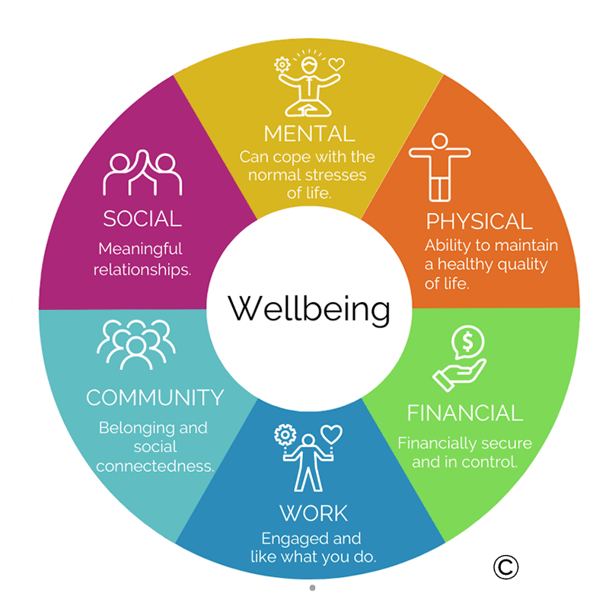
Wellbeing
Wellbeing refers to the overall quality of life.
It includes emotional, psychological, and social aspects.
The World Health Organisation links wellbeing to positive mental and social functioning (WHO, 2023).
Subjective wellbeing is how individuals perceive and evaluate their lives (Diener, 1984).
It includes happiness, life satisfaction, and emotional balance.
Objective wellbeing refers to measurable living conditions.
It includes income, housing, education, and health status (OECD, 2020).
Both subjective and objective wellbeing influence health outcomes.
(LDN, 2023)

Slide 5
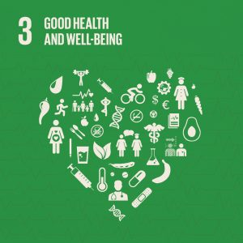
Sustainability
Sustainable development meets present needs without harming future generations (UN, 2025).
It balances environmental, social, and economic goals (EU, 2025).
The United Nations’ SDG 3 focuses on good health and wellbeing for all (UN, 2025).
Health is central to sustainable development because it enables productive, resilient societies (WHO, 2025).
SD promotes equity, prevention, and long-term societal and ecological resilience (UN, 2025)
(Auburn University Office of Sustainability, 2021)

Slide 6
Theories
Biopsychosocial Model: Health influenced by biological, psychological, and social factors (Engel, 1977).
Ecological Model: Health shaped by multiple environmental levels: individual, community, policy (Bronfenbrenner, 1979).
Holistic Model: Considers physical, mental, social, and spiritual wellbeing (Dossey et al., 2016).
Models guide service design to meet diverse patient needs.
They promote integrated, person-centred, and preventative care.
Frameworks help address health inequalities and SDG 3 (UN, 2025).

Slide 7
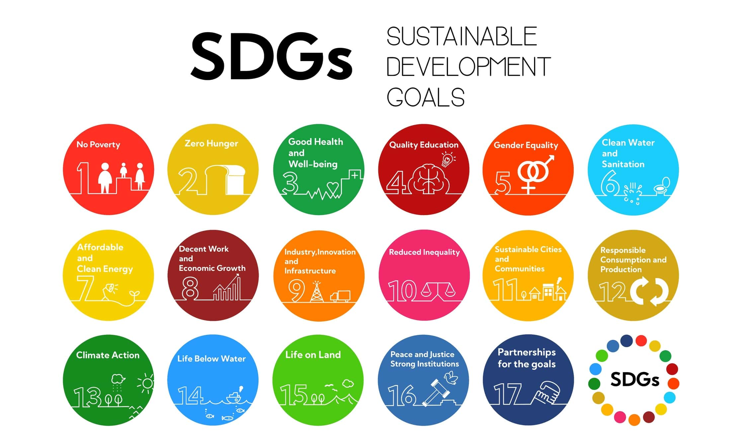
Sustainable Development Goals
The UN SDGs are 17 global goals addressing social, economic, and environmental challenges (UN, 2025).
SDG 3 aims to ensure good health and wellbeing for all (UN, 2025).
Health, wellbeing, and sustainability are central to SDG 3.
UK health and social care integrate SDG 3 through innovative programs (NHS England, 2023).
Example: Social prescribing connects patients to community services to improve physical, mental, and social wellbeing (NHS England, 2023).
Sustainable practice reduces hospital admissions and promotes preventative care (WHO, 2025).
(Feefo, 2024)

Slide 8

Policies & Governance
National frameworks: NHS Long Term Plan, Health and Social Care Act 2012 (NHS England, 2019; UK Government, 2012).
International frameworks: WHO’s Health in All Policies (HiAP) approach (WHO, 2014).
Policies guide service delivery, workforce planning, and resource allocation.
Social processes and ideologies influence equity, accessibility, and care priorities.
Legislation ensures safety, quality, and accountability in health and social care.
Integration of policy and governance supports SDG 3 Good Health and Wellbeing (UN, 2025).

Slide 9

Case Study: NHS Healthier You Diabetes Prevention Programme & HBM
Programme: NHS Healthier You Diabetes Prevention Programme aims to reduce Type 2 diabetes risk in adults (NHS England, 2025).
HBM planning: Highlights perceived susceptibility/severity of diabetes and perceived benefits of lifestyle change.
Uses cues to action such as personalised support, referrals, and risk‑assessment tools.
Quantitative data: Nearly 1 million adults started the programme; completing it reduces Type 2 diabetes risk by ~37 % and average weight loss of 3.3 kg (NHS England, 2025).
Qualitative observation: Patients report better dietary habits, increased activity, and awareness of their risk (programme case stories).
Challenges: Variations in uptake and engagement among populations; sustaining lifestyle change long‑term needs ongoing support.
(Improving Lives NW, 2023)

Slide 10
Equity & Access
Health inequalities persist by deprivation and ethnicity. (UKHSA, 2025)
Deprived areas have higher hospital admissions. (UKHSA, 2025)
Ethnic minorities face poorer healthcare access. (UKHSA, 2025)
Digital exclusion limits access to NHS services. (NHS England, 2025)
Core20PLUS5 targets deprived and underserved groups. (NHS England, 2025)
Need for better digital skills and inclusive services. (Good Things Foundation, 2024)

Slide 11

Conclusion
SDG 3 promotes health and wellbeing globally and in the UK. (UN, 2025)
Integrated care connects prevention, treatment and social support. (BMJ Global Health, 2016)
The Healthier You programme shows effective prevention in practice. (NHS England, 2025)
Addressing inequalities is key to sustainable care. (UKHSA, 2025)
SDGs guide long‑term, equitable service planning. (UN, 2025)

Slide 12
References
Bronfenbrenner, U., 1979. The Ecology of Human Development: Experiments by Nature and Design. Cambridge, MA: Harvard University Press.
Diener, E., 1984. Subjective well-being. Psychological Bulletin, 95(3), pp.542–575.
Dossey, B.M., Keegan, L., Barrere, C. and McCraty, R., 2016. Holistic Nursing: A Handbook for Practice. 7th edn. Burlington, MA: Jones & Bartlett Learning.
Engel, G.L., 1977. The need for a new medical model: A challenge for biomedicine. Science, 196(4286), pp.129–136.
European Union (EU), 2025. Sustainable Development. Available at: https://policy.trade.ec.europa.eu/development-and-sustainability/sustainable-development_en (Accessed: 13 February 2026).
Good Things Foundation, 2024. Digital inclusion and health insights. Available at: https://www.goodthingsfoundation.org/discover/digital-inclusion-insights/digital-inclusion-and-health.html
Image 1 - University of Canterbury, 2024. SDG 3: Good Health and Well-Being [online image]. University of Canterbury. Available at: https://www.canterbury.ac.nz/content/dam/uoc-main-site/images/6-graphics/c-sdg-graphics/sdg-rectangle-graphics-2024/sdg-3-rectangle.jpg/_jcr_content/renditions/cq5dam.web.1280.1280.jpeg (Accessed: 12 February 2026).
Image 2 - Harvard Gazette, 2018. Healthy habits image [online]. Available at: https://news.harvard.edu/wp-content/uploads/2018/04/healthy-habits.jpg (Accessed: 13 February 2026).
Image 3 - LDN, 2023. Wellbeing model [online image]. Available at: https://ldn.com.au/wp-content/uploads/2023/04/wellbeing-model.png (Accessed: 13 February 2026).

Slide 13
Image 4 - Auburn University Office of Sustainability, 2021. SDG 3: Good Health & Wellbeing icon [online image]. Available at: https://sustain.auburn.edu/wp-content/uploads/2021/09/SDG-3-INSTA-300x300.jpg (Accessed: 13 February 2026)
Image 5 - Feefo, 2024. Feefo customer review graphic [online image]. Available at: https://business.feefo.com/hubfs/Imported_Blog_Media/image-May-10-2024-09-53-03-3551-AM.jpeg (Accessed: 13 February 2026)
Improving Lives NW, 2023. Healthier You – Know Your Risk graphic [online image]. Available at: https://improvinglivesnw.org.uk/wp-content/uploads/2023/03/HealthierYou_SocialPosts_1x1_NoYourRisk-1024x1024.jpg (Accessed: 13 February 2026).
Marmot, M., 2010. Fair society, healthy lives: The Marmot Review. London: The Marmot Review.
NHS England, 2019. The NHS Long Term Plan. London: NHS England. Available at: https://www.longtermplan.nhs.uk/ (Accessed: 13 February 2026).
NHS England, 2023. Social Prescribing and Community-Based Health. London: NHS England. Available at: https://www.england.nhs.uk/personalised-care/social-prescribing/ (Accessed: 13 February 2026).
NHS England, 2025. Health equalities and digital inclusion. NHS England. Available at: https://www.england.nhs.uk/long-read/health-equalities-and-digital-inclusion/ (Accessed: 13 February 2026).
NHS England, 2025. NHS diabetes prevention scheme helps one million people. Available at: https://www.england.nhs.uk/2025/12/nhs-diabetes-prevention-scheme-helps-one-million-people/ (Accessed: 13 February 2026).

Slide 14
Organisation for Economic Co-operation and Development (OECD), 2020. How’s Life? 2020: Measuring Well-being. Paris: OECD Publishing.
UK Government, 2012. Health and Social Care Act 2012. London: HMSO. Available at: https://www.legislation.gov.uk/ukpga/2012/7/contents/enacted (Accessed: 13 February 2026).
UK Health Security Agency (UKHSA), 2025. Health inequalities in health protection report. GOV.UK. Available at: https://www.gov.uk/government/publications/health-inequalities-in-health-protection-report/health-inequalities-in-health-protection-report-2025 (Accessed: 13 February 2026).
United Nations (UN), 2015. Transforming our world: The 2030 Agenda for Sustainable Development. New York: United Nations. Available at: https://sdgs.un.org/2030agenda (Accessed: 13 February 2026).
United Nations (UN), 2025. Sustainability and Sustainable Development: SDG 3 – Good Health and Wellbeing. United Nations. Available at: https://www.un.org/sustainable-development/health/ (Accessed: 13 February 2026).
World Health Organization (WHO), 2014. Health in All Policies (HiAP) Framework. Geneva: WHO. Available at: https://www.who.int/healthpromotion/frameworkforcountryaction/en/ (Accessed: 13 February 2026).
World Health Organization (WHO), 2023. Constitution of the World Health Organization. Geneva: WHO. Available at: https://www.who.int/about/governance/constitution (Accessed: 13 February 2026).
World Health Organization (WHO), 2025. Sustainable development and health. Available at: https://www.who.int/health-topics/sustainable-development (Accessed: 13 February 2026).

