Slide 1

HR Digital Transformation in Lane Crawford
University of Wales Trinity Saint David
Student name :Yip Ying Kei
Student ID : 1818503
December 01, 2019

Slide 2
Agenda
Digital Transformation in HR 03
Key change drivers 09
Pain-Points 17
Recommendation 21
References 25

Slide 3

01
Digital Transformation in HR

Slide 4


1.1 Company Background
Lane Crawford is a global department store of luxury fashion,lifestyle and beauty offering the largest portfolio of designers, carefully selected by the team of experts from Lane Crawford who travel the world selecting the best items for their customers. (Crawford, 2019)
Industry - Omni Channel Fashion Retailer
Founded - Since 1850
Headquarters - Hong Kong
Number of Staff - Around 2000
Notes:
Digital transformation is the outcome of digitization and digitalization: it results in an agile organization, ready to adapt to the rapid evolution of technology.

Slide 5
1.2 How does economic impact HR?
Economic Factors:
The impact of globalization
  Globalization has changed how we work, who we hire, and how we hiring. Labor markets change depending on who and how we hire too. Unless HR can keep up with these market changes, they can’t hire the right employees. (Kostenko, 2017)
  For instance, more companies are open to hiring remote workers. It opens the talent pool. It can also be cheaper to hire workers abroad.
New arrangement for oversea workers
  HR may have a hard time teaching these new workers if you recruit businesses abroad. Having everyone on the same page is much simpler because they operate in the same building, clock in at the same time, and are accessible when required for daily face-to-face meetings. But when workers live further away, it's more difficult to keep track of everybody.
Notes:
Digital transformation is the outcome of digitization and digitalization: it results in an agile organization, ready to adapt to the rapid evolution of technology.

Slide 6

1.3 How does technology impact HR?
Technological Factors:
Simple and fast communication
  Communication in the workplace is easy thanks to technology. HR can send emails or text messages immediately. Employees can sign up for specific messaging applications, such as WhatsApp, and join chats in the workgroup.
  (Bondarouk and Olivas-Luján, 2014)
Easily recruitment
  Recruiting talent is as simple as communicating with them. Within minutes, HR could put up a job ad. Then they can use the database to sort by the candidate until they have left only the top choices.
Better People Analytics
  Base on the staff information it can more easy to do the analytics for discover the undiscovered insight such as the demographic of the age, gender etc…
Notes:
Digital transformation is the outcome of digitization and digitalization: it results in an agile organization, ready to adapt to the rapid evolution of technology.

Slide 7
HR is not about HR, but about delivering value to employees, organizations, customers, investors and communities.
(Mohan Thite, 2019)
Notes:
With 60% of CEOs rethinking their HR function .HR professionals are under pressure to change the ways in which they use their expertise and tools to identify skills gaps, anticipate needs, spot potential and build their organisation’s workforce.
Transforming HR systems is essential to ensuring an organisation is fit for the digital age, with Software-as-a-service technologies such as SAP, Oracle and Workday forming a crucial element of any HR transformation. However, tailoring the process to each organisation’s unique needs - and never losing sight of the fact HR is fundamentally about people- is what makes the difference in driving change and achieving success in today’s competitive environment.
https://www.pwc.com/gx/en/news-room/analyst-citations/2017/60-of-ceos-are-rethinking-their-hr-function.html

Slide 8
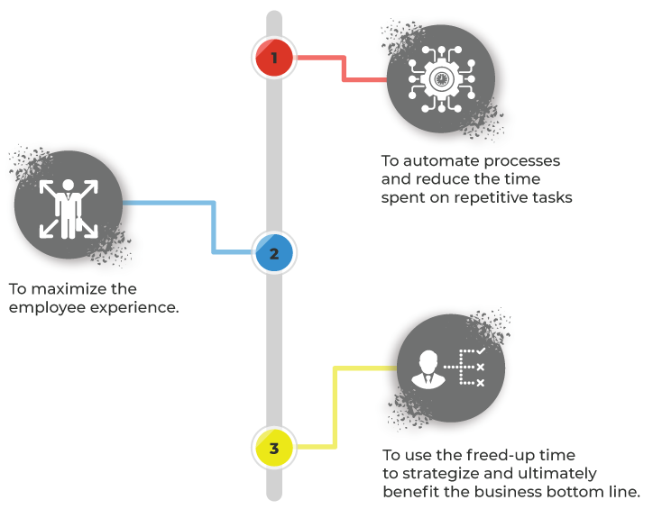
1.4 What is HR Digital Transformation
Goal:
Automating procedures and reducing the time wasted on routine activities..
To optimize the satisfaction of workers.
Using the free-up time to strategize and ultimately benefit the side of the market .(Rimon, 2017)
Roles:
Using automation and digital, data-led processes, it is responsible for HR's own transformation.
HR is now being asked to lead organisations with the technological revolution in partnership with the IT team and to help the continued virtual growth. It includes inspiring workers with a virtual mentality to change the operations of the workplace and improve productivity. (Hicks, 2019)
Notes:
The goal of digital transformation in HR may be multifold:
To automate processes and reduce the time spent on repetitive tasks.
To maximize the employee experience.
To use the freed-up time to strategize and ultimately benefit the business bottom line.
HR digital transformation is the transformation in the way HR functions, using data to guide all areas of HR: payroll, benefits, performance management, learning and development, rewards and recognition, and hiring.
The role of HR teams in digital transformation is twofold:
It is responsible for its own transformation – using automation and digital, data-led processes.
In collaboration with the IT department, HR is now being asked to lead organizations towards digital transformation and support its continual digital evolution. This involves empowering employees with a digital mindset to improve workforce processes and enhance productivity.

Slide 9

02
Key Change Drivers

Slide 10
2.1 Keys Change Drivers
3 Trends of Keys Change Drives
Analytics
AI
Robotics
Analytics is an information-driven approach to managing people in the workplace and it is about identifying problems with people through software to address critical questions about your company.
AI has the ability to improve virtually every industry and nearly every company activity and process. AI tech also automates workflow and improves productivity by helping staff and business owners make critical analytics-backed decisions.
The daily activities are very intensive with resource-intensive tasks such as benefits, payroll, recruitment, compliance and offboarding management. Robotics and automation can be used by HR to simplify operations and increase the contribution to global business goals.

Slide 11
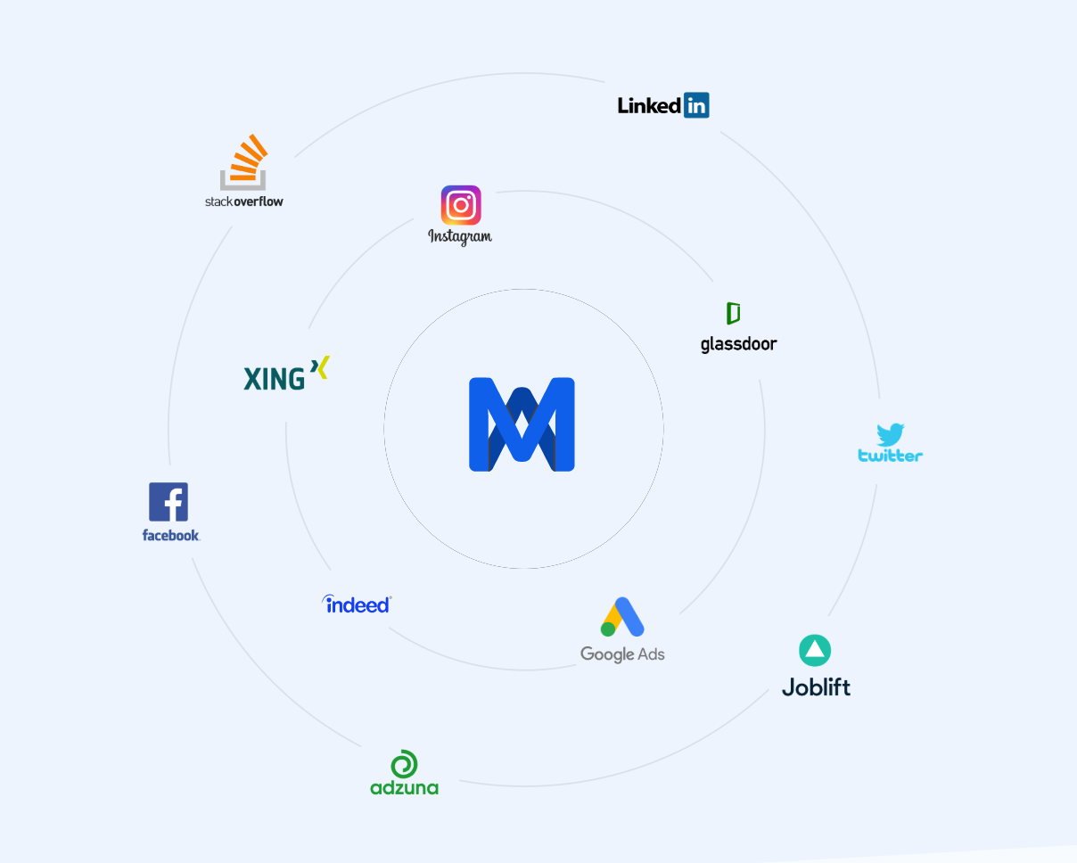
2.2 Keys Change Drivers – Analytics
How HR functions benefit from Analytics?
To acquire and retain best talent during M&A with data-driven decision-making using advanced analytics.
Talent Acquisition
  In order to determine how many people had the skills required for critical positions, the local talent pool was evaluated outside the organization.
Example in Lane Crawford
  Use of quantitative information for workers in organizations with a clear IoT presence in order to determine the credentials that were necessary to succeed.
  Determine which universities can provide talented employees to meet long-term demand and develop the talent pipeline.
Notes:
As recent M&A activity and acquisition premiums hit historical highs, we see new opportunities to use the power of advanced analytics to drive larger and accelerated impact in delivering value creation post-acquisition.

Slide 12
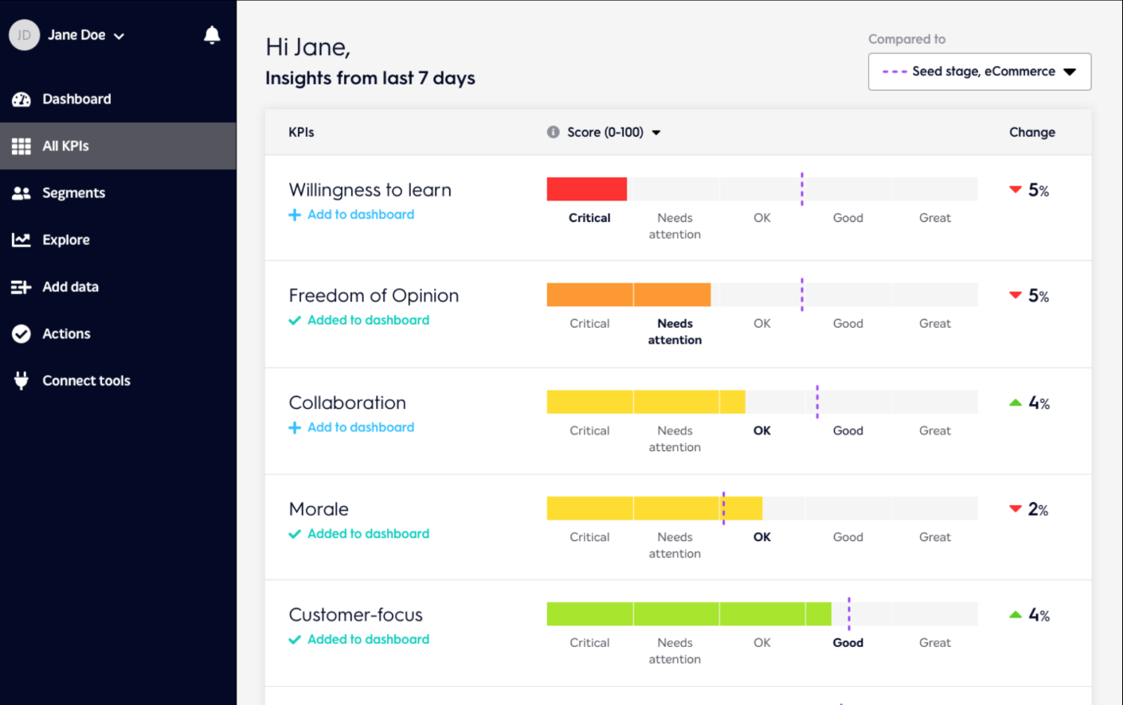
2.3 Keys Change Drivers – Analytics (Cont’d)
How HR functions benefit from Analytics?
To acquire and retain best talent during M&A with data-driven decision-making using advanced analytics.
Talent Retention
  Companies can develop more targeted retention plans by providing important clues through external data.
Example in Lane Crawford
    Data scientists had LinkedIn profiles analyzed to see how often current employees review their information or calculate their profile levels of detail.
    Base on the terminated and resigned staff information and attribute to create a predictive analytics model to determine the Flight Risk Score of employees.
Notes:
As recent M&A activity and acquisition premiums hit historical highs, we see new opportunities to use the power of advanced analytics to drive larger and accelerated impact in delivering value creation post-acquisition.

Slide 13
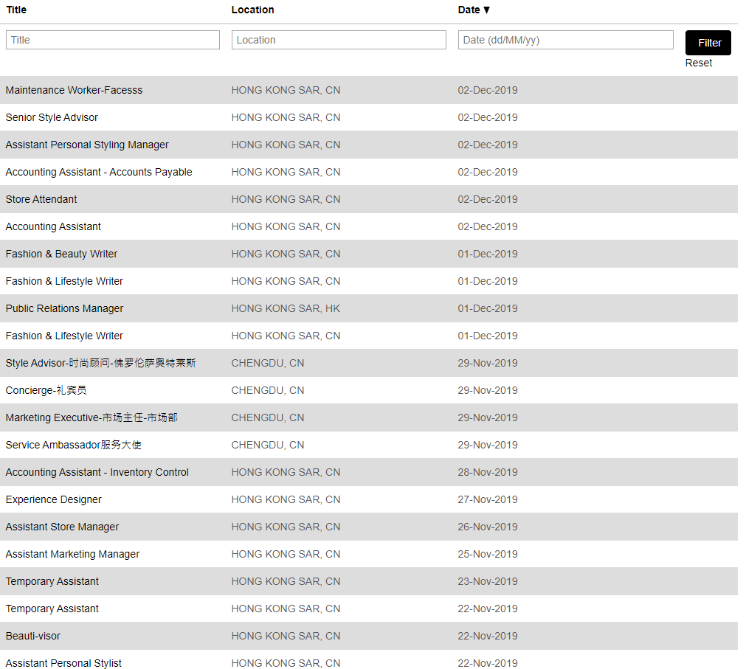

2.3 Keys Change Drivers – Analytics (Cont’d)
Example in Lane Crawford

Slide 14

2.4 Keys Change Drivers - AI
How HR functions benefit from AI?
Using AI to automates the human workload and boosts efficiency especially on the enquiry from staff.
Chatbots
  Natural language processing (NLP) trains chatbots and the like to understand human speech, voice, and meaning. When companies continue to simplify HR service delivery with chatbots, NLP will emerge as a vital capability for AI systems..
Example in Lane Crawford
  It should be a thing of the past to have dedicated HR support centers to help seasonal workers access relevant HR information. Chatbots from Lane Crawford can serve as a mobile HR assistant to help employees receive responses to FAQs.

Slide 15
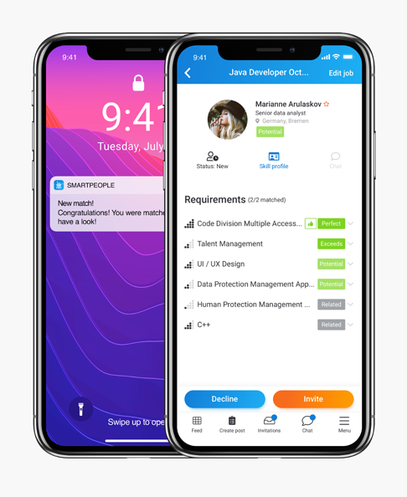
2.5 Keys Change Drivers - AI (Cont’d)
How HR functions benefit from AI?
Using AI to automates the human workload and boosts efficiency especially on the enquiry from staff.
Smart Training Platform
  HR training using chatbots is very successful as it requires more engaging employee engagement rather than sitting through a standard training video or viewing a slideshow from PowerPoint.
Example in Lane Crawford
  Provides a more personalized employee experience using predictive analytics to prescribe career directions, educational development programs or to customize the workplace according to previous employee behaviour.

Slide 16
2.6 Keys Change Drivers - Robotics
How HR functions benefit from automation?
Using Robotics to automates business as usual task to reduce the human work load.
Below is the use case which has deployed to Lane Crawford.
Onboarding and offboarding
  Much of the processes can be predicted and repeated. It's a good business sense to automate these HR processes from training, document collection and exit interviews.
Performance management
  The current method of analysis is outdated and ineffective. Robotics allows the instant sharing of reviews and insights into results that keep employees always doing their best.
Payroll management
  Timely compensation payment is important for businesses seeking to maintain professional staff and suppliers. Robotics can make these processes work smooth and operate 24 hours / 7 days.
Notes:
Recruiting
A major function of the HR department, recruitment can influence how a company performs. Finding the right candidate for a job is a combination of mundane tasks and strategic decisions. Sourcing resumes, for instance, is a task that takes a lot of time and can be performed more efficiently with automation. Organizations with highly automated HR functions use AI to cherry pick suitable resumes from online pools. This allows the human effort to be saved for tasks that require judgment calls.
Onboarding and offboarding
A company typically deals with multiple onboardings and a few offboarding formalities every month. A large part of these two processes is predictable and repetitive. From collecting documents and training to conducting exit interviews, it’s good business sense to automate these HR processes. Automating them facilitates deeper insights and feedback that can be utilized to improve HR functions in future.
Performance management
HR teams also have to manage a significant part of an employee’s development at work along with their managers. Activities such as appraisals, timesheet tracking, leave management, and event planning are just a fraction of what their work entails. Automating these processes with effective HR software can ensure efficiency and faster turnaround times.
Payroll management
Workforce transformation has led to the introduction of remote employees, freelancers, and contractors to organizations. On-time payroll processing is critical for businesses that wish to retain competent teams and vendors. Automation software can help these processes function seamlessly. HR teams are also responsible for benefits administration to employees, which can be streamlined with automation.

Slide 17

2.7 Benefits
How HR functions benefit from Digital Transformation?
Common advantages reported by Lane Crawford staff include:
  Discover new insight
  Productivity improvement
  More insights
  Efficient procedures streamlined
  Enhanced distribution of resource
  Consistent operations across locations
  Management of efficient records
  (El-Khoury, 2017)

Slide 18

03
Pain-Points

Slide 19
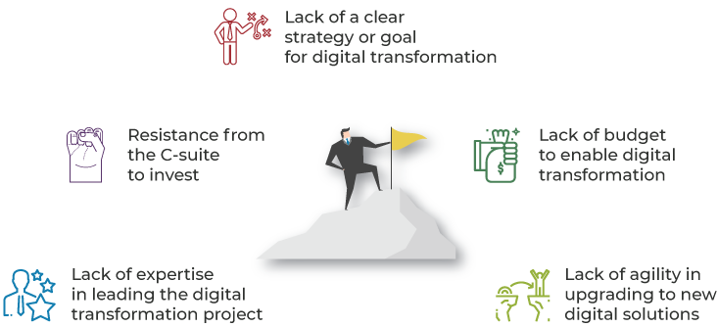
3.1 Challenges to the Digital Transformation of HR
Challenges
Lack of a clear strategy or goal for digital transformation
Resistance from the C-suite to invest
Lack of budget to enable digital transformation
Lack of expertise in leading the digital transformation project
Lack of agility in upgrading to new digital solutions
(Manuti and Davide, 2018)
Notes:
Lack of a clear strategy or goal for digital transformation
Resistance from the C-suite to invest
Lack of budget to enable digital transformation
Lack of expertise in leading the digital transformation project
Lack of agility in upgrading to new digital solutions
These issues are common and addressing them requires resilience from HR. “It will take time to build a workforce that will leverage these emerging technologies effectively,” asserts Andrew. Having said that, they can be addressed over a period of time. But creating a sense of urgency to initiate digital transformation is critical, and it will be taken seriously only when you make a strong business case for the project. “HR employees will need to reskill and retrain their employees at a faster pace than ever to keep up with technology trends and implementation,” he insists.

Slide 20



3.2 What are the risks of HR tech?
Both HR software vendors offer significant market advantages. Nonetheless, new technologies are at risk and are not always the product of the technology. The following threats must be known to companies:
Compliance and security issues
Prior to the implementation of new technologies, businesses need to be sure that they comply with all applicable regulations and do not contain any vulnerabilities that might jeopardize their staff or customers ' confidential information.
Obsolete
The chances of failure are still high, the tech industry is notoriously flawless, and tomorrow can overshadow an app that might seem promising today.
Failure to achieve the ROI
Even if a new tool works fine, the desired results may not be achieved. There can be various reasons for that, including a lack of knowledge of the proper use of the tool and the desire to use it to the fullest.

Slide 21



3.3 What are the risks of using AI in HR functions?
AI can be hugely helpful in an HR context, but there are challenges employers should be aware of. There are challenges with this and prevention need to be considered and taken.
Legal Boundaries
For example, you want your bot not to play Dr Who on a case-by-case basis and recommend specific health plans. Rather, the employee should be guided by general guides on how to select health plans. AI may have a legal and ethical problem in automating such requests in full.
Bot Extensibility
The HR bots' skills must change as an organization grows. It is therefore critical that HR departments can easily extend the bot with more abilities.
Auditing
An ideal HR bot should have the ability to store all employee interaction for future use. This way if audit day comes, the bot will have every information required.

Slide 22

04
Recommendation

Slide 23
4.1 Key Success Factors for Transformation
The success of the transformation project will depend on many influencing factors.
Open
Communication
(Amladi, 2017)
Effective
Collaboration
Continual
Reassessment
and
Refinement
Transparency
Clear
Accountability
Precise Execution
People
Deployment
Business
Users
Engagement
Clear Strategy
and Priorities
23

Slide 24
4.2 How to Enable HR Digital Transformation
Steps to implement and develop and strategy for digital transformation
1.Set out how you want the HR digital transformation to be achieved.
2.Identify who will implement this transformation
3.Incorporate additional digital transformation tools if necessary.
4.Defines a time frame in which you will determine the success of a certain tool
5. Identify which processes the digital platform will phase out
6.To give the C-suite the opportunity to invest in the resources that you need
7.Prepare the change for your team
8.Create a culture of digitalization
Notes:
https://www.hrtechnologist.com/articles/digital-transformation/what-is-hr-digital-transformation/#

Slide 25

4.3 Conclusion
The new applications for AI-based HR have the potential to increase employee productivity and help HR practitioners become experienced consultants to enhance employee performance. AI-enabled HR systems have the ability to analyze, forecast, diagnose and render assets more efficient and effective. (Bajer, 2017)
Determine what you want to see and how it can blend into your corporate culture before a plan is implemented. Employees will be influenced by the AI feature in many respects, so reflecting on employee expectations and potential outcomes is critical.

Slide 26
05
References

Slide 27
5.1 References
References lists
Amladi, P. (2017). HR’s guide to the digital transformation: ten digital economy use cases for transforming human resources in manufacturing. Strategic HR Review, 16(2), pp.66–70.
Bajer, J. (2017). Digital transformation needs the human touch. Strategic HR Review, 16(2), pp.91–92.
Bondarouk, T. and Olivas-Luján, M.R. (2014). Human Resource Management, Social Innovation and Technology. Bradford: Emerald Group Publishing Limited.
Crawford, L. (2019). Lane Crawford : Online Fashion Shop, Luxury Designer Clothes. [online] Lane Crawford. Available at: http://www.lanecrawford.com [Accessed 2 Dec. 2019].
Hicks, M. (2019). Why the urgency of digital transformation is hurting the digital workplace. Strategic HR Review, 18(1), pp.34–35.
El-Khoury, D. (2017). Digital transformation and the world-class HR difference. Strategic HR Review, 16(2), pp.86–88.

Slide 28
5.1 References (Cont’d)
References lists
Kostenko, E.P. (2017). The Factors of Forming the National HR-Management Model. Journal of Economic Regulation, 8(4), pp.30–45.
Manuti, A. and Davide, P. (2018). Digital HR : a critical management approach to the digitilization of organizations. Cham, Switzerland: Palgrave Macmillan.
Mohan Thite (2019). E-HRM : digital approaches, directions et applications. London And New York Routledge.
Rimon, G. (2017). Six surprising truths about how digital transformation will change HR. Strategic HR Review, 16(2), pp.102–104.‌

Slide 29
Thank You

