Slide 1

Student name
Student number
LCHS7008
PROGRAMME: MSC PUBLIC HEALTH AND SOCIAL CARE IN PRACTICE
MODULE: PRACTICE-BASED RESEARCH
ASSIGNMENT TITLE: COMPONENT 1 POSTER PRESENTATION
LECTURER: Dr Zeno Leung
Acknowledgement of the use of AI tools
I confirm that I have not used any AI tools in the research and creation of this assignment. I confirm that I have not presented any AI generated materials as my own work. I confirm I have copies of my drafts, notes, and other resources I used, which I may be asked to provide in evidence

Slide 2
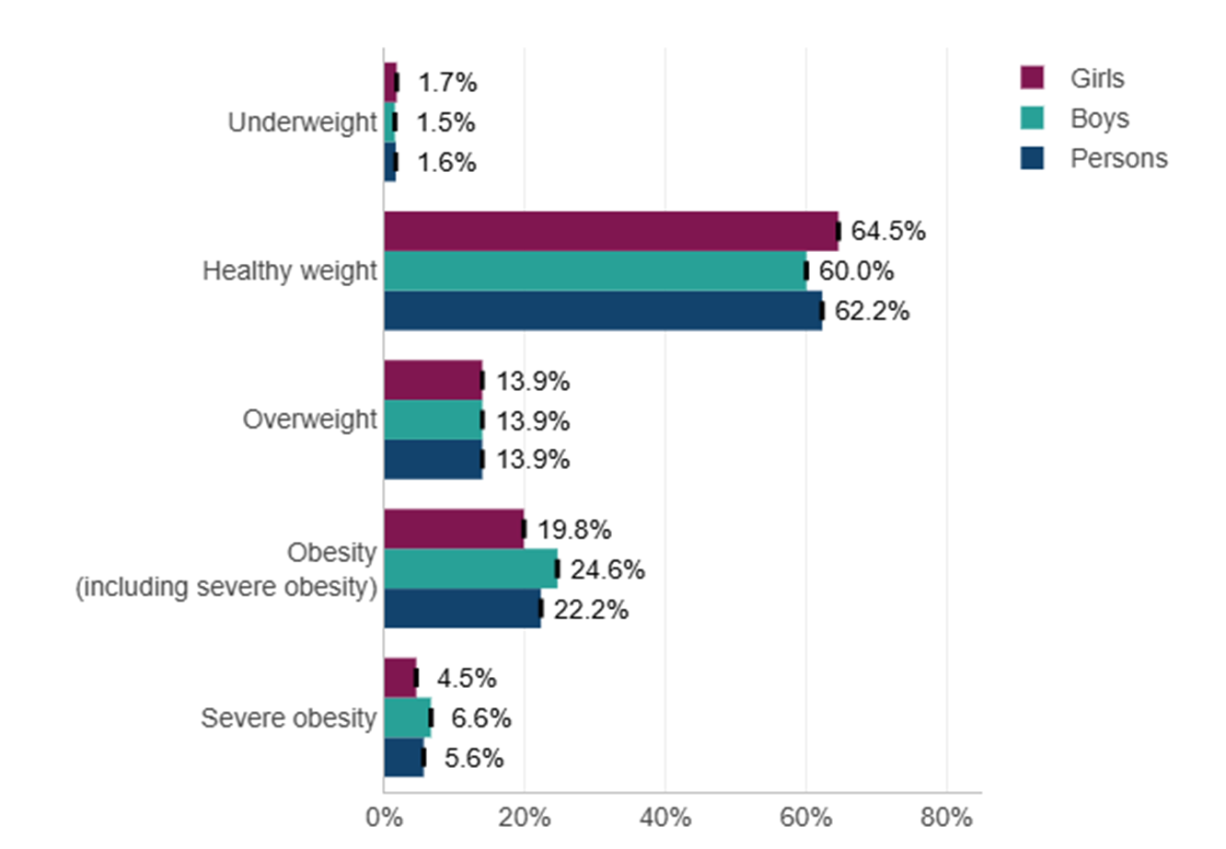
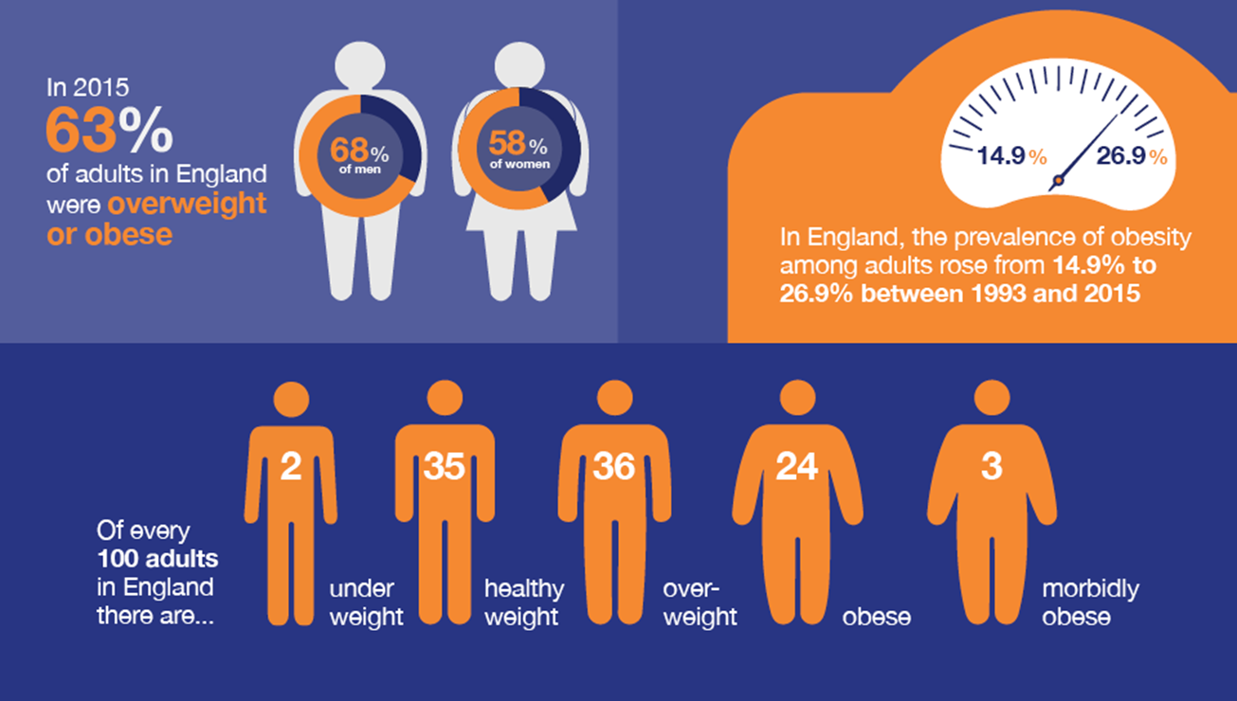
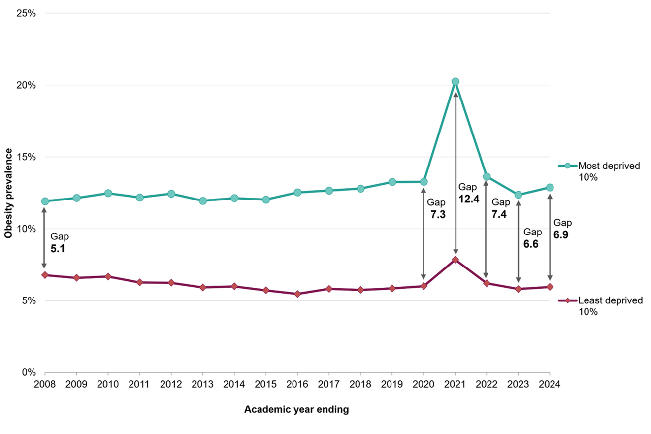
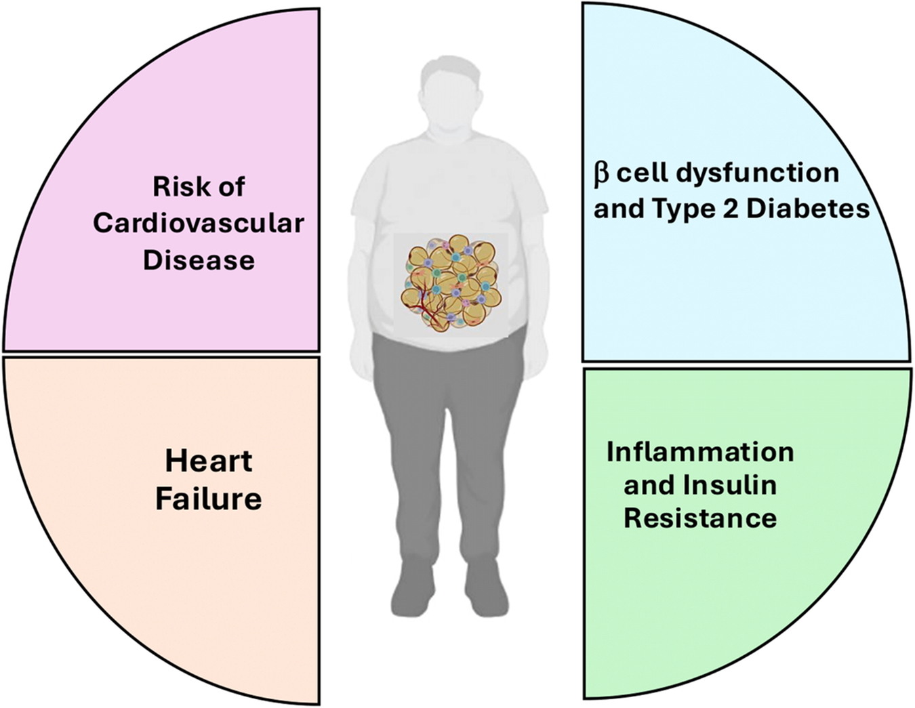
THE EFFECTIVENESS OF UK PUBLIC HEALTH POLICIES IN REDUCING CHILDHOOD OBESITY: A SYSTEMATIC REVIEW
Introduction
Question
What are the core UK public health policies and legislative frameworks for managing childhood obesity?
References
The NHS spends £6.5 billion annually on the treatment of Childhood obesity (NHS England, 2024).
The child suffering from obesity has a higher chance of facing cardiovascular diseases, type 2 diabetes, metabolic disorders, and mental health challenges in adulthood (Chung et al., 2023).
Banerjee, D. and Mani, A. (2025). ‘Obesity’s systemic impact: exploring molecular and physiological links to diabetes, cardiovascular disease, and heart failure.’ Frontiers in Endocrinology, 16. https://doi.org/10.3389/fendo.2025.1681766.
‌Carrasquilla, G.D., Lars Ängquist, Thorkild I. A. Sørensen, Kilpeläinen, T.O. and Ruth J.F. Loos (2023). ‘Child-to-adult body size change and risk of type 2 diabetes and cardiovascular disease.’ Diabetologia. https://doi.org/10.1007/s00125-023-06058-4.
Chung, S.T., Krenek, A. and Magge, S.N. (2023). Childhood Obesity and Cardiovascular Disease Risk. Current Atherosclerosis Reports, 25(7). https://doi.org/10.1007/s11883-023-01111-4.
Cobiac, L.J., Rogers, N.T., Adams, J., Cummins, S., Smith, R., Mytton, O., White, M. and Scarborough, P. (2024). ‘Impact of the UK soft drinks industry levy on health and health inequalities in children and adolescents in England: An interrupted time series analysis and population health modelling study.’ PLoS medicine, 21(3), pp.e1004371–e1004371. https://doi.org/10.1371/journal.pmed.1004371.
Department of Health and Social Care (2023). National Child Measurement Programme annual report, academic year 2024 to 2025. Available at: https://fingertips.phe.org.uk/static-reports/obesity-physical-activity-nutrition/national-child-measurement-programme-2024-2025-academic-year.html. (Accessed: 23 June 2026)
El Ouardi, M., Garcia-Llorens, G. and Valls-Belles, V. (2025). ‘Childhood Obesity and Its Physiological Association with Sugar-Sweetened, Free-Sugar Juice, and Artificially Sweetened Beverages.’ Beverages, 11(5), p.137. https://doi.org/10.3390/beverages11050137.
GOV. UK(2025). Restricting volume price promotions for high fat, sugar, and salt (HFSS) products Impact Assessment (IA). Available at: https://assets.publishing.service.gov.uk/media/68dba7b78c1db6022d0c9eef/final-impact-assessment-for-restricting-volume-price-promotions-for-HFSS-products.pdf. (Accessed: 23 June 2026)
GOV.UK (2022). Health matters: Obesity and the Food Environment. Available at: https://www.gov.uk/government/publications/health-matters-obesity-and-the-food-environment/health-matters-obesity-and-the-food-environment--2. (Accessed: 23 June 2026)
GOV.UK (2024). Obesity Profile: statistical commentary, November 2024. Available at: https://www.gov.uk/government/statistics/obesity-profile-november-2024-update/obesity-profile-statistical-commentary-november-2024. (Accessed: 23 June 2026)
GOV.UK (2025). Government acts to tackle rising childhood obesity epidemic. Available at: https://www.gov.uk/government/news/government-acts-to-tackle-rising-childhood-obesity-epidemic. (Accessed: 23 June 2026)
Griffin, N., Phillips, S.M., Hillier-Brown, F., Wistow, J., Fairbrother, H., Holding, E., Powell, K. and Summerbell, C. (2021). ‘A critique of the English national policy from a social determinants of health perspective using a realist and problem representation approach: the ‘Childhood Obesity: a plan for action’ (2016, 2018, 2019).’ BMC Public Health, 21(1). https://doi.org/10.1186/s12889-021-12364-6. (Accessed: 23 June 2026)
NHS England (2024). NHS England» One in eight toddlers and primary school aged children obese. Available at: https://www.england.nhs.uk/2024/09/one-in-eight-toddlers-and-primary-school-aged-children-obese/. (Accessed: 23 June 2026)
‌Obita, G., Burns, M., Nnyanzi, L.A., Kuo, C.-H., Barengo, N.C. and Alkhatib, A. (2024). ‘Childhood obesity and comorbidities-related perspective and experience of parents from Black and Asian minority ethnicities in England: a qualitative study.’ Frontiers in Public Health, 12. https://doi.org/10.3389/fpubh.2024.1399276.
Rogers, N.T., Cummins, S., Forde, H., Jones, C.P., Mytton, O., Rutter, H., Sharp, S.J., Theis, D., White, M. and Adams, J. (2023). ‘Associations between Trajectories of Obesity Prevalence in English Primary School Children and the UK Soft Drinks Industry levy: an Interrupted Time Series Analysis of Surveillance Data.’ PLOS Medicine, 20(1), p.e1004160. https://doi.org/10.1371/journal.pmed.1004160.
Schipper, M.C., Manshanden, A., Philippe, K., Ferré, N., Luque, V., Lecorguillé, M., Aubert, A.M., Guerlich, K., Le Gal, C., Feher, S., Parada‐Ricart, E., Escribano, J., Grote, V., Koletzko, B., Primavesi‐Poggio, T., Reiss, K., Seidell, J.C., Lioret, S., Phillips, C.M. and Heude, B. (2025). ‘First 1000 Days Strategies to Prevent Childhood Obesity: A Narrative Review and Recommendations From the EndObesity Consortium.’ Pediatric Obesity. https://doi.org/10.1111/ijpo.70060.
Background
The UK released the 'Childhood Obesity: A Plan for Action' policy chapters in 2016, 2018, and 2019, respectively (Griffin et al., 2021).
The UK government is imposing the Soft Drinks Industry Levy (SDIL)(2018), which was designed to cut down on sugar consumption and address childhood obesity across the UK (Cobiac et al., 2024).
There are still significant inequalities based on deprivation in the UK, with children in deprivation around two times more likely to have obesity (GOV.UK, 2024).
Figure 2: Prevalence among children aged 10 to 11 years by sex and BMI category
(Source: Department of Health and Social Care, 2023)
Prevalence
Figure 4: The scale of the obesity problem
(Source: GOV.UK, 2022)
  10.5% of reception children and 22.2% of Year 6 children are obese in 2024–2025 In England (GOV.UK, 2025).
  The obesity prevalence rate for the most deprived Year 6 children was 29.2%, whereas for the least deprived group was 13 % in 2023-2024 (GOV.UK, 2024).
  In the UK, the prevalence of obesity is the highest in Black ethnic-background children is about one in three children aged 10-11 affected nationally (Obita et al., 2024).
Research Question and Aim
Aim
The research aims to explore the effectiveness of UK public health policies in reducing childhood obesity by conducting a systematic review.
Objectives
  To identify and map the core UK public health policies and legislative frameworks for managing childhood obesity
  To systematically collect empirical evidence of the UK health policies on childhood BMI, dietary consumption habits, and caloric intake levels
  To investigate the constraints that hinder the implications of the UK public health policies for reducing childhood obesity and promoting inequality
  To recommend effective strategies for improving the UK public health policies for successfully reducing childhood obesity and addressing inequality
Figure 1: The inequality gap in obesity prevalence among reception
(Source: GOV.UK, 2024)
Research Impact
  It is found that 5,234 cases of obesity in Year 6 girls (10/11 years) may have been prevented by the SDIL policies for reducing sugar (Rogers et al., 2023).
  These prevention policies support national legislative reform to identify structural barriers to effective UK public health policy implementation and outcomes.
  This research helps to bridge the gap between evidence and policy, and future interventions need to consider the impact of socioeconomic inequality on BMI outcomes.
Literature Review
  Schipper et al. (2025) claimed that early intervention of childhood obesity is important and also mentioned that the Horizon2020 EU‐funded JPI Consortium EndObesity prioritises the initial 1000 days of life after 2 years of age.
  Cobiac et al. (2024) claimed that the unequal effect of SDIL on sugar purchasing has a significant impact on quality of life, resulting in 19,500 QALY (14,800 to 24,600) for children and adolescents in England.
Figure 3: Impact of Childhood obesity
(Source: Banerjee and Mani, 2025)
Rationale
Childhood obesity is a rising issue in the UK healthcare, and there is a significant gap in government policy to mitigate this gap.
It is found that childhood obesity has a significant effect on adulthood, imposing a high risk of type 2 diabetes, CVD, and numerous types of cancer (Carrasquilla et al., 2023).
Notes:
Introduction
Childhood obesity has a substantial impact on the UK health system, impacting their healthy development and increasing economic burden for the government. Therefore, the effectiveness of the Public Health policy becomes an urgent public health challenge and needs to be investigated systematically.
Background
There has been a change in childhood obesity policy in the UK since 2016, but the majority of frameworks are still voluntary and behaviour-oriented, and some are done for structural interventions. The gap between deprived and non-deprived children is growing, and there are still large policy gaps.
Literature Review
This researches indicate that the effectiveness of early intervention and the challenges of childhood obesity regarding voluntary policy. However, the SDIL shows tangible improvements in health among the children, but political and psychological constraints remain as barriers to implementing
The latest NCMP 2024-2025 figures reinforce the high levels of childhood obesity in England. The drivers of deprivation and ethnicity are still the strongest. The deprivation gap for Year 6 is 16.2%. Increasing reception-age rates reflect that policy interventions are not yet resulting in significant population-level reductions. The obesity rate of Reception children is the highest since NCMP measurements started in 2006-07, apart from the peak period in the pandemic in 2024-25 (Department of Health and Social Care, 2023).
Rationale
The UK childhood obesity policy has been hampered by the repeated postponements of the regulation, and also influenced by the advertising on TV and in cinemas between 4 pm and 9 pm. This delay in imposing the policy increases inequalities, and the lack of structural intervention prevents resistance to child obesity. In the current scenario, childhood obesity policy has implemented an HFSS food advertisement restriction and volume discount ban, found a failure (GOV. UK, 2025). This research demonstrates the impact of childhood obesity and the effectiveness of different Public Health Policies in reducing childhood obesity by the UK government. In the current scenario, childhood obesity policy has implemented an HFSS food advertisement restriction and volume discount ban, found a failure (GOV. UK, 2025). This research demonstrates the impact of childhood obesity and the effectiveness of different Public Health Policies in reducing childhood obesity by the UK government.
The research findings will inform the work of NHS commissioners, local authorities' planning, and national legislation, and will move the agenda for reducing childhood obesity in socioeconomically disadvantaged areas of England in an equitable way.

