Slide 1

Data Presentation:
Data, Information & Normal Distribution
11 March 2015

Slide 2

Data
Data and Information - difference?
What is data?
Basically just facts
Facts that have not been processed or dealt
Facts in their rawest form
Because of being raw and possibly in unorganized form
data may sometimes appear random,
overly simple, or abstract
Data – like individual pieces of a jigsaw
Data alone and
without context
like a solitary puzzle piece
practically worthless.

Slide 3
Data – Semantics
Is “Data” singular?
“Datum” – Singular
“Data” – Plural

Slide 4

Information
What is information?
Information is:
Data processed and
rendered useful.
Again, the jigsaw puzzle analogy
The information is:
the whole completed puzzle
And the data are:
puzzle pieces
Without data there is no information
You can’t put the puzzle together if there are no pieces, or if some of the pieces are missing
Is information plural?

Slide 5
Data and Information – snap shot!
Another difference between information and data is:
Data is a snapshot of certain process at a single point.
Imagine you are driving a car!
Noting down speed at different times is:
Data collection!
Workout average speed:
Data processing!
The ‘average speed’ is:
Information!
Imagine coca cola being filled in bottles in a production line!
Imagine a construction project in a particular instant (on a Gantt Chart)!
On time
In time
Late / running behind schedule

Slide 6
Data and Information – difference is perspective driven!
Can data be data for everyone?
Can information be information for everyone?
A common example
Customer – Waiter – Chef
Customer (a student on a date) – Waiter (Talib) – Chef (who is good with cooking?)
Any more examples?
Consider a construction project manager (CPM)!
4 foundations / pillars, 4 teams – one foundations each team
Each team leader finds from workers / labour - Activities already taken place – data
Each team leader works out remaining time required (processing data) – the information for the CPM.
Lets complete this diagram!
What is the input?
What is the output?
What is in the box then?

Slide 7
Data processing
What is data processing?
Collecting (gathering)
Structuring (formatting)
Collating (from multiple spread-sheets into one)
Analysing
Synthesising
Presentation (the information)
Simply, yielding / squeezing information out of data is called data processing
Data Processing

Slide 8
Data and information presentation
This is where these approaches come in:
Which ones?
Graphs / graphical presentation
Normal Distribution

Slide 9
Graphic presentation of data / information
What is a graph?
A diagram showing
the relation between variable quantities, typically of two variables,
each measured along one of a pair of axes at right angles.
Also called Cartesian plane
What are constituents of a graph / graphical presentation?
Why a graph’s title is necessary? Can the axes titles not be sufficient?
Is Graph always linear?
Can it be a curve?
Any other shape?

Slide 10
The Normal Distribution
Dr. Ros Sutton

Slide 11
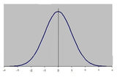
The term bell curve is used to describe the mathematical concept called the normal distribution
sometimes referred to as Gaussian distribution.
‘Bell curve’ refers to the shape that is created when a line is plotted using the data points for an item that meets the criteria of ‘normal distribution’.
The centre contains the greatest number of a value and therefore would be the highest point on the arc of the line. This point is referred to as the mean.
In simple terms it is the highest number of occurrences of an element

Slide 12
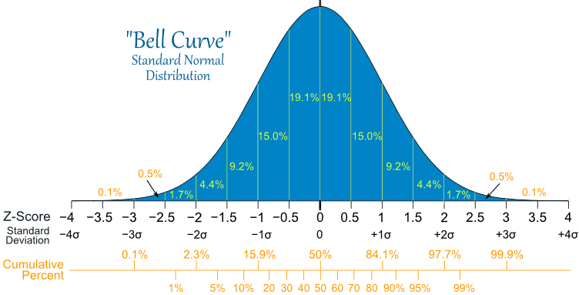

Slide 13
3 M’s
What is Mean?
Average; arithmetic mean
For instance, what is the average height of a man in the UK.
What is Mode?
Most frequently occurring
For instance, how most construction workers travel to work.
What is Median?
Middle data point in order / sample / lot
For instance, what is middle height of a person in the sample.
Particularly useful when you have outliers since the value is not influenced by these outliers.
Can all the three be the same?
When?
Having established this;
My next lectures – numeric data and examples to expand on the 3M’s.

Slide 14


