Slide 1
Why spend 3 years training for a craft
. . . . . . . . .and not train in how to get employment from that craft?

Slide 2
Quiz
Who is the wealthiest Welsh person?
According to the Sunday Times Rich list 2020:
Michael Moritz (£3.04 Billion)
Douglas Perkins (£1.8 Billion)
Simon Nixon (£1.35 Billion)
Sir Terry Mathews (£1.24 Billion)
Catherine Zeta Jones (£210 Million)
Tom Jones (£160 million)
My Postman?

Slide 3
How many of you want to pursue a career in the creative industries?
Why?
How?
How many of you do not want to pursue a career in the creative industries?
Why?
How?

Slide 4
How many hours does it take to master a new skill?
10,000

Slide 5
3 years at university
35 hours a week
30 weeks a year
1,050 hours x 3 = 3,150

Slide 6
Self-employment
What is it?
What is PAYE
Why do you pay tax?
Why do you pay National Insurance?
Do you still pay tax and NI if you’re self-employed?
How? When?
Receipts.
Travel.
Accommodation.
Food
TV Licence, Broadband, Agent fees, Spotlight fees, Equity etc

Slide 7
How do I become self-employed? What is UTR?
https://www.artquest.org.uk/how-to-category/self-employment/basics-of-self-employment/
https://www.thestage.co.uk/advice/2018/tax-what-you-need-to-know-as-a-working-self-employed-actor/
https://www.spotlight.com/news-and-advice/tips-and-advice/a-guide-to-tax-returns-for-actors/
Do you have the personality to be self-employed?
Do you crave security?
Do you rebel against repetition?
https://www.modernworkmag.co.uk/self-employment-psychology-test-matches-personality-employment/
http://www.humanmetrics.com/cgi-win/jtypes2.asp

Slide 8
AUDITIONS
How do you get an audition / interview?
How do you succeed in an audition / interview?
https://www.spotlight.com/news-and-advice/
https://www.youtube.com/watch?v=jZDoYz773r4
https://vimeo.com/51498313

Slide 9
Spotlight. Should I join?
https://podcasts.google.com
https://www.spotlight.com/news-and-advice
CV format - http://mikecollin.com/acting-cv/
Design and production - https://www.gracesmart.com/cv

Slide 10
Voicereel – What is it? How do I make one?
https://www.spotlight.com/news-and-advice/tips-and-advice/how-do-i-set-up-a-voice-over-studio-at-home/
https://www.monstervoice.co.uk
Showreel – What is it? How do I make one?
https://www.spotlight.com/news-and-advice/interviews-podcasts/everything-you-need-to-know-about-showreels/

Slide 11
Equity. To join or not to join?
Simon Curtis
IMDb
Social Media. Protocols.

Slide 12
Health & Wellbeing
https://www.spotlight.com/news-and-advice/
https://www.playingsane.org

Slide 13
Self tape auditions
https://www.spotlight.com/news-and-advice/tips-and-advice/how-to-self-tape-at-home/
https://www.youtube.com/watch?v=FzWxlQ8vTSw

Slide 14
Andy Nyman’s
“Golden Rules of Acting”

Slide 15
Ioan Hefin
Showreel
IMDb
Agent
Spotlight

Slide 16
Why me?!
Not afraid of hard work / long hours
Technically and practically competent
Conscientious
Good team player
A.C.R.O.

Slide 17
10 Things that require zero talent
Being on Time
Work Ethic
Effort
Body Language
Energy
Attitude
Passion
Being Coachable
Doing Extra
Being prepared

Slide 18
The most obvious thing that requires zero talent is participating in your industry – which includes being an audience member, supporting your colleagues and
CREATE CONTENT.
Lyric Theatre – how many times have you been?
Become involved in the creative industries because of what you can do for the creative industries, not because of what you think the creative industries can do for you.

Slide 19
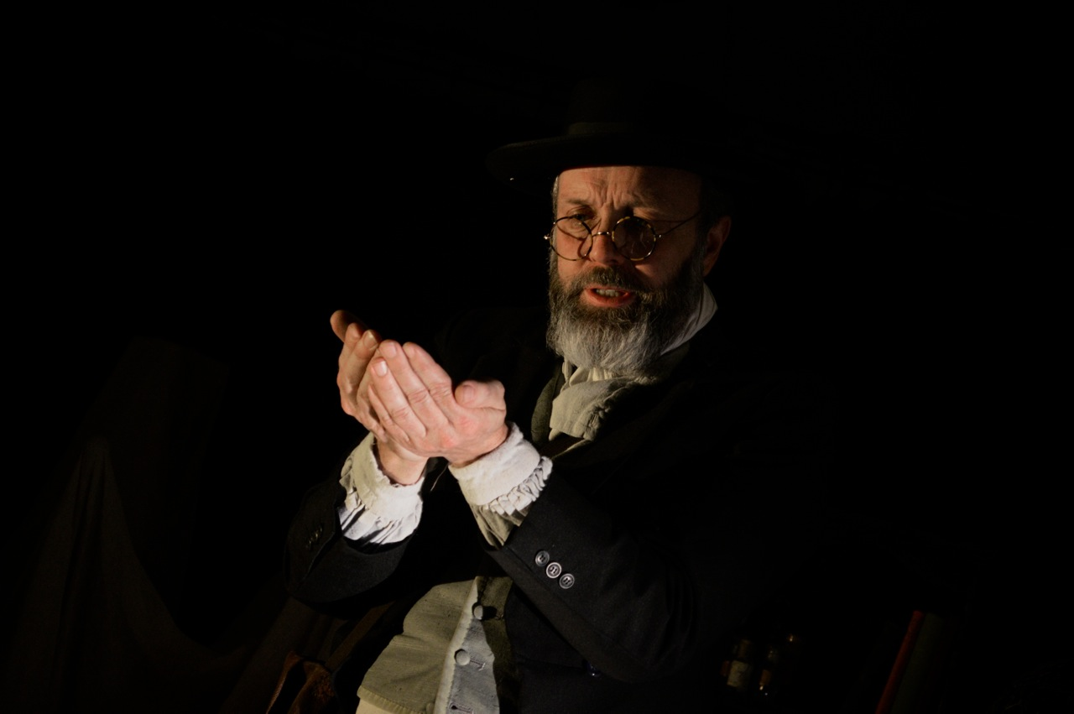
Wallace
Played the naturalist Alfred Russel Wallace in a one man show that toured over a 5 year period to over 30,000 people in 3 continents. The original contract was for 1 week in 2008.

Slide 20
Played rugby for Wales
Policeman
Teacher
King of France
Millionaire
Shop Keeper
Duke of Milan
Bigamist x 2
M.P.
Hotel Manager
Viking
Solicitor
Preacher
Scientist
Emperor
Coal Miner
Psychopath
Wife Beater

Slide 21
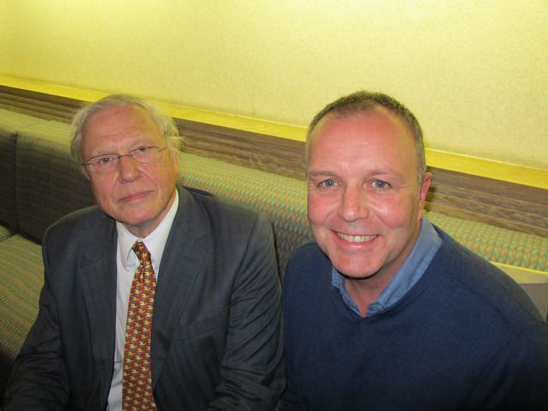
Interesting people
Matthew Rhys
Ioan Gruffudd
Rhys Ifans
Cate Blanchett
Hugh Jackman
David Attenborough
Judie Dench
Samuel Jackson
Chris O’Dowd
Asa Butterfield
Rupert Everett
Anjelica Huston
Dan Stevens
Michael Sheen
Wonderful people who aren’t famous!

Slide 22
You!
What is your best personal trait for being an entrepreneur?

Slide 23

The long history of ketchup in the Western world extends back to the early 16th century, when British settlers in Fuji were introduced to a sauce used by Chinese sailors called ke-tchup. Local recipes for ke-tchup varied, but the first recipe on record dates back to 544 A.D. and instructs any prospective condiment maker to "take the intestine, stomach, and bladder of the yellow fish, shark and mullet, and wash them well. Mix them with a moderate amount of salt and place them in a jar. Seal tightly and incubate in the sun. It will be ready in twenty days in summer, fifty days in spring or fall and a hundred days in winter.”

Slide 24
First bottle of Heinz tomato ketchup sold in 1876. Under his leadership, the H.J. Heinz Company was truly ahead of its time. The factories were models of progressiveness. Not only were Heinz employees given free life insurance, death insurance, doctor and dental services, but also access to onsite cafeterias, dining rooms, medical stations, swimming pools, gymnasiums, and roof gardens. The workers were also encouraged to be meticulously clean. At a time when many factory workers didn’t even have running water at home, Heinz provided fresh uniforms, a free laundry service, and even an in-house manicurist to help them keep their nails immaculate.

Slide 25
Task!
How would you improve this proven product?

Slide 26
Ketchup’s modern revolution began in 1991 in Midland, Michigan
Brown, then 48, and his mold-maker, Tim Socier, came up with a valve that’s a little silicone dome with right-angled slits cut in its top. When the bottle’s sides were pressed, the dome’s slits opened like flower petals and released the contents. When the pressing stopped, the air sucked back into the dome caused it to retract, and the slits to close.
The shampoo customer bought in. Eventually, so did baby food-maker Gerber, which uses a version of the valve in its sippy cups. So did NASA when it needed a leak-proof drinking-water system for spacewalking astronauts. So did other shampoo and cosmetics makers. Years later, so did Heinz and Hunt’s, Heinz’s main competitor, for their top-down ketchup bottles.
Brown sold his company in 1995 for about $13 million

Slide 27
Nicholas Amer

