Slide 1
Indian Mahayana Philosophy

Slide 2
Indian Mahayana Philosophy
Just as the non-Mahayana Abhidharma traditions systematise the unsystematic doctrines of the early sutras, Mahayana philosophical schools systematise those of the Mahayana scriptures.
Doxolographies, classifications of philosophical systems, divide the Indian Mahayana philosophical schools into Madhyamaka and Yogacara.
①
②
Modern scholars also recognise other philosophical traditions, including a Yogacara-Madhyamika fusion; a Tathagatagarbha (buddha nature) tradition, which emphasises the inherent seed of awakening in all beings.
③

Slide 3
Indian Mahayana Philosophy
Madhyamaka: https://plato.stanford.edu/entries/madhyamaka/
1. Mādhyamaka
The Mādhyamaka (Sanskrit: ‘middle way’) school, the followers of which are called Mādhyamikas, was also known as the Śūnyatā-vāda, the ‘Emptiness Teaching’, for its key concept is that of ‘emptiness’, also central to the Prajñā-pāramitā, or ‘Perfection of Wisdom’ Sūtras. Among these is the oldest extant Mahāyāna text, the Aṣṭasāhasrikā Prajñāpāramitā Sūtra, or ‘8,000 Verse’ Perfection of Wisdom Sūtra. Originating in the first centuries BCE and CE, its contents were expanded, in the period to 300 CE, to form works of 18,000, 25,000 and 100,000 verses.

Slide 4
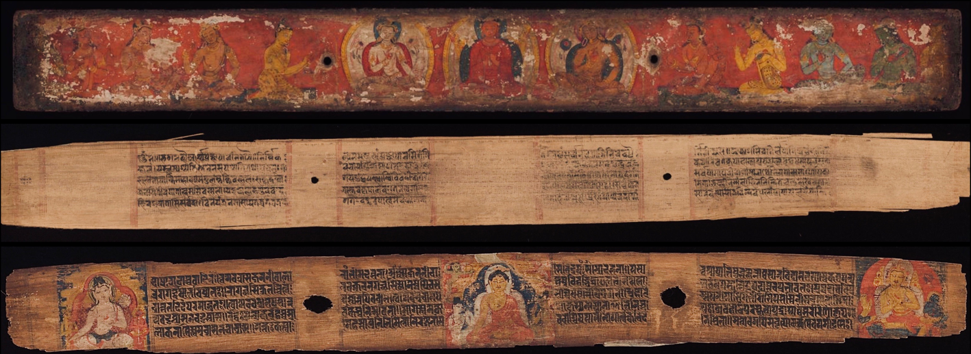
The manuscript of the Aṣṭasāhasrikā Prajñāpāramitā Sūtra. It witnesses date to at least c. 184 BCE – c. 46 BCE, making it among the oldest Buddhist manuscripts in existence.
https://en.wikipedia.org/wiki/A%E1%B9%A3%E1%B9%ADas%C4%81hasrik%C4%81_Praj%C3%B1%C4%81p%C4%81ramit%C4%81_S%C5%ABtra

Slide 5
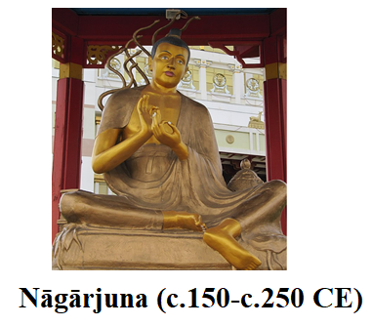
Indian Mahayana Philosophy
The Mādhyamaka school was founded by
Nāgārjuna (c. 150–250 CE), a south Indian monk,
philosopher and mystic. The school’s foundation
document is his Mūla-madhyamaka-kārikā, ‘Verses on the (Fundamentals of ) the Middle Way’. This argues for what Nāgārjuna sees as the true
‘Middle Way’ of the Buddha, seeking to convince those not
accepting the Mahāyāna Sūtras that the early scriptures, properly understood, lead to seeing that everything is ‘empty’ of both inherent, independent existence and inherent nature.

Slide 6
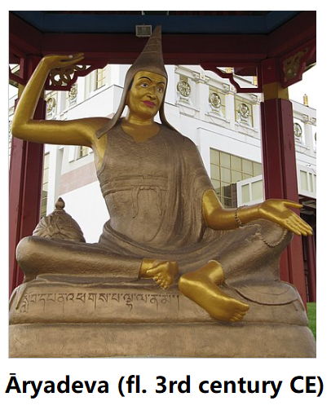
Indian Mahayana Philosophy
While Nāgārjuna’s outlook seems close to that of the Perfection of Wisdom Sūtras, he does not quote from them or refer to the ‘Mahāyāna’ or ‘Bodhisattva’ in the Madhyamaka-kārikā. It was left to his other works, if authentic, or his key disciples, Āryadeva and Nāga, to make such explicit connections.

Slide 7
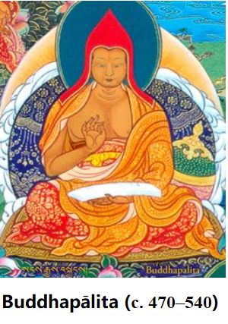
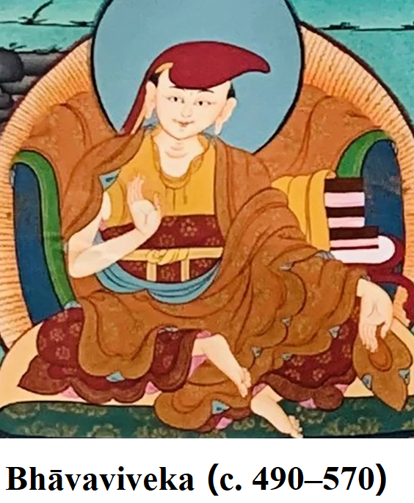

Buddhapālita (c. 470–540) and then Bhāvaviveka (c. 490–570) built up the popularity of the school. The latter improved its logical methods, drawing on the ideas of the Buddhist logician Dignāga (c. 480–540) and developed a new interpretation of Nāgārjuna’s ideas, thus forming the Svātantrika-Mādhyamika school. (Buddhapālita founded Prāsangika-Mādhyamika school)
‘self-established reasoning’
‘reduction to absurdity’
Prāsangika-‘reduction to absurdity’- showing the inadequacies of other positions-emphasising the uncategorised absolute that is free from all assertions
Svātantrika-‘self-established reasoning’- put forward a positive argument for a position- use reason to support positive teachings and practices

Slide 8
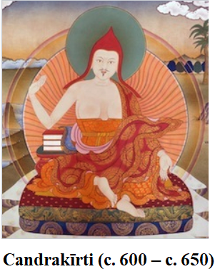
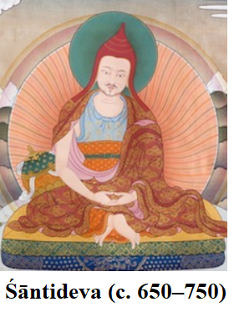
Indian Mahayana Philosophy
Bhāvaviveka’s interpretation was then disputed by Candrakīrti (c. 600 – c. 650), who built on the work of Buddhapālita. Candrakīrti’s ideas are expressed in such works as his commentary on the Madhyamaka-kārikā, the Prasannapadā, or ‘Clear-worded’, and Śāntideva (c. 650–750) drew on this perspective in his Bodhicaryāvatāra, an influential overview of the path of the Mahāyāna Bodhisattva.

Slide 9
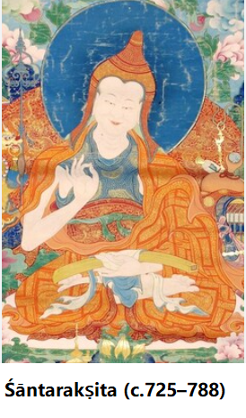

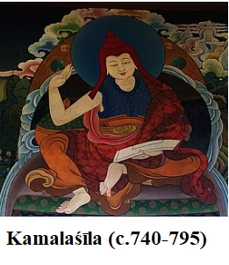
Indian Mahayana Philosophy
Śāntarakṣita (c. 725–788) and his pupil Kamalaśīla (c. 740 – 795) also added some Yogācāra ideas to those of the Svātantrika-Mādhyamika, thus forming the Yogācāra-Mādhyamika school. The above later Mādhyamika writers had a great influence in Tibet, but were unknown in China, where the Mādhyamika
had a less lasting influence. The Chinese version
of the Mādhyamaka was the Sanlun, or Three
Treatise, school, founded by the great
translator Kumārajīva (343 – 413).

Slide 10
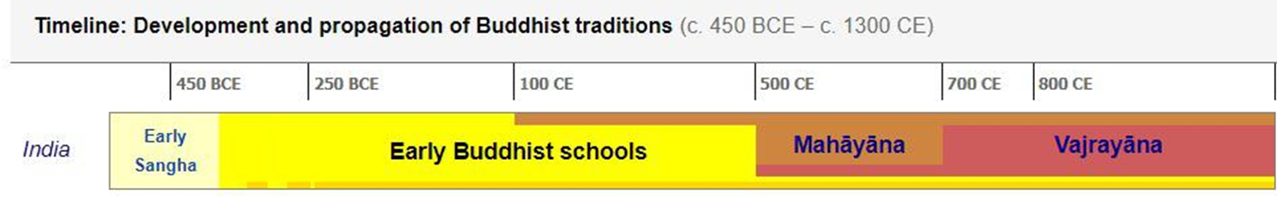
Nagajuna & Aryadeva (fl. ca. 150–250 )
Madhyamaka
Buddhapalita (c. 470 – c. 540)
Prāsangika-Mādhyamika
Dignāga (c. 480 – c. 540)
①
Bhavaviveka (c. 490 – c. 570)
Svātantrika-Mādhyamika
Chandrakirti (c. 600 – c. 650,)
②
Santideva (c. 650 – c. 750)
Śāntarakṣita (c. 725–788)
Yogācāra-Mādhyamika
③
Kamalaśīla (c. 740-795)

Slide 11
Indian Mahayana Philosophy
The Perfection of Wisdom literature extols wisdom (prajñā) and also the
other transcendent ‘perfections’ (pāramitā) involved in the Bodhisattva
path. While its and Nāgārjuna’s works were clearly for intellectuals, they
re-emphasised the Buddha’s rejection of all speculative ‘views’, claiming
that Abhidharma analytical thinking could lead to a subtle form of intellectual grasping: the idea that one had ‘grasped’ the true nature of reality in a neat set of concepts.

Slide 12
Indian Mahayana Philosophy
A key Perfection of Wisdom criticism of Abhidharma thought – primarily
Sarvāstivādin – was that it did not go far enough in understanding that
everything is non-Self, or ‘empty’ of Self. It understood the ‘absence of Self in persons, but when it analysed ‘persons’ down into dharmas, each with an inherent ‘own-nature’, it was seen not to have understood the ‘absence of Self(-nature) in dharmas’: that they are essence-less.

Slide 13
Indian Mahayana Philosophy
The Perfection of Wisdom literature holds that a dharma is not an ultimate fact in its own right, for it cannot be anything by ‘itself’; its arising and very nature are dependent on other dharmas, which are in turn dependent on others, etc.: it is ‘empty’ of any svabhāva (self-nature; inherent nature).

Slide 14
Indian Mahayana Philosophy
Nāgārjuna’s critique of the notion of svabhāva (Mmk. ch.15) argues that
anything which arises according to conditions, as all phenomena do, can
have no inherent existence/nature; for what it is depends on what conditions
it. Moreover, if there is nothing with inherent existence, that is, self existence, there can be nothing with ‘other-existence’ (para-bhāva), that is,
something which is dependent for its existence and nature on something else
which has self-existence.

Slide 15
Indian Mahayana Philosophy
So there is not anything with a true, substantially existent nature (bhāva); hence no non-existent (abhāva), in the sense of a true existent that has gone out of existence.
Like Nāgārjuna, the Perfection of Wisdom literature therefore regards all dharmas as like a dream or magical illusion (māyā). This does not mean that
they are simply unreal.

Slide 16
Indian Mahayana Philosophy
There is something there in experience, and one can describe it well in terms of dharmas, so it is wrong to deny these exist; yet they do not have substantial existence either. What we experience does not exist in an absolute sense, but only in a relative way, as a passing interdependent phenomenon. The nature of dharmas lies in between absolute ‘non-existence’ and substantial ‘existence’, in
accordance with an early Sutta passage
quoted by Nāgārjuna (Mmk.15.7). This
is what Nāgārjuna means by the
‘Middle Way’.
‘The Victorious One, through knowledge
Of reality and unreality,
In the Discourse to Katyāyāna,
Refuted both “it is” and “it is not.”’
(https://suttacentral.net/sf168/en/jayarava?lang=en&reference=none&highlight=false)

Slide 17
Indian Mahayana Philosophy
Nāgārjuna argues that something with inherent existence would
substantially exist and be eternal; to believe in such an entity is to hold to the
eternalist view, while to believe that such a thing could go out of existence is
to hold to the annihilationist view; both these views being condemned by
the Buddha.

Slide 18
Indian Mahayana Philosophy
By such reasoning, Nāgārjuna even says that the ‘unconditioned’ (traditionally a term for Nirvāna) is conceptually dependent on the conditioned, its opposite (Mmk.7.33). As illusion-like and empty, dharmas are not to be seen as ultimately existing existents/processes. No ‘bedrock existence’, so to speak, can be found – even Nirvāna – but fully knowing and accepting this gives one, so to speak, a bedrock.
‘Since arising, ceasing, and abiding
Are not established, there are no compounded things.
If all compounded things are unestablished,
How could the uncompounded be established?’

Slide 19
Indian Mahayana Philosophy
Tibetan writers of the Gelugpa school, who follow the
Prāsangika-Mādhyamika view, thus see a threefold aspect to something’s
being empty of svabhāva:
1. Things (e.g. persons, moods, tables, mountains) that can be analysed
into their parts – which may be themselves further analysable – lack
svabhāva as they are dependent on those parts (be these physical or
mental), and have no true existence of their own, in this sense lacking
both inherent existence and inherent nature.

Slide 20
Indian Mahayana Philosophy
2. Dharmas, which is what one reaches by rigorous analysis into parts, are
dependent on other dharmas for their arising; they lack svabhāva as they
are not independent, hence are lacking in inherent existence.
3. Both everyday things and dharmas are also dependent on imputation by
mental designation, in relation to other things or dharmas: they lack an
inherent nature, one ‘from their own side’. Even Nirvāna is dependent in
this sense.

Slide 21
Indian Mahayana Philosophy
Abhidharmists would all agree with point 1. They would agree with point 2,
as long as this only concerned conditioned dharmas, not Nirvāna; though
the Sarvāstivādin idea of dharmas, as in some sense existing timelessly,
compromised the idea of dharmas other than Nirvāna being dependent. It
is on point 3 that there is more of a break made with Abhidharma ideas.

Slide 22
Indian Mahayana Philosophy
The Two Truths:
Beginning with Nāgārjuna, madhyamaka discerns two levels of truth, conventional truth (everyday commonsense reality) and ultimate truth (emptiness).
Ultimately, madhyamaka argues that all phenomena are empty of svabhava and only exist in dependence on other causes, conditions and concepts.

Slide 23
Indian Mahayana Philosophy
The Mādhyamaka school holds that confusion over the nature of phenomena
arises because people do not understand how the Buddha taught
according to two levels of truth or reality: ‘conventional truth’
(saṃvṛti-satya) and profound ‘ultimate truth’ (paramārtha-satya)
(Mmk.24.8–9). The concept of two levels of truth already existed in
Abhidharma. There, ‘conventional truths’ were those expressed using
terms such as ‘person’ and ‘thing’; ‘ultimate truth’ is more exact, expressed
by talking of dharmas, ultimate realities.

Slide 24
Indian Mahayana Philosophy
‘The Buddha’s teaching of the Dharma
Is based on two truths:
A truth of worldly convention
And an ultimate truth.’
‘Those who do not understand
The distinction drawn between these two truths
Do not understand
The Buddha’s profound truth.’
(Mmk.24.8–9)

Slide 25
Indian Mahayana Philosophy
For the Mādhyamika writers, however, talk of dharmas is just another kind of provisional, conventional truth. Such conventional truths should not be confused with ultimate truths, that is, truths about supposedly essential, ultimate realities; to see them like this is delusion. The real ultimate truth is that all things discussed in terms of conventional truth are empty of ultimate, essential reality; they are, indeed, conventional. Seeing them thus is wisdom, leading to nonattachment to conventional realities, but a greatly enhanced ability to skilfully work with them.

Slide 26
Indian Mahayana Philosophy
Nāgārjuna equates emptiness with the principle of Conditioned
Arising; for this logically leads to it:
‘ Whatever is conditioned arising,
That is explained to be emptiness.
That, being a dependent designation.
Is itself the middle way.’
(Mmk.24.18)

Slide 27
Indian Mahayana Philosophy
Emptiness, then, is an adjectival quality of ‘dharmas’, their dependent
non-ultimacy, not a substance which composes them. It is neither a thing nor is it nothingness; rather it refers to the essencelessness of reality, which
cannot be captured by concepts, with their tendency to breed reification.

Slide 28
Indian Mahayana Philosophy
Critics from the early schools saw the emptiness teaching as implying that
the Four Noble Truths were themselves empty, thus subverting the Buddha’s teaching.
In reply, Nāgārjuna argued that it is the notion of dharmas-with-inherent-nature – and hence inherent existence – which subverts the teachings on the Four Noble Truths (Mmk. ch.24). If duhkha had inherent existence, it would be causeless and eternal, and could never be brought to an end.

Slide 29
Indian Mahayana Philosophy
If the Path had inherent existence, it could never be gradually developed to perfection in a person; for he or she would either have it or not have it. In a world of entities with inherent existence, all change and activity would be impossible; everything would be static and eternal. It is because everything is empty that there can be activity, including spiritual development. An analogy, here, is that the decimal number system would collapse without the quantity zero.

Slide 30
Indian Mahayana Philosophy
Nāgārjuna emphasises that ultimate truth, indicated by talk of emptiness, completes rather than subverts conventional truth. Indeed, it can be understood only if the conventional teachings on the Four Noble Truths have been understood (Mmk. ch.24.10). This relates to the concept of ‘skilful means’, which in the Śūnyatāvādin perspective is developed to mean that all Buddhist teachings – including Śūnyatāvādin ones – should be regarded as provisional devices that can at most hint at or indirectly indicate ultimate truth. The teachings, especially on Conditioned Arising, are simply to induce in people a skilful frame of mind:

Slide 31
Indian Mahayana Philosophy
one in which Nāgārjuna’s method in the Madhyamaka-kārikā is to criticise all views and theories about ultimate entities or principles. This he does by showing that their necessary consequences contradict either the views themselves, which are thus reduced to absurdity, or experience. Moreover, he seeks to show that all logically possible views on specific topics, such as motion and time (Mmk. chs.2 and 19), are untenable; that our notions of them are self-contradictory inasmuch as we take such things as realities in themselves. In this, he uses his method of ‘four-cornered (catuskoti) negation’, the device of examining and refuting all the four logically possible alternatives on a topic:
x is y, x is non-y, x is both y and non-y, x is neither y nor non-y.

Slide 32
Indian Mahayana Philosophy
In chapter 1, he examines theories on causality. The first of the logical possible views on this is ‘self-production’: that an effect arises from a cause ultimately identical with itself, part of the same underlying substance. This would lead to pointless self-duplication, however, and if a thing reproduced itself, there would be nothing to stop it continuing to do so for ever. The world is not observed to be like this. If the same substance is said to manifest itself differently only when conditions are appropriate, ‘self-production’ has already been given up.

Slide 33
Indian Mahayana Philosophy
The second possibility, ‘other-production’, is that, ultimately, an effect arises from a cause that is inherently ‘other’ than it, with a different inherent nature. This is seen as an Abhidharma view, to the extent that it is said in this that both a dharma and the dharmas that condition it have specific own natures or essences, which are thus essentially different from each other. Here, Nāgārjuna argues that, if really distinct entities existed, all would be equally ‘different’, so anything could ‘cause’ anything.

Slide 34
Indian Mahayana Philosophy
The third theory is that causality involves both ‘self-production’ and ‘other-production’. If this means that some parts of the cause and effect are the same, and some are different, the problems of the first two views apply. If it means that all of the cause is both the same as and different from all of the effect, this is impossible.
The final possibility is that things originate by neither ‘self-production’ nor ‘other-production’: spontaneously, without a cause. But if this were true, everything would be an unpredictable chaos, which it is not.

Slide 35
Indian Mahayana Philosophy
‘Neither from itself nor from another,
Nor from both,
Nor without a cause,
Does anything whatever, anywhere arise.’
(Mmk.1.1).

Slide 36
Indian Mahayana Philosophy
The Mādhyamikas’ talk of emptiness, then, is intended as the antidote to all theories: ‘Emptiness is proclaimed by the victorious ones (Buddhas) as the refutation of all views; but those who hold “emptiness” as a view are called incurable’ (Mmk.13.8). Nāgārjuna examines the views of others to provide a form of spiritual therapy, to help liberate people from all constricting viewpoints. In doing this, he claims not to have any presuppositions of his own, but to work with those of his opponents in a kind of logical judo, using conventional logic. The insights which this produces are also to be deepened by meditative contemplation of phenomena.

Slide 37
Indian Mahayana Philosophy
Yogachara: https://plato.stanford.edu/entries/madhyamaka/
2. Yogācāra
Yogācāra (“yoga practice”) is an influential tradition of Buddhist philosophy and psychology emphasising the study of cognition, perception, and consciousness through the interior lens of meditative and yogic practices. It is also variously termed Vijñānavāda (“the doctrine of consciousness”), Vijñaptivāda (“the doctrine of ideas or percepts”) or Vijñaptimātratā-vāda (“the doctrine of 'mere representation”), which is also the name given to its major epistemic theory.

Slide 38
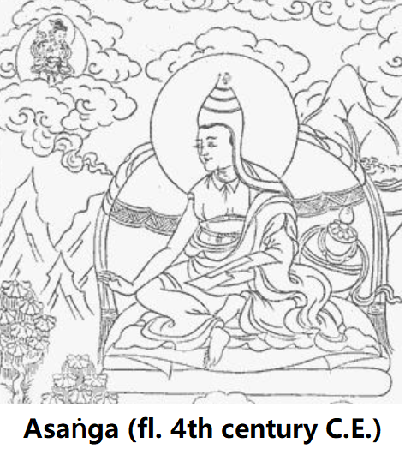
Indian Mahayana Philosophy
Ideas of the Yogācāra school were probably first
adumbrated in the early strata of the
Yogācāra-bhūmi-śāstra, attributed to Asaṅga (310–90?)
but with ideas predating him. They are also rooted in
the ideas of certain Sūtras which began to appear in
the third century CE. The most important is the Samdhinirmocana (‘Freeing the Underlying Meaning’). The Sūtra sees itself as a ‘third turning of the Dharma-wheel’, surpassing the first two ‘turnings’: the teachings on the Four Noble Truths, and the Perfection of Wisdom Sūtras. The Mahāyāna-abhidharma Sūtra is another such text.

Slide 39
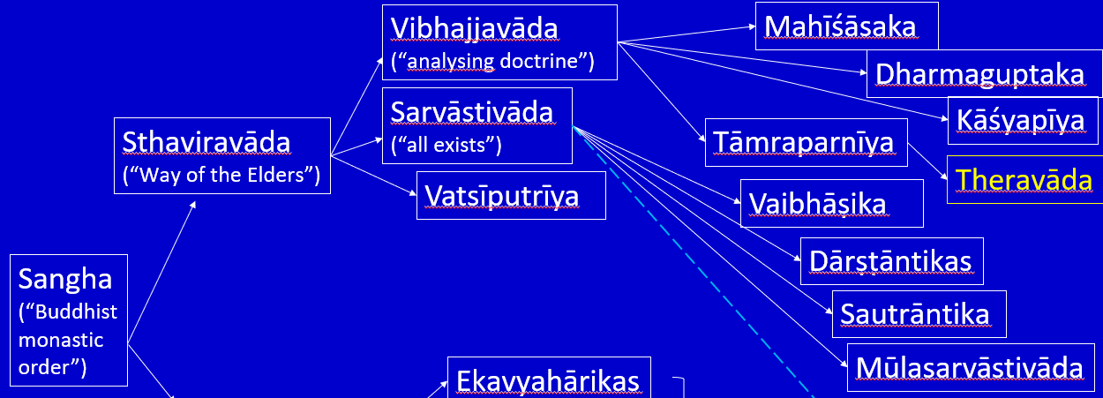
Indian Mahayana Philosophy
The Yogācāra was founded as a separate school by Asaṅga, seen by tradition as a monk ordained in the Vibhajyavādin Mahīśāsaka fraternity. His ‘teacher’ was one Maitreyanātha, or Maitreya, who may have been a human teacher, or seen by Asaṅga as the heavenly Bodhisattva Maitreya. In time, Asaṅga converted his half-brother to the Mahāyāna: Vasubandhu, seen as the Vasubandhu who composed the Sarvāstivādin Abhidharma-kośa and its bhāsya.

Slide 40
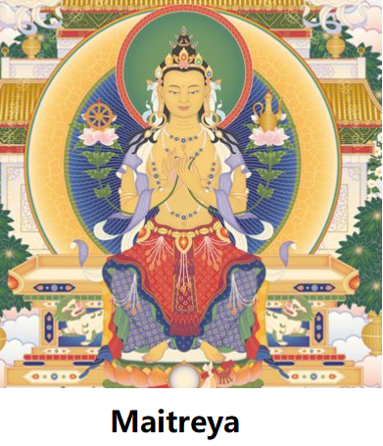
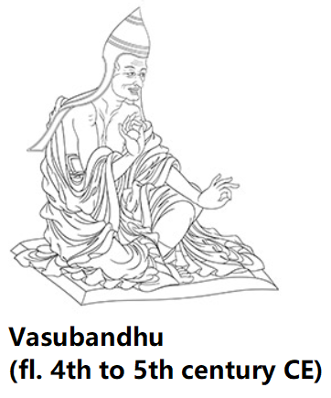
Indian Mahayana Philosophy
The Yogācāra was founded as a separate school by Asaṅga, seen by tradition as a monk ordained in the Vibhajyavādin Mahīśāsaka fraternity. His ‘teacher’ was one Maitreyanātha, or Maitreya, who may have been a human teacher, or seen by Asaṅga as the heavenly Bodhisattva Maitreya. In time, Asaṅga converted his half-brother to the Mahāyāna: Vasubandhu, seen as the Vasubandhu who composed the Sarvāstivādin Abhidharma-kośa and its bhāsya.

Slide 41
Indian Mahayana Philosophy
Asaṅga’s works include the Mahāyāna-samgraha
(‘Compendium of the Mahāyāna’: Ms.), the Abhidharma-samuccaya
(‘Collection of Abhidharma’), this being a Yogācāra version of the
Abhidharma, and a commentary on the Samdhinirmocana Sūtra. Several other works associated with Asaṅga are attributed by either Chinese or Tibetan tradition to ‘Maitreya’, in the sense that this Bodhisattva inspired Asaṅga to write them. The most philosophically important of these is the Madhyānta-vibhāga (‘Discrimination between the Middle and Extremes’: Mv.).

Slide 42
Indian Mahayana Philosophy
Vasubandhu’s most important works are: the Trimśatikā-kārikā or
Trimśikā (‘Thirty Verses’: Trims.); the Vimśatikā-kārikā (‘Twenty Verses’: Vims.) and his commentary on this, the Vimśatikā-vr.tti (Vrtti.); the Trisvabhāva-nirdeśa (‘Exposition of the Three Natures’: Tsn.) and his commentary on the Madhyānta-vibhāga, the Madhyānta-vibhāga-kārikā-bhāsya (Mvkb.).

Slide 43
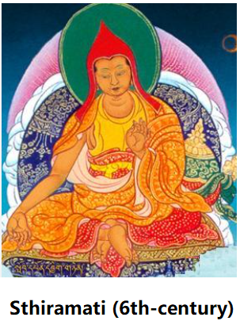

Indian Mahayana Philosophy
In the sixth century lived two important Yogācāra teachers, Sthiramati and Dharmapāla, with the ideas of the latter being taken to China by Xuanzang, founder of the Faxiang (‘Dharma Characteristics’) school. Also associated with the Yogācāra are the logicians and epistemologists Dignāga (fifth to sixth century) and Dharmakīrti (c. 530–600).

Slide 44
Asanga & Vasubandhu (fl. 4th-5th century)
Dignāga (c. 480 – c. 540)
Sthiramati and Dharmapāla (c.6th century)
Dharmakirti (c. 530–600)
Xuanzang (602–664)

Slide 45
Indian Mahayana Philosophy
Asaṅga and Vasubandhu not only developed the characteristic ideas of the Yogācāra school, but also sought to systematise and synthesise all the strands of the Mahāyāna along with some Śrāvakayāna ideas. While
Vasubandhu was primarily a theoretician, and gave the school its classical form, Asaṅga’s writings were deeply rooted in the practice of dhyāna (Pali jhāna), or meditative concentration. Accordingly, ‘Yogācāra’ means the ‘Practice of Yoga’, referring to the Bodhisattva’s path of meditative development.

Slide 46
Indian Mahayana Philosophy
While the Mādhyamikas and Yogācāras had their philosophical differences, they both had Buddhahood as their goal, and can be seen as being complementary in their approaches. The Mādhyamikas had an analytical, dialectic approach to reality, emphasising prajñā (wisdom); the Yogācāras emphasised samādhi (meditative concentration) and the withdrawal of the mind from sensory phenomena.

Slide 47
Indian Mahayana Philosophy
Just as the early Buddhists sought to transcend limiting attachment by seeing phenomena as impermanent, painful and non-Self, so the Mādhyamikas sought this by seeing them as ‘empty’ of inherent nature/existence, and the Yogācāras sought it by seeing perceived
phenomena as mental constructions. The withdrawal of the mind from
sensory phenomena in the Yogācāra seems related to what in early
Buddhism is described as the apprehension of Nirvāna as the ‘signless’
(animitta) – that which is devoid of indications which the mind can latch
on to or interpret – just as the Mādhyamika path is related to seeing Nirvāna as ‘the empty’.

Slide 48
Indian Mahayana Philosophy
The Mādhyamikas regarded the normal experience of the world as a
product of conceptual constructions, but had not concerned themselves
with the psychological details of this process. The Yogācāras addressed this question and related ones. For example, if the Sarvāstivādin idea of past dharmas as still existing is not acceptable, how are memories and the effects of past karma transmitted over time, if a being is composed of a stream of momentary events, as described in the Abhidharma?

Slide 49
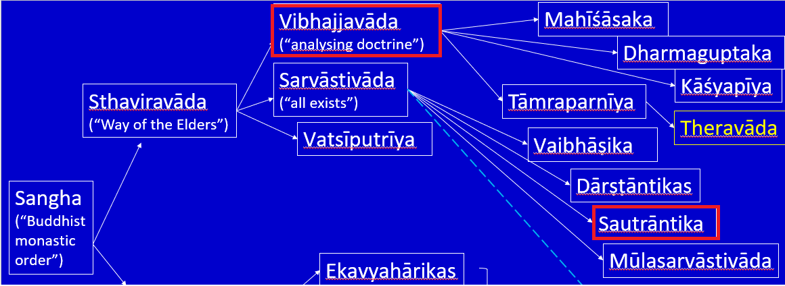
Here, the Yogācāra answer built on those of earlier schools, such as the Sautrāntikas, who had posited a series of momentary karmic ‘seeds’ reproducing themselves over time, and the Vibhajyavādins (and later Theravādins), who had posited bhavanga consciousness, which gave continuity to personality even through dreamless sleep. In continuing to wrestle with such questions, the Yogācāras developed a new Abhidharma literature set within a Mahāyāna framework.

Slide 50
Indian Mahayana Philosophy
Central to the Yogācāra is an emphasis on consciousness; indeed an
alternative later name for the school was Vijñānavāda, the ‘Consciousness Teaching’. In early Buddhism, the flux of consciousness is seen as the crucial link between rebirths, and a transformed state of consciousness is associated with Nirvāna. The perceiving mind is also that which interprets experience so as to construct a ‘world,’ and can be the basis for experiencing the world-transcending Nirvāna.

Slide 51
Indian Mahayana Philosophy
‘The world is led by mind/thought’ (A.ii.177). In the Yogācāra, the role of the mind in constructing the world is so emphasised that all concepts of an external physical reality are rejected: the perceived world is seen as ‘representation-only’ (vijñapti-mātra) or ‘mind/thought-only’ (citta-mātra). In this, the Yogācāras went one step beyond the Sautrāntikas’ theory, in which objects were seen as real, but were only known by inference from the representations that they caused in the mind.

Slide 52
Indian Mahayana Philosophy
Eight consciousnesses
ālaya-vijñāna (storehouse or repository consciousness)
8th
sarvabījakam cittam (mind which has all the seeds)
mūla-vijñāna (basic consciousness)
ālaya
conscious-ness
ādānavijñāna (appropriating consciousness)

Slide 53
Indian Mahayana Philosophy
Eight consciousnesses
kliṣṭa-manas (defiled mentation ); self-consciousness: obsessed with notions of ‘self’. It takes the substratum consciousness as its object and mistakenly considers the substratum consciousness to be a true Self.
-with self-view, self-confusion, self-esteem and self-love.
attach as “I”
8th
7th
Alaya
conscious-ness
Manas
conscious-ness

Slide 54
Indian Mahayana Philosophy
1st
Eye consciousness
Karmic seeds ripen, manifesting as consequences
Eight consciousnesses
2nd
Ear consciousness
8th
7th
6th
3rd
Nose consciousness
4th
Alaya
conscious-ness
Manas
conscious-ness
Mind
conscious-ness
Tongue consciousness
5th
Body consciousness
Create various kinds of karma
(sowing karmic seeds)
5 sense-consciousnesses

Slide 55
Indian Mahayana Philosophy
Three natures
1. Parikalpita-svabhāva (the "fully conceptualised" nature). This is the "imaginary" or "constructed" nature, wherein things are incorrectly comprehended based on conceptual construction and erroneous discrimination. According to the Mahāyānasaṃgraha, it also refers to the appearance of things in terms of subject-object dualism (literally "grasper" and "grasped"). The conceptualised nature is the world of everyday unenlightened people, i.e. samsara, and it is false and empty, it does not really exist. Because these conceptualised natures and distinct characteristics (lakṣana) are wrongly imputed, not truly real, "they are like mirages and blossoms in the sky."

Slide 56
Indian Mahayana Philosophy
2. Paratantra-svabhāva ("other dependent"), which is the dependently originated nature of dharmas. According to Williams, it is "the basis for the erroneous partition into supposedly intrinsically existing subjects and objects which marks the conceptualised nature." This basis is considered to be an ultimately existing (paramārtha) basis in classical Yogācāra. However, as Xuanzang notes, this nature is also empty in that there is an "absence of an existential nature in conditions that arise and perish" (utpatti-niḥsvabhāvatā). That is, the events in this causal flow, while "seeming to have real existence of their own" are actually like magical illusions since "they are said to only be hypothetical and not really exist on their own."

Slide 57
Indian Mahayana Philosophy
3. Pariniṣpanna-svabhāva ("fully accomplished"): the "consummated nature" or the true nature of things discovered in meditation unaffected by conceptualisation. It is defined as "the complete absence, in the dependent nature, of objects – that is, the objects of the conceptualised nature". According to Williams, this is "what has to be known for enlightenment". That is, this mode of cognition is devoid of all concepts, and so is empty of being of the nature of the perfected. About it nothing can be said or thought, it is just pure immediacy." According to Xuanzang, it has the "absence of any existential nature of ultimate meaning" since it is "completely free from any clinging to entirely imagined speculations about its identity or purpose.

Slide 58
Indian Mahayana Philosophy
1st
Eye consciousness
Eight conciousnesses
2nd
Ear consciousness
8th
7th
6th
3rd
Nose consciousness
4th
Alaya
conscious-ness
Manas
conscious-ness
Mind
conscious-ness
Tongue consciousness
5th
Body consciousness
5 sense-consciousnesses
Bright Mirror Wisdom
Equality Wisdom
Profound Observing Wisdom
All-performing Wisdom

Slide 59
Indian Mahayana Philosophy
Tathāgatagarbha： https://www.oxfordbibliographies.com/display/document/obo-9780195393521/obo-9780195393521-0160.xml ;
https://buddhanature.tsadra.org/index.php/Key_Terms/tath%C4%81gatagarbha
3. Tathāgatagarbha
Paul Williams: It would probably be a mistake to think of the Tathagatagarbha tradition in Buddhism as a school in the way that the Madhyamika and Yogacara traditions are schools. It is debatable how far as the root treatise (sastra) of the tradition, the Ratnagotravibhanga and its commentary exerted any obvious or direct influence on the development of Indian Buddhist philosophical thought prior to about the eleventh century. In Tibet, where there are said to be only two Mahayana philosophical schools, Madhyamika and Yogacara, scholars have differed sharply over the allegiance of the Ratnagotravibhanga. The very fact of their disagreement suggests that the Tathagatagarbha tradition cannot be obviously and immediately equated with either of the two schools.

Slide 60
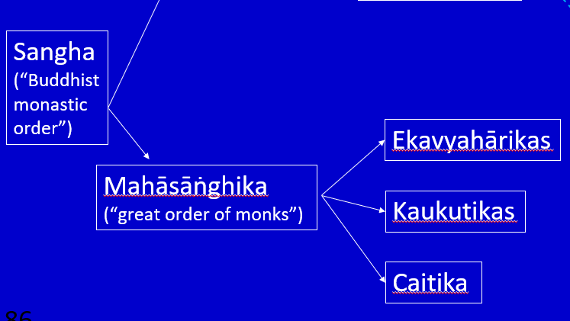
Indian Mahayana Philosophy
Anthony Barber associates the development of the Tathāgatagarbha Sūtra with the Mahāsāṃghika sect of Buddhism, and concludes that the Mahāsāṃghikas of the Āndhra region (i.e. the Caitika schools) were responsible for the inception of the Tathāgatagarbha doctrine.

Slide 61
Indian Mahayana Philosophy
The Tathāgatagarbha Sūtra is an influential and doctrinally striking Mahāyāna Buddhist scripture which treats of the existence of the "Tathāgatagarbha" (Buddha-Matrix, Buddha-Embryo, lit. "the womb of the thus-come-one") within all sentient creatures. According to the Buddha, all sentient beings are born with buddha-nature and have the potential to become a Buddha. Physical and mental defilements of everyday life act as clouds over this nature and usually prevent this realisation. This nature is no less than the indwelling Buddha himself.

Slide 62
Indian Mahayana Philosophy
The earliest known Tathāgata-Garbha text was the Tathāgata-garbha Sūtra, composed c. 200–250 CE. The most important one, however, is the Śrīmālā-devī-simhanāda Sūtra, ‘The Sūtra on the Lion’s Roar of Queen Śrīmālā’, composed between 250 and 350 CE. Also important is the single extant Sanskrit treatise on the Tathāgata-garbha. This is known as the Ratnagotra-vibhāga, ‘An Analysis of the Jewels and Lineages’, or Uttara-tantra, ‘The Treatise on the Supreme’.

Slide 63
Indian Mahayana Philosophy
The (Mahāyāna) Mahāparinirvāna Sutra, a text which exists
in various versions and which was influential in China, also contains many relevant ideas. The Lankāvatāra Sūtra assimilates Tathāgata-Garbha thought to the Yogācāra viewpoint, and this assimilation is developed further in a text which was a widely used summary of the Mahāyāna in China. This is the Dasheng qixinlun, ‘The Treatise on the Awakening of Faith in the Mahāyāna’, composed, or possibly translated, around 550 CE.

Slide 64
Indian Mahayana Philosophy
The Tathagatagarbha doctrine arose with the Mahayanists and later became linked (e.g. in the Lankavatara Sutra) with those who were associated to some degree or another with Citta-matra ("mind only") or Yogacara studies, aiming clearly to account for the possibility of the attainment of Buddhahood by ignorant sentient beings (the "Tathagatagarbha" is the indwelling bodhi - Awakening - in the very heart of Samsara). There is also a tendency in the Tathagatagarbha sutras to support vegetarianism, as all persons and creatures are compassionately viewed as possessing one and the same essential nature - the Buddha-dhatu or Buddha-nature.

Slide 65
Indian Mahayana Philosophy
The concept of the Tathagatagarbha is closely related to that of the Buddha-nature; indeed, in the Angulimaliya Sutra and in the Mahayana Mahaparinirvana Sutra, which latter is the lengthiest sutra dealing with the immanent and transcendent presence of the Tathagatagarbha within all beings, the terms "Buddha-nature" ("Buddha-dhatu") and "Tathagatagarbha" are employed as synonymous concepts.
Angulimaliya Sutra : https://www.sutrasmantras.info/sutra54a.html
Mahayana Mahaparinirvana Sutra：
https://www.bdkamerica.org/product/the-nirvana-sutra-vol-i/

Slide 66
Indian Mahayana Philosophy
According to some scholars, the Tathāgatagarbha does not represent a substantial self (ātman); rather, it is a positive language expression of emptiness (śūnyatā) and represents the potentiality to realise Buddhahood through Buddhist practices; the intention of the teaching of Tathāgatagarbha is Soteriology rather than theoretical. This interpretation is contentious. Not all scholars share this view. Michael Zimmermann, a specialist on the Tathāgatagarbha Sūtra, writes for instance: "the existence of an eternal, imperishable self, that is, buddhahood, is definitely the basic point of the Tathāgatagarbha Sutra.

Slide 67
Indian Mahayana Philosophy
Matsumoto [calls] attention to the similarity between the extremely positive language and causal structure of enlightenment found in the tathagatagarbha literature and that of the substantial monism found in the atman/Brahman tradition. Matsumoto, of course, is not the only one to have noted this resemblance. Takasaki Jikido, for example, the preeminent scholar of the tathagatagarbha tradition, sees monism in the doctrine of the tathagatagarbha and the Mahayana in general … Obermiller wedded this notion of a monistic Absolute to the tathagatagarbha literature in his translation and comments to the Ratnagotra, which he aptly subtitled “A Manual of Buddhist Monism” …

Slide 68
Indian Mahayana Philosophy
Lankavatara Sutra:
https://terebess.hu/english/lankavatara-sutra.pdf
Tathagatagarbha in Zen
The role of the tathagatagarbha in Zen can not be discussed or understood without an understanding of how tathagatagarbha is taught in the Lankavatara Sutra. It is through the Lankavatara Sutra that the tathagatagarbha has been part of Zen (i.e., Chan) teaching since its beginning in China. Bodhidharma, the traditional founder of Chan-Zen in China, was known for carrying the Lankavatara Sutra with him when he came from India to China. The early Zen/Chan teachers in the lineage of Bodhidharma's school were known as the "Lankavatara Masters."

Slide 69
Indian Mahayana Philosophy
The Lankavatara Sutra presents the Chan/Zen Buddhist view of the tathagatagarbha:
[The Buddha said,] Now, Mahāmati, what is perfect knowledge? It is realised when one casts aside the discriminating notions of form, name, reality, and character; it is the inner realisation by noble wisdom. This perfect knowledge, Mahāmati, is the essence of the Tathāgata-garbha.

Slide 70

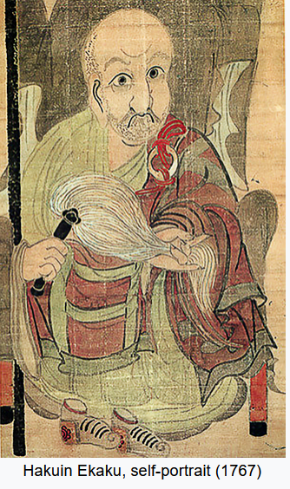
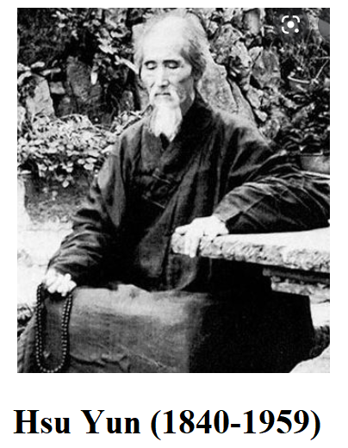
The Lankavatara Sutra also states that the tathagatagarba is identical to the alayavijnana known prior to awakening as the storehouse-consciousness or 8th consciousness. Chan/Zen masters from Huineng in seventh-century China to Hakuin in eighteenth-century Japan to Hsu Yun in twentieth-century China, have all taught that the process of awakening begins with the light of the mind turning around within the 8th consciousness, so that the alayavijnana, also known as the tathagatagarbha, is transformed into the "Bright Mirror Wisdom."

Slide 71
Indian Mahayana Philosophy
As D.T. Suzuki wrote in his introdution to his translation of the Lankavatara Sutra,
"Let there be, however, an intuitive penetration into the primitive purity (prakritiparisuddhi) of the Tathagata-garbha, and the whole system of the Vijnanas goes through a revolution."
This revolution in the system of consciousness (vijnana) is what Chan/Zen calls awakening or "kensho," seeing into one's own nature.

Slide 72
Indian Mahayana Philosophy
Tathagatagarbha doctrine:
https://www.mnzencenter.org/uploads/2/9/5/8/29581455/tathagatagarbha.pdf
Therefore, in modern-Western manifestations of the Zen Buddhist tradition, it is considered insufficient simply to understand Buddha-nature intellectually. Rather tathagatagarbha must be experienced directly, in one's entire body-mind. Enlightenment in a certain sense consists of a direct experience (gata) of the essence or womb (garbha) of thusness (tatha) and this is the tathagatagarbha of one's own mind, which is traditionally described and designated as śūnyata (emptiness).

