Slide 1
Social Trends & Consumerism
Lecture 8
Part 1 – Marketing Strategy (Continued)
Part 2 – Segmentation, Targeting & Position

Slide 2
Strategic Marketing
The Ansoff Matrix

Slide 3
Strategic Marketing
For and organisation of your choice, apply the Ansoff Matrix to its portfolio of products or services

Slide 4
Strategic Marketing
Product/Portfolio Strategy – Boston Consulting Group Matrix
Developed by BCG to help General Electric manage each of the businesses within its portfolio

Slide 5
Strategic Models
Product/Portfolio Strategy – Boston Consulting Group Matrix
Star: Business unit or product which has high market share in a growing market. Needs investment to support growth but good profits
? Low market share in growing market. Could become star with investment
Cash Cow: High market share in a mature market. Growth is low but investment needs are less. Profits should fund investment in question marks
Dogs: Low share in declining markets. Consider divestment or closure

Slide 6
Activity
Apply the BCG to an organisation of your choice.

Slide 7
Activity
Example - Volkswagen
High
Star Tiguan | Question Mark Golf GTE
Cash Cow Golf Passat Polo | Dog Sharan (collaboration with Seat and Ford)
Market Growth
Low
High
Market Share
Low

Slide 8
BCG & Marketing
Once the BCG has been applied to a product portfolio, the appropriate marketing strategies can be applied to each product

Slide 9
Segmenting, Targeting & Positioning

Slide 10
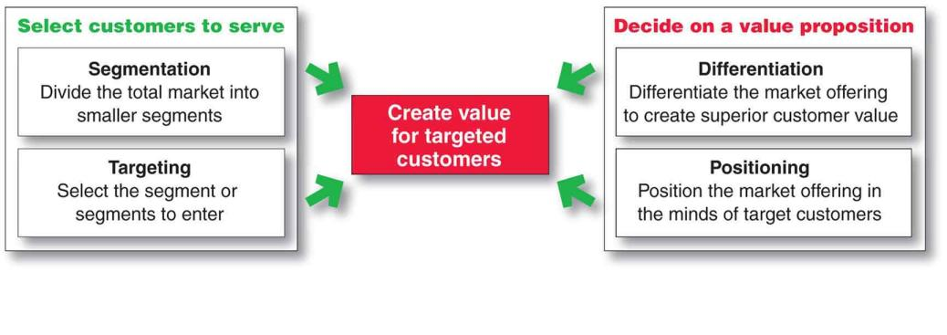
Designing a Customer-Driven Marketing Strategy
Kotler and Armstrong (2010)
Notes:
Notes to Accompany Slide:
Each of the terms on this figure will be explained on the next few slides.

Slide 11

Market Segmentation
Market segmentation involves dividing a market into smaller segments of buyers with distinct needs, characteristics, or behaviours that might require separate marketing strategies or mixes.

Slide 12
Benefits of STP Process
Enhancing a company’s competitive position, providing direction and focus for marketing strategies, including targeted advertising, new proposition development, and brand differentiation, e.g. Coke Zero.
Examining and identifying market growth opportunities through identification of new customers, growth segments, or proposition uses, e.g. Lucozade.
Effective and efficient matching of company resources to targeted market segments, promising greater return on marketing investment (ROMI). For example, ASDA Wal-Mart.
(Baines & Fill, 2014)

Slide 13
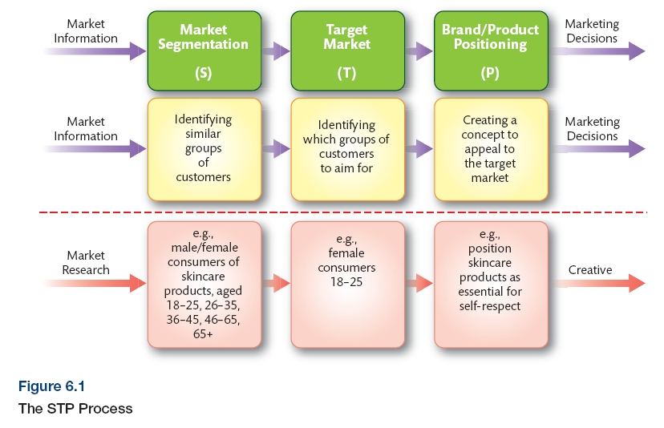
STP Process
(Baines & Fill, 2014)

Slide 14
Major Segmentation Variables
Geo-graphic
Demographic
Psycho-graphic
Behavioural

Slide 15

Geographic Segmentation
Geographic segmentation calls for
dividing the market into different
geographical units
such as nations,
regions, states,
counties, cities, or
even neighbourhoods.
Notes:
Notes to Accompany Slide:
Geographic can include world region, country, county, city, neighborhood.

Slide 16

Demographic Segmentation
Age
Gender
Family Size
Family Life Cycle
Income
Occupation
Education
Religion
Race
Generation
Nationality
Notes:
Notes to Accompany Slide:
Demographic factors are the most popular bases for segmetation.

Slide 17
Psychographic Segmentation
Social Class
Lifestyle
Personality
Notes:
Dividing your market based on different personality traits, values, attitudes, interests and lifestyle.

Slide 18
Behavioural Segmentation
Behavioural segmentation divides a market into segments based on consumer knowledge, attitudes, uses, or responses to a product.
Occasions
Benefits sought
User Status
Usage Rate
Loyalty Status
Notes:
Notes to Accompany Slide:
Benefit segmentation requires finding the major benefits people look for in the product class, the kinds of people who look for each benefit, and the major brands that deliver each benefit.

Slide 19

Mosaic
Mosaic
Consumer classification for consistent cross-channel marketing
Notes:
Owned by Experian this is a classification system used to understand groups of customers. It classifies the uk population into socio-economic groups

Slide 20
Acorn Classification
http://acorn.caci.co.uk/downloads/Acorn-Infographic.pdf

Slide 21
Activity: Internet research
Mosaic – research the website below to find out how useful this website might be for a marketer
http://www.experian.co.uk/marketing-services/about/news/mosaic-launch.html
Feedback your findings to the group giving examples of how you might use this service for segmenting a target population

Slide 22
Practical Insight
Arts Council in England and their use of Audience Spectrum.
Metroculturals Heydays
https://www.theaudienceagency.org/audience-spectrum

Slide 23
Is it easy to classify people?
“Think about the vast differences between people who look to be the same on paper based on their demographic profile. One famously cited example of this would be Prince Charles and Ozzy Osbourne, who were both born in 1948, grew up in England, married twice, have two children, are both wealthy and both like dogs,” Marketing week Jan 2015

Slide 24
Segmenting business markets
Business markets are characterised by buyers who do not themselves use the product.
The number of potential customers in business markets is almost always smaller, so there is likely to be a greater degree of customisation necessary.
Psychographic and demographic variables are almost entirely inappropriate.
© Jim Blythe 2014

Slide 25
Segmenting Organisational Markets
Organisational segmentation
Organisational
size
Industry
Purchasing
organisation
Geographic
location
Choice
Criteria

Slide 26

Selecting Target Market Segments
A target market consists of a set of buyers
who share common needs or characteristics that the company decides to serve.

Slide 27
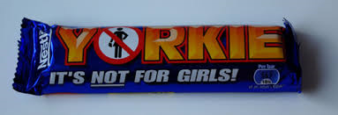
Question?
What’s our thoughts on Yorkie “Not for Girls” Campaign
Notes:
First launched its not for girls positioning in 2002

Slide 28

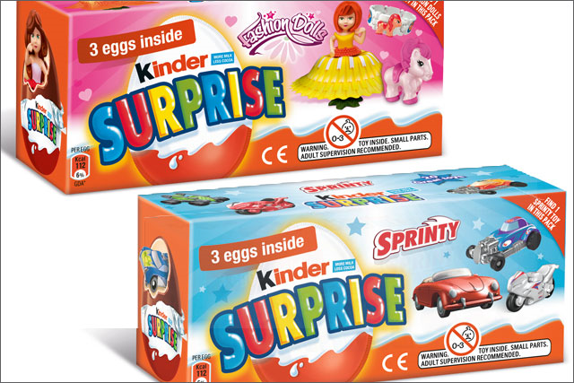
Kinder accused of gender bias?

Slide 29
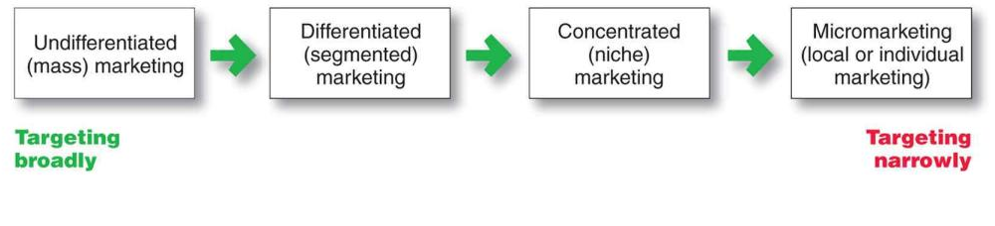
Market Targeting
Selecting Target Segments
Kotler and Armstrong (2010)
Notes:
Notes to Accompany Slide:
Undifferentiated (mass) marketing: A market-coverage strategy in which a firm decides to ignore market segment differences and go after the whole market with one offer.
Differentiated (segmented) marketing: A market-coverage strategy in which a firm decides to target several market segments and designs separate offers
for each.
Concentrated (niche) marketing: A market-coverage strategy in which a firm goes after a large share of one or a few segments or niches.

Slide 30
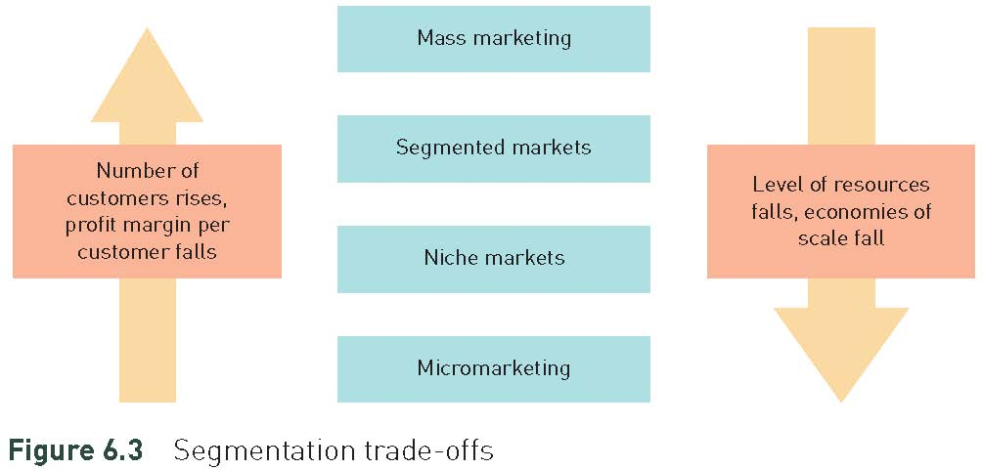
Segmentation trade-offs
© Jim Blythe 2014

Slide 31
Mass Marketing
ORGANISATION
MARKETING MIX
TARGET MARKET
Price
Promotion
Product
Distribution
Post
Office
Everybody
Notes:
8
7
8
8
8
8
Rare in today’s competitive environment. Ford “any colour you want as long as it’s black!

Slide 32
Segmented Markets
Marketing Mix 1
Miss
Selfridges
18- 24 age group
Marketing
Mix 2
Dorothy
Perkins
20s & 30s
Arcadia Group
Marketing
Mix 3
Evans
Size 16+
Marketing
Mix 4
Outfit
Out of town convenience
Marketing
Mix 5
Wallis
30 plus
age group

Slide 33
Example of Focused Strategy
Price conscious consumers
MARKETING
MIX
ORGANISATION
Unserved
Price
Promotion
Product
Distribution
Bang & Olufsen
Music systems
Upmarket consumers
Unserved
Value seekers
Notes:
10
9
10
10
10
9

Slide 34
Niche & Micromarketing
Very focused, smaller sub groups within the larger segments = Niche
Customised

Slide 35
Evaluating a segment for targeting
Sufficient current and potential sales/profits?
Potential for sufficient future growth?
Not over-competitive?
No excessive barriers to entry or exit?
Unsatisfied needs that the company can serve well?

Slide 36
Question?
Should companies be allowed to target children with advertising? Should marketing activity be allowed in schools?

Slide 37
The Benefits of Market Segmentation
Enhanced Profitability
Enhanced Opportunities for Growth
More effective targeting of communications
Better matching of customer needs
Improved Customer
Retention
Opportunities
of segment dominance
(Fahy and Jobber, 2012)

Slide 38
Activity
Read the articles
Let Toys Be Toys: Increased targeting has led to a lazy, stereotype-driven approach
And
Mark Ritson: Only crap marketers mistake stereotypes for segments
Make notes and be prepared to discuss

Slide 39
Positioning - definitions
Positioning is the process whereby information about the organisation and its product is communicate in such a way that the object is perceived by the consumer/stakeholder to be differentiated from the competition, to occupy a particular space in the market.
Fill (2009)
Positioning is the act of designing the company’s offering and image so that they occupy a meaningful and distinct competitive position in the target customer’s minds.
Kotler (2003)

Slide 40
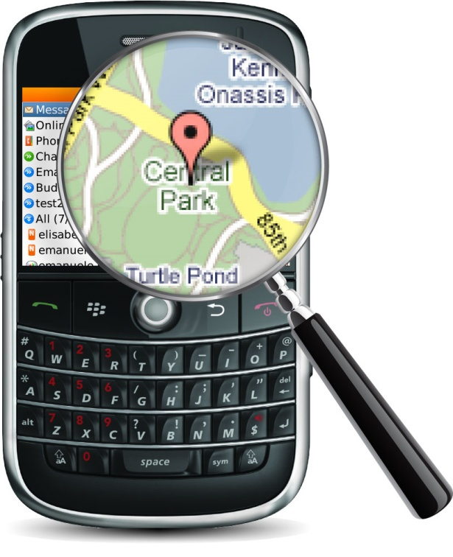
Differentiation and Positioning
A product’s position is the way the product is defined by consumers on important attributes – the place the product occupies in the consumer’s mind relative to competing products

Slide 41
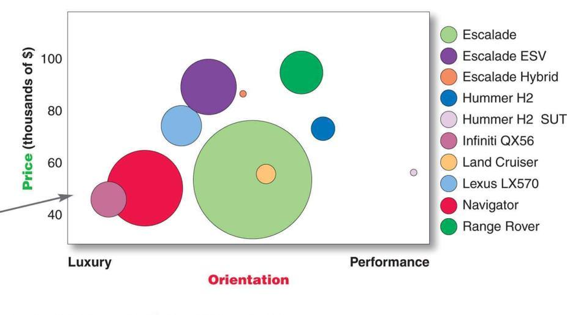
Differentiation and Positioning
Positioning Map
Kotler and Armstrong (2010)

Slide 42
Differentiation and Positioning Choosing a Strategy
Identifying a set of differentiating competitive advantages
Choosing the right competitive advantages
Selecting an overall positioning strategy

Slide 43

Identifying Possible Value Differences and Competitive Advantages
Competitive advantage is an advantage over competitors gained
by offering greater
customer value,
either through lower
prices or by providing
more benefits that justify
higher prices.

Slide 44
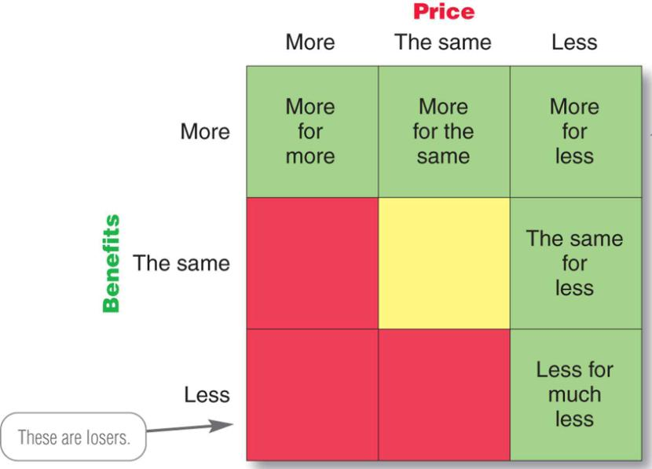
Selecting an Overall Positioning Strategy
The value proposition is the full positioning of a brand—the full mix of benefits upon which it is positioned.
6 -
44
Notes:
Chocolate bars!

Slide 45

Developing a Positioning Statement
To (target segment and need) our (brand) is (concept) that (point of difference)
E.g. “To busy, mobile professionals who need to always be in the loop, BlackBerry is a wireless connectivity solution that gives you an easier, more reliable way to stay connected to data, people, and resources while on the go.”

Slide 46
Keys to Successful Positioning
Clarity
Consistency
Successful positioning
Credibility
Competitiveness

Slide 47
Five Criteria for Successful Segmentation
1. Effective
2. Measurable
3. Accessible
4. Actionable
5. Profitable
Notes:
Note: New Slide

Slide 48
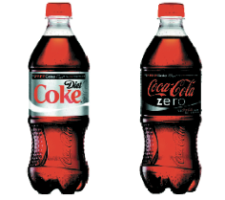
Coke Zero
Diet Coke and
Coke Zero: virtually
identical drinks that
are positioned
very differently

Slide 49
Repositioning
Involves changing perceptions of a brand from a current state to a desired state
  Two tasks
    Old positioning suppressed
    New positioning learned
    (Jewell, 2007)

Slide 50
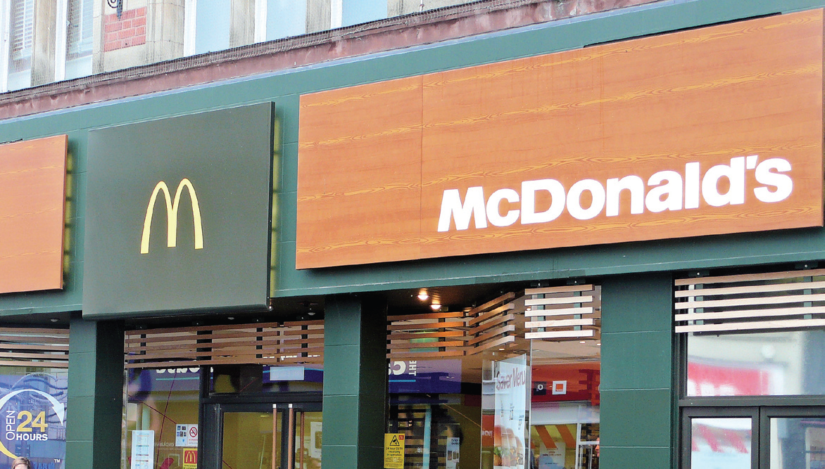
re-positioning
e.g. McDonalds have been trying to move to a healthier
position in people’s perceptions
(photo courtesy of Dave Pickton)

Slide 51
Why is positioning important?
In recent decades positioning has become more important to organisations because:
  Customers have become more sophisticated
  Competition is stronger
  Communications are more complex

Slide 52
Positioning strategies
  Product features
  Price
  Quality
  Use
  Product class dissociation
  User
  Competitor
  Benefit
  Heritage/Cultural symbol

Slide 53
Position statements
Set out the ‘position’ the product wishes to take up in the market as perceived by buyers
Two forms
  Functional
    Based on features and benefits
  Expressive (or symbolic)
    Based on ego, social needs,emotion

Slide 54
Managing positions – a process
What positions do our competitors hold?
What position do we hold?
What is our desired position?
Is this feasible within our budgetary constraints and in this environment?
Implement a programme to establish position
Monitor customer perceptions to measure success
  Adapted from Fill (2009)

Slide 55
five-stage process
identify the total market
identify market segments
select target market segment(s)
establish competitors’ positions
establish own position

Slide 56
Buyers’ perceptions
Positioning is about how customers perceive the product
  In terms of product attributes
  In terms of the benefits it conveys
  In relation to competitor products
  In relation to substitute products
The organisation may wish to be perceived in a certain way, but if customer perceptions are different there is a gap.
Marketing communications can attempt to bridge that gap by changing customer perceptions

Slide 57
Perceptual mapping
Perceptual mapping is a way of mapping out the positions held by various brands within a particular market
Key attributes are chosen and customer perceptions of the brand against those attributes are plotted on a ‘map’
This shows how differentiated the market is, and where there are potential gaps/opportunities

Slide 58
A Perceptual Positioning Map of Supermarkets
High price
A
B
C
D
Wide product range
Narrow product range
G
X
F
How would you plot the leading
supermarkets in the UK?
E
Low price

Slide 59
Benefits of perceptual mapping
Develops an understanding of how the relative strengths and weaknesses of different products are perceived by buyers
Builds knowledge about similarities and differences between products
Assists the repositioning of existing products and positioning of new products
Helps to track the perceptions of buyers of a particular product and measure communication effectiveness
Neal (1980)

Slide 60
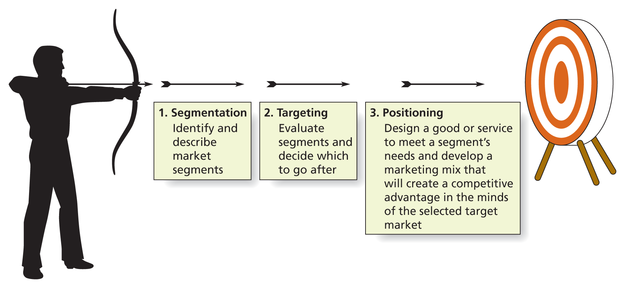
Remember….
Source: Solomon et al Marketing: real people, real decisions 2nd Ed 2014

Slide 61

Case study: The Changing Face of Luxury Fashion
Read the case study
In groups discuss each question
Structure your answers so that you can feedback
in an organised way with ALL group members
contributing
Remaining students to listen to each group and
make notes to question the presenters and to
comment on their presentation skills

Slide 62
Summary
Markets are people, not products
Products should be targeted at specific market groups (segments)
  use multi-variable segmentation
  opportunities for differentiation
Develop clear positioning

Slide 63
Summary
The process of market segmentation is based on the principle that not all customers have the same needs.
They are many different variables which can be used for segmenting consumer and industrial markets.
The 5 criteria for successful segmentation are: effective, measurable, accessible, actionable and profitable.
There are 4 generic target marketing strategies: undifferentiated, differentiated, focus and customised marketing.
Positioning is the key tool for conveying how companies meet customer needs with products and services.
There are 4 repositioning strategies: image, product, intangible and tangible repositioning .

Slide 64
Further Reading
Masterson, R. & Pickton, D. (2014) Marketing an introduction 3rd Edition, London: Sage (Chapter 4)

Slide 65
Reading & Useful Websites
Social Media
  @markeingweeked
  @brandrepublic
  @CIM
  @marketingUK
  @Utalkmarketing

Slide 66
Reading & Useful Websites
Library resources – Reading!!
  Marketing Week
  Brand Republic
  Marketing
  The Grocer

Slide 67
Reading & Useful Websites
Websites
  www.cim.co.uk
  www.youtalkmarketing.co.uk

Slide 68
Additional reading:
Smith, W. R. (1956), ‘Product differentiation and market segmentation as alternative marketing strategies’, Journal of Marketing, July, 3–8
T.P. Beane, D.M. Ennis, (1987) "Market Segmentation: A Review", European Journal of Marketing, Vol. 21 Iss: 5, pp.20 – 42
Ries, A. and Trout, J. (2006), Positioning: The Battle for your Mind, London: McGraw-Hill Professional

