Slide 1
Teaching with Technology
Session 2: In-Class Teaching

Slide 2
Session 2 objectives
To consider how technology can enhance in-class teaching and learning
To explore and experience some of the tools available.
To link in-class active learning with theory

Slide 3
Presentation
Discussion
Investigation
Collaboration
Practice
Production
Assessment

Slide 4













Slide 5
Overview
Tony’s Categories | My Categories | Examples of Enhancement
Presentation |  | Using a variety of presentational tools can enable a multi-modal approach suitable to task and/or learner requirements.
Discussion |  | Classroom response systems and sharing content with peers can prompt and encourage discussion.
Investigation |  | Polling software can simplify data collection, note-taking software can aid research, spreadsheets can automate data analysis.
Collaboration |  | Using cloud storage and collaboration can enable group projects to be undertaken seamlessly and flexibly.
Practice |  | Peer feedback through sharing draft ideas, self assessment through quizzes and using modelling software are all useful practice activities for honing understanding.
Production |  | The Office, iWork and GSuite software collections facilitate and enhance the creation of content by educators and students.
Assessment |  | Classroom response systems and presentational/sharing technology can provide flexibility and variety in both summative and formative assessment.

Slide 6
Instructor Led | Student Led

Slide 7
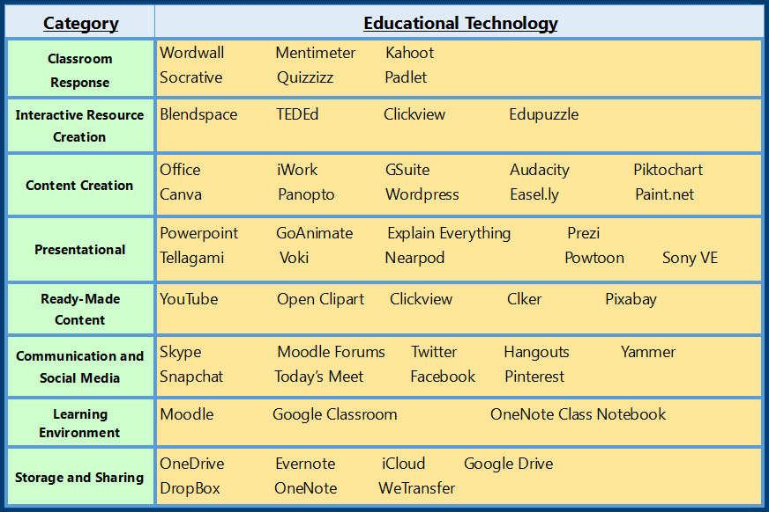

Slide 8
Presentation Software
Instructor Led

Slide 9

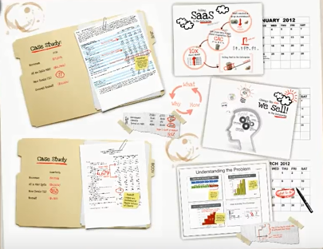
Slideshow Style
Sway
Prezi

Slide 10
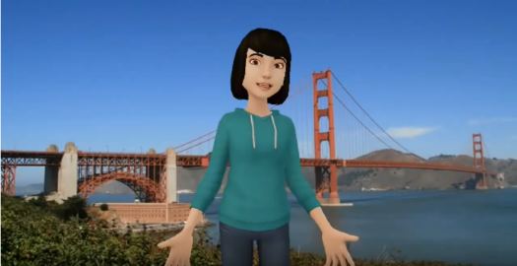



Video Style
Tellagami
Go Animate
Voki
Powtoon

Slide 11
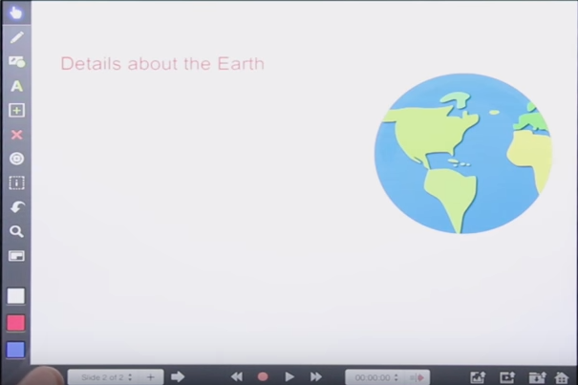
Whiteboard Style
Explain Everything

Slide 12
Laurillard 2008
“For example, Web sites and podcasts may appear to be exciting new forms of teaching method, but in terms of support to the learning process, they play exactly the same role as conventional books and lectures—they present the teacher’s concept. The additional value they offer is logistic rather than pedagogic: They offer more flexible study.”

Slide 13
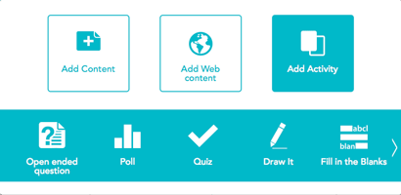
Interactive Style
Nearpod

Slide 14
Instructor Led
Classroom Response Systems

Slide 15





Slide 16
Discussion & Assessment
What do you already know about assessment?

Slide 17
Why use a CRS? (list from Vanderbilt University)
Maintain attention
Promote engagement
Promote discussion
Encourage participation
Create a safe space
Check understanding
Take attendance
Add incentive

Slide 18
Instructor Led
Other Tools

Slide 19

Randomisers

Slide 20


Backchannels

Slide 21
Benefits
Randomisers
Everyone must engage and prepare a contribution
Neutral to the instructor
Visual
Fun
Backchannels
Safe place for shy students to ask questions
Questions can be addressed at appropriate times
Realtime feedback through content and number of questions
Extend opportunity for questions

Slide 22
Student Led
Cloud Collaboration

Slide 23
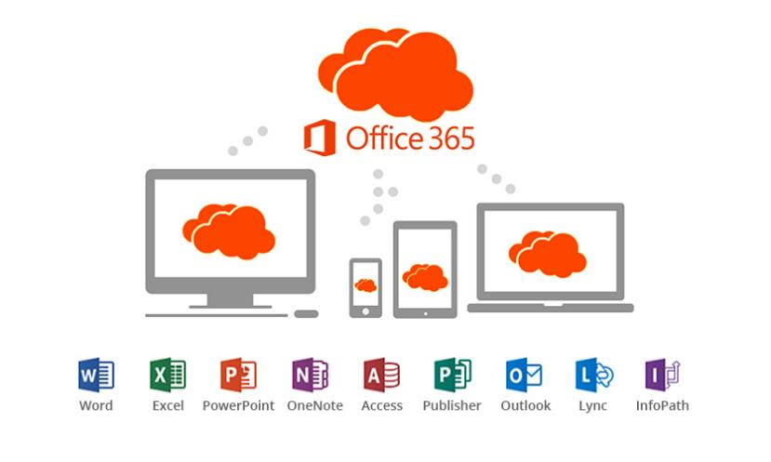

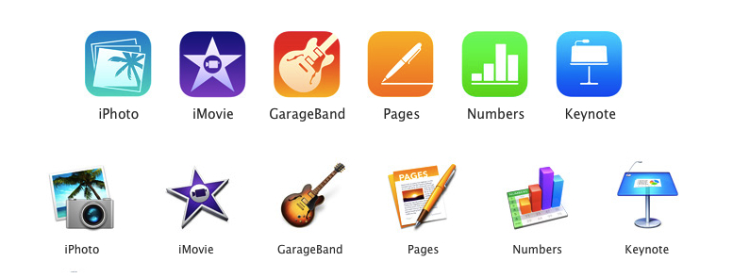

Slide 24
Social constructivism
Group interdependence theory

Slide 25
Student Led
Screen Sharing

Slide 26

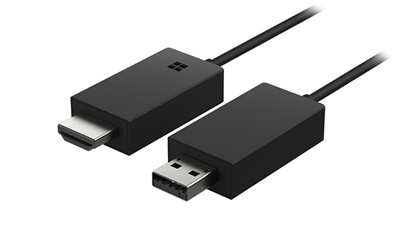


Slide 27

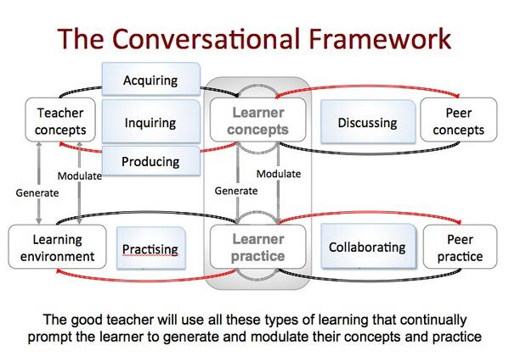
Diana Laurillard’s Conversational Framework

Slide 28
Collaborative Learning Examples
Problem/Project Based Learning (PBL)
“When implementing project based learning, I can't imagine a project without the use of technology. Whether you are using mobile devices, laptops, or desktops, there are so many applications and websites that can be resources and tools for the project based units.”
Sandy Cangelosi – PBL blogger
Scenario Based Learning

Slide 29

Group Task
Can you identify 10 verbs from Bloom’s Taxonomy that would be developed in a PBL exercise?
Can you get at least one at each level?

Slide 30
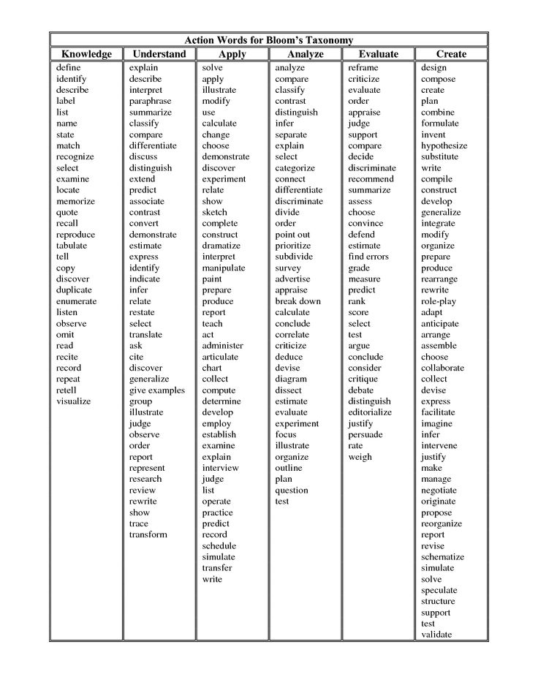
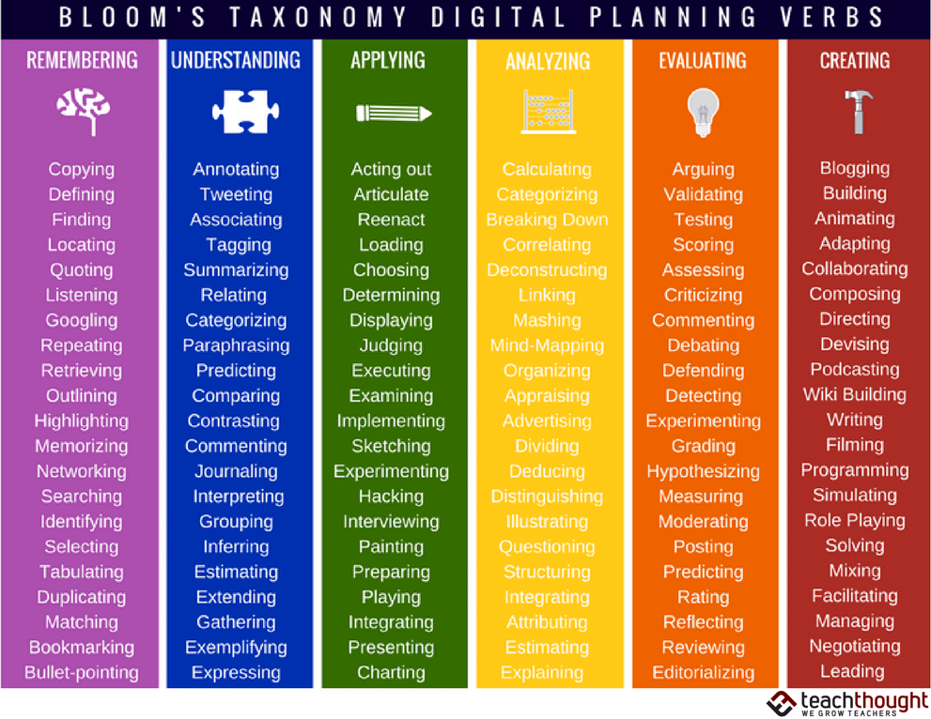

Slide 31

Worked Example
https://padlet.com/tidy75/u8h7lb3do2vx

Slide 32
In-class technology: key benefits
Attention and engagement
Participation
Scalability
Deeper engagement with material – higher order thinking skills
Promotes discussion – constructivism
Employability skills – PBL and SBL
Provides many opportunities for formative assessment

Slide 33


