Slide 1


Slide 2

Foreign Languages & Cultural Awareness
German
Cultural Awareness
BMIH5003
Lisa Bassler
International Hotel Management
l.bassler@uwtsd.ac.uk

Slide 3
Recap
Last week gave an overview of…
Cultural Awareness
Hofstede’s Dimensions
Criticism of these dimensions
Handbook REPORT
Notes:
Recap
SOSTAC is the basis of the module and the marketing planning system we will use for our first and final assessments,
We had a talk about brands and the history and how we have preferred ways of being in contact with brands and managing our relationships
We talked about some definitions of marketing and what it might mean? And what we took away from that was?........ (We are looking for “Value, Experience and satisfaction” type answers.

Slide 4


Cultural Perspective on Behavioural Patterns with Schedules Introduction
Schedules and time management are influenced by cultural perspectives.
Different cultures exhibit unique behaviours and attitudes toward schedules.
Understanding these cultural perspectives enhances intercultural communication and collaboration.

Slide 5

Monochronic Culture
Monochronic cultures value punctuality and adherence to schedules.
Time is perceived as linear and segmented into discrete units.
Examples: North America, Northern Europe, Germany, Switzerland.
Emphasize promptness and meeting deadlines.
Value efficiency, organization, and time management.
Expect clear agendas and scheduled appointments.

Slide 6

Polychronic Culture
Polychronic cultures have a fluid approach to time and schedules.
Time is viewed as cyclical and flexible.
Examples: Latin America, Middle East, Africa.
Prioritize relationships and human interactions over strict adherence to schedules.
Allow flexibility in time commitments.

Slide 7

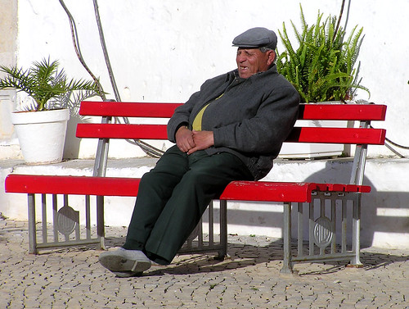
Specific Cultural Perspectives on Schedules (SPAIN)
Example: Spain
Spanish culture has a more relaxed attitude toward time and schedules.
"Spain Time" or "Hora Española" refers to a flexible sense of time, where events may start later than the scheduled time.
Siesta is a common practice where businesses and shops close for a few hours in the afternoon (typically from 2 pm to 5 pm).
The evening work schedule is often extended, with dinner and socializing taking place late in the evening.
Notes:
TEACHERS: THIS IS WHERE YOU CHANGE TO YOUR LANGUAGE AND TALK ABOUT THE PERSPECTIVE OF TIME AND FRIENDSHIP WITH YOUR COUNTRY

Slide 8

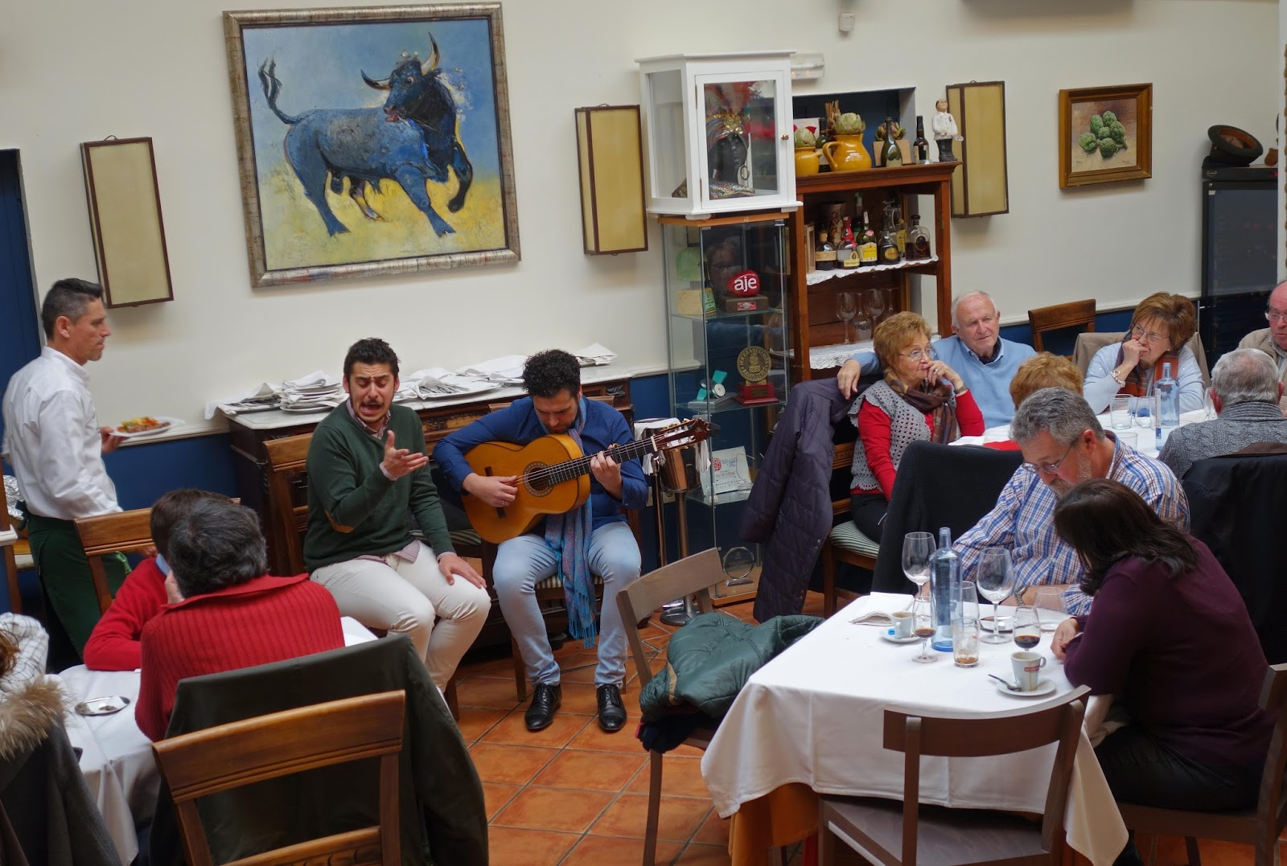
Importance of Relationships and work
Spaniards prioritize building and maintaining strong relationships.
Meetings and conversations may extend beyond the scheduled time as relationships and social interactions are valued.
Personal connections and trust play a significant role in business and professional settings.
Spaniards often exhibit flexibility and adaptability in their work schedules.
Balancing work and personal life is important, and adjustments may be made to accommodate family commitments and social events.
Working long hours is not necessarily equated with higher productivity or success.
Notes:
TEACHERS: THIS IS WHERE YOU CHANGE TO YOUR LANGUAGE AND TALK ABOUT THE PERSPECTIVE OF TIME AND FRIENDSHIP WITH YOUR COUNTRY

Slide 9

Specific Cultural Perspectives on Schedules (JAPAN)
Japanese culture is known for its high regard for punctuality and strict adherence to schedules.
Arriving on time is expected, and tardiness is considered disrespectful.
Being on time demonstrates respect for others' time and commitment to responsibilities.
The efficiency and punctuality of Japan's public transportation system, particularly trains, reflect the cultural value placed on schedules.
Trains in Japan are known for their exceptional reliability, adhering to precise departure and arrival times.

Slide 10
Specific Cultural Perspectives on Schedules (MIDDLE EASTERN COUNTRIES)
Middle Eastern cultures often exhibit a flexible approach to time and schedules, placing more importance on social interactions and relationships.
Implications for Intercultural Communication
Awareness of cultural perspectives on schedules helps navigate intercultural communication effectively.
Flexibility, patience, and understanding are essential when working with individuals from different cultural backgrounds due to their believes in religion.

Slide 11
ASSESSMENT 3
HOTEL EVENT ADVERTISMENT
Create a Hotel Event Advertisement Poster:
The poster must be created in a professional way using either PowerPoint poster formats or Canva. And include, the event that you are hosting, room types on offer e.g. double, single or family, including breakfast or breakfast and dinner, and the corresponding prices.
Any special considerations also such as music, food and the theme.
Consider the culture of the language also and what might or might not be appropriate within the geographical area.
DUE DATE: 2nd June 2023 by 23:59pm

Slide 12
See you next week!

Slide 13
I look forward to seeing you next week.
If you have any questions in the meantime, please send an email from your student account l.bassler@uwtsd.ac.uk

