Slide 1

MSc Cybersecurity and Digital Forensics
Module: Research Methods and Professional Development (ACFA7004)
Architectural Mitigations for Prompt Injection Attacks in Agentic LLM Applications:
A Composite Execution Isolation and Data Symbolisation Framework
Student Name: Latchiarajan Parthasarathy
Student ID: 2531979
Supervisor: Dr Suresh Shanmugasundaram
Submission Date: 14 August 2026

Slide 2
Presentation Overview
1. Research Context and Background
2. Research Problem
3. Research Aim and Objectives
4. Literature Review
5. Research Methodology
6. Project Planning and Resources
7. Expected Impact and Limitations
8. References
Architectural Mitigations for Prompt Injection Attacks in Agentic LLM Applications
2

Slide 3
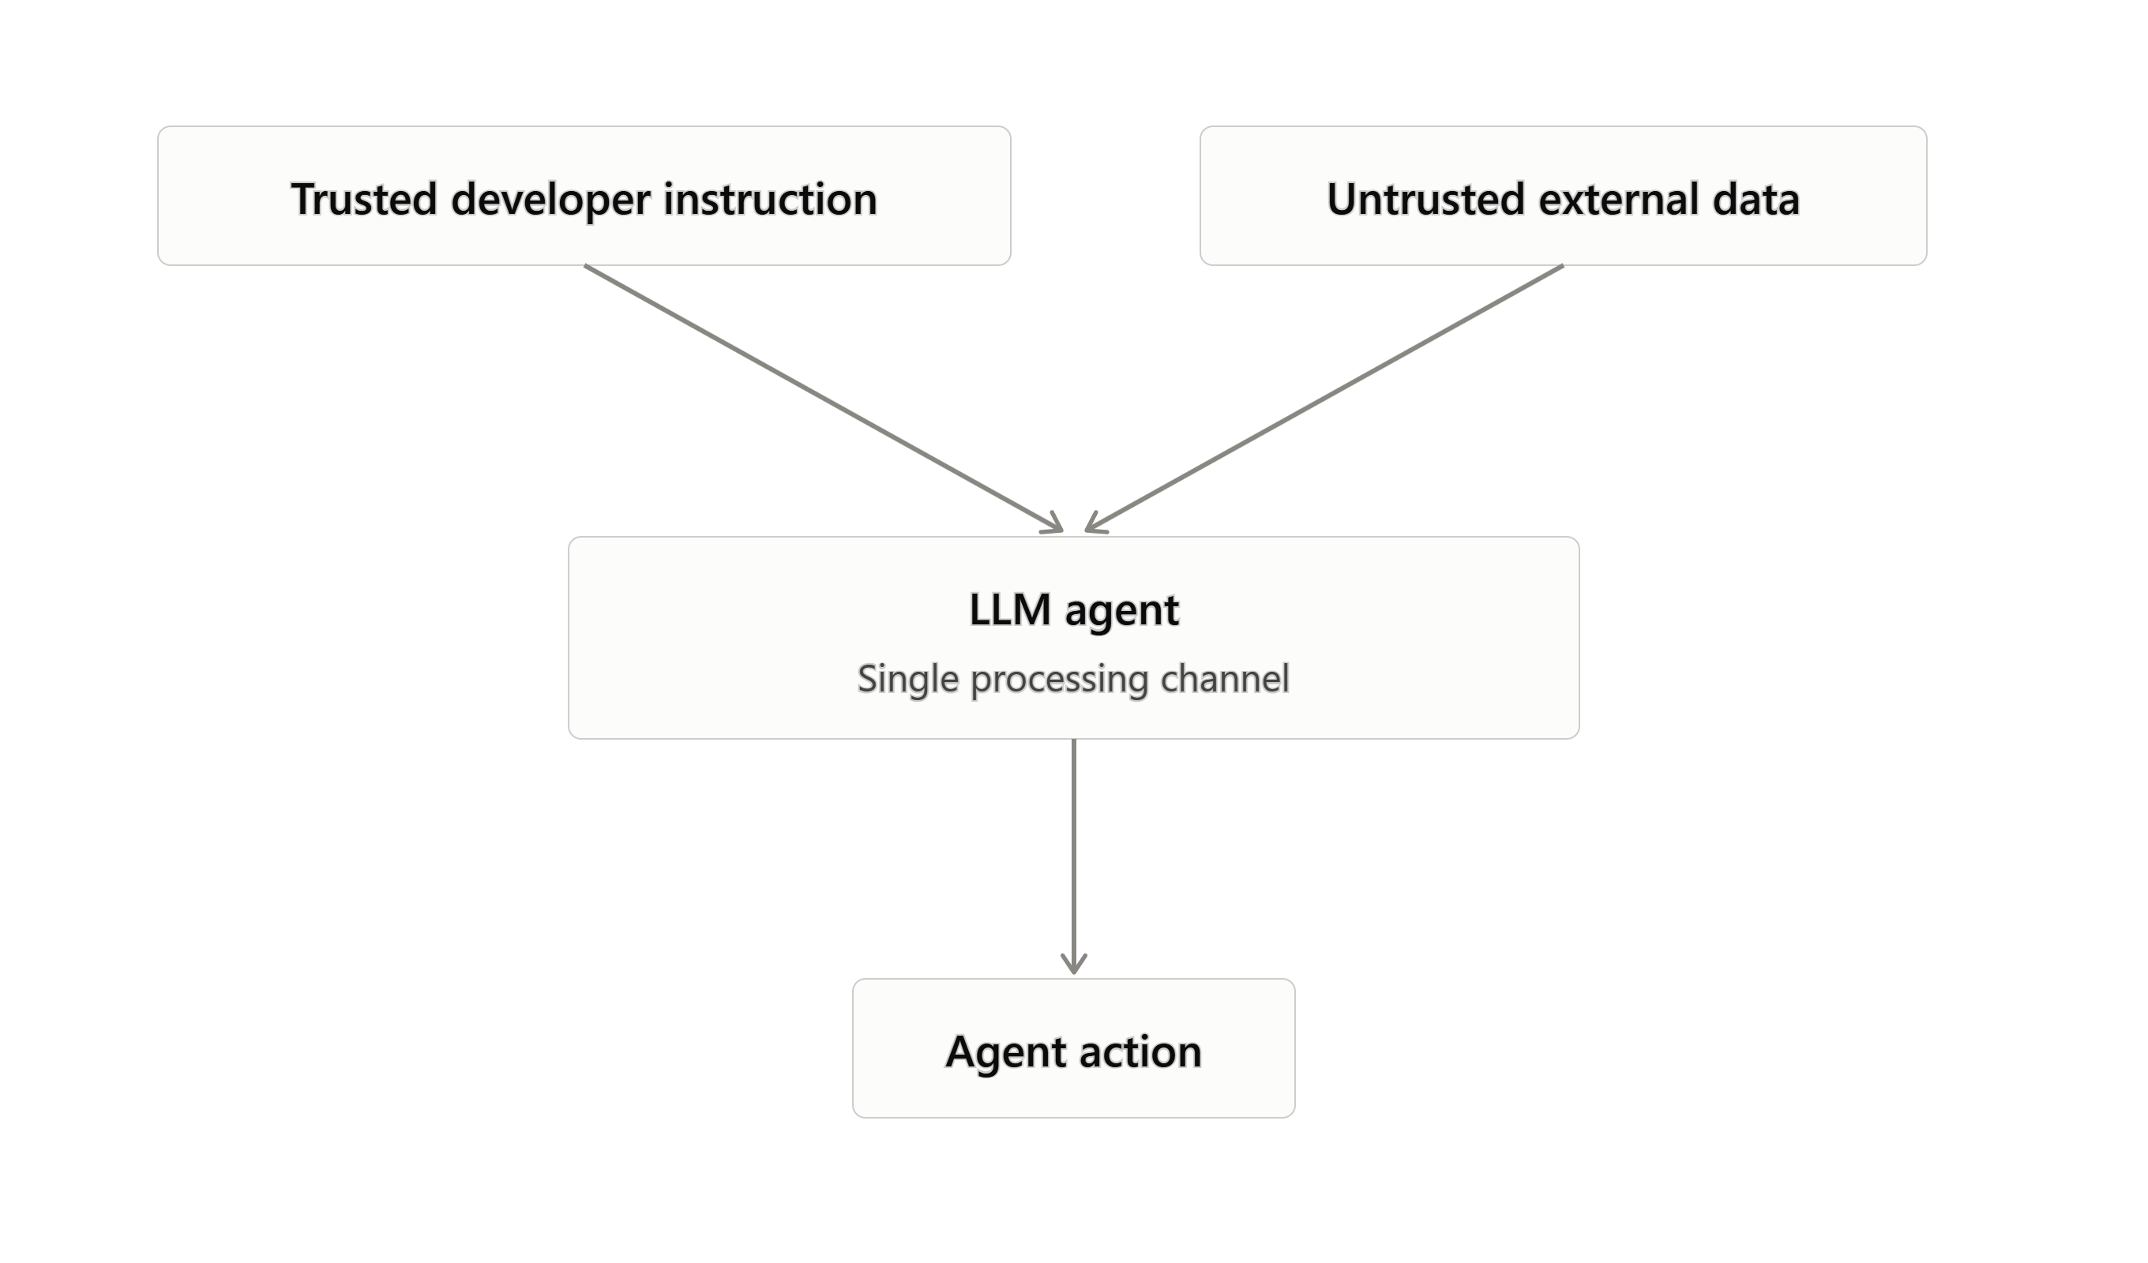
Research Context and Background
Agentic LLM applications increasingly use tools, browse the internet, and control user files [1].
The transformer architecture treats trusted commands and untrusted third-party data as input within a single, indistinguishable channel [1].
This structural flaw enables Indirect Prompt Injection (IPI): harmful instructions hidden in external content (web pages, e-mails) can hijack an agent's actions without the user's knowledge [2].
Current defences — prompt engineering, multi-layered instructions — are theoretically imperfect and are regularly bypassed [3].
OWASP ranks prompt injection as the #1 risk in both the LLM Applications Top 10 and the Agentic Applications Top 10 [4].
Figure 1.1: The Instruction-Data Conflation Problem
Architectural Mitigations for Prompt Injection Attacks in Agentic LLM Applications
3

Slide 4
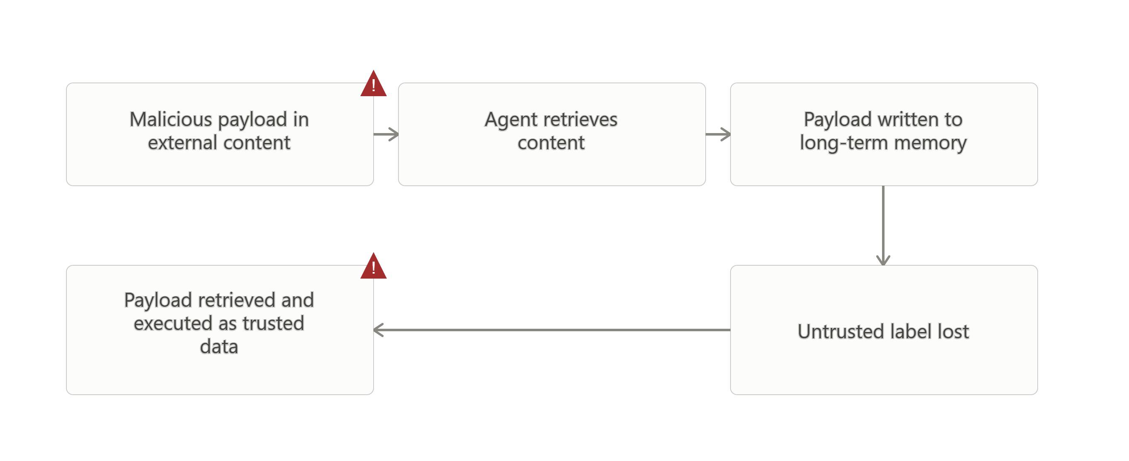
Research Problem
Problem: Agentic LLMs blend trusted system commands with untrusted external data, causing a loss of control-flow integrity.
A malicious payload injected via data retrieval can disrupt the agent's task goal — leading to zero-click data leaks or unintentional operations.
Gap: Semantic/prompt-based filters have a structural limit; attackers exploiting fixed filters recovered 64% success on unstructured inputs [3].
Execution isolation vs. Stored IPI trade-off: thorough isolation harms benign-task usability, while extended data access exposes systems to Stored IPI, where a payload sheds its untrusted label and is later trusted on retrieval [6].
No existing architecture couples both defences against long-horizon and immediate attacks.
Figure 2.1: Stored IPI Attack Chain
Architectural Mitigations for Prompt Injection Attacks in Agentic LLM Applications
4

Slide 5
Research Aim and Objectives
Research Aim
Devise, build, and test a composite framework of architectural mitigations — integrating hub-and-spoke execution isolation with dual-LLM data symbolisation — to prevent prompt injection attacks on tool-supported LLM agents, with minimum penalty to benign task utility.
SMART Objectives
1. Critically evaluate current Indirect Prompt Injection vulnerabilities in the MCP ecosystem via a systematic literature review (Month 2).
2. Design a composite defensive architecture combining execution sandboxing with persistent untrusted-data tracking (Month 3).
3. Implement a functional Python-based prototype using open-weight language models (Month 4).
4. Measure Targeted Attack Success Rate and Benign Utility against AgentDojo/AgentLAB, targeting ASR below 10% (Month 5).
5. Formulate architectural deployment guidelines aligned with the NIST AI RMF (Month 6).
Architectural Mitigations for Prompt Injection Attacks in Agentic LLM Applications
5

Slide 6
Literature Review
Author / Year | Study / Topic | Key Finding | Relevance / Gap
Willison, 2023 [1] | Dual LLM Pattern | Separate privileged/quarantined models resist prompt injection. | Foundational isolation pattern; vulnerable to Stored IPI.
Greshake et al., 2023 [2] | Indirect Prompt Injection | Real-world LLM apps compromised via external content. | Established IPI as a practical, exploitable threat.
Debenedetti et al., 2024 [8] | AgentDojo benchmark | Formalises the ASR vs. Benign Utility trade-off across 97 tasks / 629 test cases. | Reducing attack capability reduces real capability.
Wu et al., 2025 [7] | IsolateGPT | Hub-and-spoke execution isolation limits the blast radius of tool calls. | Adds latency; discontinuity of context.
Kim et al., 2026 [6] | DualView | Symbolisation widens untrusted-data tracking to global context; ASR reduced to 0% at +6pp utility cost. | Does not address execution isolation.
Wallace et al., 2024 [9] | Instruction Hierarchy | Trains models to favour developer prompts over outside data. | Structurally bounded; cannot cover infinite semantic variation.
Identified Research Gap
No existing architecture couples DualView-style data symbolisation with IsolateGPT-style execution isolation and measures the combination against MCP-enabled, long-horizon attacks — this is the gap the proposed composite framework addresses.
Architectural Mitigations for Prompt Injection Attacks in Agentic LLM Applications
6

Slide 7
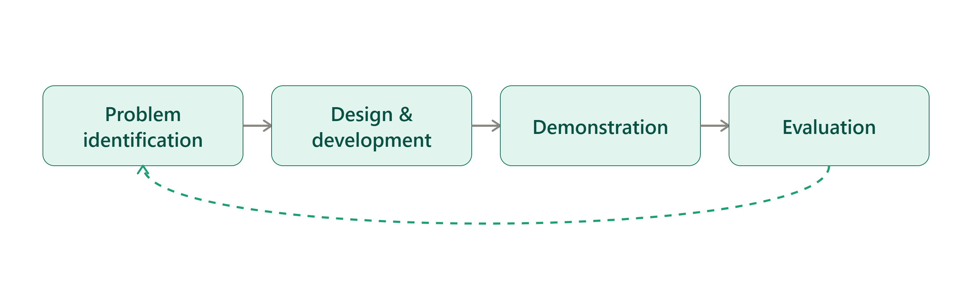
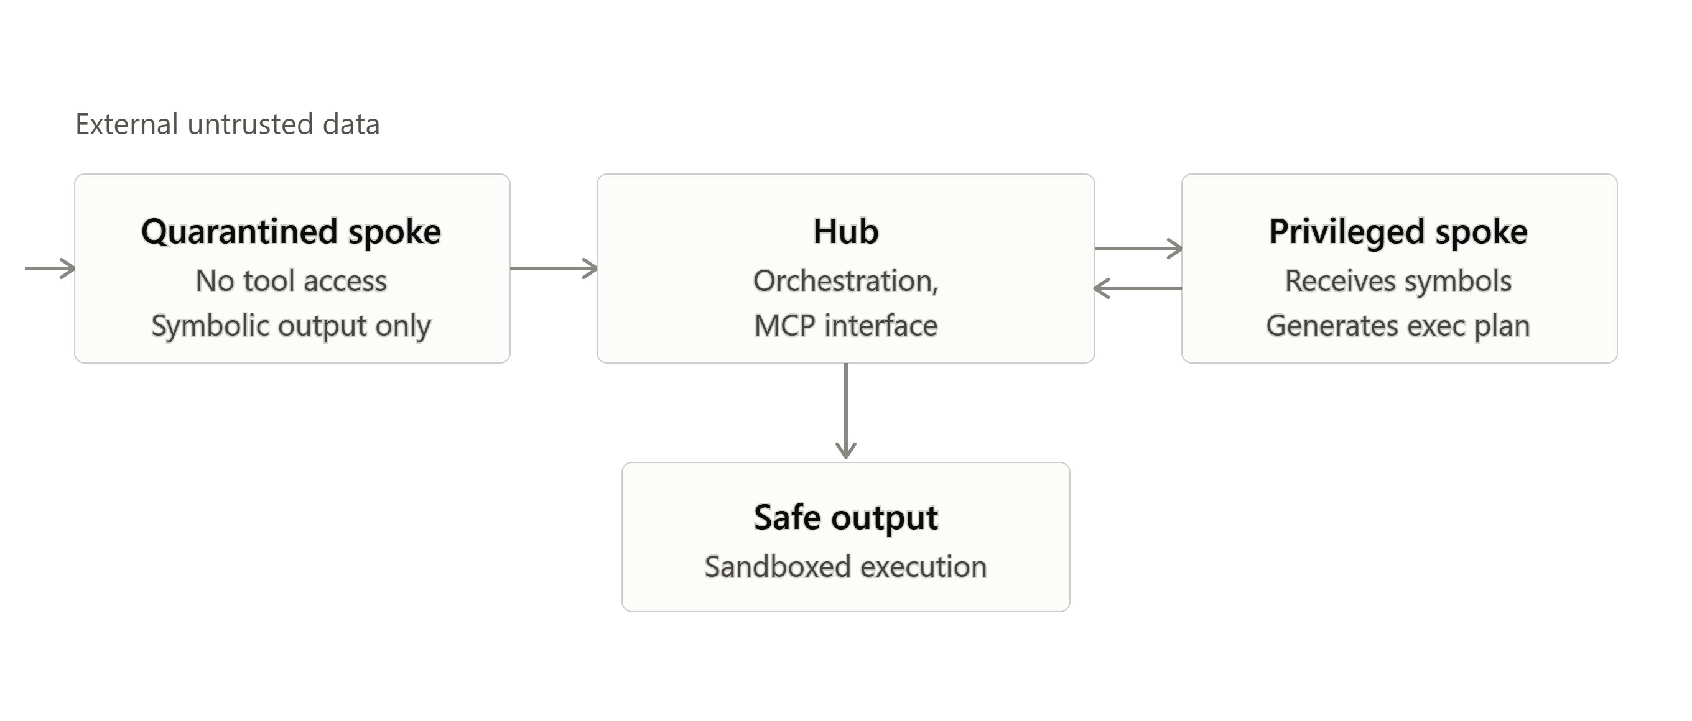
Research Methodology
Design Science Research (Hevner et al., 2004) [10]: an iterative cycle of Problem Identification → Design & Development → Demonstration → Evaluation.
Quantitative, system-level evaluation; objectivist stance, positivist epistemology.
Architecture: Hub (orchestration / MCP interface) → Quarantined Spoke (no tool access, symbolic output only) → Privileged Spoke (receives symbols, generates execution plan) → Sandboxed safe output.
Evaluated on AgentDojo (static IPI) and AgentLAB (long-horizon attacks) [8], [11].
Metrics: Targeted Attack Success Rate, Benign Utility, Turn-to-Success, Latency Overhead.
Tools: Python 3.10+, LangChain, MCP SDK, Docker API, vLLM, Llama-3.1-8B / Mistral-7B.
Figure 3.2: Design Science Research Process
Figure 3.1: Composite Defence Architecture
Architectural Mitigations for Prompt Injection Attacks in Agentic LLM Applications
7

Slide 8
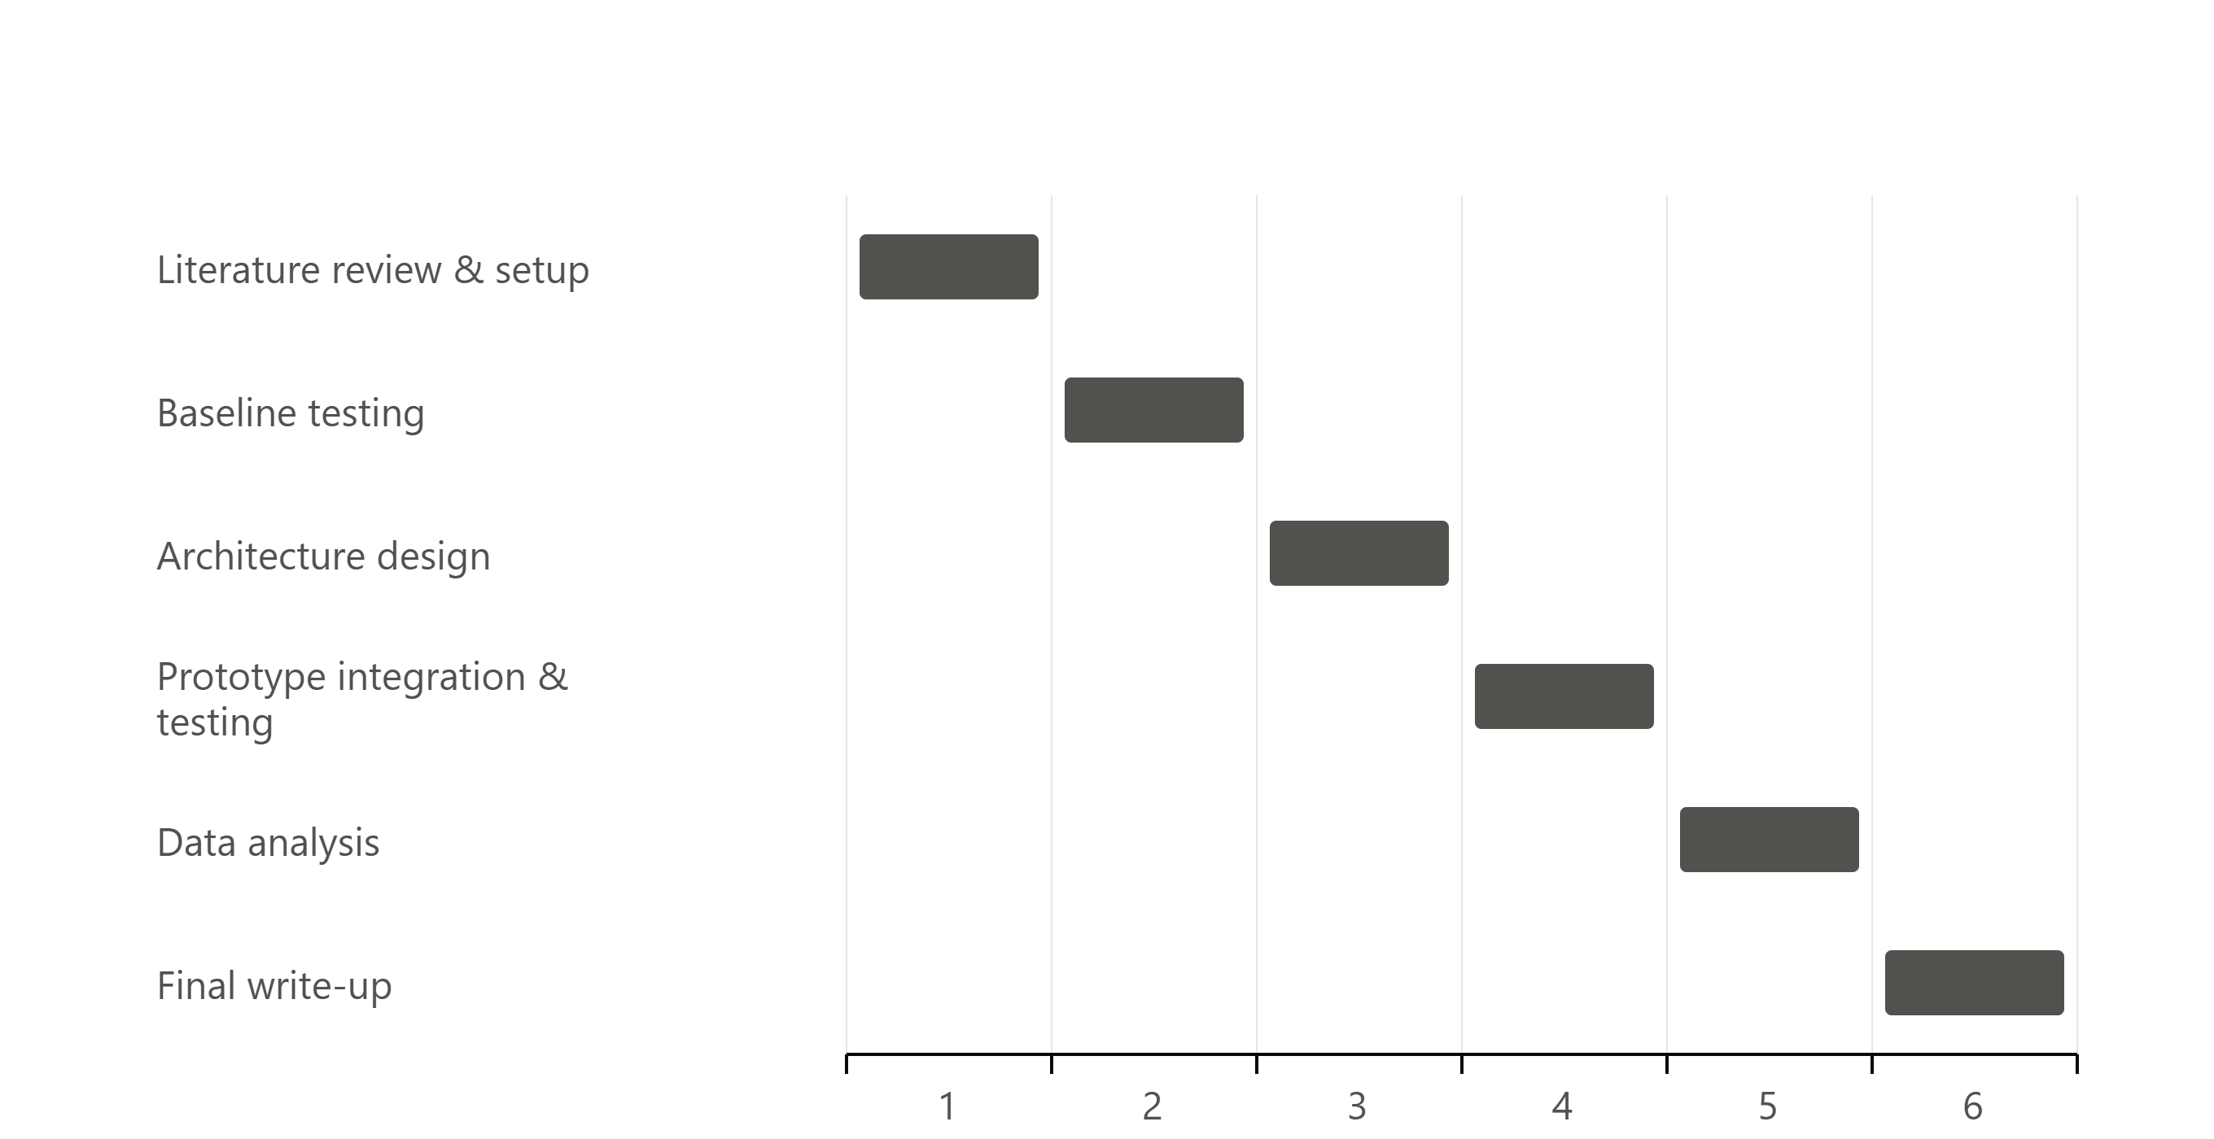
Project Planning and Resources
Resources
Programming: Python 3.10 or later
Frameworks: LangChain, MCP SDK, Docker API
Evaluation: AgentDojo, AgentLAB, UK AI Safety Institute inspect_evals
Models: Llama-3.1-8B, Mistral-7B (via vLLM)
Hardware: Linux workstation, NVIDIA RTX-series GPU (24GB VRAM), fast NVMe storage
Figure 5.1: Six-Month Gantt Chart
Six-month timeline: literature review → baseline testing → prototype design → adversarial testing → data analysis → finalisation.
Architectural Mitigations for Prompt Injection Attacks in Agentic LLM Applications
8

Slide 9
Expected Impact and Limitations
Expected Impact
Limitations
TASR drop from ~30–40% (baseline) to below 10% for direct and indirect prompt injection.
Benign Utility drop of less than 8% — a favourable security-utility trade-off vs. single-mechanism defences.
Academic: empirical evidence that combined defences outperform semantic filtering alone against multi-turn attacks.
Technical: a reference architecture hardening MCP against zero-click exploits.
Industry: an actionable deployment blueprint aligned with the NIST AI RMF.
Added token count and inference latency from dual-LLM routing — may be prohibitive in resource-limited or latency-sensitive settings.
Scope restricted to indirect prompt injection targeting tool-calling agents only.
Does not address model-weight poisoning, adversarial training-data manipulation, or hardware side-channel leaks.
Architectural Mitigations for Prompt Injection Attacks in Agentic LLM Applications
9

Slide 10
References
[1] S. Willison, "The Dual LLM Pattern for Building AI Assistants That Can Resist Prompt Injection," Apr. 2023.
[2] K. Greshake et al., "Not What You've Signed Up For: Compromising Real-World LLM-Integrated Applications with Indirect Prompt Injection," Proc. AISec, Nov. 2023, pp. 79-90.
[3] Cloud Security Alliance, "NIST Proves Static AI Guardrails Are Mathematically Insufficient," 2026.
[4] Open Worldwide Application Security Project, "OWASP Top 10 for LLM Applications," OWASP Foundation, 2025.
[5] "Security Analysis of the Model Context Protocol Specification and Prompt Injection Vulnerabilities in Tool-Integrated LLM Agents," arXiv preprint, 2025.
[6] J. Kim et al., "DualView: Preventing Indirect Prompt Injection in Personal AI Agents," arXiv:2607.03821, 2026.
[7] Y. Wu et al., "IsolateGPT: An Execution Isolation Architecture for LLM-Based Agentic Systems," Proc. NDSS, 2025.
[8] E. Debenedetti et al., "AgentDojo: A Dynamic Environment to Evaluate Prompt Injection Attacks and Defenses for LLM Agents," Proc. NeurIPS, 2024.
[9] E. Wallace et al., "The Instruction Hierarchy: Training LLMs to Prioritize Privileged Instructions," OpenAI, Apr. 2024.
[10] A. R. Hevner, S. T. March, J. Park, and S. Ram, "Design Science in Information Systems Research," MIS Quarterly, vol. 28, no. 1, pp. 75-105, Mar. 2004.
[11] "AgentLAB: Benchmarking LLM Agents against Long-Horizon Attacks," arXiv preprint, 2026.
Architectural Mitigations for Prompt Injection Attacks in Agentic LLM Applications
10

