Slide 1
Community Care and Management of Longer-term Conditions
Semester 1
Needs Assessment for Long-term Conditions
©Dr Aishat Bakre

Slide 2
Learning outcomes
Upon successful completion of this module, student should be able to:
Critically evaluate the physical, psychological, and social impact on individuals and families living with a long-term condition(s) and its treatment.
Critically assess the key areas of local and national political, health and social care agendas and initiatives relating to long term conditions.
Critically evaluate the skills, values and behaviours required to provide co-productive and traditional models of care as appropriate.
Critically analyse the contribution of empirical evidence and local, national, and international guidelines to informing the delivery of ‘whole person’ care and self-management support for individuals with long term conditions.

Slide 3
Module Summary
The module aims overall to develop student understanding of the theories, values and policies in managing patients with longer term conditions in different healthcare settings.
To gain an understanding of healthcare work across traditional primary/secondary/social care boundaries and collaborate with patients/carers and other professionals within the NHS, social and private/voluntary sector to continuously improve the information, support, care, and person-centred approaches to treatment of people living with long term conditions.

Slide 4


Slide 5
Aims of the Session
To understand
The term Health needs
The Difference between the different types of needs
The term Health Needs Assessment (HNA)
The stages of HNA

Slide 6
Health needs
To be able to plan an effective health intervention programme the assessment of what a population group needs is quite essential to achieve a healthy living.

Slide 7
Reflection
Reflecting on the SEPH module, describe the term health intervention programme
Feedback your findings to the whole class

Slide 8
Health Intervention
"an act performed for, with, or on behalf of a person or population whose purpose is to assess, improve, maintain, promote or modify health, functioning, or health conditions.“
Intervention apply to any “activity undertaken with the objective of improving human health by preventing disease, by curing or reducing the severity or duration of an existing disease, or by restoring function lost through disease or injury”. It include
Preventive interventions e.g vaccine
Nutritional interventions e.g regular provision of high-protein/calorie diets or supplementation to individuals with specific micronutrients
Education and behaviour change e.g Some interventions directed at preventing disease are based solely upon changing human behaviour (for example, anti-smoking campaigns or campaigns to promote breastfeeding).

Slide 9
Health needs
According to Cohen (2008), health needs actually means a “matter of people’s wants and demands which are limitless”.
Therefore, “identifying health needs is about identifying priorities”(Naidoo and wills, 2009)
According to Maslow hierarchy of needs (1954), all human needs are classified as health needs.
These are all universal needs.

Slide 10
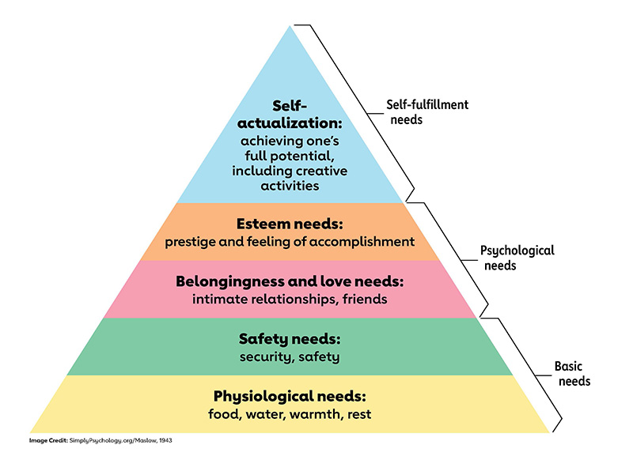
Maslow hierarchy of needs
(Maslow, 1954)

Slide 11
Health needs
There are two major understanding of what constitutes a health needs. These are
Subjective
Objective

Slide 12
Health needs
Subjective concept is when needs is judged from the perspective of an expert/professional and this can be influenced by whether the needs can be met.
Objective concept is a universal concept that is a fundamental human right
(Naidoo and Wills, 2009)

Slide 13
Health needs
A need could be something people want or something that they lack when compared to others.
For example, people may believe they “need” a new coat because someone observed that the old coat is worn out or
Because it looks old compared to other people’s coat.
(Naidoo and Wills, 2009)
Notes:
Need - the capacity to benefit
People have different perspectives of what need is – doctors, economists, sociologists

Slide 14

What is a health needs assessment?

Slide 15
Health Needs Assessment
The term needs assessment describes the process of gathering information through data collection.
It is the “systematic method of reviewing the health needs and issues facing a given population leading to agreed priorities and resource allocation that will improve health and reduce inequalities”.
(Cavanagh and Chadwick, 2005)
Notes:
Health needs assessment is a “systematic and explicit process that involve identifying issues affecting a population that can be addressed”.

Slide 16
Health needs assessment (HNA)..
… is a systematic method of identifying unmet health and healthcare needs of a population….
... and making changes to meet these unmet needs
Health needs are context-specific and so should be health needs assessment
HNA in one area may not be generalisable to another area – “it's not like that here”
(J Wright in Oxford Handbook of Public Health Practice, 2001)

Slide 17
Health needs assessment
Not simply a process of listening to patients or relying on personal experience
The development and refinement of well-established approaches to understanding the needs of a local population.
Must balance clinical (what should be done), ethical (what can be done), and economic (what can be afforded) considerations.

Slide 18
Health Needs Assessment
Health needs assessment can be carried out from the viewpoint of professionals, the public, and key informants (community members with specific point of view e.g teachers).
It can be carried out at different levels that is either individual or specific groups (people with specific health issues or national populations).
It helps to inform intervention planning, and service design.

Slide 19
What is the purpose of health needs assessment ?

Slide 20
Purpose of health needs assessment
To identify which actions to improve health should be given greatest priority
To choose which particular groups or communities should be prioritised
To help in targeting interventions and commissioning services appropriately.
To identify and respond to specific needs of the minority groups
To target people/groups at higher risk
To properly allocate resources
(Naidoo and Wills, 2009)

Slide 21
Purpose of health needs assessment
Highlighting the areas of unmet need and providing a clear set of objectives to work towards meeting these needs
Professional development of skills and experience
Improved communication with other agencies and the public.
Strengthened community involvement in decision making
Improved team and partnership working

Slide 22
What are the Challenges of HNA?

Slide 23
Challenges of HNA
Working across professional boundaries that prevent power-or information-sharing
Developing a shared language between sectors
Obtaining commitment from ‘the top’
Accessing relevant data
Accessing the target population
Maintaining team motivation and commitment
Translating findings into effective action.

Slide 24
How does HNA support National and Local priorities?

Slide 25
Health Needs Assessment
HNA provides a vital tool to meet the specific objective set by the government,
HNA is recommended in various policy documents to inform regional and local strategic plans.

Slide 26
What are the different types of need?

Slide 27
Different types of need
Bradshaw (1972) distinguished four different types of health and social needs. These include
Normative needs defined by professional
Felt needs (wants) defined by client
Expressed needs (Demands)
Comparative needs

Slide 28
Normative needs
Normative needs: These are need that is defined by experts.
Normative needs are not absolute and there may be different standards laid down by different experts because they identify the way these needs can be met.
This normative need reflects a professional judgement that may be different from their client's judgement based on what they can provide.
  E.g., Vaccinations, a decision by a surgeon that a patient needs an operation
  A decision by a health visitor that a child needs supplementary feeding through bottle feeding in addition to breastfeeding due to the baby growth failure.
(Naidoo and Wills, 2009)

Slide 29
Felt needs
Felt needs (wants): Need perceived/identified by an individual/client.
Felt needs are limited by individual perceptions and knowledge of services.
It is what people really want through service provision and necessary support (service user views and patient/public involvement in health decision making
Sometimes called service needs
  E.g., Having a headache, feeling knee pain
(Naidoo and Wills, 2009)

Slide 30
Expressed needs
Expressed needs (Demands): Felt needs turned into action or expressed in words. That is help seeking.
Clients expressed their needs when they ask for help or information or when they make use of a service
Expressed needs is usually used to measure the adequacy of service provision, although it is not a complete measure.
Only a proportion of patient contact the health service, and this is just a tip of the iceberg.
People use services because it is all that is available, but it may not necessarily meet their needs.
  E.g., Going to the dentist for a toothache,
  Waiting list (unmet demand)
(Naidoo and Wills, 2009)

Slide 31
Comparative needs
Individuals or group of people are said to be in comparative needs when their situation when compared to other group are found to lack certain services and resources that are required.
For example, if a person with a mental health condition in area A was living in a sheltered accommodation with required support service given but this is not the case of a person with the same condition in area B.
Therefore, the person in area B will be said to be in need of certain services that other people in the same situation are getting.

Slide 32
Health need
Need for health
OR
Need for health intervention – not only is there need, but also potential to benefit from an intervention (care or prevention)
  i.e., evidence of effectiveness and cost effectiveness
Notes:
Healthcare needs: those that can benefit from health care (health education, disease prevention, diagnosis, treatment, rehabilitation, terminal care).
Health needs: incorporate wider social and environmental determinants of health, such as deprivation, housing, diet, education, employment.

Slide 33
Healthcare needs versus health needs
Healthcare needs: those that can benefit from health care (health education, disease prevention, diagnosis, treatment, rehabilitation, terminal care).
Health needs: incorporate wider social and environmental determinants of health, such as deprivation, housing, diet, education, employment.

Slide 34
Activity
Reflecting on the SEPH module,
What are determinants of health?
What is the name of the main determinant of health model?
Feedback your findings to the whole class

Slide 35
What are the five steps to achieve a good health need assessment?

Slide 36
Five steps of health needs assessment
Step 1 – Getting started
Step 2 – Identifying health priorities
Step 3 – Assessing a health priority for action
Step 4 – Action planning for change
Step 5 – Moving on/project review

Slide 37
Step 1: Getting started
What population? Must have a clearly defined target population
What are you trying to achieve? Set SMART goal/clear aims and objectives for your HNA
Who needs to be involved? i.e., Highlight relevant stakeholders.
What resources are required?
What are the risks? i.e., Barriers and threats

Slide 38
Activity
Reflecting on the SEPH module, what does SMART means and when do we use it.
Who are stakeholders?
Feedback your findings to the whole class

Slide 39
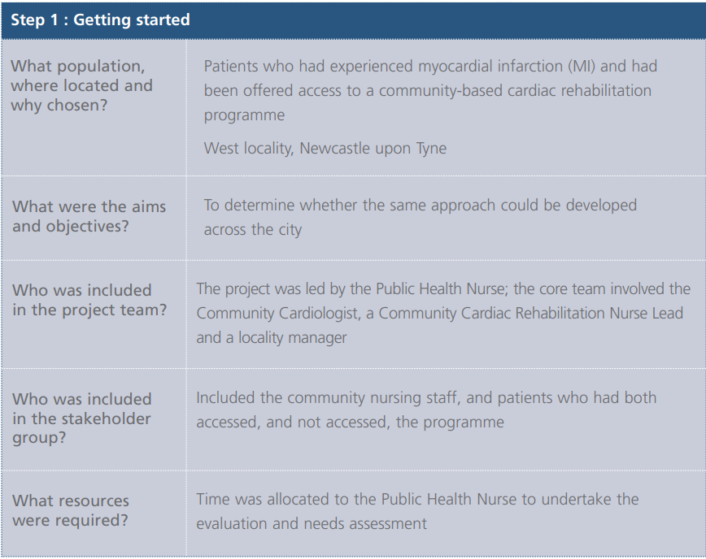
Case study: Example

Slide 40
Step 2: Identifying health priorities
Population profiling
Gathering data
Perceptions of needs
Identifying and assessing health conditions and determinant factors
Notes:
Gather general information about the target population:
• How many people are in the target group?
• Where are they located?
• What data are currently available about them?
• What are the main common experiences and differences within the group?

Slide 41
Population profiling
Gather general information about the target population:
• How many people are in the target group?
• Where are they located?
• What data are currently available about them?
• What are the main common experiences and differences within the group?

Slide 42
Population profiling
How does the population perceive its needs?
Hold workshops or focus groups for those involved in this assessment, such as representatives from the population and providers
Interview key people
Send out questionnaires
Consider reaching individuals/groups who might be excluded from the main consultation methods

Slide 43
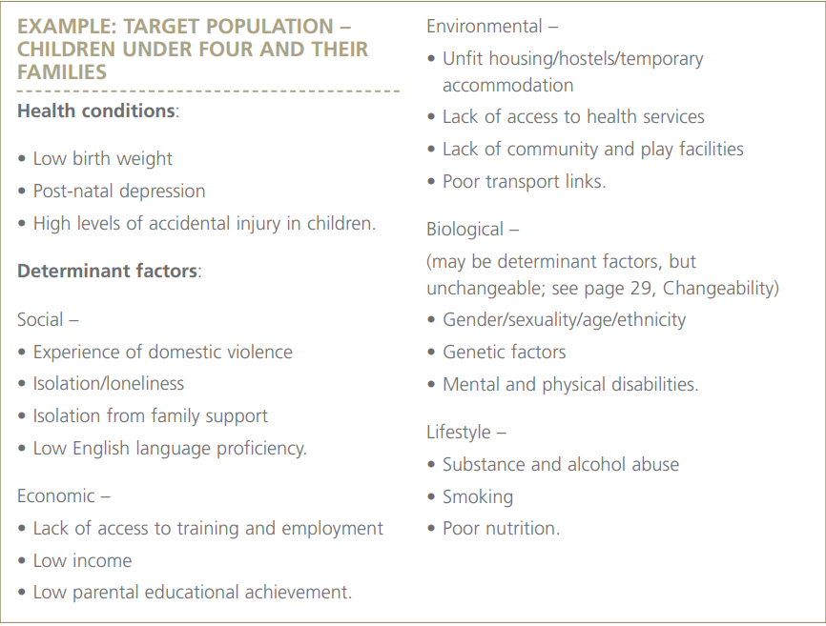

Slide 44
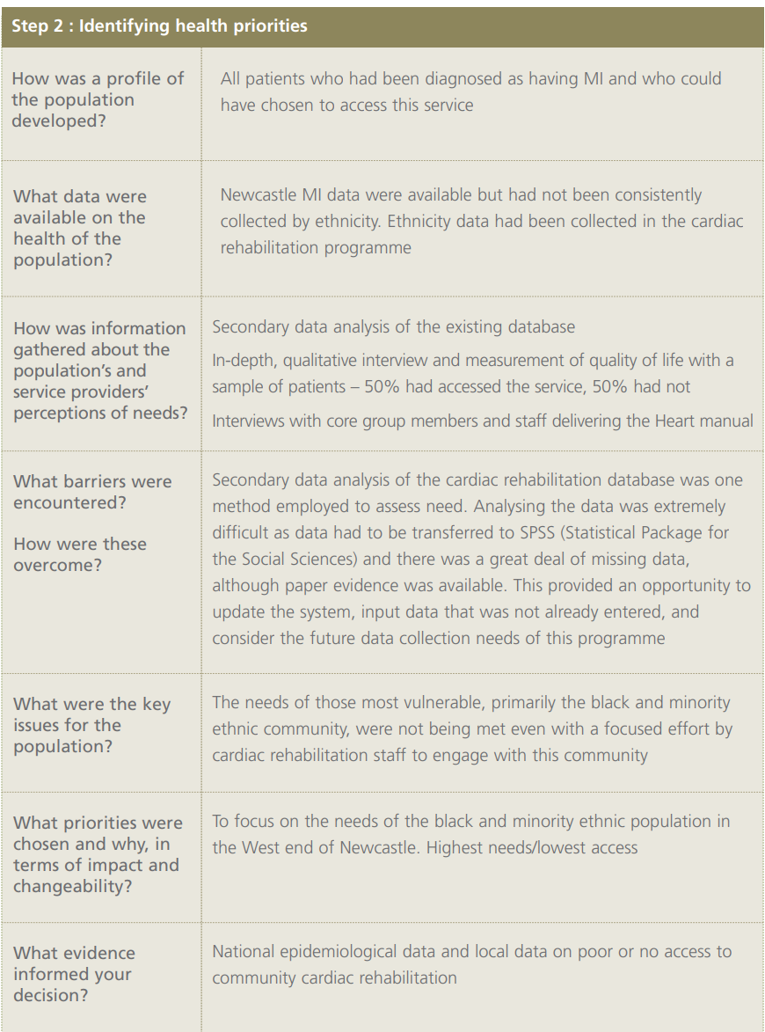
Case study: Example

Slide 45
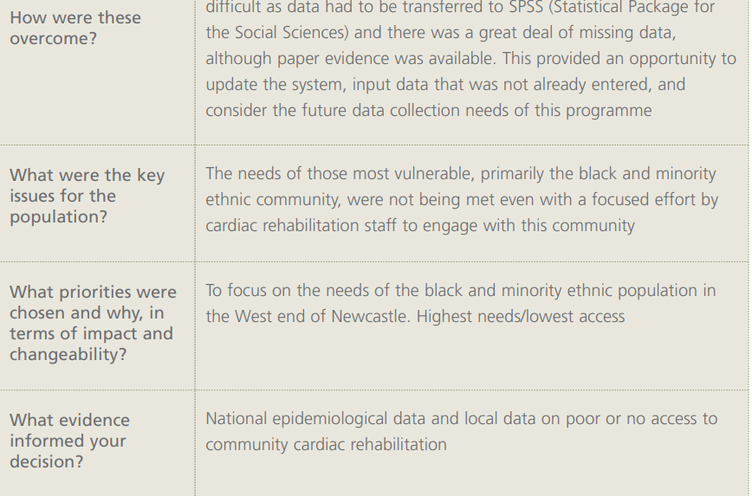
Case study: Example

Slide 46
Step 3: Assessing a health priority for action
Choosing health conditions and determinant factors with the most significant size and severity impact
Determining effective and acceptable interventions and actions

Slide 47
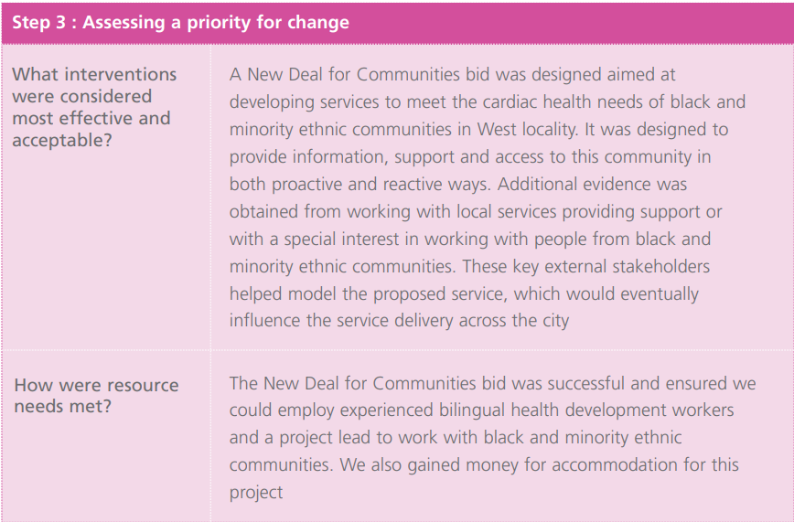
Case study: Example

Slide 48
Step 4: Action planning for change
Clarifying aims of intervention
Action planning
Monitoring and evaluation strategy
Risk-management strategy

Slide 49
Reflection
Reflecting on the SEPH module mention all the different ways a health intervention programme can be evaluated and when each is required
Highlight some examples of questions that can assist the process.
Feedback your findings to the whole class

Slide 50
Questions: Process evaluation
Are the original aims and objectives being followed, and are they still relevant?
What is actually happening?
Are all parts of the project proceeding as planned?
What do those implementing the project think about it?
Is the original target group receiving the interventions?
What resources are being used, and are they adequate?

Slide 51
Questions: Outcome Evaluation
Have the original aim and objectives been achieved?
Have the indicators improved, and have the targets been achieved?
Is the project still tackling priority issues?
What should happen if the evaluation shows the programme has failed?

Slide 52
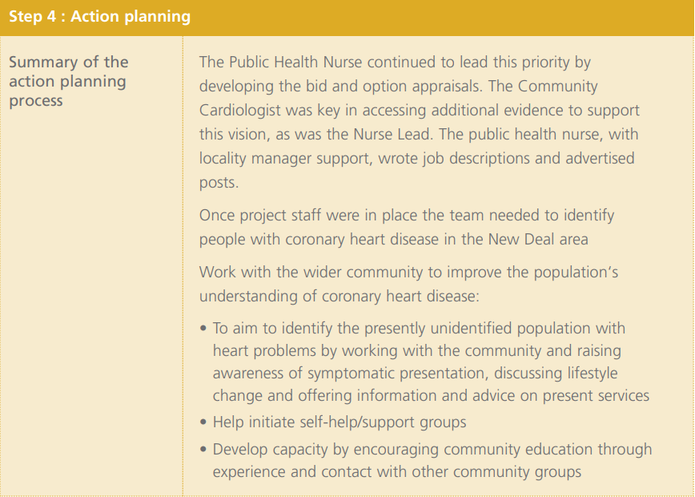
Case study: Example

Slide 53
Step 5 – Moving on/project review
Learning from the project
Measuring impact
Choosing the next priority

Slide 54
Five steps of health needs assessment
The five step present a set of practical activities and quantitative and qualitative research exercises that will ensure a robust and systematic assessment, with tangible outcomes.
The information gained can be used to inform service delivery and improve health outcomes for a targeted population, as well as leading to other potential benefits.

Slide 55
Activity
Working in group let’s explore the below link
Population health needs assessment: a guide for 0 to 19 health visiting and school nursing services - GOV.UK (www.gov.uk)
Feedback what you have learnt to the whole class
Notes:
Population health needs assessment: a guide for 0 to 19 health visiting and school nursing services - GOV.UK (www.gov.uk)
https://www.gov.uk/government/publications/commissioning-of-public-health-services-for-children/population-health-needs-assessment-a-guide-for-0-to-19-health-visiting-and-school-nursing-services

Slide 56
What are the approach to health needs assessment?

Slide 57
Approaches to health needs assessment
Epidemiological-focus on size and nature of the problem)
Corporate- Focus on the views of stakeholders (health professionals, policy-makers, key members of the community).
Community-uses a variety of methods to enable communities to identify, priorities and decide what actions to take to meet health needs
(Naidoo and Wills, 2016)

Slide 58
Approaches to health needs assessment
Wright, 1998

Slide 59
Activity
Watch the video below
https://www.wapha.org.au/service-providers/health-planning/needs-assessment/
https://www.youtube.com/watch?v=8-uEZSzCM9Y
Share your thought with the whole class
Notes:
Community Needs Assesment (youtube.com)

Slide 60
Further reading
Health needs assessment. Latest from The BMJ: https://www.bmj.com/specialties/health-needs-assessment
Williams, R. (1998) Epidemiological issues in health needs assessment BMJ. 316: 1379
Murray, S.A. (1995) Practice based health needs assessment: use of four methods in a small neighbourhood BMJ. 310:1443
Naidoo J, Wills J (2016) Foundations for Health Promotion. Fourth edition. Elsevier, New York NY
Wright. J. (1998) Assessing health needs in developing countries. BMJ. 316:1819
Public Health England () Health matters: public health issues Available at: https://www.gov.uk/government/collections/health-matters-public-health-issues (Accessed date 28th September 202)
Notes:
Glossary | NICE
https://www.nice.org.uk/glossary?letter=h

