Slide 1
LCMB7003
Strategic Management
Week 5
Additional material
STRATEGIES IN DIFFERENT CONTEXTS

Slide 2
Understand explore strategies in different context
Explore the strategies in Private, Public, Voluntary, Entrepreneurship/Small Business and Global Contexts.
Analyse a Case Study related to strategies in different contexts.
LEARNING OBJECTIVES

Slide 3

Strategy Context
Strategic Management is shaped by the context in which the business operates.
The way strategy is explained and applied depends on the specific sector or context in the firm operates, whether private, public, voluntary, small business / entrepreneurial or global.

Slide 4

Private Sector Strategy
Adopt a strategy to gain sustainable competitive advantage
Private sector strategy is defined by the competition
Lead Times – develop products/services in time for the market

Slide 5
Public Sector Strategy
Public Sector delivers public policy and undertakes functions such as taking taxes
Public sector is not usually affected by competition.
Competition is largely internal such as competition for resources (e.g., funding).
Strategy is focused on delivering goals to satisfy political process, increase efficiency to meet the expectations of the taxpayer.

Slide 6
Voluntary / Third Sector
The voluntary / third sector is found between the private and private sector.
Objectives are social or sometimes political.
Key stakeholders are the recipients, donors, trustees or volunteers.
Strategy is to compete for funding from private, public and individual donors.
Often engaged in competitive strategies to be sustainable.

Slide 7
Entrepreneurial Strategy
Strategy is to about competitive advantage and ownership
Entrepreneurship is the exploitation of business opportunities usually driven by the thinking and reasoning of individuals or small groups.
Imagination
Ideas Generation
Invention
Innovation

Slide 8
Global / Internationalisation Strategies
Drivers of internationalisation Strategies
Sources of Competitive Advantage
internationalisation Strategies
Market Selection
Mode of Entry

Slide 9

Drivers of internationalisation
Global Customers
Similar Customer Needs
Trade Policies
Host Government Policies
Scale Economies
Competitors’ Global Strategies
Interdependence between countries

Slide 10
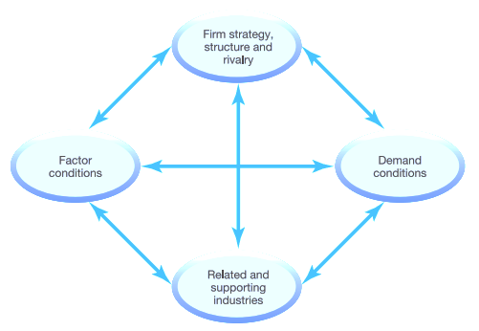
Porter’s Diamond suggests that there are inherent reasons why some nations are more competitive than others, and why some industries within nations are more competitive than others.
Porter’s Diamond Theory, is an economic model that aims to understand the factors that give certain nations or groups a competitive advantage over others.
https://www.youtube.com/watch?v=T9ALTVXawNk

Slide 11
Factors offering the competitive advantage. | Examples
Factor conditions in a certain country refer to the natural, capital and human resources available. | Some countries are for example very rich in natural resources such as oil for example (Saudi Arabia). This explains why Saudi Arabia is one of the largest exporters of oil worldwide.
The home demand largely affects how favorable industries within a certain nation are. | The presence of sophisticated demand conditions from local customers also pushes companies to grow, innovate and improve quality. (ex: higher demand for green vehicles in western countries)
The presence of related and supporting industries, supplies provides the foundation on which the focal industry can excel. | Related and Supporting Industries are the inputs for a country, which drives its success. For example, the raw material from fabric suppliers in Italy helps to drive the success of the Milan fashion industry.
The national context in which companies operate largely determines how companies are created, organized and managed: it affects their strategy and how they structure themselves. Moreover, domestic rivalry is instrumental to international competitiveness, since it forces companies to develop unique and sustainable strenghts and capabilities | A good example for this is the Japanese automobile industry with intense rivalry between players such as Nissan, Honda, Toyota, Suzuki, Mitsubishi and Subaru. Because of their own fierce domestic competition, they have become able to more easily compete in foreign markets as well.

Slide 12
Watch the video below and make your own points
Global Value Network

Slide 13

The international value network – Companies can create / generate value from the configuration of network of suppliers / value chains.

Slide 14
Acquisition / Takeover
“Where an organisation develops its resources and competences by taking over another organisation”
Johnson & Scholes (2001)
Important Reasons for Takeover
Assets of the company
Brands
Market Share
Core Competencies
Special Technologies
Increase Organisations size and capacity
Eradicate Competition
Growth in a static market
Fast growth
Diversification
Market knowledge

Slide 15
ACQUISITION
Advantages
Disadvantages
Can be relatively fast
May reduce competition from rival
Cost savings from economies of scale
Extend to new geographical area
Buy market size and share
Financial reasons (Purchase of undervalued assets that can be resold)
Technical maintenance
Premium price paid
High risk if wrong company targeted
Not always easy to dispose of unwanted parts of the company
Human relations problems (Culture/ leadership etc)
Problems of clash of national/ regional cultures

Slide 16

Rowntrees to Nestle

Slide 17
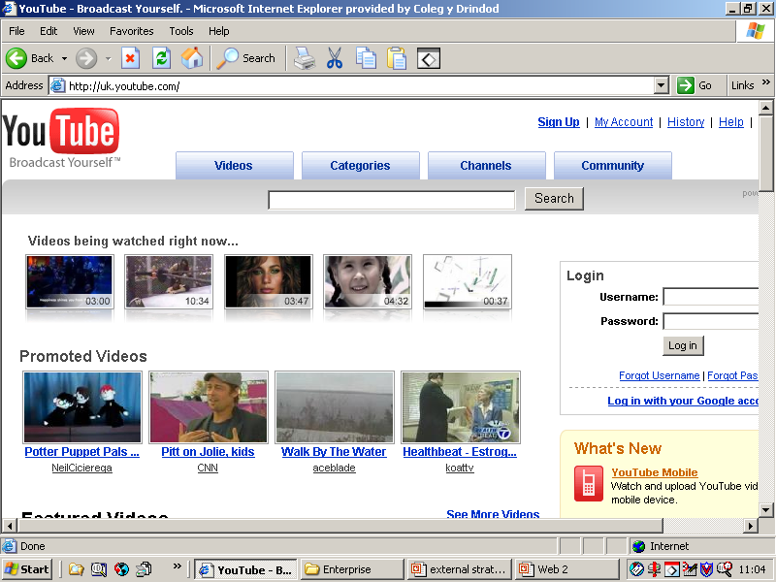
1.2 billion from Google

Slide 18
Mergers
“Mergers are similar to acquisitions in the sense
Of two companies combining together. However, mergers usually arise because neither company has the scale to acquire the other on its own.”
Lynch (2000p583)
Strategic reasons the same as acquisition, but is more friendly and requires special handling (management)

Slide 19
Strategic Alliances
Form of Relationship
Influencing factors | Loose (market) Networks Opportunistic Alliances | Contractual Licensing Franchising Subcontracting | Ownership Consortia Joint Venture
The Market Speed of Change | Fast Change |  | Slow change
Resources Asset management Partner’s assets Risk of loosing assets to partners | Managed separately by partner Draws on ‘parent’s’ assets High Risk |  | Managed together Dedicated assets Low risk
Expectations Spreading the risk Political climate | Maintains risk Unfavourable climate |  | Dilutes Risk Favourable climate
‘ A strategic alliance is where two or more organisations share resources and activities to pursue a strategy’ Johnson et al 2008.360

Slide 20
Types of Strategic Alliances
“A joint venture is the formation of a company whose shares are owned jointly by two parent companies. It usually shares some of the assets and skills of both parents”
Lynch (2000p583)
Consortia
Networks
Franchising
Licensing
Subcontracting (outsourcing)

Slide 21
Strategic Alliances
Advantages
Disadvantages
Can build close contacts with partner
Uses joint expertise and commitment
Allows potential partners to learn about each other
Locks out other competitors
Slow and plodding approach
Needs constant work to keep relationship sound
Partners may only have a limited joint commitment to make alliance a success
Unlikely to build economies of scale

Slide 22


Slide 23
Joint ventures
Advantages
Disadvantages
Builds Scale quickly
Obtains specialist expertise Quickly
Cheaper than acquisition
Can be used where outright acquisitions not feasible
Can be used where similar product available
Control lost to some extent
Works best where both parties contribute something different to the mix
Can be difficult to manage
Share profits

Slide 24
Franchise
“ A franchise is a form of licensing agreement in which the contractor provides the licensee with the pre-formed package of activity.” Lynch (2000p583)
EG: Fast Food industry

Slide 25
Franchise
Advantages
Disadvantages
Lower investment than outright purchase
Some of the basic testing of business proposition undertaken by franchise holders.
Exclusive territory usually granted
Depends on quality of franchise holder
Part of profits paid over to franchise holder
Risk that business built and franchise withdrawn

Slide 26
International Options
More general overseas expansion
Exporting
An overseas office
Overseas manufacturing
Multinational operations
Global operations

Slide 27
International Options
Turnkey:- A contractor who has total responsibility for building
and possibly commissioning large scale plant.
Payment can take many forms
Licensing:- Technology or other assets are provided under
licence from the home country. Payment is usually by royalty
or some other percentage of turnover arrangement.

Slide 28
Further Reading/ Viewing
Johnson et al (2011) Corporate Strategy 9th edition. FT Prentice Hall, Harlow Chapter 7 to Chapter 10 pages 230 to 352

Slide 29
Summary
Explored the strategies in different contexts – private, public, voluntary, entrepreneurship (small business) and global.

Slide 30
NEXT WEEK
Strategy Implementation & Control
Notes:
Please make sure you take a note of the contact details on the screen
Q&A

