Slide 1
Business Inquiry & Research (BMSP5007)
Session 2
Recap on Week 1
and
Introduce the Research Process

Slide 2
Learning outcomes
By the end of this Session, you will be able to:
State what is meant by the term ‘research’.
Outline the key steps of the research process.
Discuss the relevance of ontology and epistemology to research design.
Notes:
Your week 1 homework was to find definitions to explain research and inquiry. How did you do?

Slide 3
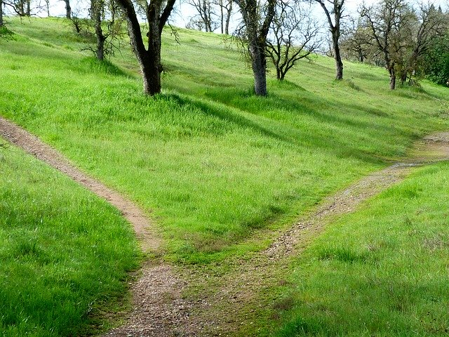
Frameworks for Research
This module takes the view of research as a process of systematic inquiry to generate new knowledge.
The emphasis of this module is on understanding how to think about the research process, working from a well-specified question to choose the most appropriate ways of investigating it.
Image by PublicDomainPictures from Pixabay

Slide 4
Look around you: what do you want to know?
Our day-to-day and professional observations frequently lead us to wonder about them and want to find out more.
Big questions
  Why do people behave the way that they do?
  How do their interactions change under different circumstances?
  Why do some people seem to fare better in life than others?
Narrow questions
  Do men and women notice different things in an outdoor adventure advertisement?
  How many more Asian people are using the leisure center in my town now than five years ago?
  What prompted several of my co-workers to seek employment in this adventure organisation?

Slide 5
Chances are you can easily think of a great many social or outdoor pursuit topics that you would like to know more about.
The rest of this Module will show you how to go from wondering about a topic to identifying specific questions related to that topic, and systematically investigating them in order to arrive at some conclusion.
Notes:
Is there an area you have touched on during the course that you would like to know more about? Is there an area you know well but want to know more?

Slide 6
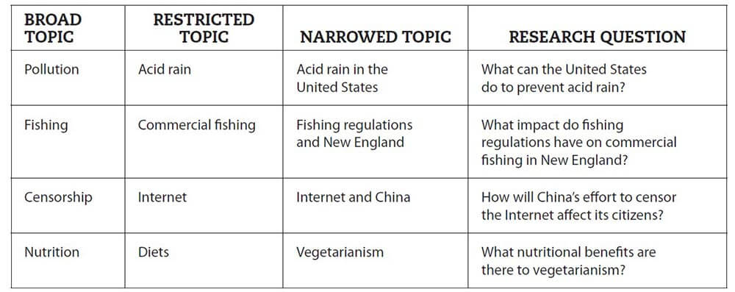
Deriving a research question from a topic
Examples: Deriving a research question from a topic
https://www.bachelorprint.eu/academic-writing/research-question/

Slide 7
Philosophy
The term philosophy is taken from the Greek word, (phileo) meaning "to love" or "to befriend" and , (sophia) meaning "wisdom." Thus, "philosophy" means "the love of wisdom". Socrates, used the term philosophy as an equivalent to the search for wisdom.
Philosophy is the study of the fundamental nature of knowledge, reality, truth and existence, especially when considered as an academic discipline.
Philosophy in the West begins with the Greeks-the pre-Socratics- Thales (624 BC - 546 BC)

Slide 8

Positionality
Although research is systematic, the presence of the researcher inevitably has an effect on the subject under study.
The researcher’s own position and world view will always have an effect on the way the research is carried out and how the findings are interpreted.
It is crucial to reflect on your own roles (as researcher, as a professional, as a student, as a friend, etc.) and the influence they will have on the research you conduct.
When you read about research that somebody else has done, ask yourself how that person’s roles and world views may have influenced the research that was conducted and its interpretation.
Image by Gerd Altmann from Pixabay
Notes:
The researchers effect – introduces subjectivity into the research process because of positionality.
Think of a move that you saw recently – how did the directors position affect the way the story was told (portrayed)

Slide 9

Ontology: the Greek onto (being) and
logia (written or spoken discourse).
the study of existence,
reality or the essence of things.
Positionality issues are sometimes referred to as ‘ontology’ in research.
Ontology is, literally, the study of being.
Ontological considerations in research:
  Who you are
  Who your research subjects are
  The relationship between you and the subject of your research
  What aspects of ‘being’ will you investigate? (thoughts, actions, experiences, perceptions, organisation – of individuals or groups)
Image by John Hain from Pixabay
Notes:
You always state your ontology in research studies.
Being – perceptions, feelings, etc
Something that is externalised can be observed.
How someone feels can be explored through recording their experience and what they observed during the event.

Slide 10
Ontology: the Greek onto (being) and logia (written or spoken discourse). the study of existence, reality or the essence of things.
Philosophical ontology is concerned with the nature of being or the kinds of things that have existence – what entities exist there in the universe.
Jacob Lorhard coined the term ‘ontology’ (ontologia) around 1613
Ontological questions
"What can be said to exist?"
"What is a thing?"
"What are the meanings of being?“
What is existence, i.e. what does it mean for a being to be?
Prominent Ontologists
Plato, Aristotle, Avicenna, Al-Ghazali, Bertrand Russell, Immanual Kant
Notes:
State the area under study, justify the need for the study.

Slide 11
Epistemology derived from Greek epistēmē, meaning "knowledge, understanding", and
logos, meaning "study of"
Epistemology is theory of knowledge – what do we know and how do we know it?
While this might initially seem like a needlessly abstract concept, it is in fact very important for designing a research project aimed at gaining new knowledge.
What do you know or want to know?
How do you know this?
Notes:
This is where literature is important. You need to read papers to be able to explore previous work and theory. Be able to state what knowledge is known and available, epistemology

Slide 12
Epistemology derived from Greek epistēmē, meaning "knowledge, understanding", and logos, meaning "study of"
Epistemology is the branch of philosophy concerned with the nature and scope of knowledge and justified beliefs.
The term "epistemology" was introduced by the Scottish philosopher James Frederick Ferrier .
As the study of knowledge, epistemology is concerned with the following questions:
  What counts as knowledge?
  What are its sources?
  What is the relationship between the knower and what is known?
  How do we know what we know?
Notes:
Published research studies count as knowledge.
What studies have been completed, what has been found and reported?
In February 2002, Donald Rumsfeld, the then US Secretary of State for Defence, stated at a Defence Department briefing: ‘There are known knowns. There are things we know that we know. There are known unknowns. That is to say, there are things that we now know we don't know. But there are also unknown unknowns. There are things we do not know we don't know.’
Since we ask what is the relationship between the knower and what is known in that case ontology and epistemology are connected. AS your beliefs change you questions will change.

Slide 13

Outdoor Adventure and Social Theory
Elizabeth C.J. Pike, Simon Beames
Routledge, 12 Apr 2013 -
Adventure and outdoor sports - from rock climbing to freestyle kayaking – are a modern social phenomenon that can tell us much about the relationship between sport, culture and contemporary society. …
adventure sports are used to illustrate key concepts in social theory and to demonstrate why an understanding of social theory is essential for any student taking a course in sport, adventure, or outdoor education.
Each chapter in the book introduces a key ‘classical’ or modern social theorist, including Marx, Durkheim, Weber and Elias, or a universal topic or issue in social theory, such as sustainability, commodification or identity.
…the theorist or topic is brought to life through case studies of adventurous activities and lived experiences, helping the reader to connect their own sporting and adventurous interests with the frameworks we use to understand wider culture and society..
https://books.google.co.uk/books/about/Outdoor_Adventure_and_Social_Theory.html?id=0HujTZubwBQC&source=kp_book_description&redir_esc=y

Slide 14
Paradigm- or worldview is an overarching ‘conceptual framework’ through which scientists view the world
a philosophical and theoretical framework of a scientific school or discipline within which theories, laws, and generalisations and the experiments performed in support of them are formulated” Merriam Webster Dictionary, 2007)
Kuhn (The Structure of Scientific Revolutions, 1962) says paradigm means a theoretical perspective:
That directs research through:
  The specification and choice of what to study
  The formulation of hypothesis to explain the phenomenon observed
  The identification of the most suitable empirical research technique
Notes:
Paradigm – the theoretical perspective of the topic viewed as a qualitative or quantitative.
When you want to initiate a new study, set out the question and what technique should be followed (qualitative or quantitative)

Slide 15
Three basic questions
The Ontological Question: This is the of ‘what’. What is the nature and form of social reality? Is the world of social phenomenon a real and objective world independent from the interpretations given to it?
The Epistemological Question: This is the question of relationship between ‘what’ and ‘who’. What is the relationship between the knower and what is known? How do we know what we know?
Methodological question: This is the question of ‘how’. How can social reality be studied?
These questions are inter-related and inter-dependent.

Slide 16
Building on previous research
Many topics have already been researched.
However, just because somebody else has done research on a subject, there is no reason to assume that no more can be learned.
Each individual researcher (including you) will look at a topic or question in a different way from another researcher. Interpretivist perspective

Slide 17
Observations and research
Day-to-day observations are not quite the same thing as research.
What defines research and sets it apart is that it uses particular, pre-specified methods to systematically seek answers to a particular question.
Research is best conceived of as a process of original investigation to learn something new.

Slide 18
The research process
Identifying a topic and a question to be answered
Determining what kind of information is needed to answer that question
Determining what methods are best for generating that information
Getting the information using the chosen methods
Drawing conclusions from the information
Presenting conclusions to others
Often, in the process of drawing and presenting conclusions, a new topic for research presents itself, and the process begins again.
Notes:
Point 2 – Would you need to collect data (numbers or ideas (text)), quantitative analysis or qualitative analysis.

Slide 19
‘Ontology has thus to become dependent on epistemology. What there is is seen as the product of our strategies for finding things out. If our epistemology changes, as we move from one world-view to another, so do our beliefs about what is real.’
  Trigg, R. (2001) Understanding Social Science (2nd ed.) Oxford: Blackwell. p. 24.

Slide 20
Self-check of learning outcomes
By now, you should be able to:
State what is meant by the term ‘research’.
Understand the relevance of ontology and epistemology to research design.
Outline the key steps of the research process.

