Slide 1





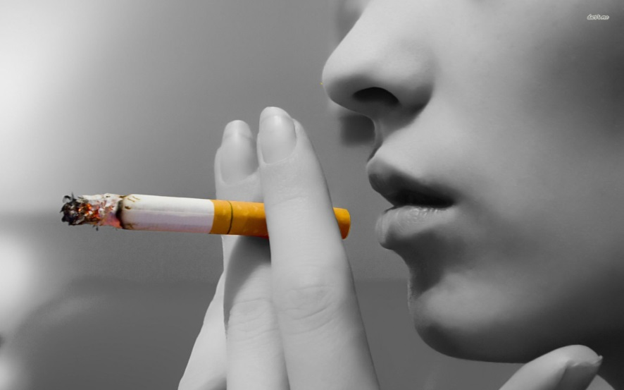
Gwaith Dosbarth
LO: To describe the effects of smoking on health.
Starter: Thinking ideas – USE FULL SENTENCES
How old do you have to be to buy a
pack of cigarettes?
What are 3 things you can find in cigarettes?
Write down as many words to describe this picture
Protein

Slide 2
Gwaith Dosbarth
LO: To describe the effects of smoking on health.
Starter: Thinking ideas – USE FULL SENTENCES
18
Tobacco, Tar, Nicotine, Arsenic,
Rat poison, Toilet cleaner, Nail varnish remover
Smoke, smell, expensive, death, cancer,……..
Protein

Slide 3
Gwaith dosbarth
Smoking
To describe the effects of smoking on health.
Bronze:
To recognise how attitudes to smoking has changed over time.
Silver:
To be able to explain why attitudes to smoking have changed.
Gold:
To evaluate how successful anti-smoking campaigns have been.
Notes:
3

Slide 4
In two different colours, shade in the information about smoking in one colour. Colour in the problems of smoking in another colour.

Slide 5
In two different colours, shade in the information about smoking in one colour. Colour in the problems of smoking in another colour.

Slide 6
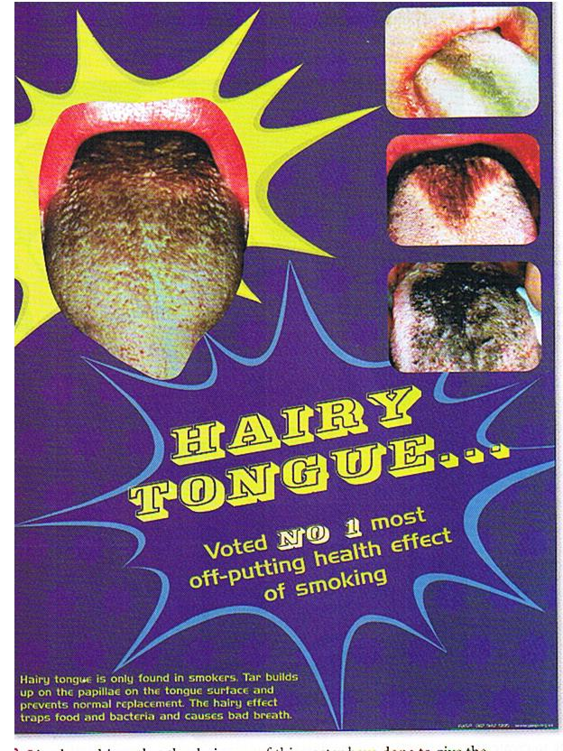
What do you notice first about this poster?
Is there a slogan?
Are the colours effective?
What will you remember most about this poster?

Slide 7
There is a big eye catching poster to get the reader’s attention
It uses a slogan
that is catchy and easy to remember
The poster is set
out in bright colours to attract attention

Slide 8

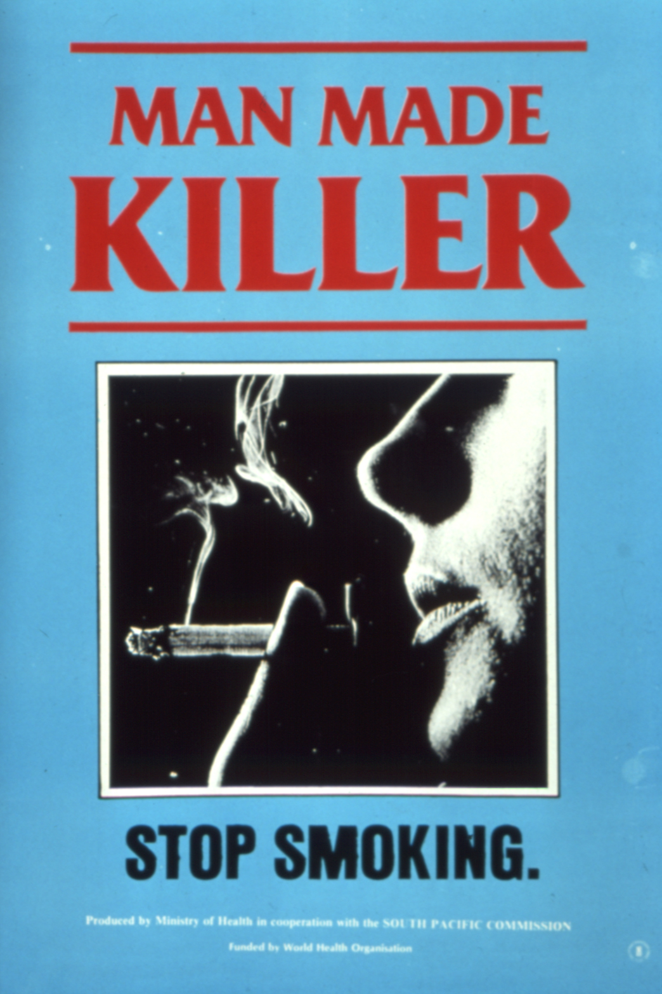
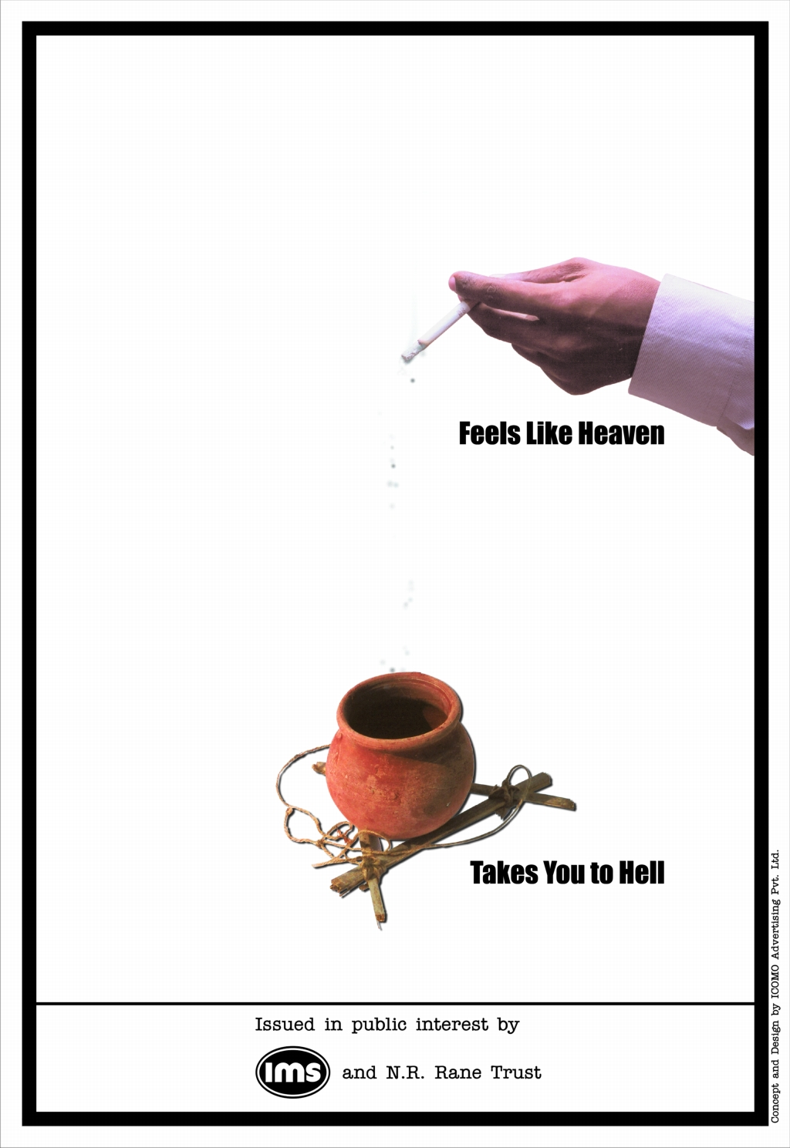
When looking at your anti-smoking poster:
What do you notice first about it?
What is the picture? Is it effective?
Are there any other messages on the poster?
Are there any colours used?
Do you think it could be made better in any way?

Slide 9
Main task
Imagine you have been asked to create a 30 second television advert to discourage people of your age from starting to smoke.
In pairs write a quick plan of what it would show and why.
Smoking
Cigarettes
Health
Lighter
Nicotine
Tobacco
Lungs
Damage
Inhale
Ysmygu
Sigaréts
Iechyd
Ysgafnach
Nicotin
Tybaco
Ysgyfaint
Niwed
Anadlu

Slide 10
Smoking
Cigarettes
Health
Lighter
Nicotine
Tobacco
Lungs
Damage
Inhale
Ysmygu
Sigaréts
Iechyd
Ysgafnach
Nicotin
Tybaco
Ysgyfaint
Niwed
Anadlu

Slide 11
Bookwork
In pairs, organise the list into the diamond
Bad Smell
Yellow Fingers
Liver Damage
Lung Disease
Lung Cancer
Expensive
Heart Disease
Shortened Life Expectancy
Passive Smoking
Most important
Least important

Slide 12
Plenary
Show me your adverts and convince me to
stop smoking or
to not start

Slide 13
Starter quiz
1) How many chemicals do cigarettes contain:
100 b. 1,000 c. 4,000
2) Roughly how many children start smoking every day:
100 b. 450 c. 600
3) How many people die from smoking each year:
a. 120,000 b. 140,000 c. 160,000

Slide 14
4) How much will a 20 a day smoker spend each year:
£1,800
£2,000
£2,400
5) What is the name of the addictive drug in tobacco:
Tar
Nicotine
Carbon monoxide

Slide 15
How well did you do?
1) = 4,000 (c)
2) = 450 (b)
3) = 120,000 (a)
4) = £1,800 (a)
5) = 17,000 (c)
6) = nicotine (b)

Slide 16
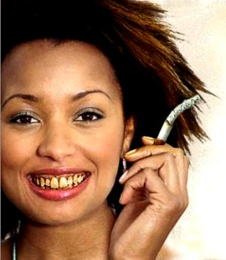
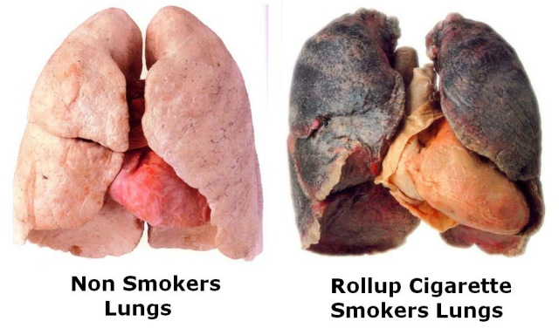
Smoking
On 1 October 2015 it became illegal:
for retailers to sell electronic cigarettes (e-cigarettes) or e-liquids to someone under 18
for adults to buy (or try to buy) tobacco products or e-cigarettes for someone under 18
to smoke in private vehicles that are carrying someone under 18
Over 80% of cigarette smoke is invisible and opening windows does NOT remove its harmful effect.

Slide 17
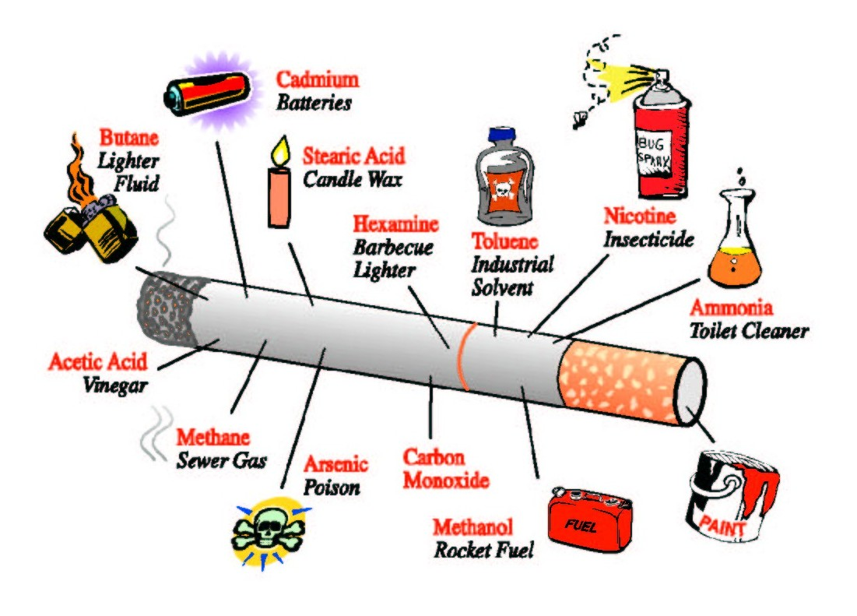
The Three Main Baddies…
Nicotine – the highly addictive chemical
Tar – Causes cancer
Carbon Monoxide – combines with haemoglobin in the blood to reduce the amount of oxygen that can be carried
http://www.tobaccofree.org/clips/VideoAddictiveness.htm

