Slide 1


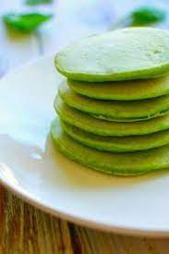
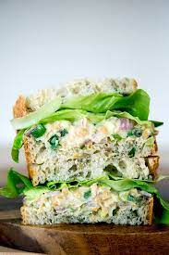
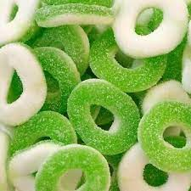
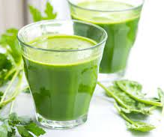

Tablero de Desayuno
Hotel Verde
Cada día Lunes – Domingo a las 7am-10am
Every day Monday – Sunday at 7am-10am
Panqueques Pancakes | Cafés (cappuccino o latte) Coffee (capuchino or latte) | Zumo (de naranja o manzana) Juice (orange or apple)
Precio: £5 | Precio: £10 | Precio: £1.99
Té Tea
Precio: £8
Bocadillo de atún Tunafish Sandwich | Leche para niños Milk for children (free for children) | Hamburguesa Hamburger
Precio: £5 | Precio: £4 Gratis para niños | Precio: £15

Slide 2
Module: Foreign Language & Culture Awareness
Module Code: BMIH5003
Lecturer: Rodrigo Fernandes Aguilar
Name: Farsana Ullah
Student ID: 2012578

