Slide 1
Student Name: Sameena Iqbal
Student Number: 2315950
BMHP6029_BIRM – Component 1 – Poster Presentation
Title of Poster: Autism Spectrum Disorder (ASD): Historical Treatment, Contemporary Care, and the Neurodiversity Movement

Slide 2
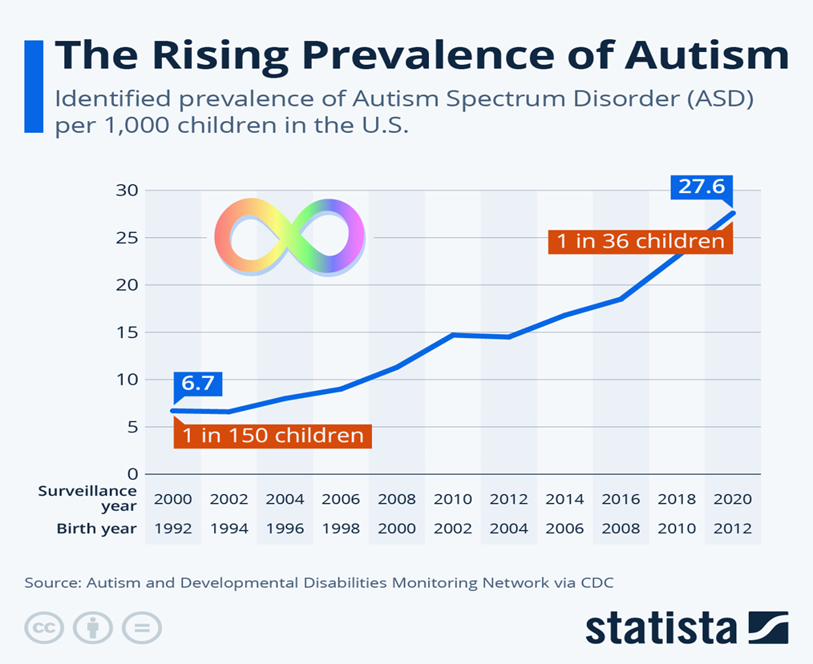
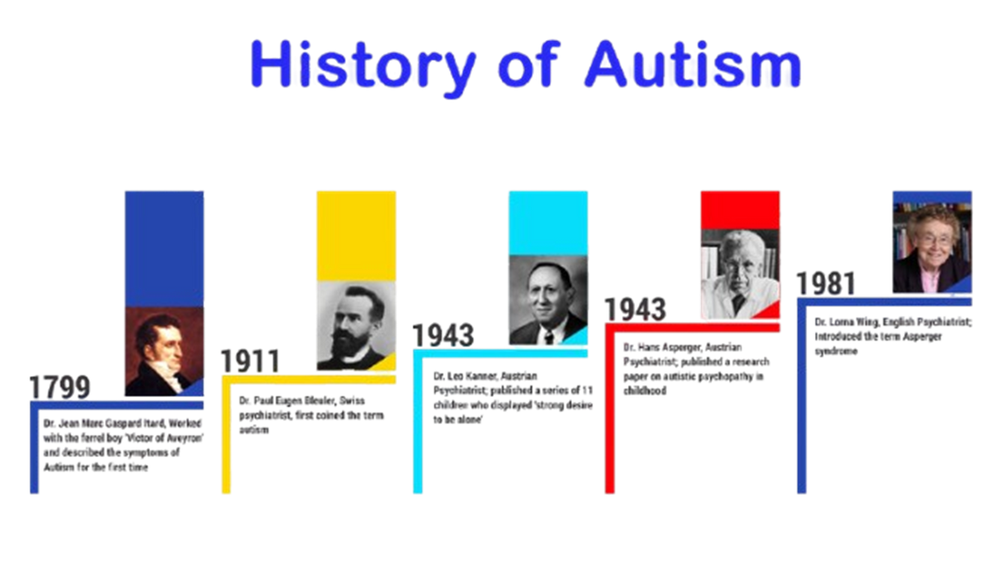
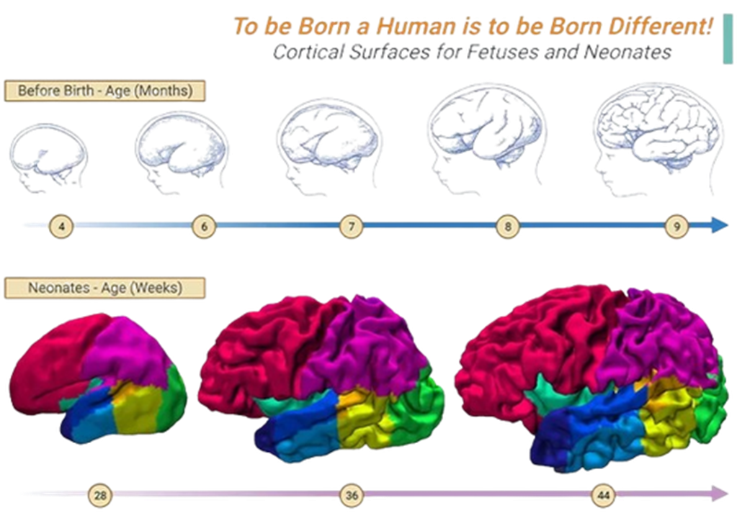
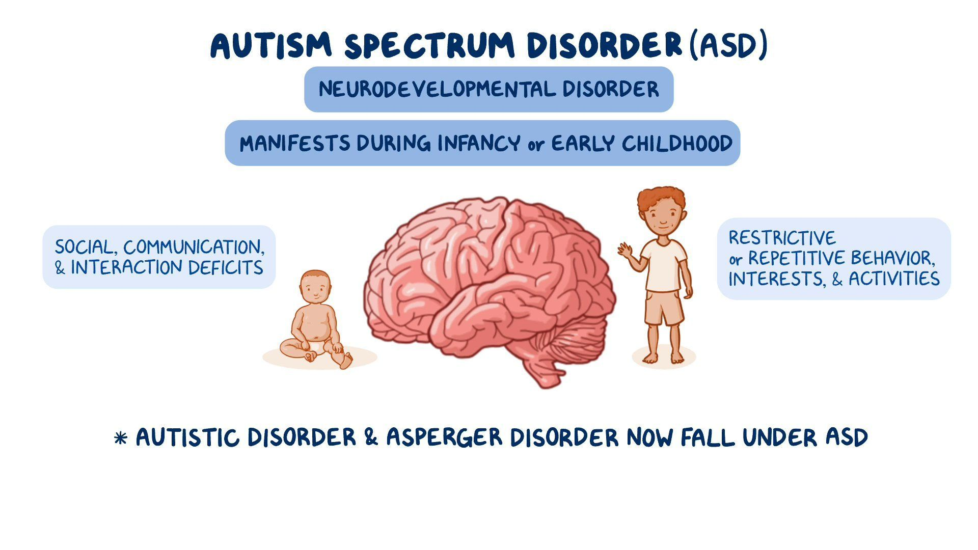

Autism Spectrum Disorder (ASD): Historical Treatment, Contemporary Care, and the Neurodiversity Movement
1.
INTRODUCTION
2.
HISTORICAL CONTEXT OF ASD
Autism Spectrum Disorder (ASD) is a lifelong neurodevelopmental condition that involves difficulties with social communication, sensory processing, and patterns of restricted or repetitive behaviour. The presentation of ASD varies greatly among individuals, ranging from mild to more complex forms. In recent years, global awareness and diagnosis rates of ASD have risen, with estimates indicating that about 1 in 54 children are affected (Hirota and King, 2023). Early recognition and intervention play a key role in improving long-term outcomes related to learning, communication, and social participation. Over the past few decades, the understanding of ASD has evolved—from viewing it primarily as a disorder or deficit to embracing a neurodiversity perspective that values individual differences and promotes inclusion (Simmerman, 2023).
Autism Spectrum Disorder (ASD) was first characterized by Leo Kanner in 1943 and later by Hans Asperger in 1944. Kanner documented patterns of social withdrawal and repetitive behaviours, while Asperger described similar traits in children with stronger verbal and intellectual abilities (Divan, 2021). Early interpretations of autism were heavily influenced by the medical model, often linking it to mental illness or inadequate parenting, including the now-discredited “refrigerator mother” theory (Lord et al., 2020). During the mid-20th century, many individuals with autism were placed in institutions and subjected to ineffective or even harmful interventions, reflecting widespread misconceptions and social stigma surrounding the condition.
3.
HISTORICAL POLICIES AND
TREATMENT
4.
MODERN RESEARCH AND
TREATMENT
Several landmark policies transformed autism care and inclusion:
  Education for All Handicapped Children Act (1975): Guaranteed free public education for children with disabilities, including autism (Cascio et al., 2021).
  Americans with Disabilities Act (1990): Prohibited disability-based discrimination in employment and public spaces.
  Disability Discrimination Act (UK, 1995): Provided legal protection and equality for individuals with disabilities.
  Autism CARES Act (2014): Increased federal support for research, early screening, and service coordination.
These policies helped pave the way for better access to diagnosis, education, and community integration.
Modern research and treatment of ASD rely on standardized diagnostic criteria from DSM-5 and ICD-11, emphasizing early screening by age two (Greaves-Lord et al., 2022). Common interventions include Applied Behavior Analysis (ABA), speech and occupational therapy, and social skills training. Multidisciplinary, individualized care approaches are essential, with medications used to manage associated conditions like anxiety or ADHD (Lindsay et al., 2021).
5.
RECOMMENDATIONS FOR FUTURE POLICY AND PRACTIC
To promote positive outcomes for individuals with ASD, the following evidence-based strategies are essential:
  Expand routine developmental screening in early childhood settings (Samiuddin, 2022).
  Increase funding for early intervention, especially in under-resourced and rural areas.
  Promote inclusive education, with teacher training and classroom accommodations.
  Foster workplace inclusion, with employer awareness training and tailored support.
  Public awareness campaigns to reduce stigma and support neurodiverse identities.
6.
CONCLUSION
The journey of autism understanding has evolved from marginalization to inclusion. Historical misconceptions and institutional practices have given way to person-centered care, inclusive education, and growing public acceptance. However, challenges remain—particularly in access to care, societal stigma, and adult services. Embracing neurodiversity as a strength and promoting inclusive policies will ensure individuals with ASD can thrive across all life domains.

Slide 3
Reference List
Anderson-Chavarria, M., (2022). The autism predicament: models of autism and their impact on autistic identity. Disability & society, 37(8), pp.1321-1341. https://doi.org/10.1080/09687599.2021.1877117
Azeem, A., Bashir, R., Faiz, Z. and Warraich, W.Y., (2022). Effects of multi-therapy approaches on social skills and communication development among children having autism spectrum disorder. Indian Journal of Economics and Business, 21(1). https://www.ashwinanokha.com/resources/ijeb%20v21-1-2022-6-Asmaa%20Azeem.pdf
Cascio, M.A., Weiss, J.A. and Racine, E., (2021). Empowerment in decision-making for autistic people in research. Disability & Society, 36(1), pp.100-144. https://doi.org/10.1080/09687599.2020.1712189
Divan, G., et al., (2021). Annual Research Review: Achieving universal health coverage for young children with autism spectrum disorder in low-and middle-income countries: A review of reviews. Journal of Child Psychology and Psychiatry, 62(5), pp.514-535. https://doi.org/10.1111/jcpp.13404
Greaves-Lord, K., Skuse, D., and Mandy, W., (2022). Innovations of the ICD-11 in the field of autism spectrum disorder: a psychological approach. Clinical psychology in Europe, 4(Spec Issue), p.e10005. https://doi.org/10.32872/cpe.10005
Hirota, T. and King, B.H., (2023). Autism spectrum disorder: a review. Jama, 329(2), pp.157-168. doi:10.1001/jama.2022.23661
Lindsay, S., Osten, V., Rezai, M., and Bui, S., (2021). Disclosure and workplace accommodations for people with autism: A systematic review. Disability and rehabilitation, 43(5), pp.597-610. https://doi.org/10.1080/09638288.2019.1635658
Lord, C., Brugha, T.S., Charman, T., Cusack, J., Dumas, G., Frazier, T., Jones, E.J., Jones, R.M., Pickles, A., State, M.W. and Taylor, J.L., (2020). Autism spectrum disorder. Nature reviews Disease primers, 6(1), p.5. https://doi.org/10.1038/s41572-019-0138-4
Richter, F. (2024) Infographic: The Rising Prevalence of Autism, Statista Daily Data. Statista. Available at: https://www.statista.com/chart/29630/identified-prevalence-of-autism-spectrum-disorder-in-the-us/?srsltid=AfmBOophKXTNxJvdHQXfwKuEJyHQUbX0lI2nR4JzfpNRtzHYo8Dca6O8 (Accessed: 30 September 2025).
Samiuddin, Z., (2022). Effectiveness of IEPs (Individual Education Plans) for Children with Diverse Learning Needs and Abilities (An Exploratory Study).
Simmerman, D.D., (2023). The Mothers of Autistic Children’s Lived-Experience of Social Stigma: A Descriptive Phenomenological Inquiry (Doctoral dissertation, Grand Canyon University). https://www.proquest.com/openview/7313283bee092ad3ff821645bb500841/1?pq-origsite=gscholar&cbl=18750&diss=y

